Slide 1
Sentiment Analysis for Airline Reviews NLP
Tazinder Pal Singh
1216160
AIM1 (24 W)

Slide 2
Introduction
Dataset: Airline Reviews
Task: Sentiment Analysis (Classifying reviews as positive or negative)

Slide 3
Data Preparation
Loaded 'Airline_Reviews.csv' using pandas
Focused on columns: 'Review_Title', 'Review', 'Recommended’
Converted 'Recommended' to binary labels ('positive'/'negative’)
Split data: 80% training, 20% testing

Slide 4
Text Preprocessing
Used SpaCy for tokenization, lemmatization, and stop word removal
Created 'Processed_Review' column with cleaned text

Slide 5
Model Development
Implemented two models:
a) SpaCy Text Classification Model
b) Random Forest Classifier with TF-IDF vectorization

Slide 6
SpaCy Model Training
Initialized blank English model
Added text classification component
Trained for 5 epochs
Saved model as "text_classifier_model"

Slide 7
Random Forest Model
Created pipeline with TfidfVectorizer and RandomForestClassifier
Performed hyperparameter tuning using GridSearchCV
Parameters tuned: n_estimators, max_depth

Slide 8
Model Evaluation
Metrics used: Accuracy, Precision, Recall, F1-score
Visualizations:
a) Confusion Matrix
b) ROC Curve and AUC Score
c) Word Clouds for positive and negative reviews

Slide 9
Results Visualization
Confusion Matrix: Shows true vs predicted labels
ROC Curve: Illustrates model's discriminative ability
Word Clouds: Highlight frequent terms in positive and negative reviews

Slide 10
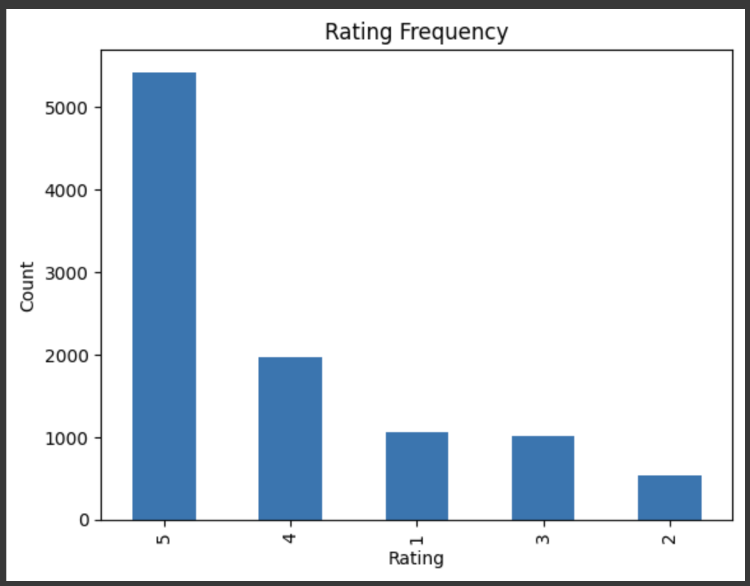

Slide 11
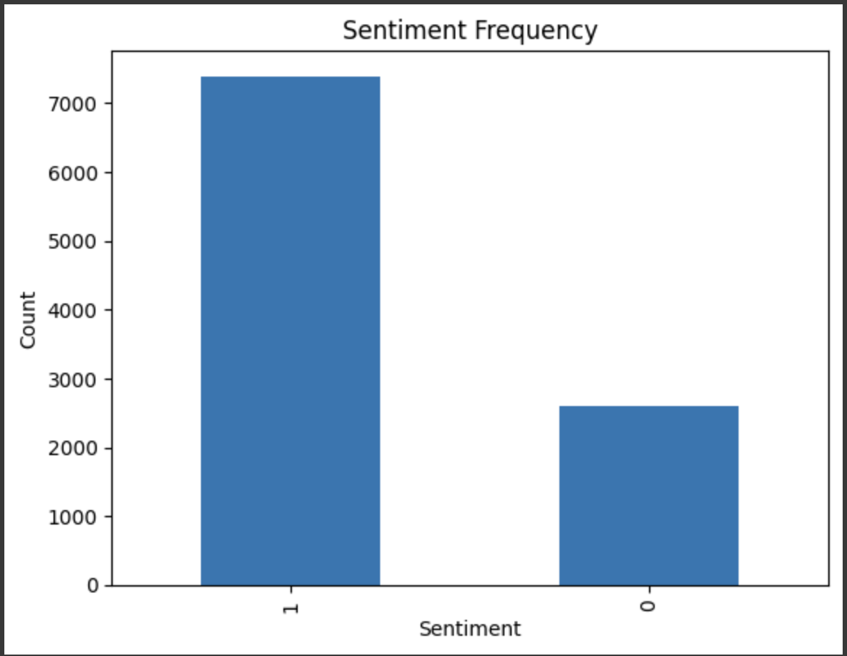

Slide 12
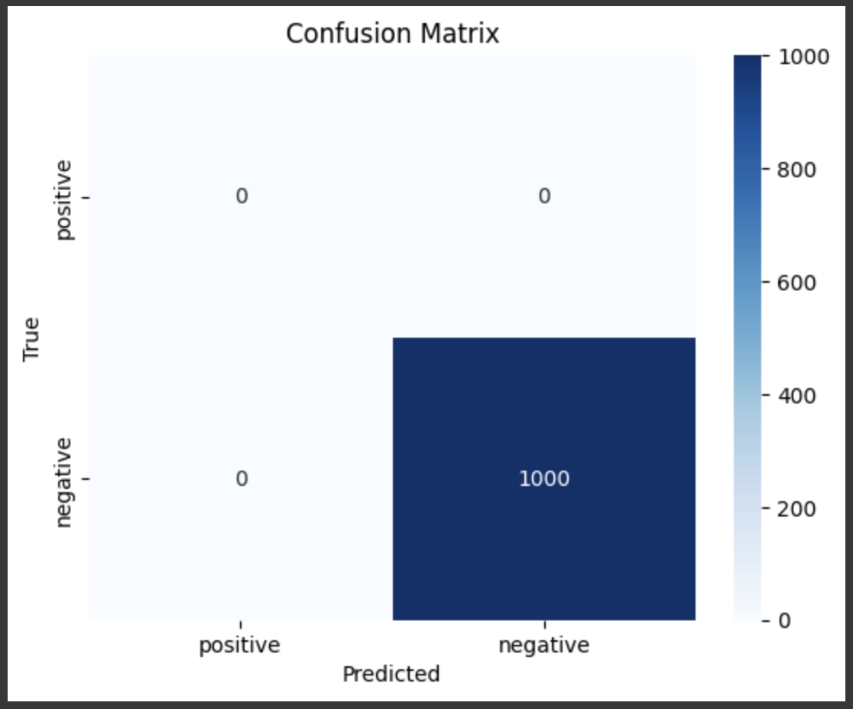

Slide 13
Key Findings
Most indicative words for positive and negative sentiments Any class imbalance or bias observed in predictions

Slide 14
Conclusion
Summary of model performance
Insights gained from the analysis
Potential areas for improvement

Slide 15
Future Work
Experiment with other algorithms (e.g., deep learning models)
Incorporate additional features (e.g., review length, rating)
Perform more extensive hyperparameter tuning

