Slide 1

International Islamic University Chittagong
Department of Computer Science and Engineering
A Project Presentation on Shikhboamra – an E-learning Ecosystem
Submitted by: Name : Tazneya Safawath ID : C-171254 Name : Sazeda Akter ID : C-171244 | Supervised by: Muhammed Nazmul Arefin Associate Professor, Dept. of CSE, IIUC
1

Slide 2
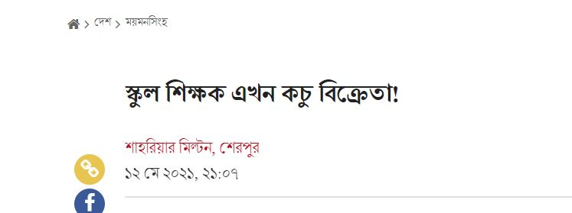
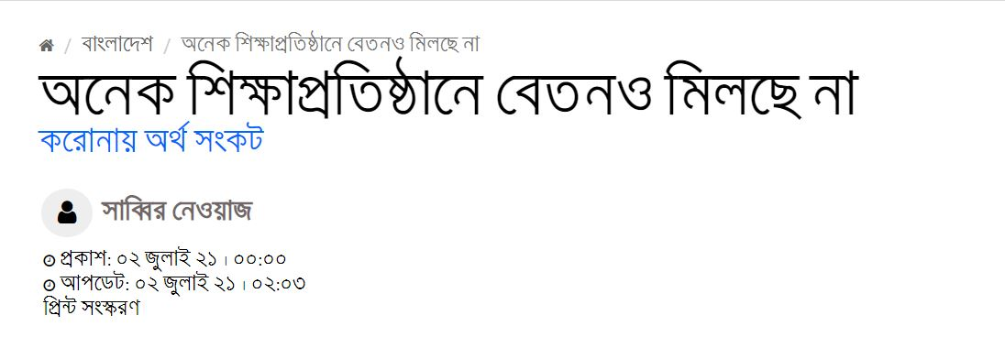
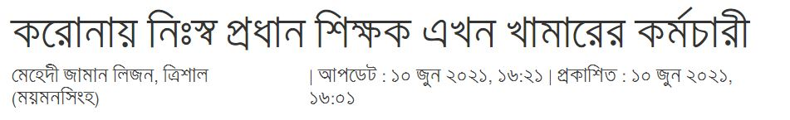
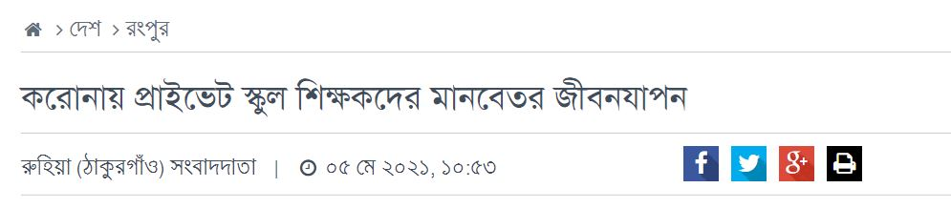
2

Slide 3
Problem Regarding Teacher
01
This is the scenario for only School & College teacher
02
There have more teacher outside of School & College who have suffer from corona outbreak.
3

Slide 4
Problem Regarding Student
01
Most of the Educational institution and other platform maintain live class
02
All kind of lecture content ( lecture video, lecture note), exam facility are not available in one platform
03
Student can’t track their strong point and weak point
4

Slide 5

To overcome those limitations we’re bringing a system
5

Slide 6
Our Goal
01
Create a common communication platform for
Teacher & Student
02
Creating a platform where all kind of lecture content ( lecture video,lecture note,lecture ppt) are available in one place.
03
Creating a performance tracking for both studnet & teacher.
04
Ensure an earning opportunity for teacher.
5

Slide 7






Literature Review
6

Slide 8

Limitation in existing system
Lack of earning opportunity for teacher
Performance tracking not available
All kind of lecture content along with exam facility not available in one platform
7

Slide 9
User Journey
Teacher
8

Slide 10
Add lecture video
Create Course
Add lecture note/ppt
Login/Signup
Add Exam
Communicate with
Student
Track student performance
9

Slide 11
User Journey
Student
10

Slide 12
Complete lecture video
Enroll Course
Read lecture note/ppt
Login/Signup
Perform Exam
Communicate with
Teacher
Track performance
11

Slide 13
Development Tools
Frontend
Backend
Database
Project Management
HTML
CSS
Javascript
Sweetalert
PHP(Laravel Framework)
Mysql
Trello
12

Slide 14
Methodology
We will use prototype model as software process model
Requirement gathering
Quick Design
Building Prototype
Engineer Product
Refining Prototype
Customer Evaluation
13

Slide 15
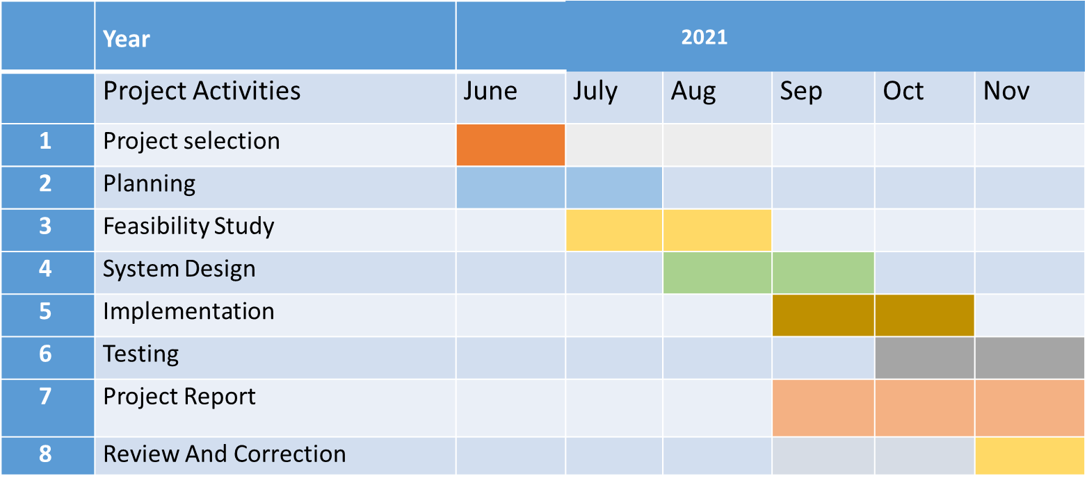
Gantt Chart
14

Slide 16
Conclusion
Online learning is beneficial to the students, tutors and the institution offering these courses. To develop a project to bring all the features that students want into a particular system, which will improve student outcomes and satisfaction. Moreover, it will be cost and time friendly. And the Instructor/Teacher will benefit by making money from this.
15

