Slide 1

A Comparative Study of DC-DC Converters for Maximum Power Point Tracking of Solar Array
By: Tazwar Siddique
Military Institute of Science and Technology

Slide 2

Motivation
Combatting climate change through renewable energy revolution.
Maximizing solar power with advanced MPPT techniques.
Unveiling strengths and weaknesses of top DC-DC converters.

Slide 3
Research Objectives
Comparing five DC-DC converters for optimal solar power tracking.
Assessing efficiency, speed, and ripple under varying conditions.
Revealing the best converter for PV systems.

Slide 4
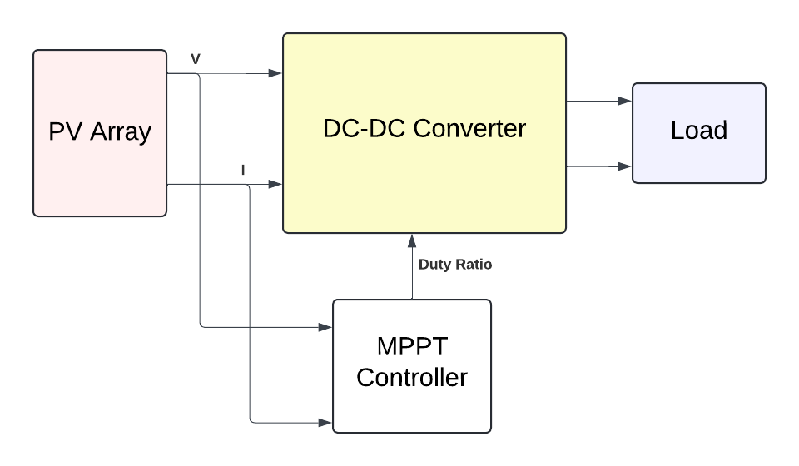
Methodology
System Model
PV Array
MPPT Controller
DC-DC Converters
  Boost, Buck-Boost, Cuk, SEPIC, Zeta
Fig: Block Diagram of System Model

Slide 5
Methodology
2. Simulation Scenarios
Standard: 1000 W/m², 25°C.
Low Irradiance: 500 W/m², 25°C.
High Temperature: 1000 W/m², 50°C.

Slide 6
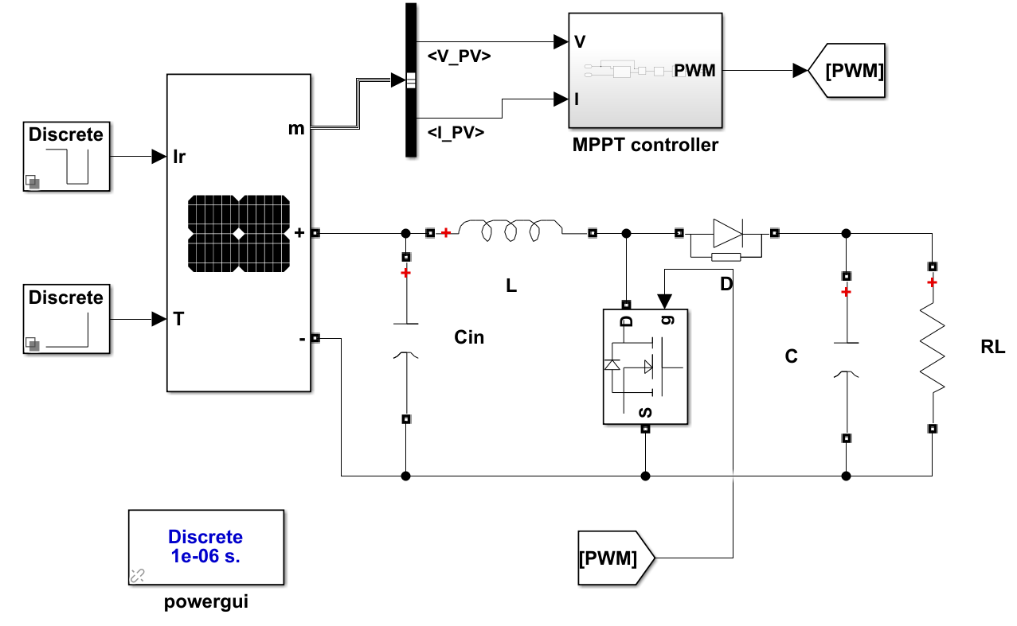
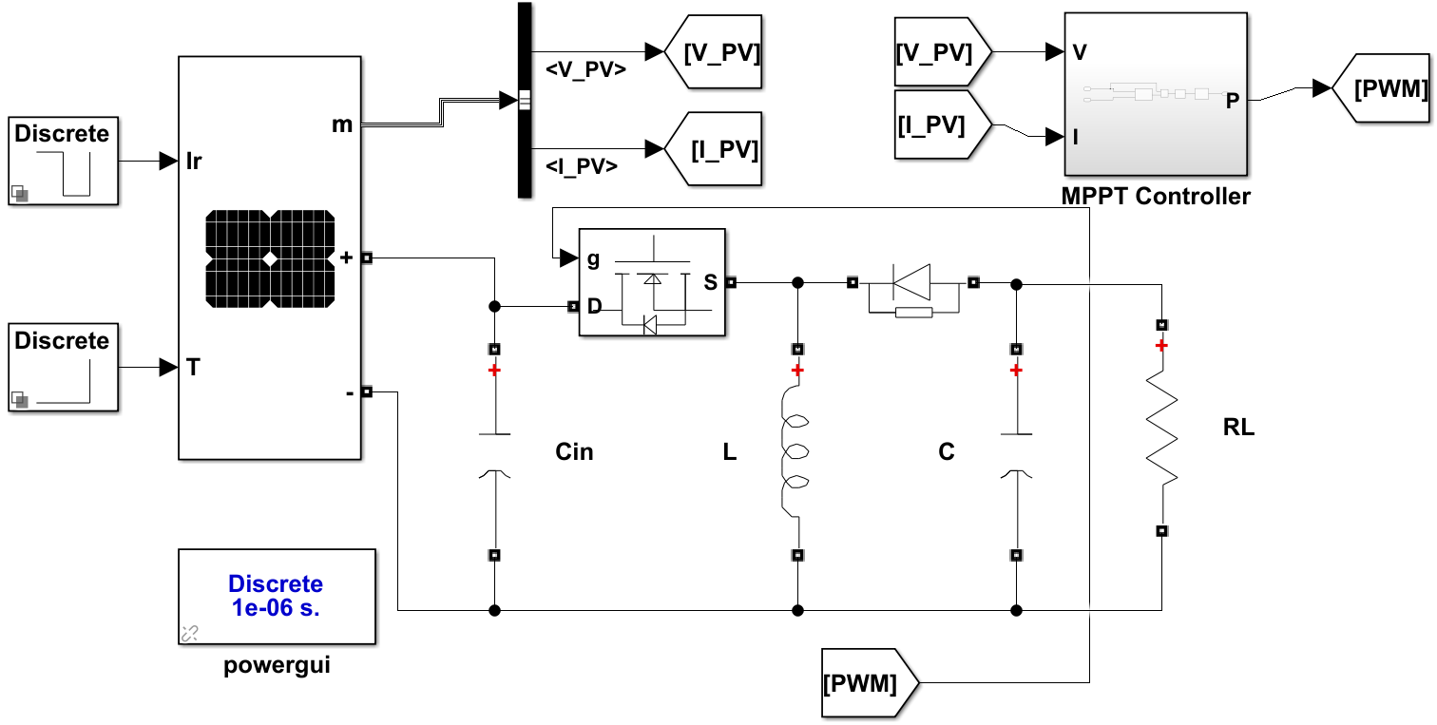
Methodology
Boost Converter: Buck-Boost Converter:
Fig: Boost Converter Simulink Model
Fig: Buck-Boost Converter Simulink Model

Slide 7
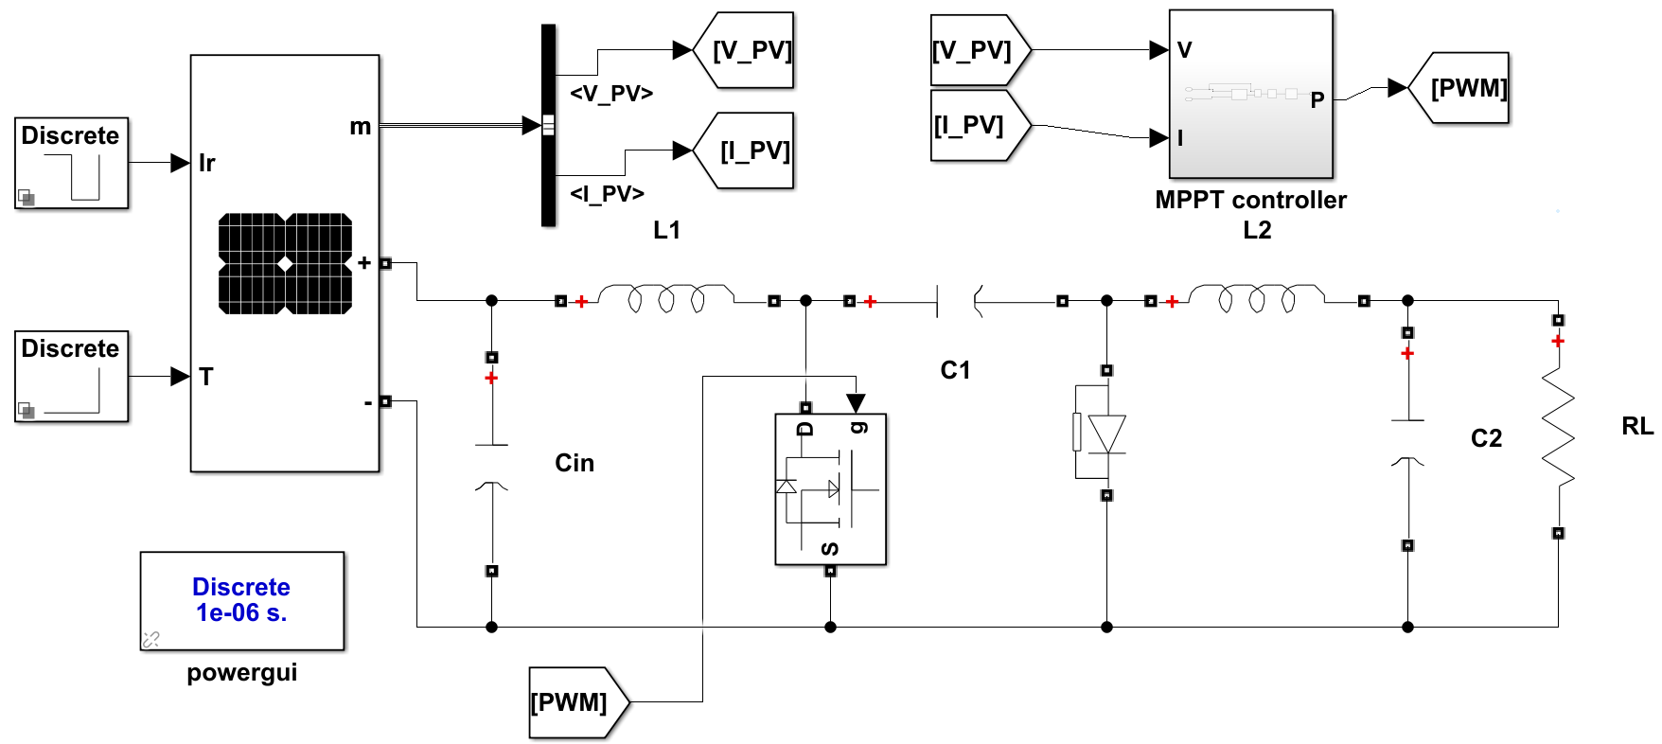
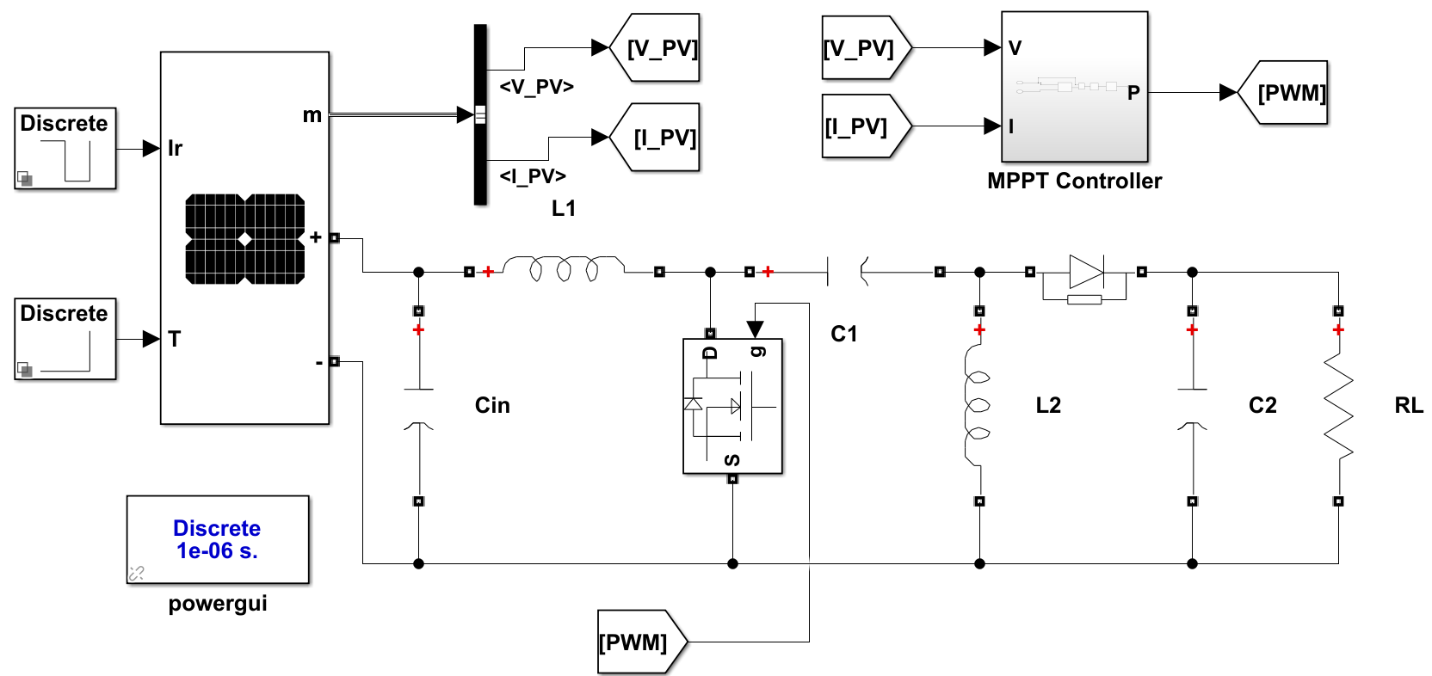
Methodology
Cuk Converter: SEPIC Converter:
Fig: Cuk Converter Simulink Model
Fig: SEPIC Converter Simulink Model

Slide 8
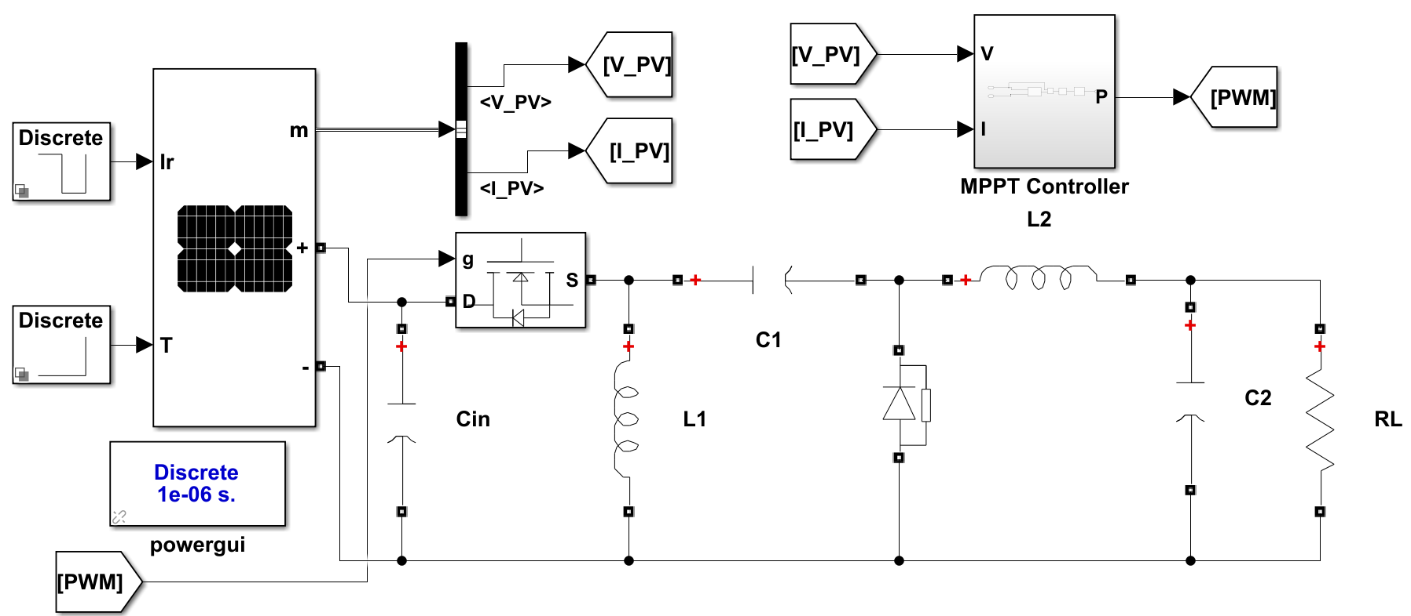
Methodology
Zeta Converter:
Fig: Zeta Converter Simulink Model

Slide 9
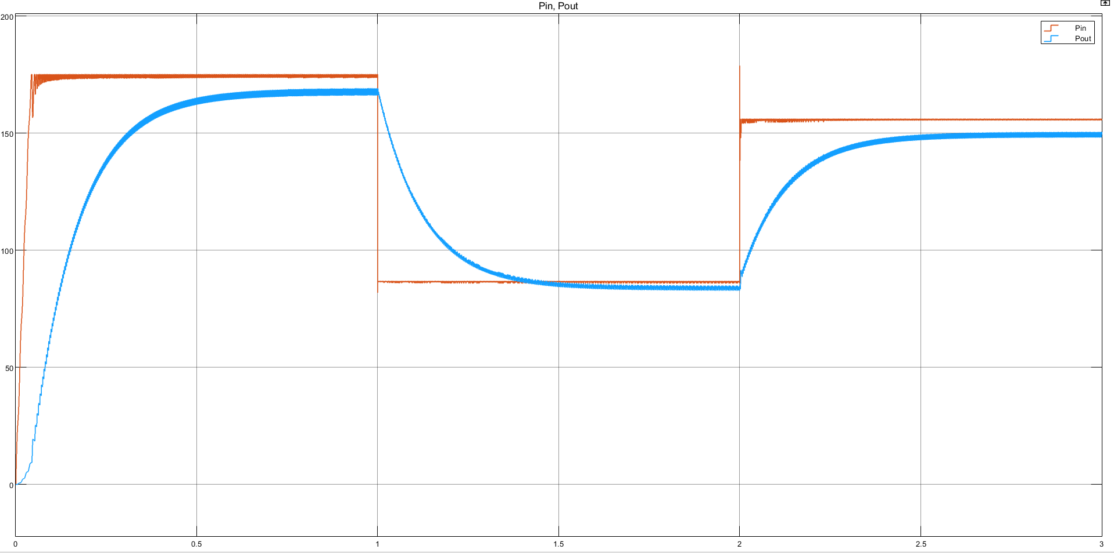
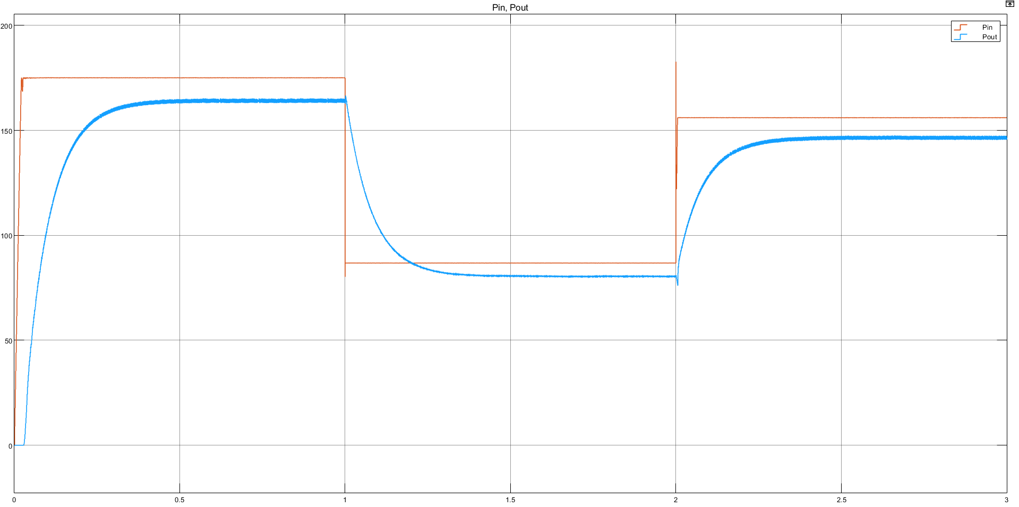
Result and Analysis
Fig: Response curve of Boost Converter
Fig: Response curve of Buck-Boost Converter

Slide 10
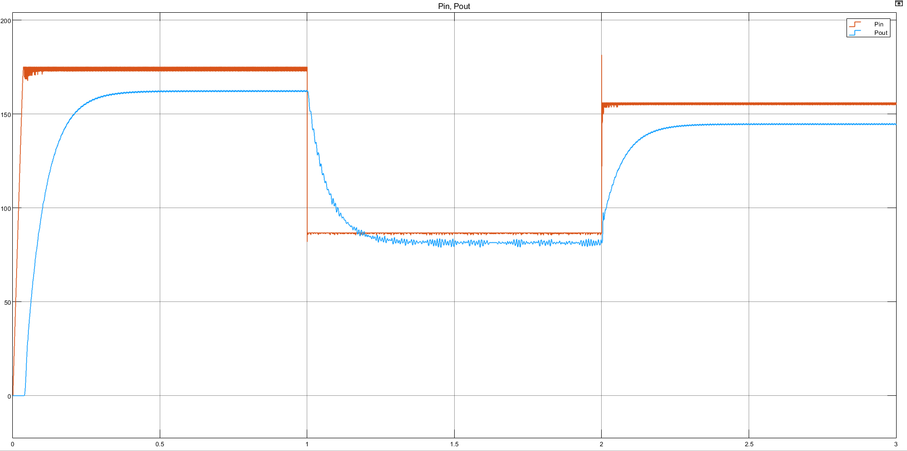
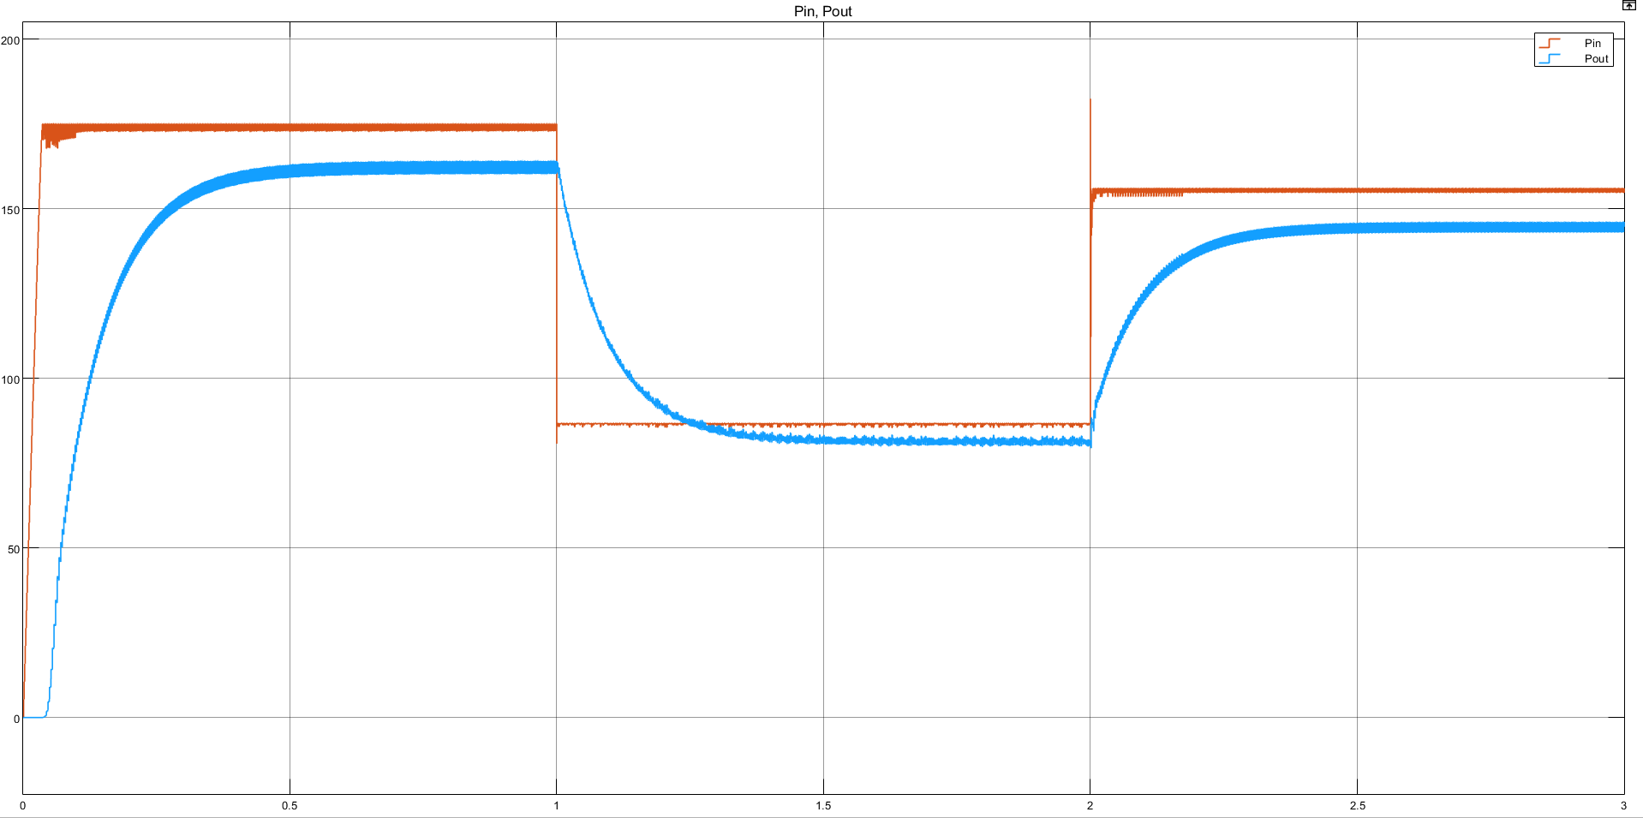
Result and Analysis
Fig: Response curve of Cuk Converter
Fig: Response curve of SEPIC Converter

Slide 11
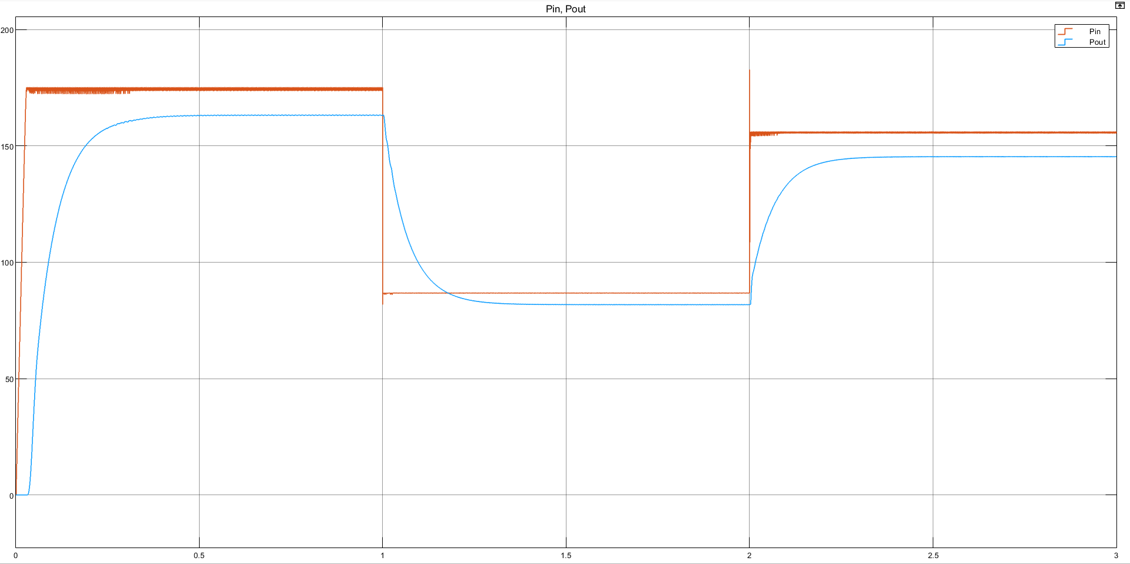
Result and Analysis
Fig: Response curve of Zeta Converter

Slide 12
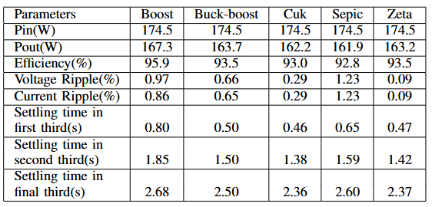
Result and Analysis
Performance Metrics of DC-DC Converters:

Slide 13
Conclusion
Boost converter offers highest efficiency, best for stable conditions.
Zeta and Buck-Boost provide balanced efficiency and stability, ideal for varying conditions.
Zeta has the lowest ripple, making it highly stable.
Converter choice should match environmental conditions for optimal PV performance.

Slide 14
Thank You

