Slide 1

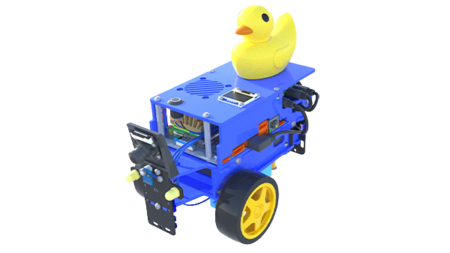
AVOIDING DUCKS AND OTHER OBSTACLES
EE483: INTRODUCTION TO ROBOTICS
GROUP 11
Tazwar Siddique
Hariz Razali
Hamad Alkooheji

Slide 2
TABLE OF CONTENT
01.
WHY THIS PROJECT?
02.
PROJECT DESCRIPTION
03.
PROJECT GOALS
04.
METHODOLOGY
05.
RESULTS
06.
CHALLENGES
07.
FUTURE SCOPE

Slide 3
WHY THIS PROJECT?
Obstacle avoidance is a core real-world autonomous driving challenge.
Extends Duckiebot beyond simple lane following → toward full autonomy.
Integrates all EE483 skills: perception, ROS nodes, control, PID, system integration.

Slide 4

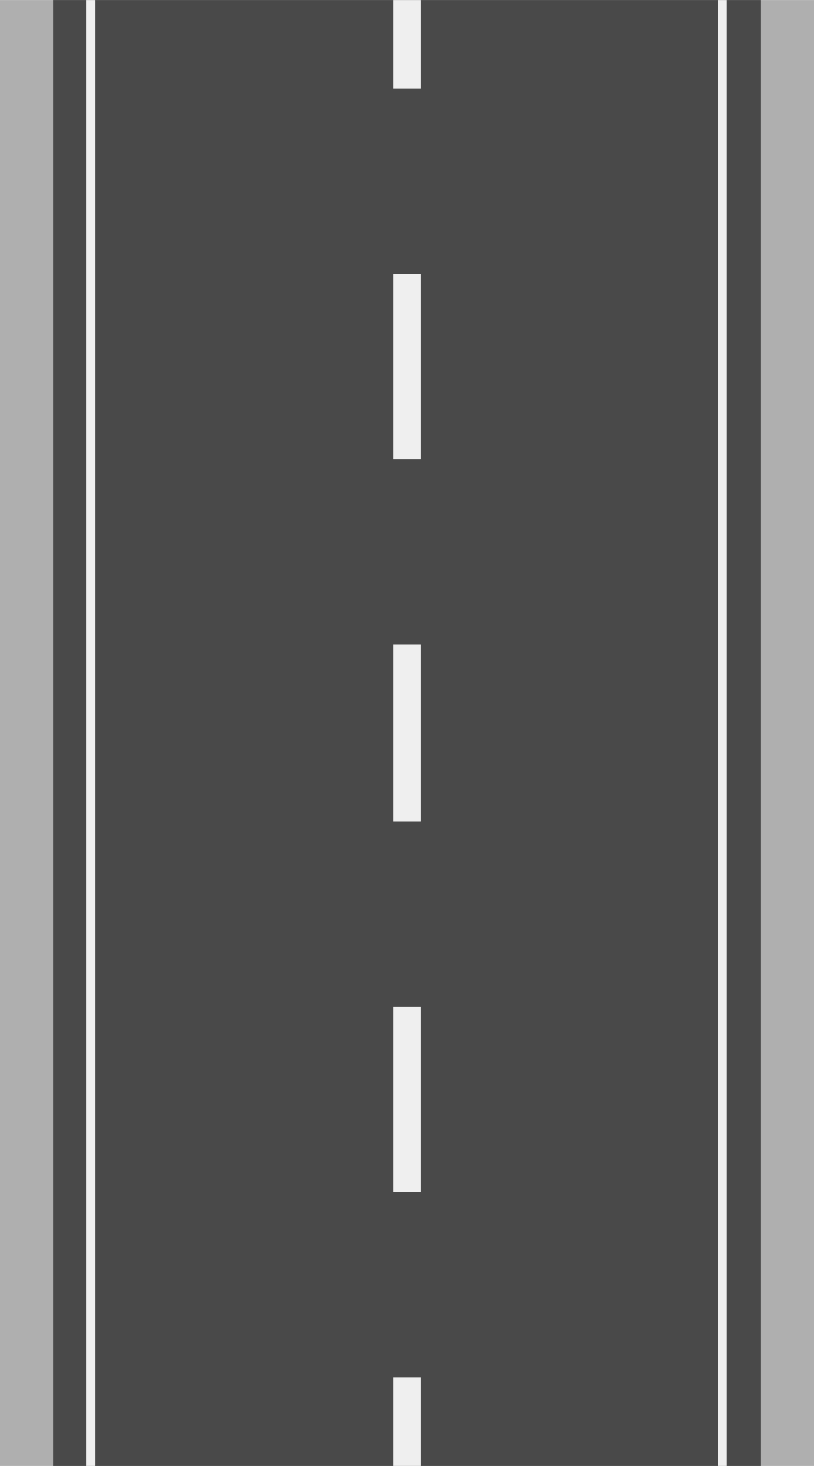

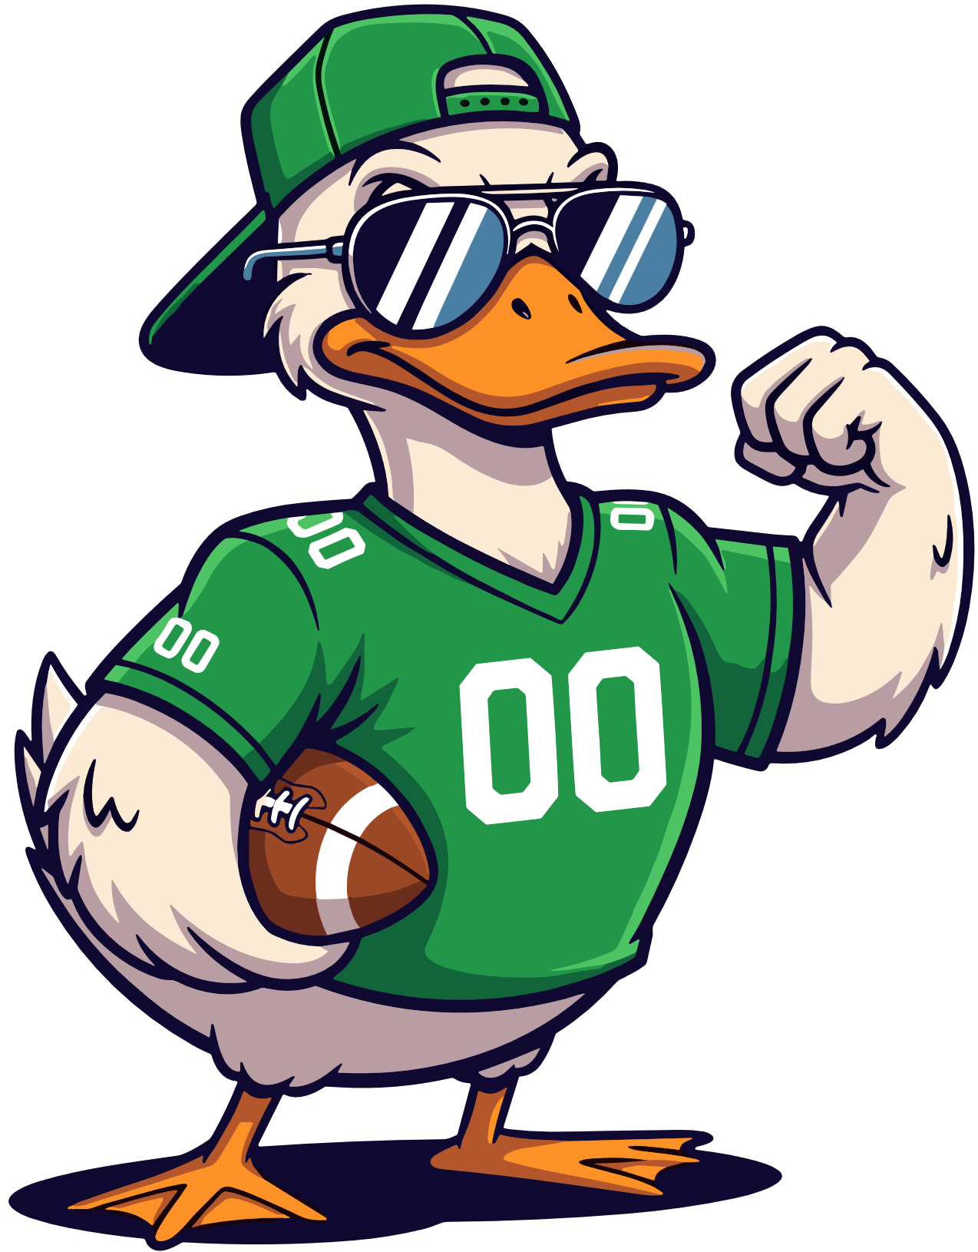


PROJECT DESCRPTION
Fig 1: Example of Obstacle Avoidance
Build a Duckiebot that can detect obstacles and avoid them safely.
Uses lane detection (Lab 2 & 3) for road following.
Uses Duckietown object-detection + LiDAR sensor to detect ducks/robots.
Avoidance control performs stop/turn maneuver, then returns robot to the lane.
Goal: smooth, safe, fully autonomous navigation in a Duckiebot environment.

Slide 5



PROJECT GOALS
MAIN GOAL
QUANTITATIVE OUTCOME
ASSUMPTIONS
Enable the robot to perceive obstacles and steer away safely.
Obstacle detection accuracy: 100% (achieved).
Successful obstacle avoidance: target > 70%.
Reliable re-centering after avoidance.
Configurable safety stop distance.
Only avoid static obstacles.
Duckiebots are the only obstacles on the track.
Track configuration same as Lab 3 – One square.

Slide 6


METHODOLOGY
KEY NODES
KEY TOPICS
Camera Node → image input
Lane Detection Node → line edges
Vehicle Detection Node → obstacle info
Lane Keeping Node → PID Control
Avoidance Control Node → generates wheel commands
/camera_node/image/compressed
/lane_filter_node/lane_pose
/front_center_tof_driver_node/range
/vehicle_detection_node/centers
/car_cmd_switch_node/cmd

Slide 7
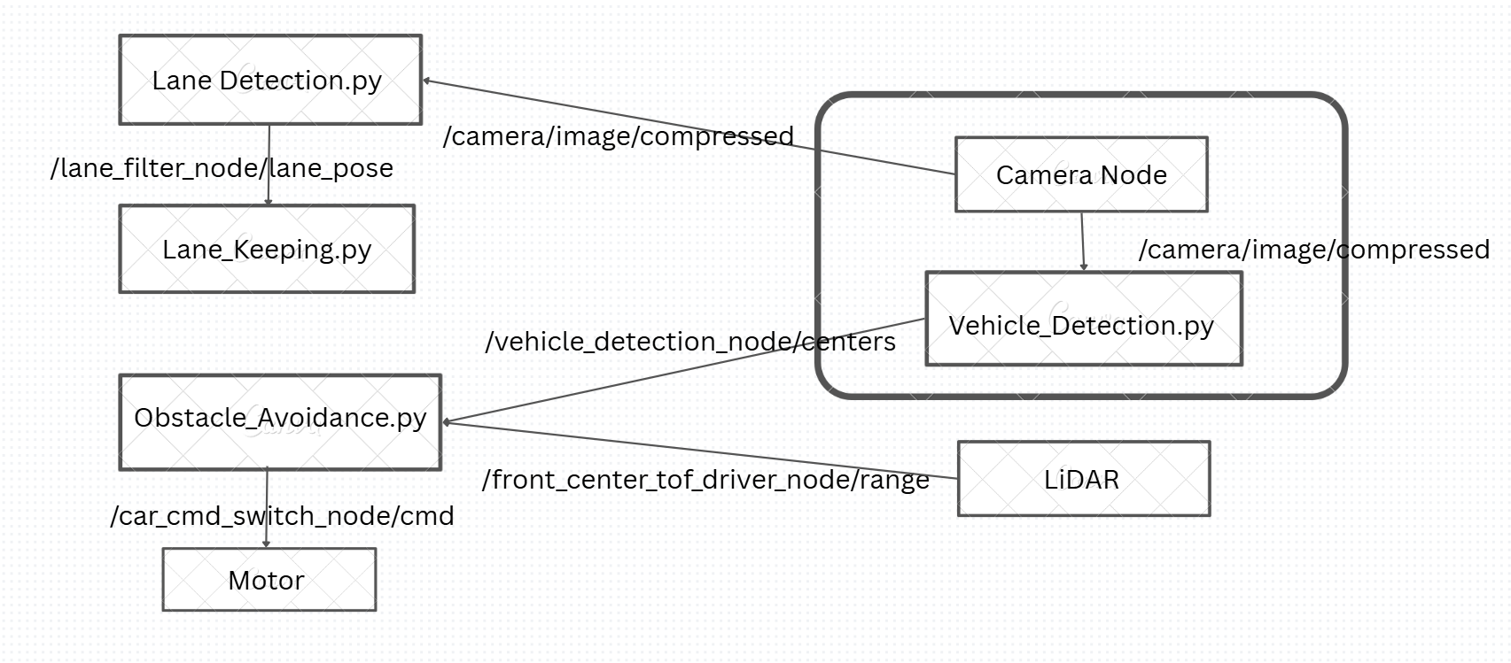
METHODOLOGY
Fig 2: ROS Architecture Diagram

Slide 8
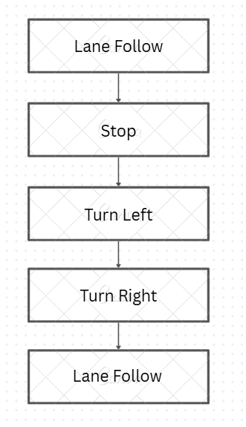
METHODOLOGY
Finite State Machine (FSM)
A Finite State Machine (FSM) is a control model that describes system behavior using a finite number of states and rules for switching between them based on conditions or events.
It is widely used in robotics for:
Decision making
Behavior sequencing
Mode switching
Each state sends different velocity commands
Transitions are based on:
Obstacle detection
Fixed timing conditions
Only the LANE FOLLOW state uses PID control

Slide 9
METHODOLOGY
Sensor Fusion for Obstacle Detection
Camera (Vision Sensor)
Captures real-time images of the environment
Used for Duckiebot detection only
Detects the characteristic rear dot pattern of Duckiebots
Output Topic: /vehicle_detection_node/centers
Provides a Boolean flag:
True → Duckiebot detected
False → No Duckiebot detected
Final Avoidance Trigger Condition:
Duckiebot detected AND Range ≤ 0.2 m
Camera
Identifies what the object is
Avoids reacting to random objects
Prevents false triggers
LiDAR / Time-of-Flight (ToF) Sensor
Measures forward distance to objects
Output Topic: /front_center_tof_driver_node/range
Provides real-time distance in meters
 | LiDAR
 | Measures how far it is
 | Provides precise distance
 | Enables safe stopping

Slide 10
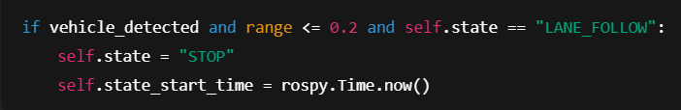
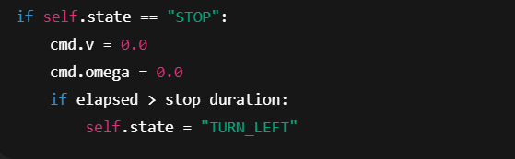
METHODOLOGY
Code Breakdown
This code ensures the robot only reacts when both vision and LiDAR agree, reducing false triggers.
Ensures safe stopping
Prevents collision before maneuvering

Slide 11
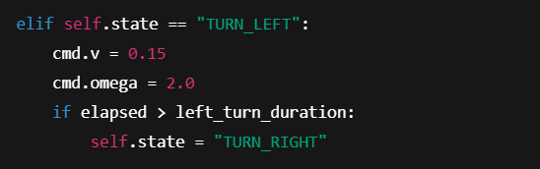
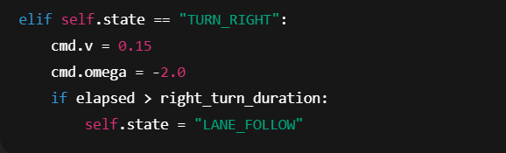
METHODOLOGY
Code Breakdown
Initiates obstacle bypass
Fixed forward velocity
Fixed left angular velocity
Re-orients robot back toward lane
PID resumes control immediately afterward

Slide 12
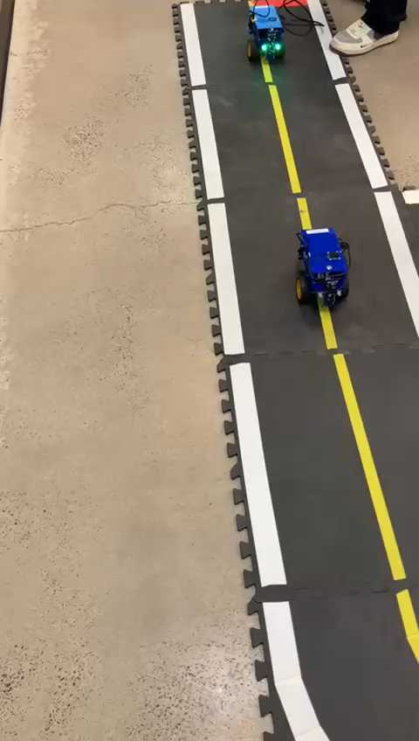
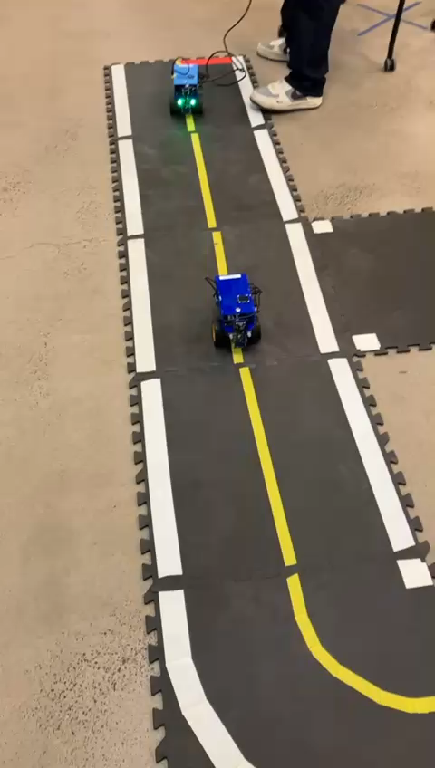
RESULTS - FAILURES

Slide 13
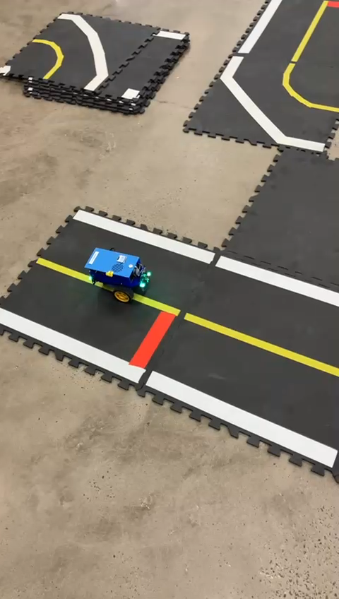
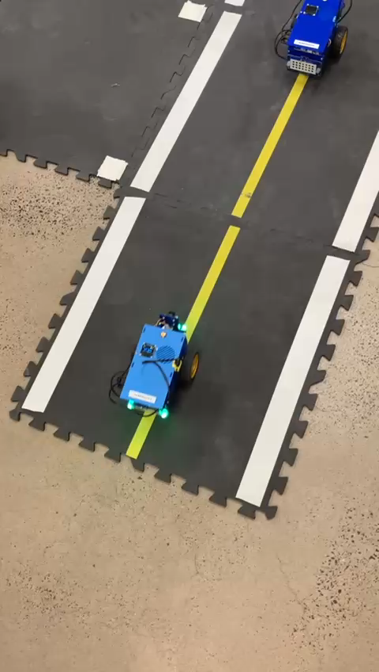
RESULTS - SUCCESSES

Slide 14
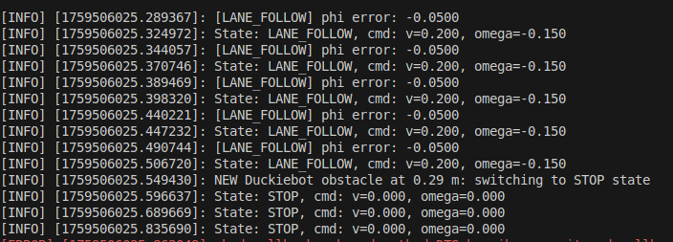
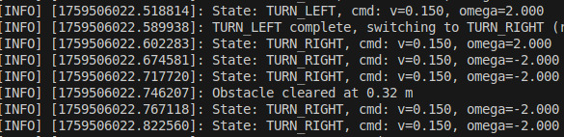
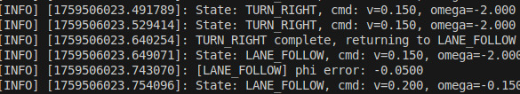

RESULTS
Fig 2a: Terminal Output at Initial Run Stage
Fig 2b: Terminal Output at Final Run Stage

Slide 15
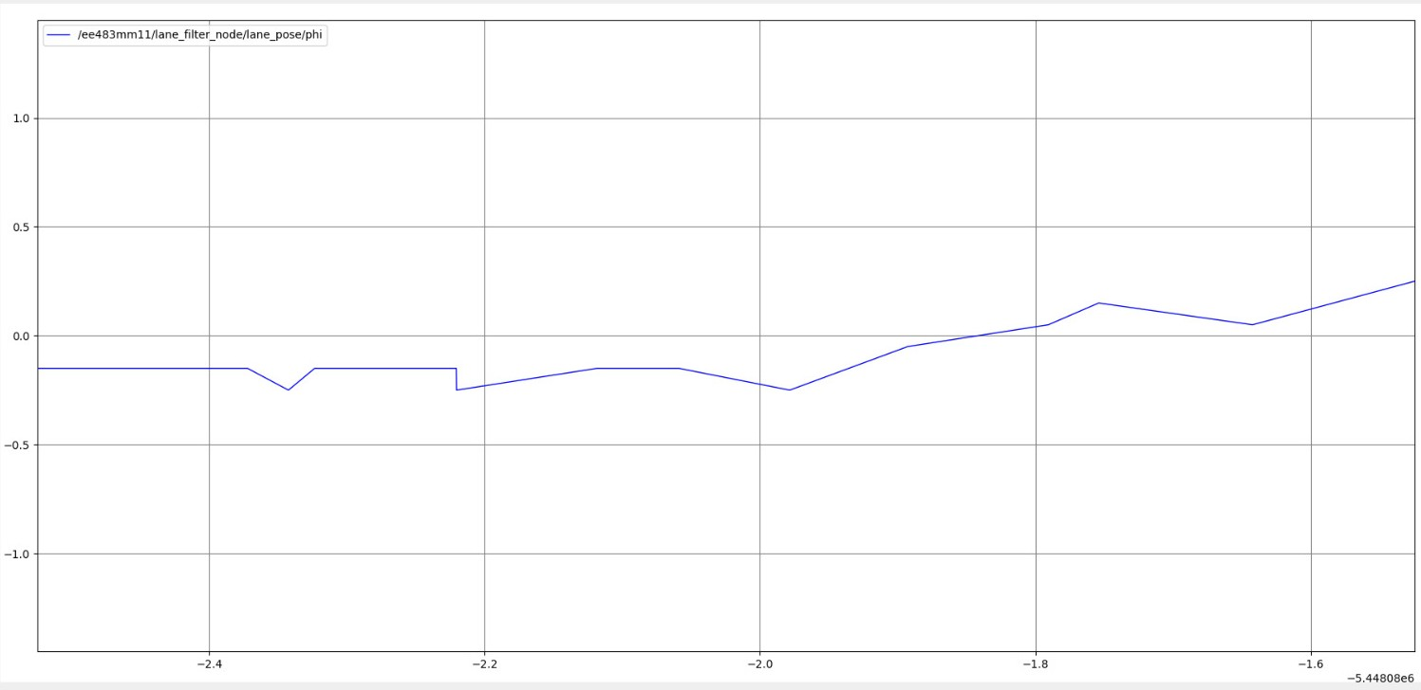
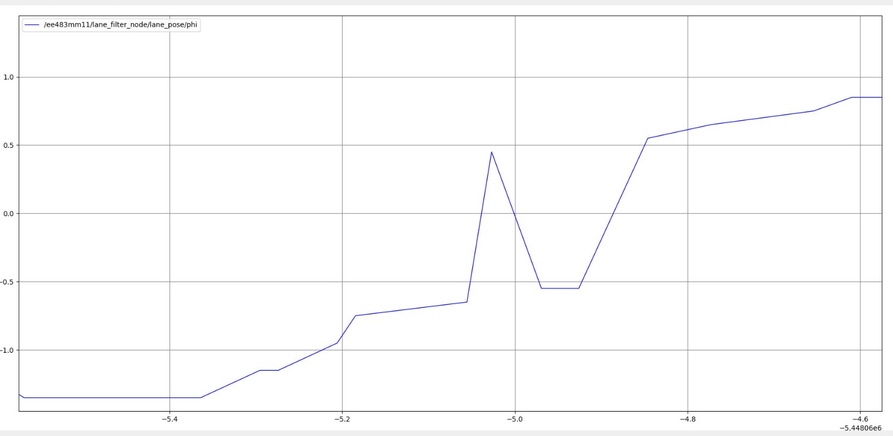
RESULTS
Fig 3a: Angle of Attack at start position
Fig 3b: Angle of Attack when turning left to avoid obstacle

Slide 16
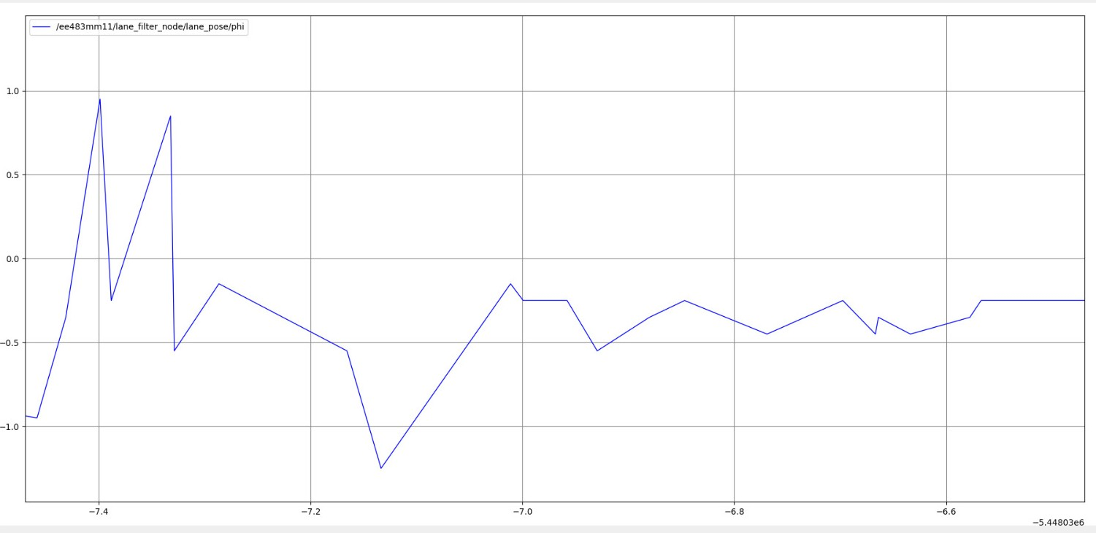
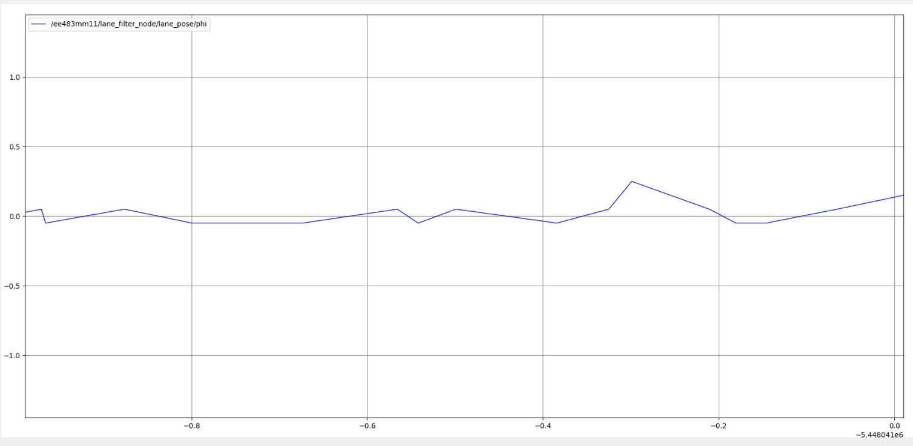
RESULTS
Fig 3c: Angle of Attack when Turning Right to come Back to Track
Fig 3d: Angle of Attack when back on Lane Following Stage

Slide 17
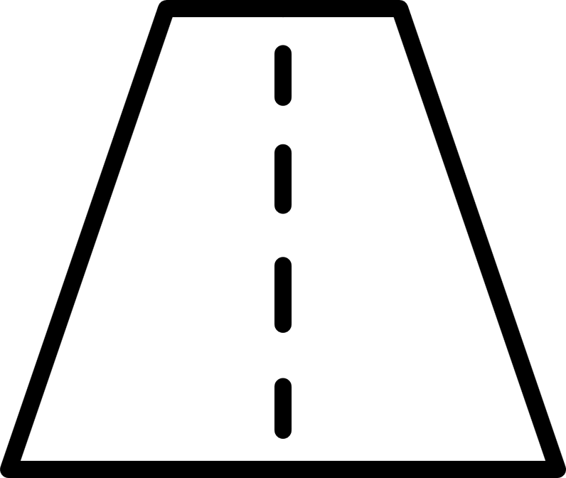
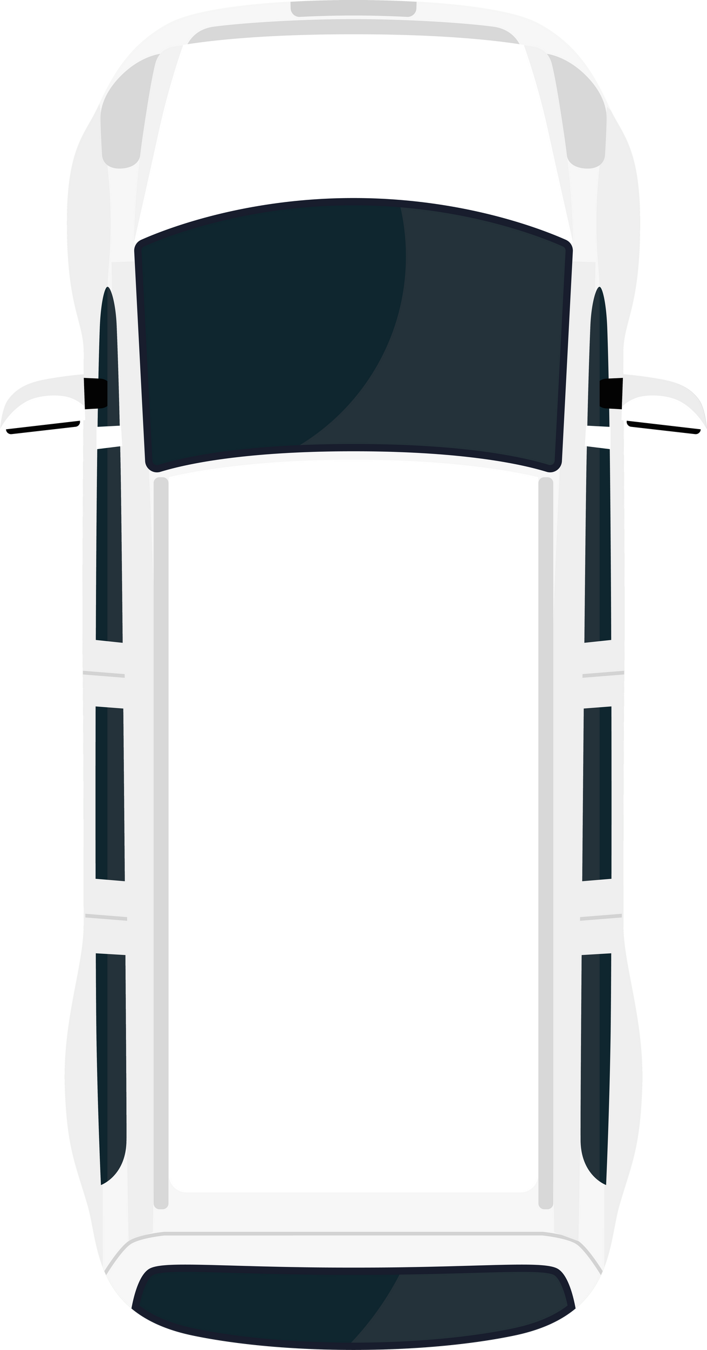
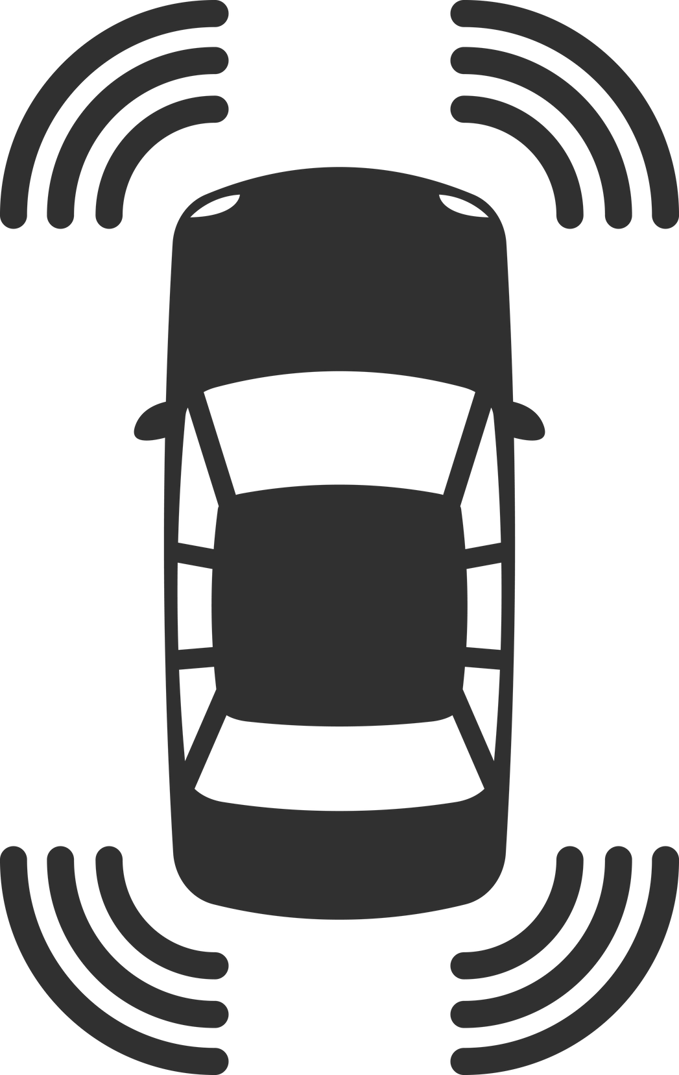

CHALLENGES
LANE DETECTION
LANE KEEPING
OBSTACLE AVOIDANCE
Hard to tune Hough transform for stable lane lines
Cropped image size too small which missed lane features
Difficult to mask yellow & white lanes consistently
Filter node issues → lane pose not stable
PID tuning very sensitive.
Robot inconsistent: some laps perfect, some laps fail
ToF sensor readings noisy and unreliable
Closed-loop avoidance failed → switched to open-loop PID
Integration of lane + detection + control nodes tricky

Slide 18
FUTURE SCOPE
Closed-Loop Obstacle Avoidance
Replace time-based turning with sensor-feedback-based control.
Lane pose for realignment.
Include wheel odometry for better motion estimation.
2. Multi-Obstacle Handling
Detect multiple Duckiebots simultaneously
Select safe passing direction dynamically (left/right)
3. Prediction of Moving Obstacles
Extend the vision system to track moving Duckiebots over time
Estimate relative velocity and heading direction.

Slide 19


THANK YOU

