Slide 1
Multi-Scale Super Resolution With Blind De-noising Using Residual Learning For Digital Art
Student: Santiago Mazagatos Pérez
Supervisor: Sergio Escalera Guerrero

Slide 2
Super Resolution
Ideally: increasing the size of an image without losing fidelity.
Restore a hypothetical High Resolution image from a Low Resolution image.
Given an actual LR and HR pair, the restored Super Resolution image given by LR should be identical to the HR image.
HR
SR
HR
LR
=
Downsampling
Model

Slide 3
Classic SR Methods: Dictionary methods
Create a database of low resolution patches and high resolution patches.
Input is processed and defined in terms of the low resolution patches.
The coefficients used to define the input using the low resolution patches are applied to their corresponding high resolution patches and the image is reconstructed.

Slide 4
New Approach: SRCNN
Using example LR and HR pairs, let the network learn the desired upsampling function on its own.
Much less handcrafted than dictionary approaches.
Most of current SR work is based on CNNs.

Slide 5
SRCNN based application: Waifu2x
Trained with digital art (mainly anime).
Input is upscaled before processing and then deblurred by the network, making it capable of using any scale (with diminishing results as the scale increases and thus the blurriness of the input increases).
Requires different models for different noise levels.

Slide 6
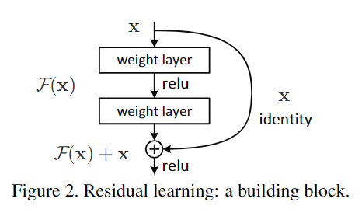
Residual Learning
Used to mitigate the vanishing/exploding gradient problem.
Skip connections are added to the network to allow outputs from earlier layers to affect deeper layers.
Allows for very deep architectures and thus highly complex models.
[K. He, 2016] Deep Residual Learning for Image Recognition

Slide 7
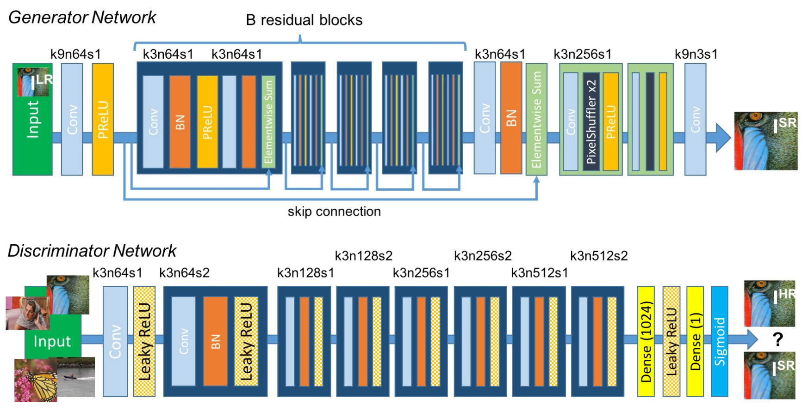
SRResNet and SRGAN
SRResNet: modified ResNet model for Super Resolution tasks.
SRGAN: Generative Adversarial Network using SRResNet as a generator, and a discriminator to determine whether or not a generated SR image looks “natural”.
[C. Ledig, 2017] Photo-Realistic Single Image Super-Resolution Using a Generative Adversarial Network

Slide 8
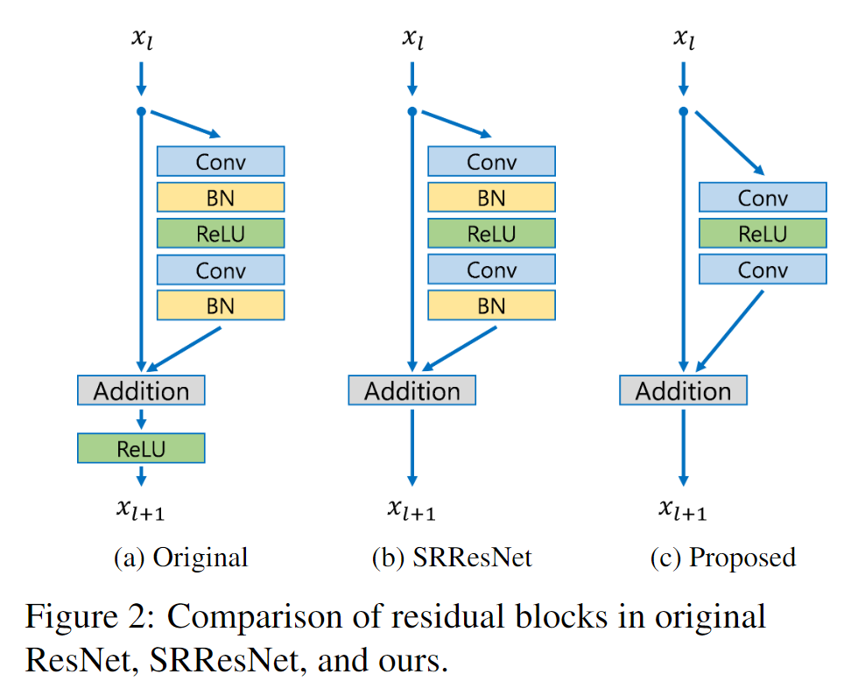
Starting point: EDSR
Modification of SRResNet.
Batch Normalization layers are removed.
Thanks to reduced memory and computational requirements, the network can be deeper, and convolutional layers can have a higher number of filters.
[B. Lim, 2017] Enhanced Deep Residual Networks for Single Image Super-Resolution

Slide 9
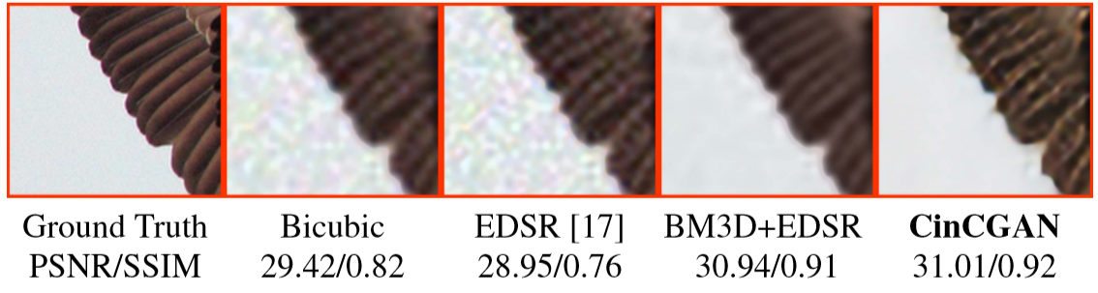
Starting point: CinCGAN
Model that uses two CycleGANs along with a SR network (EDSR in the case of the paper).
Unsupervised super-resolution (no HR-LR pairs needed in training).
Unsupervised denoising.
[Y. Yuan, 2018] Unsupervised Image Super-Resolution using Cycle-in-Cycle Generative Adversarial Networks

Slide 10
Denoising: BM3D
BM3D is a method proposed in a 2007 paper based on collaborative filtering.
The method processes an image in blocks by matching them with similar blocks and using collaborative filtering, in other words, estimating a clean block from all the similar blocks.
Still popular despite its age, it’s used as a reference in the CinCGAN paper when paired with EDSR for denoising tasks.

Slide 11
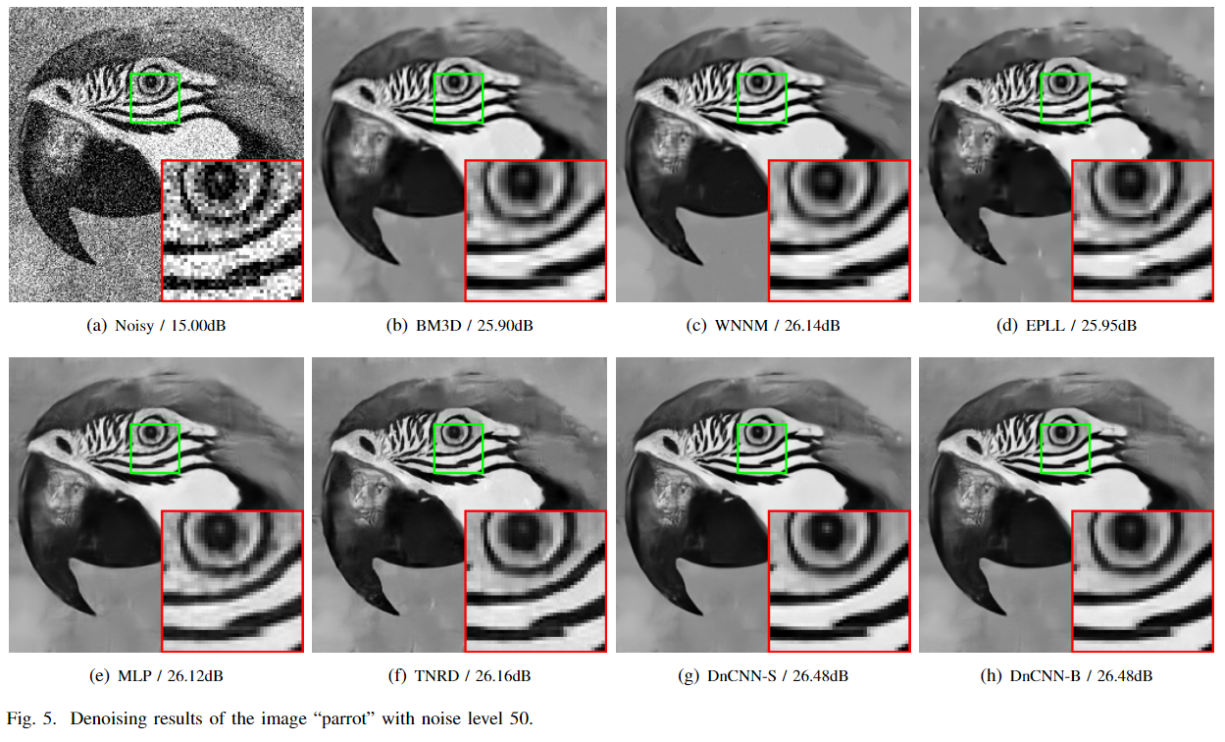
Denoising: DnCNN
An adaptation of the VGG network for denoising.
Deep network
Residual learning
Blind denoising
Deblurring as a means of SR
[K. Zhang, 2016] Beyond a Gaussian Denoiser: Residual Learning of Deep CNN for Image Denoising

Slide 12
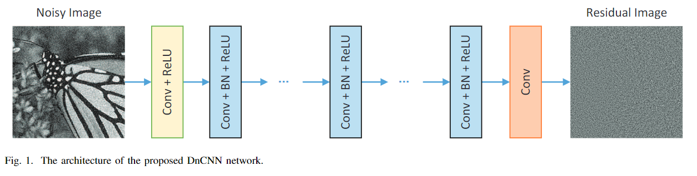
Denoising: DnCNN
[K. Zhang, 2016] Beyond a Gaussian Denoiser: Residual Learning of Deep CNN for Image Denoising

Slide 13
CNTK
CNTK is an open source deep learning framework developed by Microsoft.
It has Brainscript, Python and C# APIs
Plenty of tutorials and examples available .

Slide 14
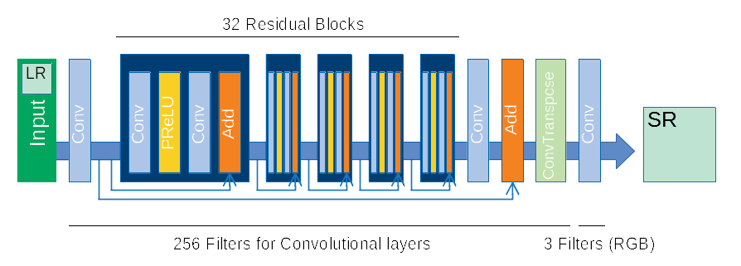
Implementation
The implementation started by modifying a code example for SRResNet to include the modifications of EDSR, including the removal of Batch Normalization layers and the increase in filters of convolutional layers and number of residual blocks.

Slide 15
Implementation
Training is done with pairs of HR and LR images, for every pair created the LR patch will be either:
Saved as a PNG (clean)
Saved as a JPEG with random quality
Saved as a PNG with random gaussian noise
HR
LR
(clean)
LR
(jpeg)
LR
(gauss)

Slide 16
Considerations
EDSR: State of the art super resolution, no denoising.
  EDSR + BM3D denoising as “state of the art” (CinCGAN paper)
DnCNN: State of the art denoising, SRCNN style super resolution, outdated.
Solution: EDSR super resolution with DnCNN style denoising to create a model beyond the current state of the art.

Slide 17
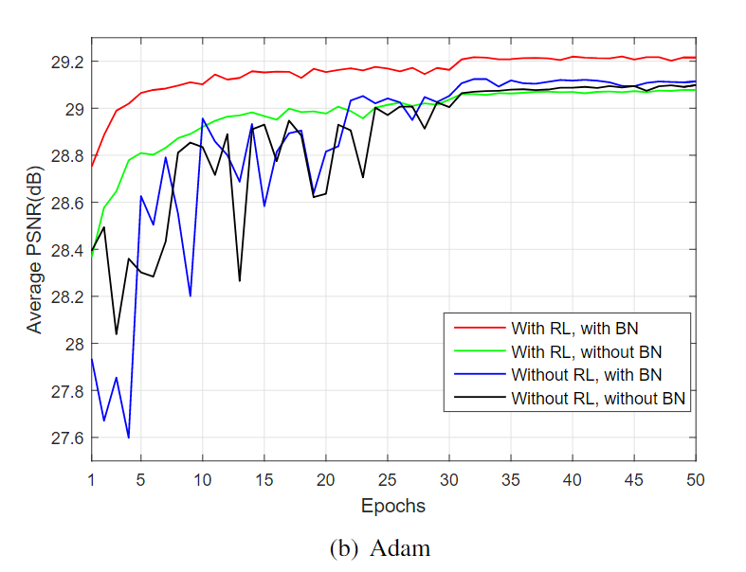
Considerations
Differences between EDSR and DnCNN architecture-wise:
EDSR doesn’t use Batch Normalization, DnCNN does.
EDSR uses L1 metric for better performance, DnCNN uses L2.
DnCNN provides a different kind of output.

Slide 18
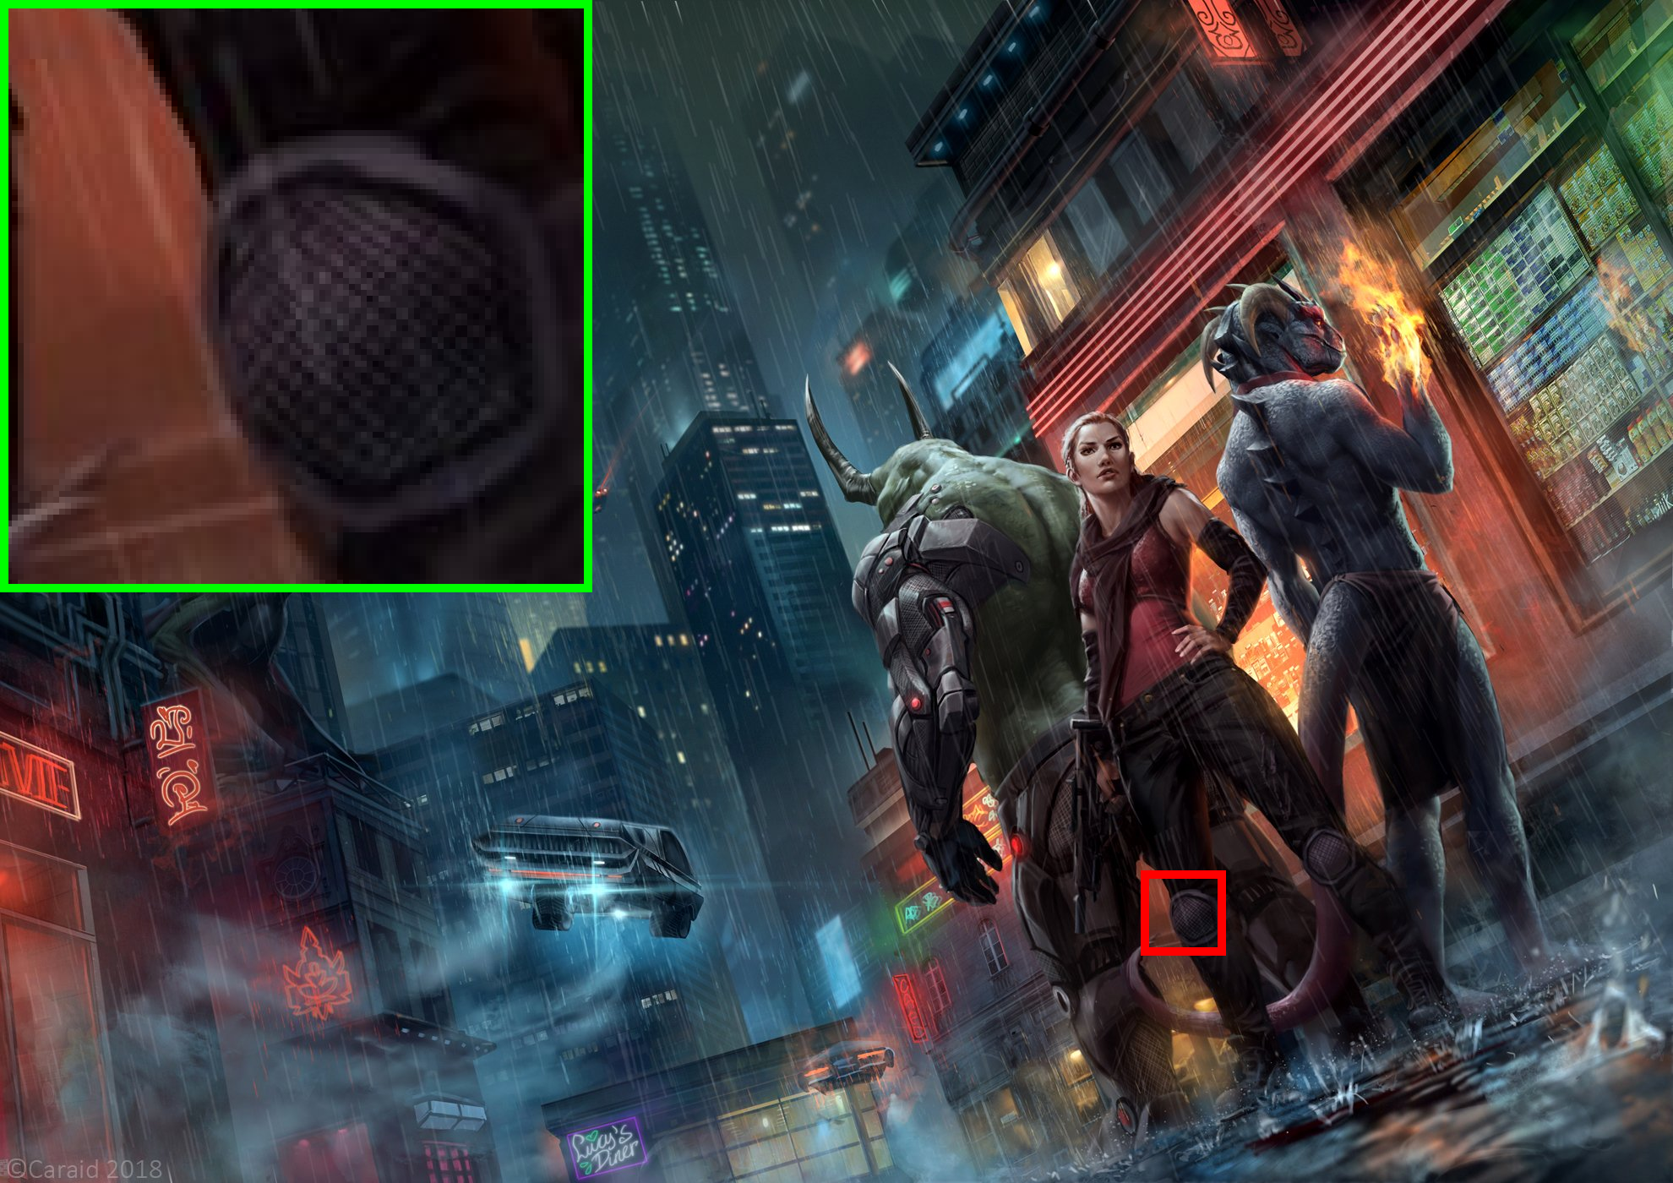



Results
HR
Bicubic
Waifu2x
(best result)
Mine

Slide 19
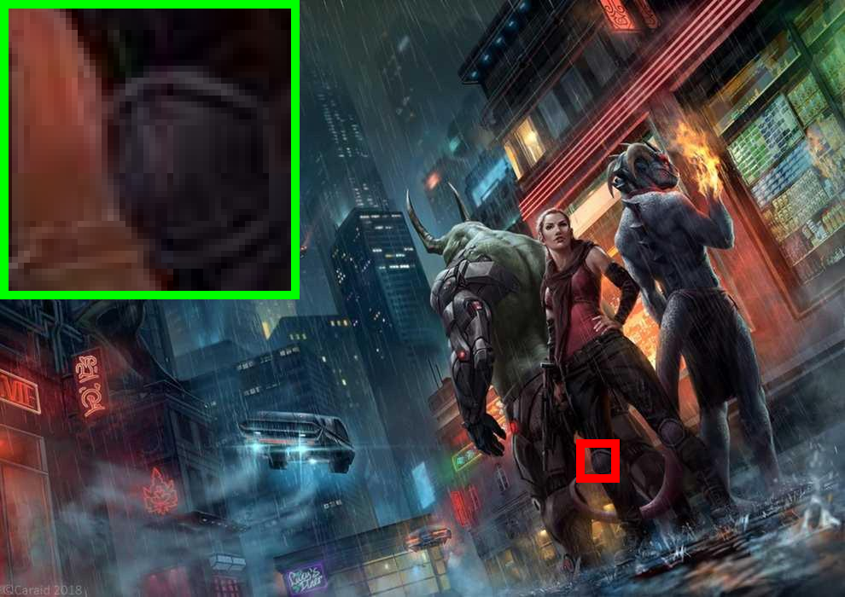
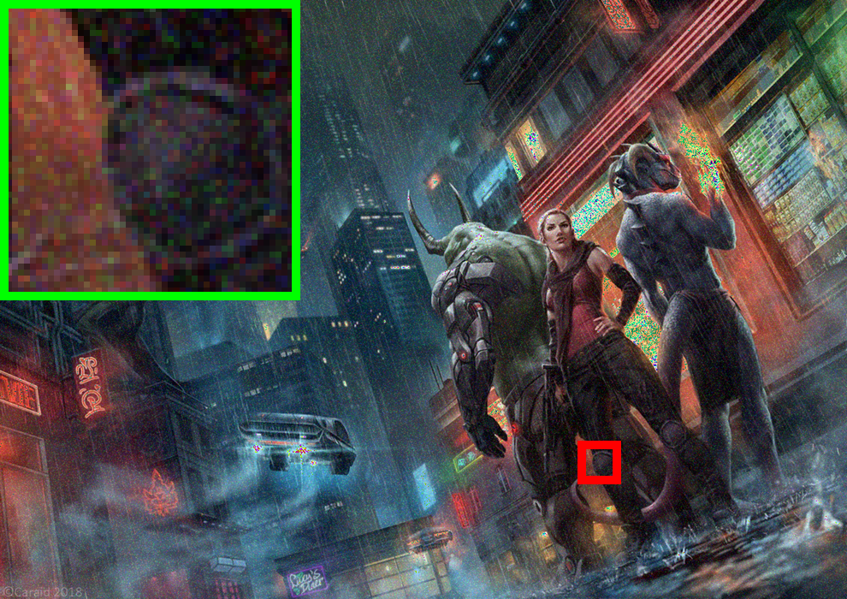
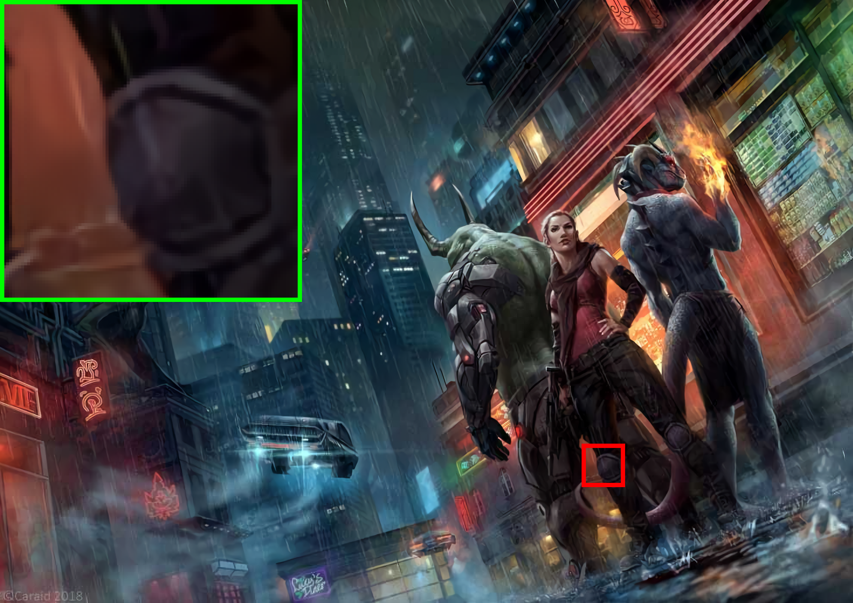
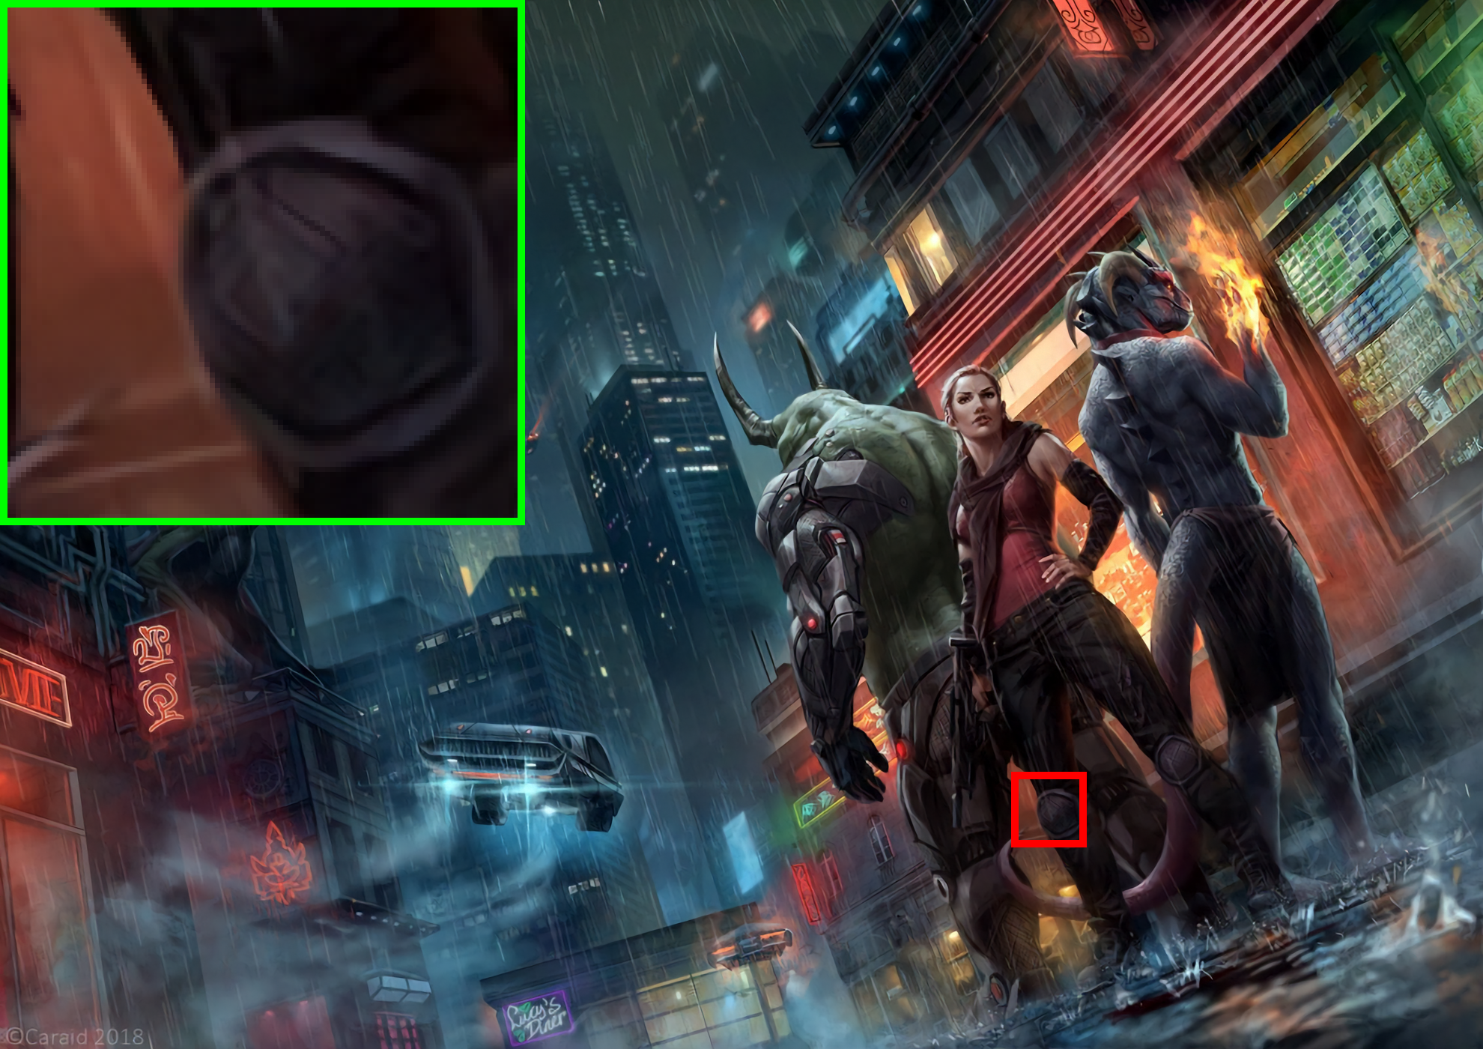
Results
JPEG LR
Quality: 50
Gaussian LR
Sigma: 25
SR Result
SR Result

Slide 20
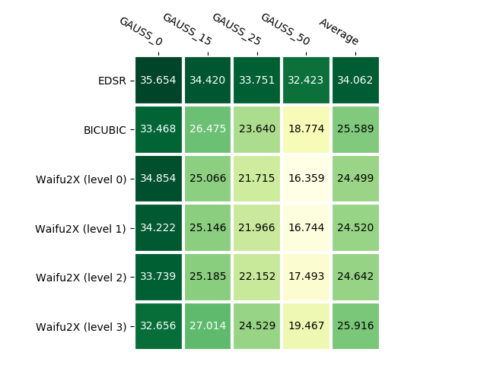
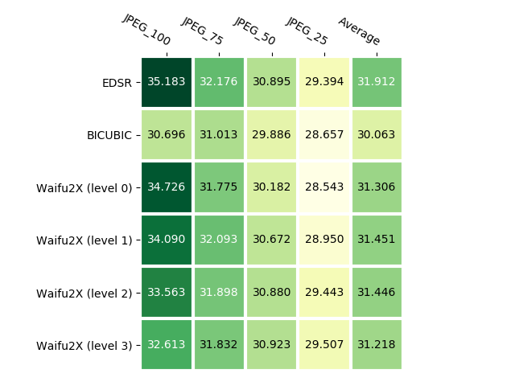
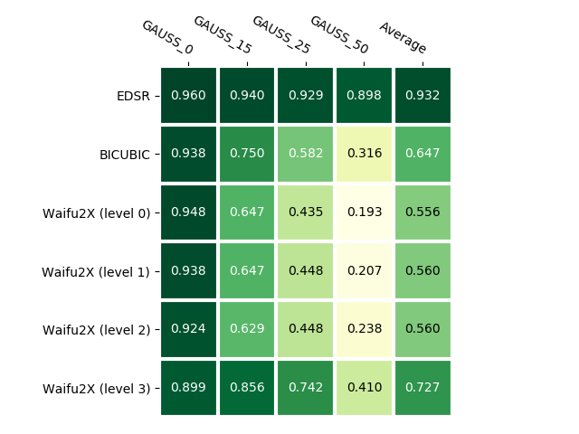
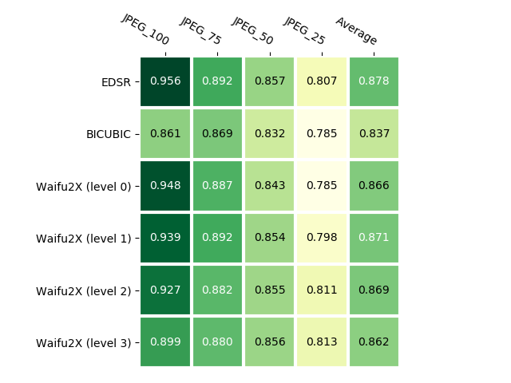
Results

Slide 21
Conclusions
Great restoration of detail in complex artwork.
Good quality denoising, especially with Gaussian noise.
Performance comparable or superior to waifu2x, possible overfitting issue in low complexity art, room for more complexity (additional noise patterns)

Slide 22
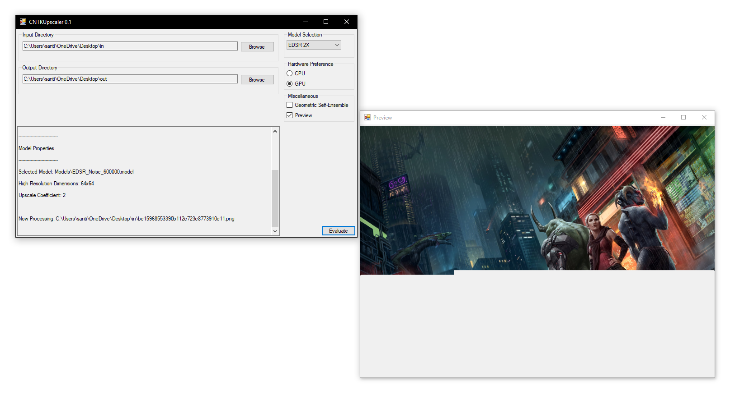
Demo & Questions

