Slide 1

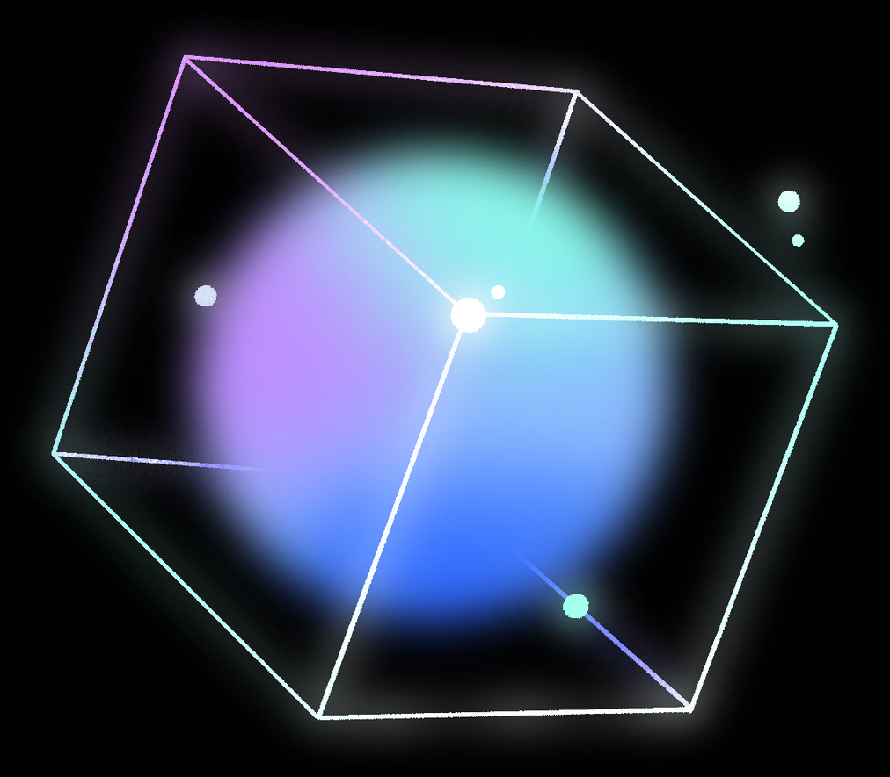




PROJECT
ARTIFICIAL INTELLIGENCE
By : ALMIR MUSTAFIĆ
TARIK BAJROVIĆ
RIJALDA ŠAĆIRBEGOVIĆ

Slide 2
TABLE OF CONTENTS
  About the Project
  Technology Stack
  Datasets
  Algorithms & Models
  How the algorithms work
  Problem & Market Opportunity
  Target Customers
  Competitive Advantage

Slide 3

ABOUT THE PROJECT
PatternScope AI is the core technology foundation for an academic handwriting authentication and automated grading system. The end goal is a platform where professors upload handwritten exams and assignments, and the system validates that the student who signed the submission actually wrote it by matching against their baseline handwriting patterns, then grades the content by extracting text from handwritten answers, analyzing topic coverage, and computing similarity scores against professor-provided answer keys.
The current implementation builds this foundation by recognizing handwritten digits, geometric shapes, and custom symbols. Users upload images or draw patterns on a canvas. The system returns predictions with confidence scores, compares multiple AI models, and learns from user feedback in real-time. In the future, we plan to extend this project to handle full text recognition, writer verification, and content-based grading.

Slide 4


  TECHNOLOGY STACK
The system is built with C++14, CMake, stb_image, and natID GUI framework.
  DATASET
The system trains on three datasets. The mnist folder contains MNIST handwritten digit data with 60,000 training images and 10,000 test images in IDX format. The datasets folder contains Quick Draw data in numpy format with 1,000 training examples and 200 test examples per category. Shapes include circle, square, and triangle. Symbols include checkmark, cross, and heart. The system uses a train-test split (see trainer.cpp). The training process uses these datasets to build pattern libraries for KNN, calculate statistics for Naive Bayes, learn weights for MLP, and select templates for A*.
  ALGORITHMS AND MODELS
1. K-Nearest Neighbors (KNN)
2. Naive Bayes
3. Mini Multi-Layer Perceptron (MLP)
4. A* Template Matcher
5. Rule-Based Engine (Fallback)

Slide 5

HOW ALGORITHMS WORK
01
02
03
04
05
06
07
🔹 1) K-Nearest Neighbors (KNN)
🔹 2) Naive Bayes
🔹 3) Mini Multi-Layer Perceptron (MLP)
🔹 4) A* Template Matcher
🔹 5) Rule-Based Engine
🔹 6) Ensemble & Active Learning
🔹 7) Model Training (Offline)

Slide 6







PROBLEM AND MARKET OPPORTUNITY
PROPOSED SOLUTION
CURRENT PROJECT SCOPE
FUTURE EXTENSION
Handwriting Authentication
  Verifies student identity
  Matches handwriting to registered baseline patterns
Automated Grading
  Extracts handwritten text
  Compares answers with professor answer keys
  Professors review only low-confidence cases
Recognizes:
  Handwritten digits
  Geometric shapes
  Custom symbols
Serves as core pattern recognition engine
  Full handwriting recognition
  Character-by-character authentication
  Text similarity analysis for grading automation

Slide 7



TARGET CUSTOMERS

Slide 8

  UNIVERSITIES AND COLLEGES PROCESSING HANDWRITTEN EXAMS AND ASSIGNMENTS
  K–12 SCHOOLS GRADING WRITTEN WORKSHEETS AND TESTS
  RESEARCH INSTITUTIONS ANALYZING HANDWRITING PATTERNS IN ACADEMIC SUBMISSIONS
01
04
02
03

Slide 9
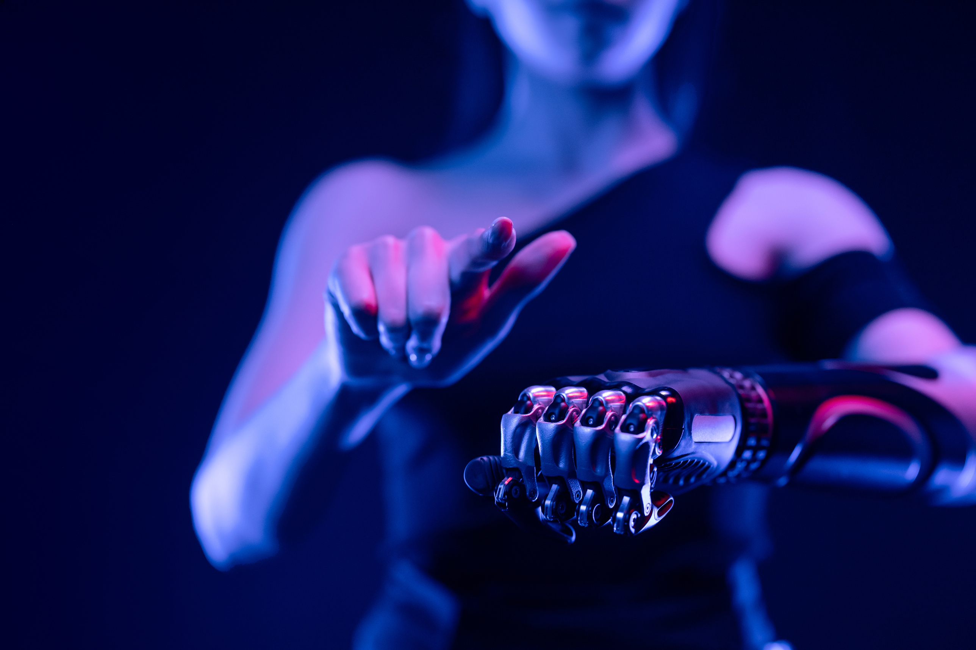
COMPETITIVE ADVANTAGE
There is no similar software on the market. The system runs offline and eliminates per-page costs and data privacy risks. The multi-model architecture allows institutions to inspect how predictions are made and which models agree or disagree. The modular design allows swap of algorithms or add models. Active learning adapts to institution-specific handwriting patterns.

Slide 10

THANK YOU!

