Slide 1
Major Css frameworks
Name: Tom Barrera
Course Name: IT 3203 Web Dev W02 Spring 2025
Assignment: Assignment #3
Due: April 27, 2025
Objective: To analyze the features of major CSS frameworks – comparison of two.

Slide 2

Project dependent
What framework is right for you?
It often depends on the project requirements. Some projects may need a more responsive site that loads quickly, while other projects may require more customization. Figuring out which framework works best for your project is often about finding the right balance to meet your specific needs. There are many CSS frameworks to choose from and each with differing strengths and weaknesses. Choosing the right CSS framework for your web project can be a game-changer (Best CSS Frameworks 2024 Compared, n.d.).

Slide 3

Intro: Focus Areas when choosing the right CSS framework
There are 5 main areas to focus on when comparing different CSS Frameworks:
Performance
Customizability
Community Support
Learning Curve
Feature Set

Slide 4
Comparison: Two major popular CSS Frameworks
CSS Frameworks:
Based on my initial research, it is obvious that choosing the right framework for your web project is important. The right CSS framework could significantly impact the project’s development and overall design consistency. For comparison, I chose two popular CSS frameworks – Bootstrap and Bulma. Each have their strengths and weaknesses, but both are used widely and have a strong community support. Next, I will cover each CSS framework in general and then do a deeper dive with a focus on their general structure and responsiveness.

Slide 5
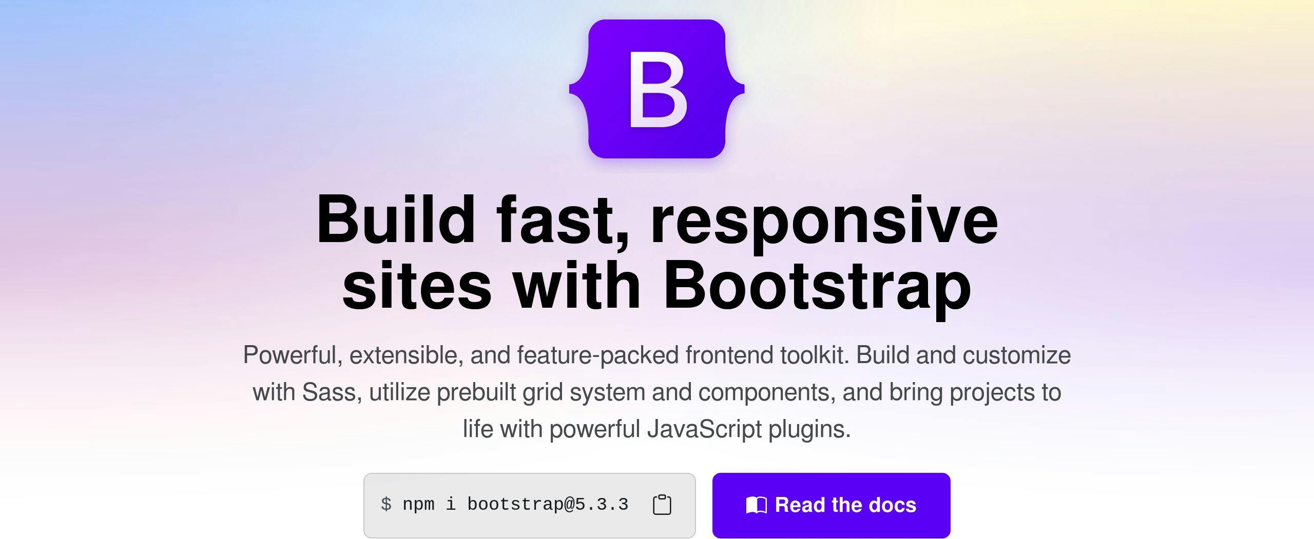
Bootstrap
Performance – Bootstrap relies on a smart layout system that works on all devices. To help speed things up, bootstrap keeps the files small. Core features include a responsive grid system with pre-designed components like forms, buttons, and navigation. Popular framework for building responsive, mobile-first websites.
Customizability – there are many things that you can change in Bootstrap providing many options for customizing it to the way that you want. You can make changes to the style of the design elements like buttons and menus to get a desired look and feel. Even with these many options, some believe that it is a little rigid for greater changes.
Community Support – Bootstrap is still very popular, and millions of websites use it. There is a large community of experienced users that will often provide help with questions.
Learning Curve – Bootstrap is a user-friendly framework that is easy for beginners. The code is simple and easy to learn. The documentation is extensive and includes a lot of examples for learning.
Feature Set – Bootstrap is feature rich. It includes features like a grid system for laying out your page, and ready-to-use components like buttons and navigation bars. It is responsive for smaller screens like phones and tablets and is supported by many different web browsers. Bootstrap includes tools for improving text styles and adding animations.
(Best CSS Frameworks 2024 Compared, n.d.)

Slide 6
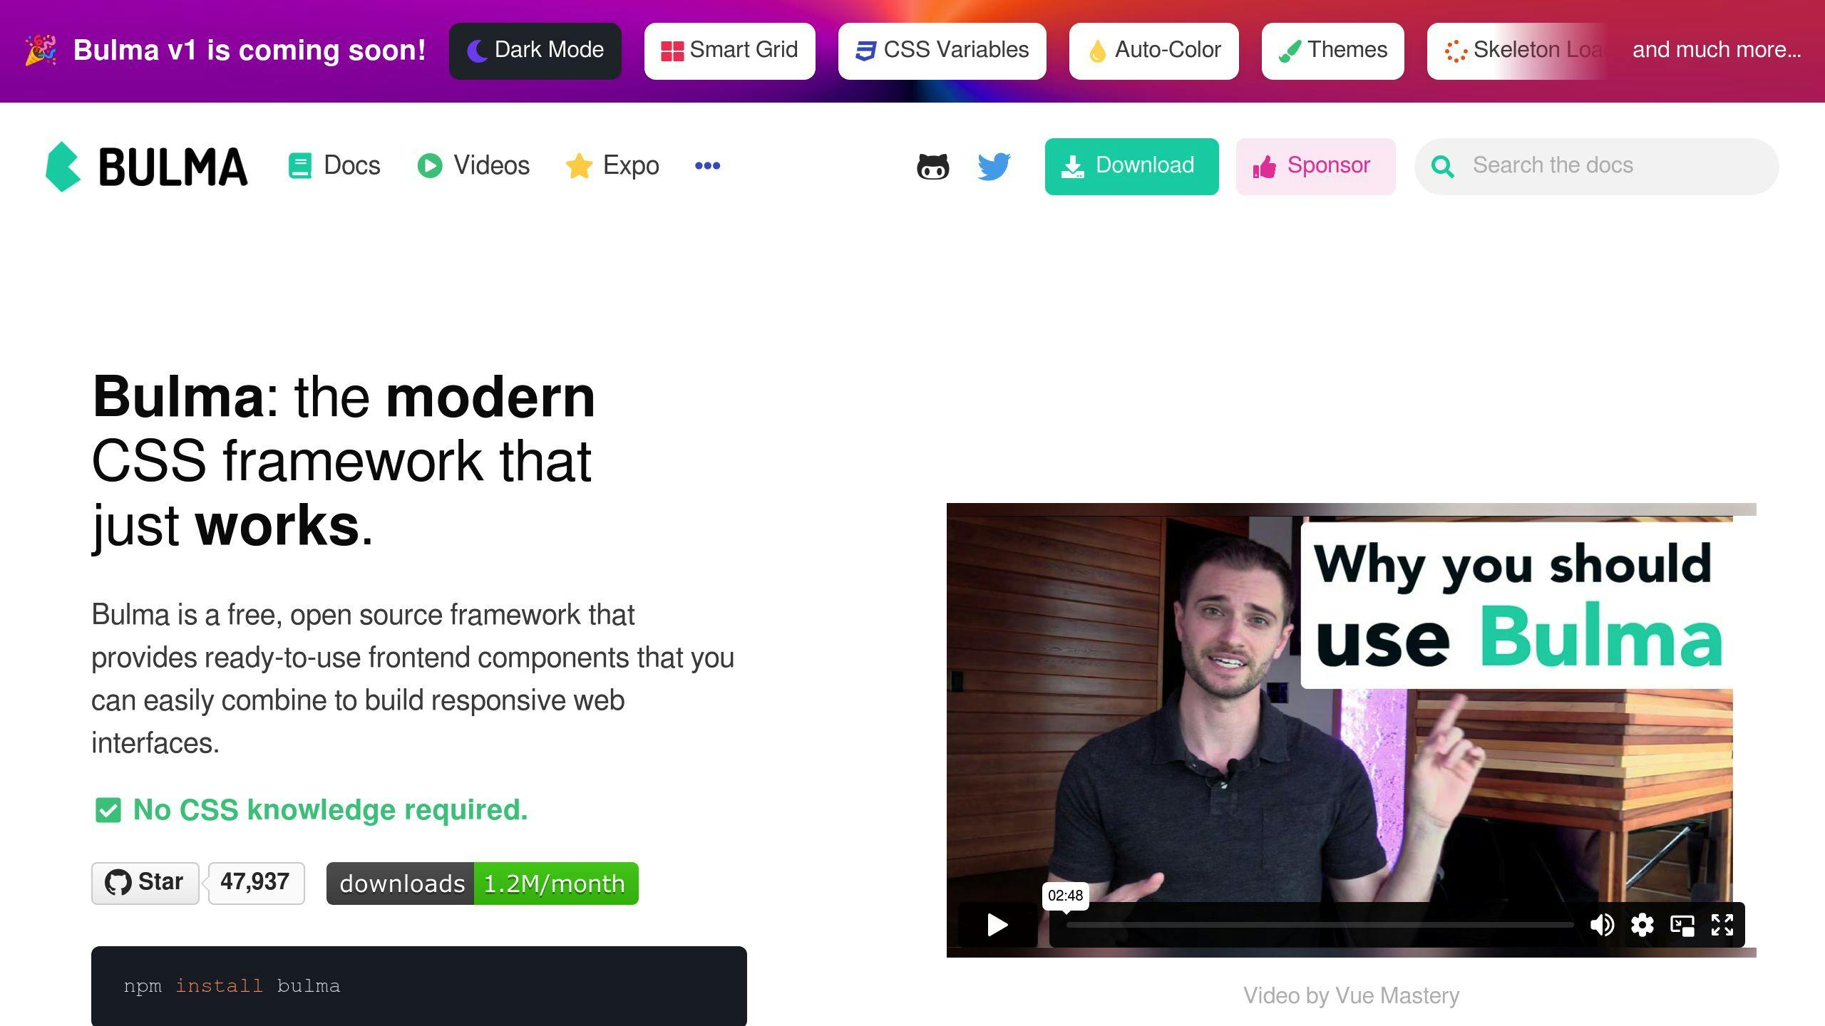
Bulma
Performance – Making websites run quickly and smoothly is Bulma’s primary objective. Utilizing CSS Flexbox for laying out and arranging items on the page improves on the speed. Including only the necessary bits of CSS helps keep file sizes at a minimum. Bulma also ensures that pictures don’t load all at once to avoid a slow loading website. Bulma’s primary focus is speed.
Customizability – Bulma is perfect for those that like to tweak things. Built on a platform that only lets you use the parts you need it still provides the capability to change the look of almost everything. Simple color and font changes can be made directly in CSS or for more detailed changes by using the advanced feature called Sass variables. Adding new elements or adjusting things is easy and straightforward.
Community Support – Bulma is an open-source project with strong community support. Many people that are supportive of Bulma are active on Stack Overflow and Github and will often provide answers to questions. The support is reliable while there may not be as many available guides and tutorials.
Learning Curve – Bulma is simple and easy to get started using. Because it uses simple CSS classes that makes sense, it is easy to learn it quickly. Bulma is user friendly for beginners and even easier for anyone with a basic understanding of HTML, CSS and JavaScript.
Feature Set – Bulma comes with many options for creating your webpage. Included are options for organizing your page, like columns and ready to use features like buttons and forms. It is supported by all major browsers and is responsive for smaller mobile device screens. It does require additional tools to support things that move or react with JavaScript interactions.
(Best CSS Frameworks 2024 Compared, n.d.)

Slide 7

Bootstrap vs Bulma A Side-by-side comparison
Quick Glance:
Framework | Performance | Customizability | Community Support | Learning Curve | Feature Set
Bootstrap | Fast | Moderate | High | Easy | Rich
Bulma | Very Fast | High | Low | Easy | Basic
Pros and Cons:
Framework | Pros | Cons
Bootstrap | Very popular and used by many Help and instructions are easy to find Includes many ready-to-use parts Great for beginners | Big changes are difficult Site may be slowed depending on the size
Bulma | Very light and quick Can be customized a lot Simplistic and easy to understand | Very few built-in components Not a lot of guides or people to help for support
(Best CSS Frameworks 2024 Compared, n.d.)

Slide 8
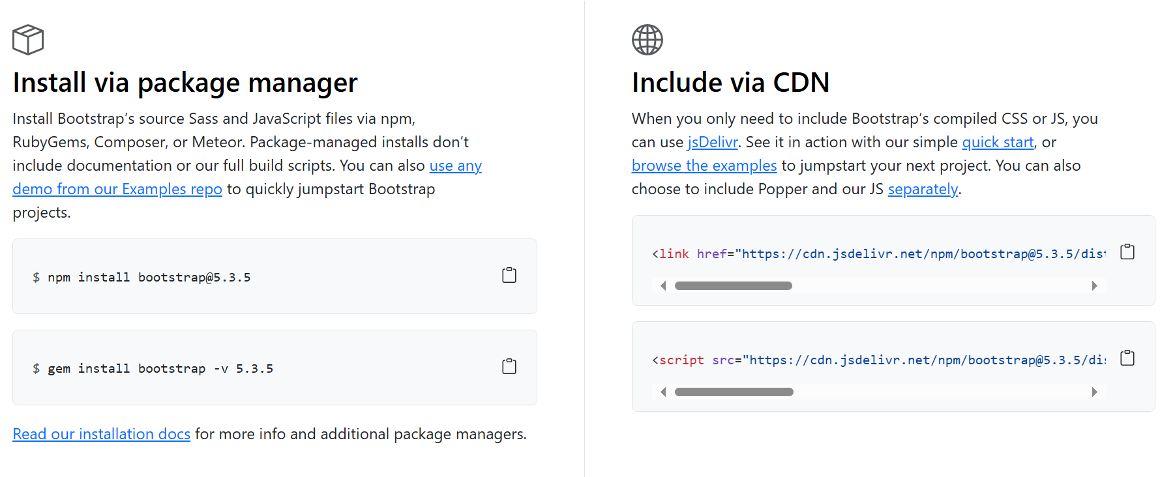
A deeper dive - Bootstrap
Overview
Bootstrap is a powerful, extensible, front-end toolkit that is feature rich for building fast, responsive websites.
Installation
Contributors (n.d.-b)

Slide 9
A deeper dive - Bootstrap
Containers
Containers are the element that Bootstrap is build on and required when using the default grid system. You can choose between a responsive fixed-width container with the max-width changing at each breakpoint or a fluid-width that is 100% wide at all times. Not required, but containers can also be nested.
Responsive Breakpoints
Taking a mobile-first approach, Bootstrap utilizes media queries (breakpoints) in their source Sass files for layout, grid system, and components. One example:
// Extra small devices (portrait phones, less than 576px)
// No media query since this is the default in Bootstrap
// Small devices (landscape phones, 576px and up) @media (min-width: 576px) { ... }
// Medium devices (tablets, 768px and up) @media (min-width: 768px) { ... }
// Large devices (desktops, 992px and up) @media (min-width: 992px) { ... }
// Extra large devices (large desktops, 1200px and up) @media (min-width: 1200px) { ... }
Contributors (n.d.-b)

Slide 10
A deeper dive - Bootstrap
Responsive Breakpoints (continued)
Alternatively, source CSS is written in Sass with all media queries available via Sass mixins:
@include media-breakpoint-up(xs) { ... }
@include media-breakpoint-up(sm) { ... }
@include media-breakpoint-up(md) { ... }
@include media-breakpoint-up(lg) { ... }
@include media-breakpoint-up(xl) { ... }
// Example usage:
@include media-breakpoint-up(sm) {
.some-class {
display: block;
}
}
Additional options like media queries to target a single element screen sizes by using both min and max breakpoint widths.
Contributors (n.d.-b)

Slide 11
A deeper dive - Bootstrap
Z-index
Utilizing z-index for several Bootstrap components helps control the layout by providing a third axis for arranging content. A default z-index scale is designed to properly layer navigation, tooltips and popovers, modals, and more.
For layered components, these are set using a high and specific arbitrary number to avoid conflicts and ensures that these overlays always appear on top of other content on your page. Bootstrap recommends that you keep these values to retain reasonably consistent behavior. If you change one of them then you will likely need to change them all.
Example:
$zindex-dropdown: 1000 !default;
$zindex-sticky: 1020 !default;
$zindex-fixed: 1030 !default;
$zindex-modal-backdrop: 1040 !default;
$zindex-modal: 1050 !default;
$zindex-popover: 1060 !default;
$zindex-tooltip: 1070 !default;
Low single digit z-index values are used to handle overlapping borders within component elements like buttons, input groups and pagination. This ensures that when you hover or focus on an element, its border appears over its siblings.
Contributors (n.d.-b)

Slide 12
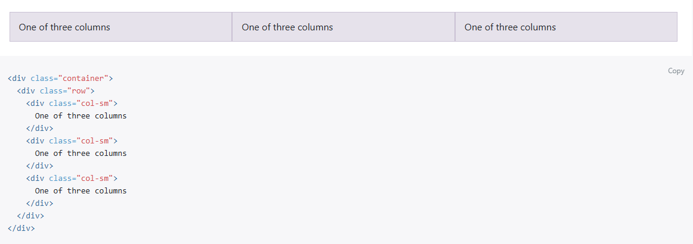
A deeper dive - Bootstrap
Grid System
Bootstrap uses a grid system built with flexbox to layout and align content in a series of containers, rows, and columns making it fully responsive. It relies on a 12-column system with five default responsive tiers, Sass variables and mixins, and dozens of predefined classes. Built with flexbox, it is fully responsive. Below is an example of a simple grid with 3 equal columns:
Contributors (n.d.-b)

Slide 13
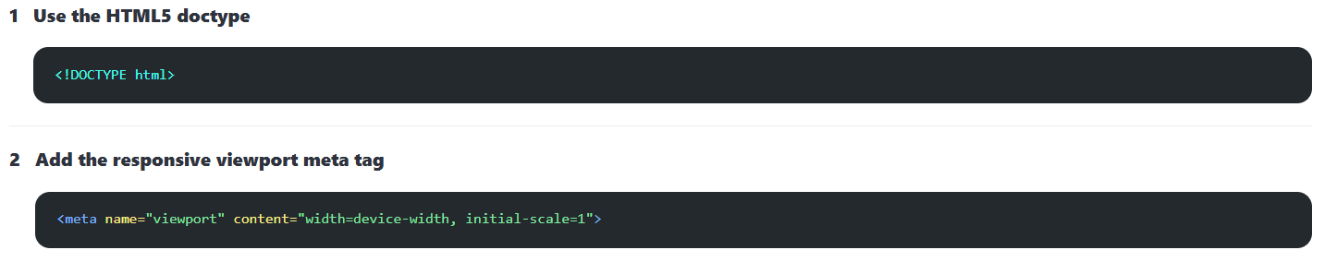
A deeper dive - Bulma
Overview
Bulma uses a CSS Library to provide CSS classes for styling HTML code. You have 2 choices for using Bulma:
You can use one of the pre-compiled .css files.
You can install the .scss files which allows you to customize Bulma to your needs.
To use Bulma, there are some code requirements to make your webpage responsive for Bulma to work correctly:
(Overview of Bulma, n.d.)

Slide 14
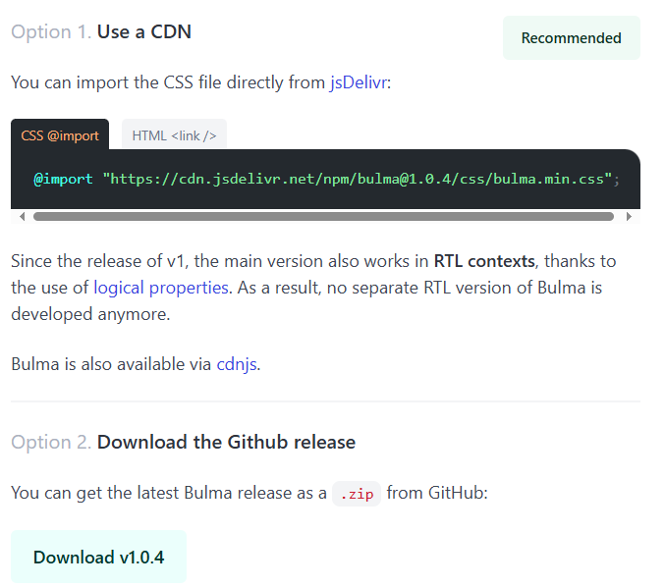
A deeper dive - Bulma
Installation 1:
Get the Bulma CSS File – a single .css file that includes all of Bulma
(Overview of Bulma, n.d.)

Slide 15
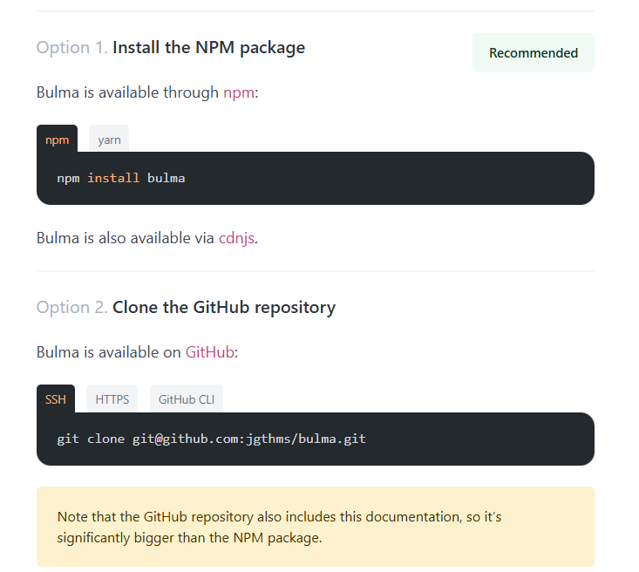
A deeper dive - Bulma
Installation 2:
Get the Bulma Sass Library – Build your own version of Bulma with a collection of .Sass files
(Overview of Bulma, n.d.)

Slide 16
A deeper dive - Bulma
Modularity – import only what you need
Bulma consists of elements and components that can be loaded individually using the @use keyword.
Example: @use “path/to/file.scss”;
Most Bulma components rely on the base styles and CSS variables defined by the default themes. It is recommended to load the sass/base and sass/themes folders as well:
// Load Bulma's base styles and themes (including the minireset)
@use "bulma/sass/base";
@use "bulma/sass/themes";
// Load other Bulma components
@use "bulma/sass/elements/button";
@use "bulma/sass/components/message";
The @use can be used to import columns, elements and components, and custom Sass variables.
(Overview of Bulma, n.d.)

Slide 17
A deeper dive - Bulma
Responsiveness
Bulma is a mobile-first framework.
Vertical by default:
Optimized for vertical reading.
Columns stacked vertically.
level component shows its children stacked vertically.
Nav menu is hidden.
Horizontal layout for both columns or level can be enforced by appending the is-mobile modifier.
Breakpoints
Bulma has 4 breakpoints which defines 5 screen sizes:
mobile: up to 768px.
tablet: from 769px.
desktop: from 1024px.
widescreen: from 1216px.
fullhd: from 1408p.
To make use of these breakpoints, Bulma provides 9 responsive mixins.
Disabling breakpoints
By default, the $widescreen and $fullhd breakpoints are enabled. You can disable them by setting the corresponding Sass boolean to false:
(Overview of Bulma, n.d.)

Slide 18
Similarities & Aspect Critique
Similarities – things they have in common:
Both are front-end frameworks.
They are based on Flexbox.
Both are highly responsive.
They are compatible with Font Awesome.
Both are Free and Open Source
Single Aspect Critique – Bootstrap vs. Bulma:
Bootstrap – it requires coding familiarity to use it so it may be difficult for a true beginner or require a longer learning curve.
Bulma – is a CSS- only framework and doesn’t come with JavaScript requiring custom scripts for adding fundamental features like toggle which needs JavaScript or JQuery.
Pieces (2023)

Slide 19
Final takeaways
After looking at both Bootstrap and Bulma CSS frameworks, my final takeaway is centered around the intended use case.
Bulma is the best option for anyone that is new to coding and looking to quickly construct a webpage. Bulma with its predefined interfaces and components makes it simple and easy to use for any newbie that has just started experimenting with CSS. However, Bulma is simplistic in nature.
For more experience developers that have a need for more advanced features and extra functionality requiring components made using JavaScript, Bootstrap is the more logical choice framework.
Another consideration is speed. Bootstrap isn’t as lightweight as Bulma. Bootstrap has a reputation for being big since it includes everything that you may need. If your use case is centered on creating a modest, straightforward website, then Bulma would be a better choice.
Pieces (2023)

Slide 20
Conclusion
In conclusion, there is no right or wrong CSS framework. After researching both Bootstrap and Bulma CSS, it really boils down to which framework fits best for your web project. Both Bootstrap and Bulma are powerful CSS frameworks that are ideal for feature-rich, responsive web applications and they both have their strengths and weaknesses pointed out in previous slides.
Bootstrap excelled in advanced features, but with a level of complexity making it a little more attractive to anyone with a more advanced coding skillset.
Bulma, on the other hand, excelled in simplicity with a modern, clean syntax base purely on CSS and Flexbox making it a great choice for a more novice person preferring a lightweight and modular approach.
All in all, the best choice ultimately depends on the demands of the project and the developer’s preference. As a newbie to web development, my choice would be Bulma since it is a better match for my skillset.

Slide 21
References
Best CSS Frameworks 2024 Compared. (n.d.). https://daily.dev/blog/best-css-frameworks-2024-compared
Contributors, M. O. J. T. a. B. (n.d.-b). Overview. https://getbootstrap.com/docs/4.0/layout/overview/
Overview of Bulma. (n.d.). https://bulma.io/documentation/start/overview/
Pieces. (2023, March 28). Bulma vs Bootstrap: How Do They Compare? DEV Community. https://dev.to/get_pieces/bootstrap-vs-bulma-css- 32bf?comments_sort=oldest#:~:text=Bootstrap%20offers%20a%20collection%20of,for%20creating %20responsive%20web%20sites.

Slide 22

Thank you
Tom Barrera
tbarrera@students.Kennesaw.edu
IT 3203 Web Dev W02 Spring 2025

