Slide 1

A Neural Collaborative Filtering Model Incorporating Neighborhood Information
Reporter: Ting Bai
Supervisor : Prof. Jian-Yun Nie
Renmin University of China
14 March, 2018
Notes:
Hello everyone, I am so excited to have the chance to present my work here, A neural……, this work is published in CIKM2017, and was awarded the best short paper runner-up

Slide 2
Outline
What are recommender systems for?
Introduction
How do they work ?
Collaborative Filtering
Content-based Filtering
Knowledge-Based Recommendations
Hybridization Strategies
Our Work
Neural Collaborative Filtering Model Incorporating Neighborhood Information
Advanced topics
Deep sequence recommendation models
Notes:
Ok, let’s begin, Here, I will first give you a brief introduction of what are recommender systems for? Then I will introduce four Paradigms of recommender systems, I will mainly focus on Collaborative filtering paradigms, which is used in our work.

Slide 3
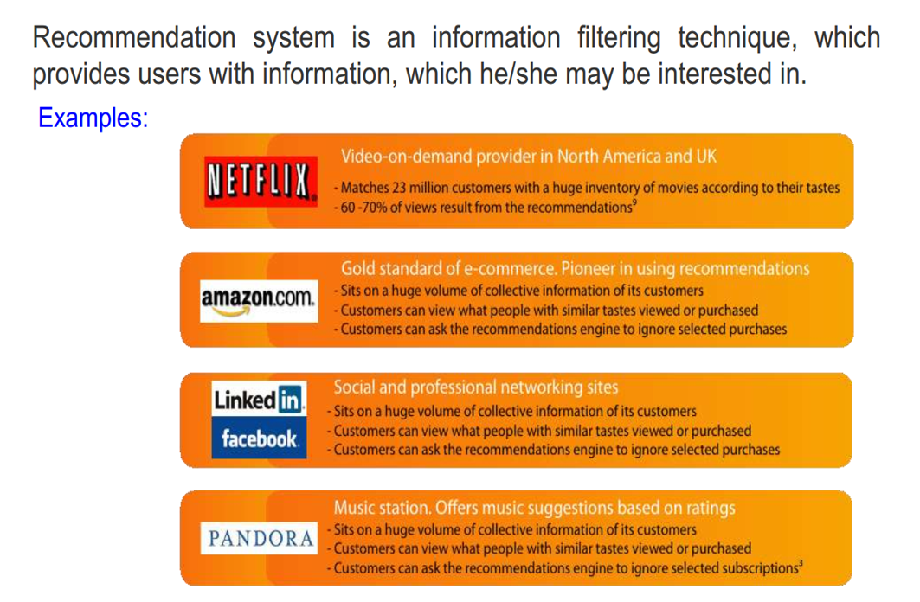
What is a recommendation system?
Notes:
Recommendation systems exists in In every aspect of our life. For example movie website Netflix, e-commence website amazon, social media facebook and music station pandora,

Slide 4
Why using Recommender Systems?
Value for the customer
Find things that are interesting
Narrow down the set of choices
Discover new things
Entertainment
…
Value for the provider
Additional and probably unique personalized service for the customer
Increase sales, click trough rates, conversion etc.
Opportunities for promotion, persuasion
Obtain more knowledge about customers
…

Slide 5
Recommender systems
RS seen as a function
Given:
User model
(e.g. ratings, preferences, demographics, situational context)
Items
(with or without description of item characteristics)
Find:
Relevance score. Used for ranking.
Finally:
Recommend items that are assumed to be relevant

Slide 6


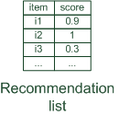
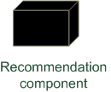
Paradigms of recommender systems
Personalized recommendations
Notes:
Given user profile and some contextual prameters, we want use recommendation component to get the corresponding score of each item. After scoring the scores of items, we can obtain the recommendation list.

Slide 7

Paradigms of recommender systems
Collaborative: "Tell me what's popular among my peers"
Notes:
The most common paradigms is to use the community data, which is also called collaborative.
The Basic Assumptions : - Users with similar interests have common preferences. The main idea of the collaborative method is to find a subset of users who have similar tastes and preferences to the target user and use this subset users for offering recommendations.
For example, your friend elly and you have the similar taste for a lot of movies. If she watch a new movie and thought it is excellent. It is more likely that the new movie also fit your taste well.

Slide 8

Paradigms of recommender systems
Content-based: "Show me more of the same what I've liked"
Notes:
Another paradigm is content-based recommendation. Different from collaborative paradim which use the "wisdom of the crowd" to recommend items. The content-based paradigm corporates the product features. It computes the relevant scores between user and item by matching the features of user and item.

Slide 9


Paradigms of recommender systems
Knowledge-based: "Tell me what fits based on my needs"
Notes:
Another paradigm of recommendation is knowledge-based recommendation, it is a specific type of recommender system that are based on explicit knowledge about the item assortment, user preferences, and recommendation criteria (i.e., which item should be recommended in which context). They are often used in conversational-based recomendation, i.e., user requirements and preferences are elicited within the scope of a feedback loop. In a search-based recommender, user feedback is given in terms of answers to questions which restrict the set of relevant items.^{[7]} An example of such a question is "Which type of lens system do you prefer: fixed or exchangeable lenses?". In the literature of recommendation systems, such explicit data is very few, hence It is rarely studied in recommendation system.
https://en.wikipedia.org/wiki/Knowledge-based_recommender_system
Knowledge-based recommender systems (knowledge based recommenders) are a specific type of recommender system that are based on explicit knowledge about the item assortment, user preferences, and recommendation criteria (i.e., which item should be recommended in which context).
Knowledge-based recommender systems are often conversational, i.e., user requirements and preferences are elicited within the scope of a feedback loop. A major reason for the conversational nature of knowledge-based recommender systems is the complexity of the item domain where it is often impossible to articulate all user preferences at once. Furthermore, user preferences are typically not known exactly at the beginning but are constructed within the scope of a recommendation session.^{[6]}
In a search-based recommender, user feedback is given in terms of answers to questions which restrict the set of relevant items.^{[7]} An example of such a question is "Which type of lens system do you prefer: fixed or exchangeable lenses?". On the technical level, search-based recommendation scenarios can be implemented on the basis of constraint-based recommender systems.^{[7]} Constraint-based recommender systems are implemented on the basis of constraint search ^{[7][8]} or different types of conjunctive query-based approaches.^{[9]}

Slide 10
Paradigms of recommender systems
Hybrid: combinations of various inputs and/or composition of different mechanism
Notes:
There is also a hybrid way to combine different kinds of paradims together to make recommendation, the most common way is to combine collaborative method and profiles of users and products.

Slide 11
Recommender systems: basic techniques
 | Pros | Cons
Collaborative | No knowledge engineering effort; Serendipity of results | Requires some form of rating feedback; Cold start for new users and new items
Content-based | No community required; Comparison between items possible | Content descriptions necessary; Cold start for new users, no surprises; Data should be in structured format
Knowledge-based | Deterministic recommendations; no cold-start; can resemble sales dialogue | Knowledge engineering effort to bootstrap; does not react to short-term trends
How do they work? (Collaborative)
Notes:
Here is a summary of the three paradigms, … In the following, we will mainly focus on the collaborative method.

Slide 12
Collaborative Filtering

Slide 13
Collaborative Filtering (CF)
The most prominent approach to generate recommendations
use the "wisdom of the crowd" to recommend items
Basic assumption and idea
Users give ratings to catalog items (implicitly or explicitly)
Users with similar interests have common preferences.
Main Approaches :
Memory-based CF
User-based CF
Model-based CF
Item-based CF
Graph-based methods
Matrix factorization
Association rule mining
Probabilistic models
Notes:
The main approaches of CF have two main mainstream, memory-based and model-based CF.
Memory-based means that the rating matrix is directly used to find neighbors / make predictions, but it does not scale for most real-world scenarios
while model-based means there is an offline pre-processing phase and at run-time, only the learned model is used to make predictions. models are updated / re-trained periodically.
Here we mainly focus on the most typical model-based recommendation approach, Matrix factorization.
User-based CF is said to be "memory-based"
the rating matrix is directly used to find neighbors / make predictions
does not scale for most real-world scenarios
large e-commerce sites have tens of millions of customers and millions of items
Model-based approaches
based on an offline pre-processing or "model-learning" phase
at run-time, only the learned model is used to make predictions
models are updated / re-trained periodically
large variety of techniques used
model-building and updating can be computationally expensive

Slide 14


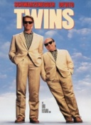


Matrix factorization
SVD: singular value decomposition
U_{k} | Dim1 | Dim2
Alice | 0.47 | -0.30
Bob | -0.44 | 0.23
Mary | 0.70 | -0.06
Sue | 0.31 | 0.93
V_{k}^{T}
Dim1 | -0.44 | -0.57 | 0.06 | 0.38 | 0.57
Dim2 | 0.58 | -0.66 | 0.26 | 0.18 | -0.36
 | Dim1 | Dim2
Dim1 | 5.63 | 0
Dim2 | 0 | 3.23
Prediction:
= 3 + 0.84 = 3.84
Notes:
Given a user-item matrix Mk, it can be decomposed into three matrixs by singular value decomposition(SVD) techinique. Including a user matrix Uk, an item matrix Ik and an rectangular diagonal (矩形对角) matrix with non-negative real numbers on the diagona. The meaning of matrix factorization is intuitive, for each user in user matrix Uk, we represent it as a k-dimensional vector and for each item in item matrix Ik, we represent it as a k-dimensional vector, we model there interaction of user and item by the rectangular diagonal matrix value. After training, we can compute the relevant score between any user and item. By ranking the relevant scores, we can select most relevant items to recommend to user.
SVD singular value decomposition

Slide 15
Motivation and Background
Traditional model-based recommendation approach, e.g., MF, is a linear latent factor model , the simple choice of inner product function can limit the expressiveness of a MF model.
Some pioneering studies apply deep learning techniques to recommender systems, in which complex user-item interactions and auxiliary information can be modeled.
However, they inherit a noteworthy weakness from previous latent factor models in which directly factorize user-item interactions:
It is poor at identifying strong associations among a small set of closely related items, especially when data is highly sparse.
Notes:
MF is simple, but it has some limitations. For example. ……..
A major problem of MF is that it adopts a simple linear factorization, which may not be sufcient to model the complex user-item interactions.
But, it’s also ….among the whole user-item matrix. Previous studies have shown that localized information, such as neighborhood. complements the interaction data and is important to improve the performance of latent factor models.

Slide 16
Our Contributions
Learning the interaction function from data. Retain the capacity of neural network models in learning an arbitrary user-item interaction function.
Enhance the ability to identify strong associations. Leverage localized information in complementing the interaction data.
We address two challenging issues:
What kind of localized information should be used.
How to model such localized information in a deep learning recommendation model.
Sampling-based algorithm

Slide 17
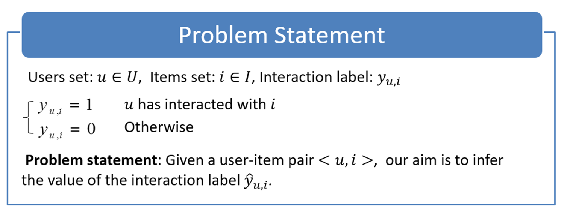
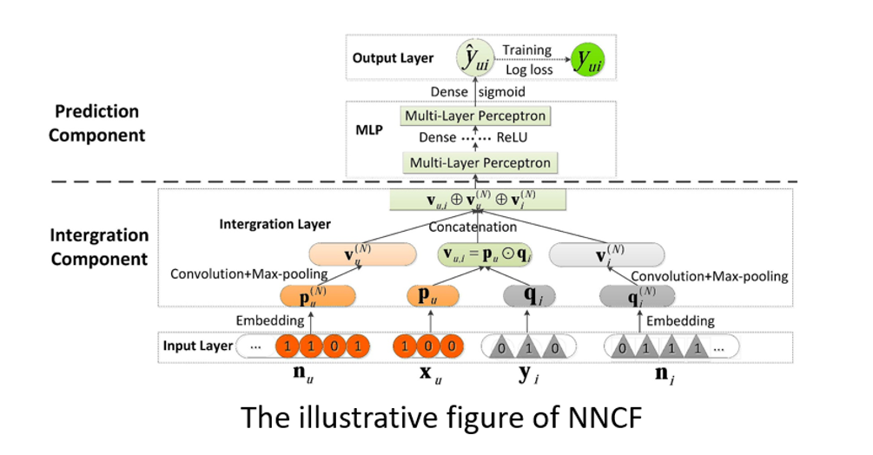
Our Neighborhood-based Neural Collaborative Filtering Model (NNCF)
Notes:
Note that our problem is given a user u and item i. The architecture of our model is shown in the following figure. It contains two component,

Slide 18
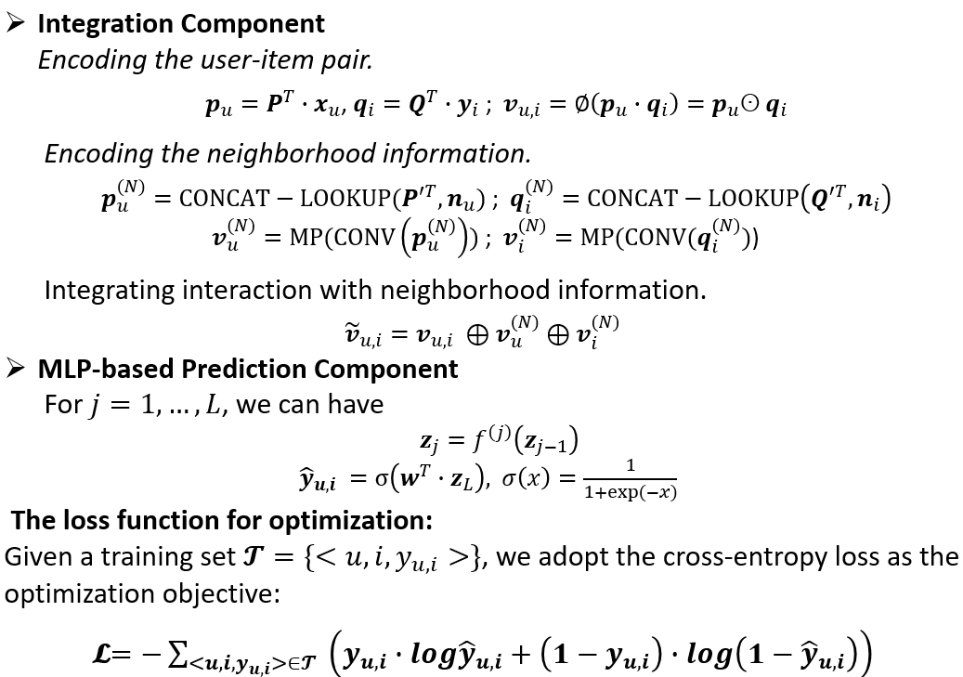
NNCF
NNCF

Slide 19
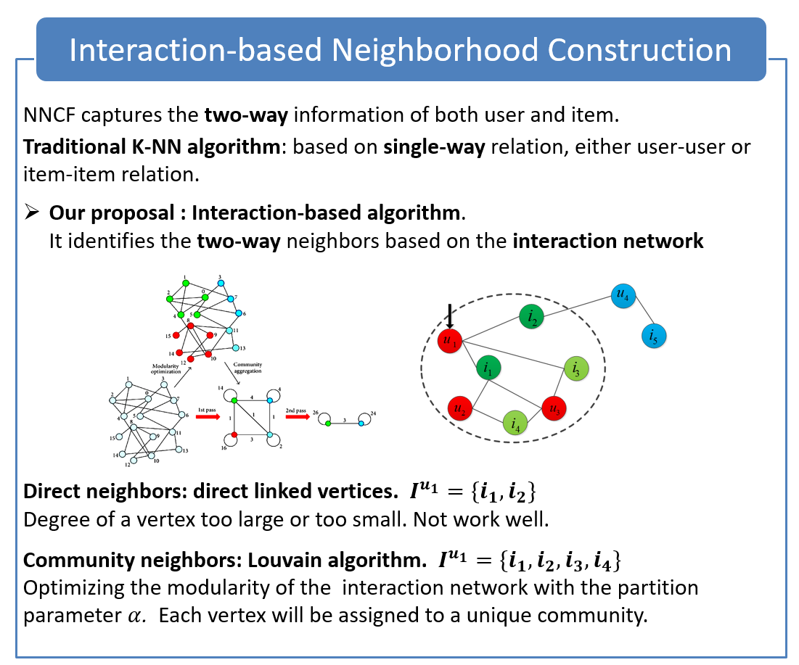
Notes:
If the vertex degree is too large, all the linked neighbors will affect the current vertex, which is likely to incorporate noise; while the vertex degree is too small, the current vertex cannot collect enough neighborhood information.

Slide 20
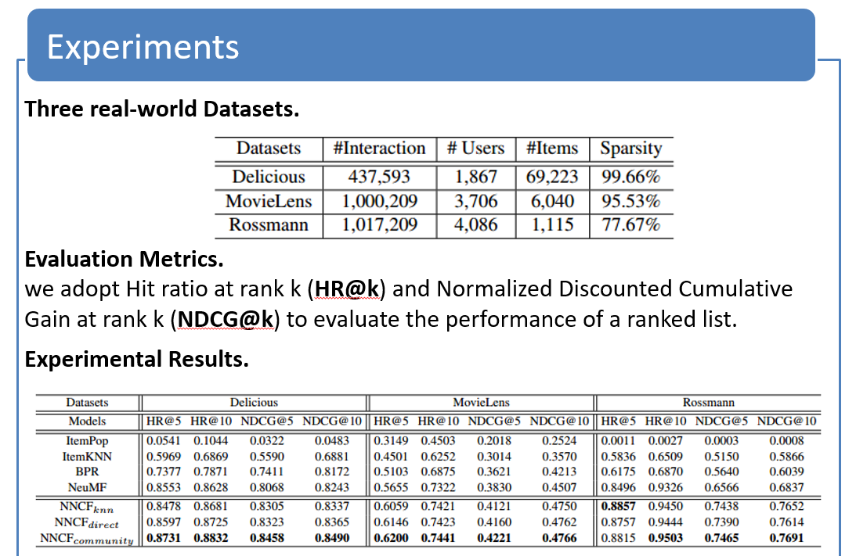

Slide 21
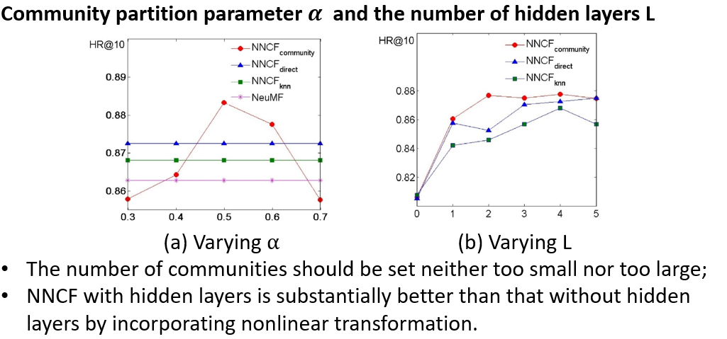
Analysis
Analysis

Slide 22
State-of-the-art models
Traditional MF models:
- PMF
Probabilistic Matrix Factorization. NIPS 2007
- BPR
BPR: Bayesian personalized ranking from implicit feedback. AUAI 2009
- eals
Fast matrix factorization for online recommendation with implicit feedback. SIGIR. 2016
Neural MF models:
- Autorec
Autorec: Autoencoders meet collaborative filtering. In WWW, pages 111–112, 2015
Notes:
Here I will introduce some classical or state-of-the-art baselines in Recommendation system, which is the competitive baselines in recommendation problems.
PMF is a competitive baseline in MF models,

Slide 23
State-of-the-art models
- CDL
Collaborative deep learning for recommender systems. KDD 2015: 1235-1244.
- NCF
Neural collaborative filtering. WWW, 2017: 173-182.
- NNCF
A Neural Collaborative Filtering Model with Interaction-based Neighborhood. CIKM 2017: 1979-1982

Slide 24
Sequence recommendation
Personalized sequence recommendation
Sequence MF models
FPMC (markov chains+MF) Factorizing personalized markov chains for next-basket recommendation. WWW 2010.
Probabilistic sequence model
Taste Over Time: The Temporal Dynamics of User Preference. ISMIR. 2013: 401-406.

Slide 25
Advanced topics
Deep Sequence recommendation
HRM
Learning hierarchical representation model for nextbasket recommendation. SIGIR 2015.
DREAM (LSTM)
A dynamic recurrent model for next basket recommendation. SIGIR 2016.
TDSSM
Multi-Rate Deep Learning for Temporal Recommendation. SIGIR2016
TransRec
Translation-based Recommendation. Recsys 2017.
User-based RNN Sequential User-based Recurrent Neural Network Recommendations. Recsys 2017.

Slide 26
Advanced topics
RRN
Recurrent recommender networks. WSDM 2017.
HRNN
Personalizing Session-based Recommendations with Hierarchical Recurrent Neural Networks. RecSys 2017
NARM
Neural Attentive Session-based Recommendation. CIKM 2018
RNNCT
Latent Cross: Making Use of Context in Recurrent Recommender Systems. WSDM 2018
Neural Tensor Factorization
Neural Tensor Factorization. arXiv preprint arXiv:1802.04416, 2018.

Slide 27
Selected Publications
Ting Bai, Bohua Yang, Wayne Xin Zhao, Ji-Rong Wen. Leveraging Online Social Media Information for Predicting the Long-tail Purchase Behaviors. CCF BigData 2015. The best paper nomination.
Ting Bai,Wayne Xin Zhao, Jun Zhang, Ji-Rong Wen. A Neural Collaborative Filtering Model with Interaction-based Neighborhood. CIKM 2017: 1979-1982. The best short paper runner-up.
Ting Bai, Hongjian Dou, Wayne Xin Zhao, Ji-Rong Wen.An Experimental Study of Text Representation Methods for Cross-Site Purchase Preference Prediction Using the Social Text Data. Journey of Computer Science and Technology. 32(4):828-842.
白婷，文继荣，赵鑫，杨伯华. 基于迭代回归树模型的跨平台长尾商品购买行为预测. 中文信息学报. 31(5):76-85.
Ting Bai, Wayne Xin Zhao, Yulan He, Ji-Rong Wen. Characterizing and Predicting Early Reviewers for Effective Product Marketing on E-Commerce Websites. Submitted to TKDE.
Ting Bai, Jian-Yun Nie, Wayne Xin Zhao, Yutao Zhu, Pan Du, Ji-Rong Wen. An Attribute-aware Neural Attentive Model for Next Basket Recommendation. Submitted to Sigir 2018.
Notes:
Here are some of my publications, if you are also interested in recommendation system, I will be very gold to have a communication with you.

Slide 28

Thank you for your attention! Q&A
Ting Bai
Email: baiting@ruc.edu.cn

