Slide 1

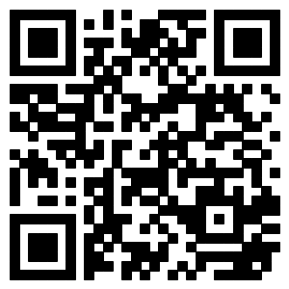

An Attribute-aware Neural Attentive Model
for Next Basket Recommendation
Ting Bai,Jian-Yun Nie, Wayne Xin Zhao, Yutao Zhu, Pan Du, Ji-Rong Wen
School of Information, Renmin University of China
Department of Computer Science and Operations Research, University of Montreal
baiting@ruc.edu.cn
Motivation and Contribution
Attribute-aware Neural Attentive Model (ANAM)
Motivation
Next basket recommendation is a new type of recommendation, which recommends a set of items, or a basket, to the user. Purchase in basket is a common behavior of consumers.
However, current methods do not track the user’s evolving appetite for items explicitly, and they ignore important item attributes such as product category.
Contribution
We propose a novel Attribute-aware Neural Attentive Model (ANAM)
Explicitly model user’s evolving appetite.
Adopting an attention mechanism to explicitly model user’s evolving appetite for items.
Incorporate the attribute information.
Utilizing a hierarchical architecture to incorporate the attribute information.
In specific, ANAM utilizes a recurrent neural network to model the user’s sequential behavior over time, and relays the user’s appetite toward items and their attributes to next basket through attention weights shared across baskets on the two different hierarchies.
Overview of the architecture of ANAM
Encoding items and item attributes.
Integrating attention weights.
Modeling user’s sequential behavior.
Long Short-Term Memory (LSTM). The input of LSTM at step t is . The output of LSTM at step t (i.e., hidden state) is represented as
The Loss Function for Optimization
For a user u and his or her previous baskets , we define the probability of an item i being purchased in the next basket by softmax function
To effectively learn from the training data, we adopt a weighted cross-entropy as the optimization objective at each step of LSTM, which is defined as
Sampling-based algorithm
Problem Statement
Given a user u, his or her purchase records sorted by time is a sequence of baskets , consists of a set of items.
The attribute of item is denoted as .The category information of items in basket is denoted as .
(Note: Each item has some attributes, such as the category and price. Currently we use the category information as item attributes, but our model could be easily extended to characterize other attribute information)
Given a user u’s purchase history, the next basket recommendation task can be defined as a prediction problem:
Infer a set of items that u would probably buy in the next basket.
Such a prediction problem can be reformulated as a ranking problem of all items for each user. With the ranking list of all items, we recommend top K items to the user.
Experiments
Contact and Code link
Note: “*” indicates the statistically significant improvements (two-tailed t-test with p<0.01 ) over the best baseline (DREAM*)

