Slide 1

Characterizing and Predicting Early Reviewers for Effective Product Marketing on E-Commerce Websites
Ting Bai
2017.03.28
Notes:
我今天报告的主题是在电子商务网站刻画和预测早其购买者

Slide 2
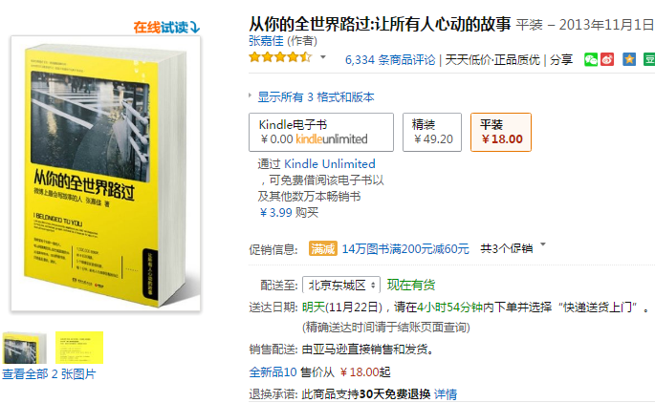
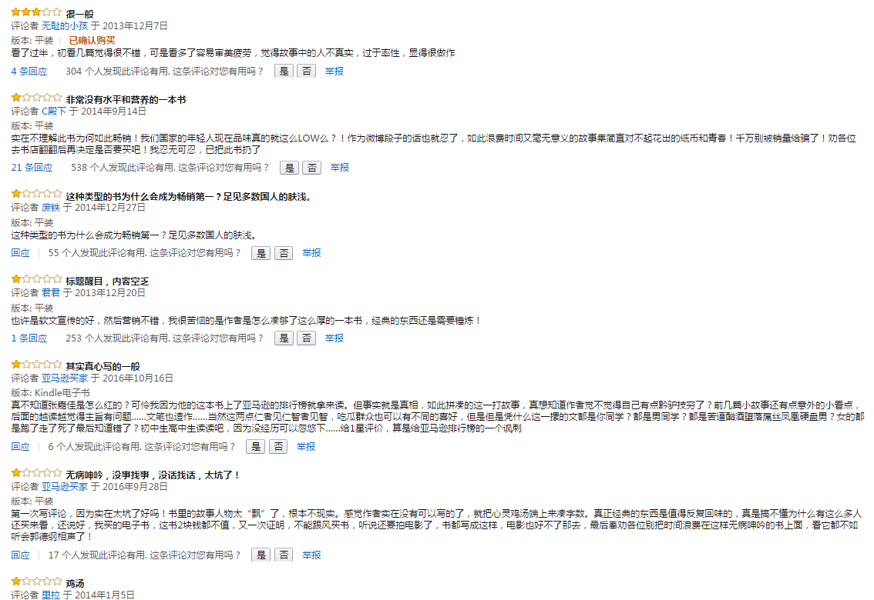
Motivation
Online reviews are important information for users before making an informed purchase decision.
Notes:
首先，我们来设想这样一个场景，
在我们实际生活中购物的时候也是一样，我们会很看重评论的信息。
商品的销售也遵循着一种马太效应，商品评价越多，越好，越有可能被购买。
而一个新商品如果有的评价数寥寥，且都是不好的评价，那消费者就普遍默认这个商品质量太差，不会去购买。

Slide 3
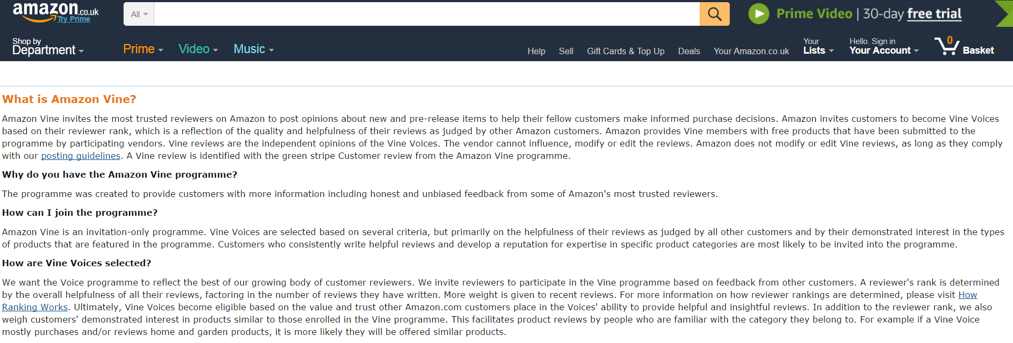
Motivation
Amazon Vine invites the most trusted reviewers on Amazon to post opinions about new and pre-release items to help their fellow customers make informed purchase decisions.
Amazon provides Vine members with free products that have been submitted to the programme by participating vendors.
Notes:
亚马逊的商家也发现了这些新商品上市时，早期购买者的评价的重要性，提出亚马逊葡萄树，通过提供免费的商品试用，来鼓励这些早期用户写出详细完善的商品评论，从而对后期的购买者的决策产生积极的影响。

Slide 4

Motivation
Early reviews have a high impact on the subsequent product sales.
Task: Finding early reviewers of product.
Improve the quality of comments
promote product sales
Notes:
再举一个贴近生活的例子，大家经常在淘宝网站购物，收到商品的同时，也经常会收到这样的商家寄来的纸片，尤其是那些不是知名大品牌，刚刚起步的小众商家，或者推出的商品没有什么评论的时候。这些商家让出一部分利益来换取早期购买用户的优质评论，从而吸引更多的人来购买。
上面的三个例子，都说明一个问题，在电子商务网站上，早期购买者对商品的评论非常重要，会影响到后续购买者的决策，从而影响商品的整个销量，影响电商的市场利益。、

Slide 5
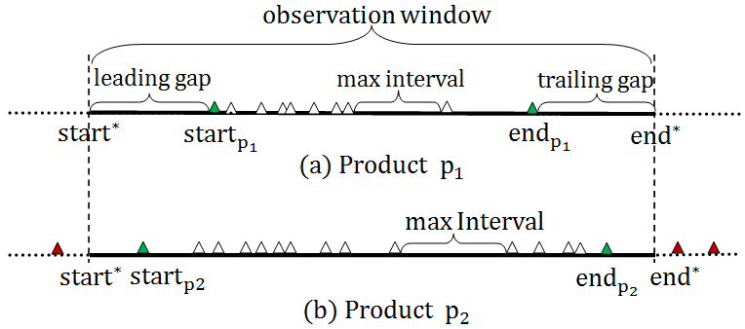
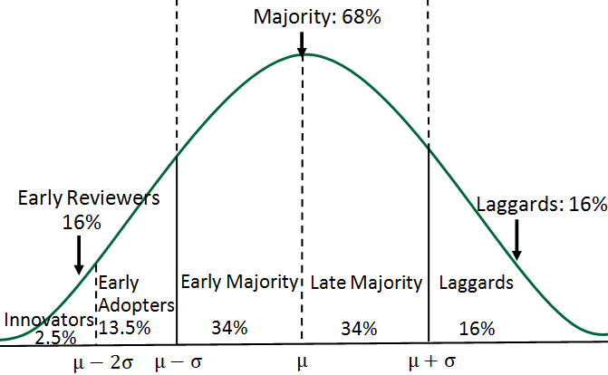
Framework
Predicting early reviewers of product
Margin-based Embedding Ranking Model (MERM)
Competition RankingMethods(TS, SVMComp)
Rote Methods(NR,NER,PER)
Complete review time span
Definition Early Reviewer
Notes:
首先我们要定义什么是早期购买者，我们要对商品的生命周期进行划分。

Slide 6
Preliminaries
Definition
Early reviewer
(stage division using Roger’s theory [30])

Slide 7
Preliminaries
Complete review time span

Slide 8
Preliminaries
Review spammers removal It was found that about 10 to15% of reviews echoed earlier reviews and might be posted by review spammers[10].
Methods:
(1) Early deviation spamming
(2) Review text spamming
(3)Time based spamming
We have identified 4.65% users who are likely to be spam users. The percentage is similar to that reported in [17].

Slide 9
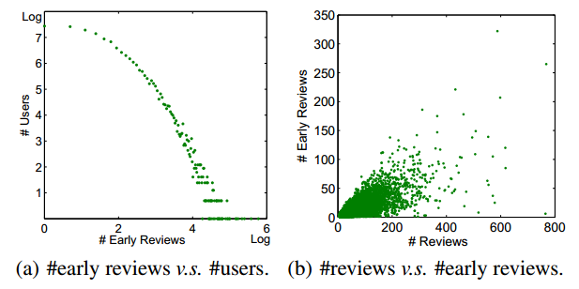
Basic Statistical Analysis
About 70% users acted as early reviewers no more than ten times, most users are cautious when making purchase decisions.
Notes:
然而如果我问你，你会去购买一个新商品吗？你可能会答，那得看尝试什么商品了？比如医药商品，很少会有人愿意充当早期购买者。

Slide 10
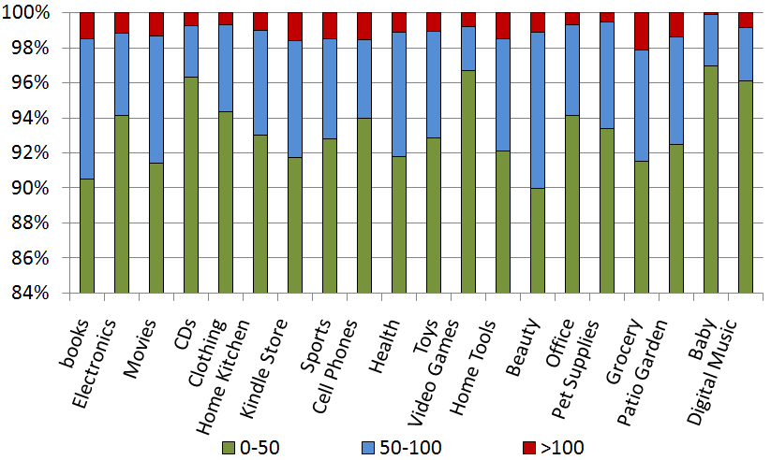
Basic Statistical Analysis
In the Baby category, over 97% users posted less than 50 early reviews.
This shows that users are more cautious in adopting new products for babies.
Notes:
所以针对这一问题，我们做了类别下的统计，在每个类别中，我们把用户按照其充当早期评论者的数量划分到三个阈值里, 绿色的表示，蓝色的表示，红色的表示，然后统计在每个类别中三个每个阈值区间用户所占的比例。一个有意思的发现，

Slide 11
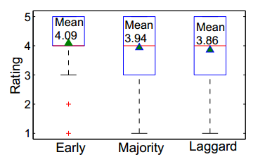
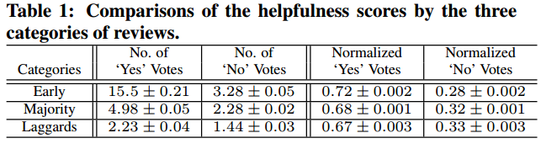
Characteristics of Early Reviewers
Early reviewer tends to assign a higher average rating score.
Early reviewers tend to post more helpful reviews
Notes:
做完了整体的分析之后，我们进一步研究这些早期购买者有什么属性特质

Slide 12
Characteristics of Early Reviewers
Connection with personality variables theory
Principle about personality variables: Earlier adopters have a more favorable attitude toward change than later adopters. (higher average rating scores can be considered as the favorable attitude towards the products)
Principle about communication behavior: Earlier adopters have a higher degree of opinion leadership than later adopters. (higher helpfulness votes of early reviews given by others can be viewed as a proxy measure of the opinion leadership)
Notes:
在做这篇分析性论文的时候，我也阅读了一些关于社会学心理学的文章。为前面从实验得出的结论提供支持。比如说。

Slide 13
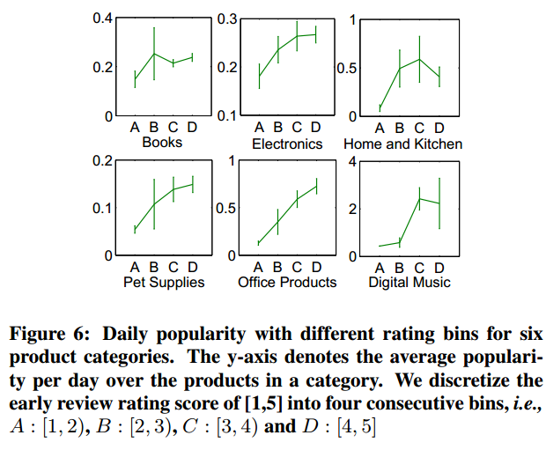
Characteristics of Early Reviewers
The Impact on Product Popularity
A higher average rating score of early reviews is likely to indicate a higher product popularity
Notes:
正如前面提到的，我们研究的动机是，早期购买者会影响商品的销量，那么早期购买者呈现出的特质：high rating 和high helpful ，是否真的对商品销量产生影响呢？

Slide 14
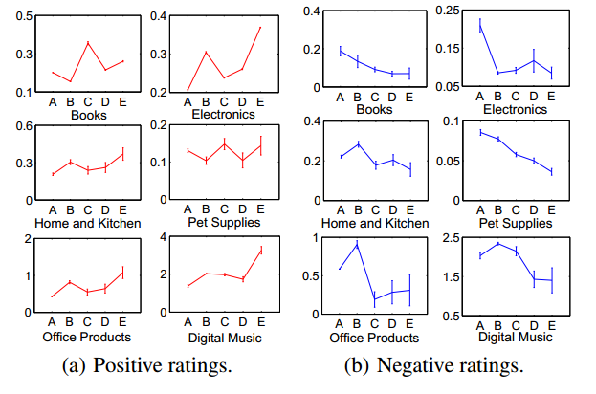
Characteristics of Early Reviewers
The Impact on Product Popularity
A higher helpfulness score of early reviews is likely to increase or decrease product popularity.
Notes:
到此为止，我们证明了早期购买者的却能够影响商品的销量，那么下一个任务就是如何找到他们，从而改善商品的早期评论，提升商品销量

Slide 15


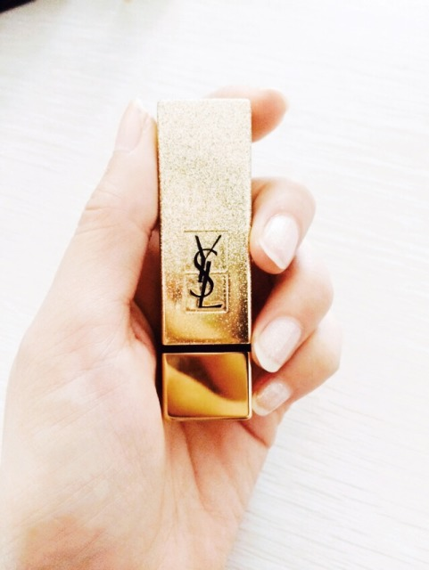
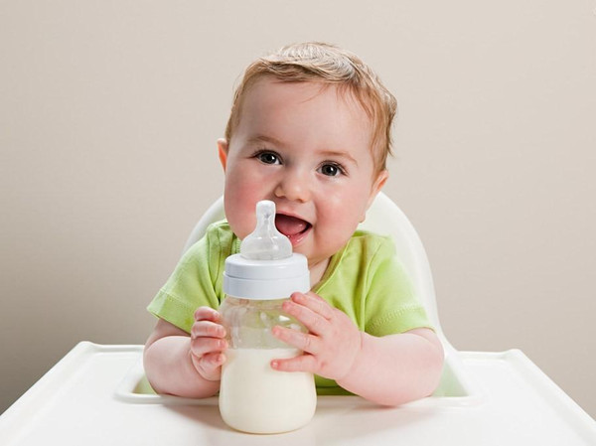
Predicting Early Reviewers
How to find them?

Slide 16
Problem Formulation
Given a product p and a candidate user set Up : {u1, u2,..., uNp}, the task of predicting early reviewers aims to produce a top-K list of users from Up, who would post reviews to p at the early stage of product p released to market. (Ranking problem)
Challenge: Cold-start ranking problem
Since we are interested in the early reviewers of a product, the predictions should be made when a new product is just released. We will have very little and sometimes even no observed user behavior data at the early stage of a new product.

Slide 17

Baselines
Rote Methods:
NR: Number of Reviews that they have previously posted.
NER: Number of times that a user has previously acted as an Early Reviewer.
PER: Rank the users based on the Proportion that a user has acted as an Early Reviewer. Defined as PER(u) =NER(u)/NR(u)
SPER: Smoothed PER. Defined as

Slide 18

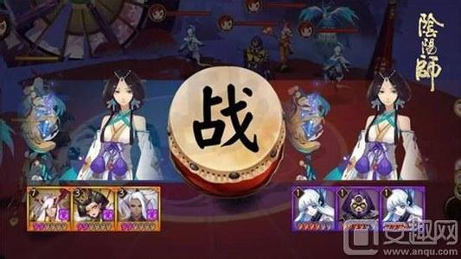
Baselines
A competition-based viewpoint to the ranking task
Product set {p}, all candidate user set {Up} : multi-player team games
decomposed into multiple pairwise comparisons between two players

Slide 19
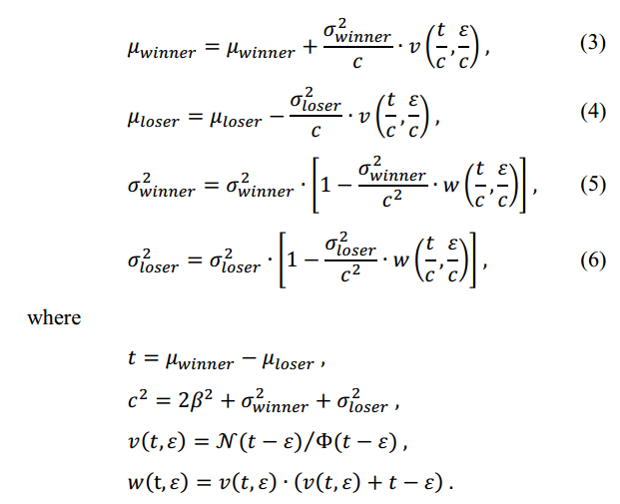
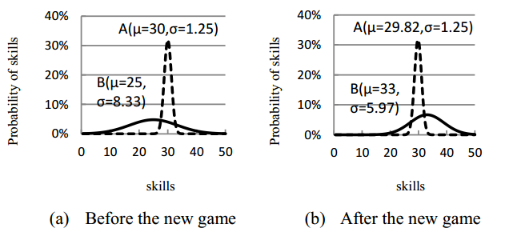
Baselines
TS [11]: TrueSkill is a Bayesian skill rating system which is designed to calculate the relative skill levels of players in multiplayer games.
Assume player ~(µ,σ)
µ: average skill of the player
σ: system’s uncertainty about its estimation of the player’ skill
Notes:
Trueskill 排名是一个基于技能的排名。服从高斯分布，

Slide 20
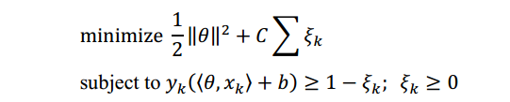
Baselines
SVMComp [36]: The SVM model learns the relevance weight of each document from these extracted pairwise comparisons.
ө : the early score of each player.
Xk: vector of length n associated with a pairwise competition between users
y: the win-loss result.
Pairwise (ui,uj)

Slide 21
Methods Comparison
Method | Advantages and Disadvantages
Rote Methods (NR, NER, PER, SPER) | Cannot make use of relation between users; Have nothing to do with the feature of product and users.
Competition-based Simple Methods (TS, SVMComp) | Make use of relation between users; Have nothing to do with the feature of product and users.

Slide 22
Predicting Early Reviewers
How to find them?

Slide 23


Our Method
Margin-based Embedding Ranking Model (MERM)
: Product vector (labeled doc2vec: category label, title of product)
: user vector (learning parameter)
Training set pairwise
Minimize
:user vector
New product Ranking users

Slide 24
Evaluation metrics
Overlapping Ratio at rank k (OR@k)
Hit ratio at rank k (Hit@k).
Ratio of Correct Comparison Pairs (RCCP)
Notes:
加入Five times negative users. OR@k 是说给定candidate list 和一个真实list ,前K个中命中的个数
hit@k 前K个命中early 中的个数

Slide 25
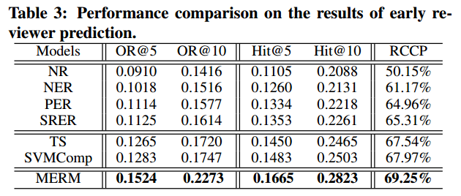
Results and Analysis

Slide 26
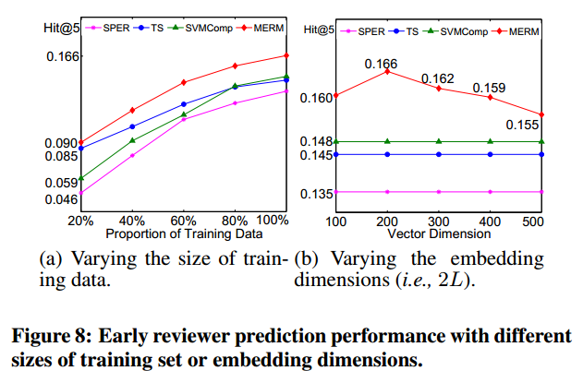
Results and Analysis

Slide 27
Methods Comparison
Method | Advantages and Disadvantages
Rote Methods (NR, NER, PER, SPER) | Cannot make use of relation between users; Have nothing to do with the feature of product and users.
Competition-based Simple Methods (TS, SVMComp, B-T, B-C) | Make use of relation between users; Using a single number to represent a player, which is a bit simplistic. B-C model learns a multi- dimensional representation. Have nothing to do with the feature of product and users
Margin-based Embedding Ranking Model (MERM) | Make use of relation between users; Using the feature of product.

Slide 28
Thank You Q&A
Ting Bai
Email:baiting0317@163.com

