Slide 1
Submission Links:
Video Presentation: [Click Here]
Vercel Deployment: [Click Here]
GitHub Repository: [Click Here]
Figma: [Click Here]

Slide 2
Expeditions Deli
By Roderic Henry & Tom Byrne

Slide 3

Business Analysis
Business: Expeditions Deli
Specialty: Sandwiches with flavors from around the world.
Brand archetype: The Explorer
Customer Persona: Jane
“Jane is 24 years of age and is very curious about trying new foods that are complete, easy to travel with and not messy as she's always on the go. Jane appreciates diversity in food and pays attention to the ingredients.”

Slide 4
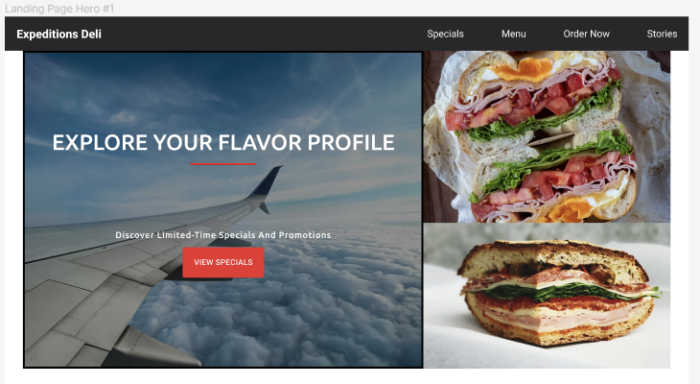
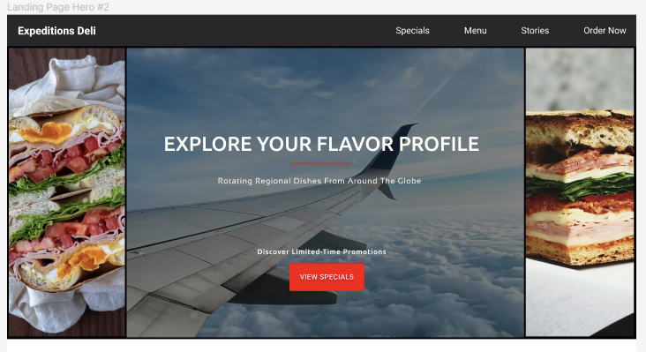
Useability Testing Process (1 of 4)
Initial Hero Designs:

Slide 5
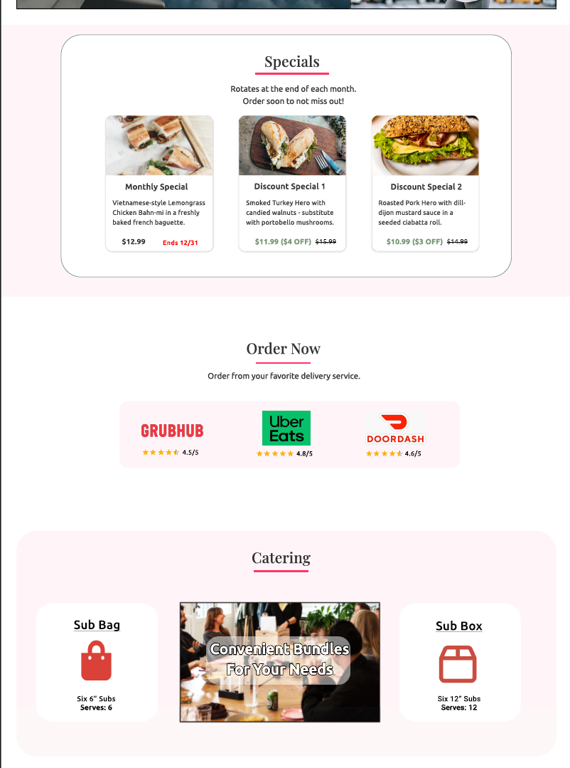
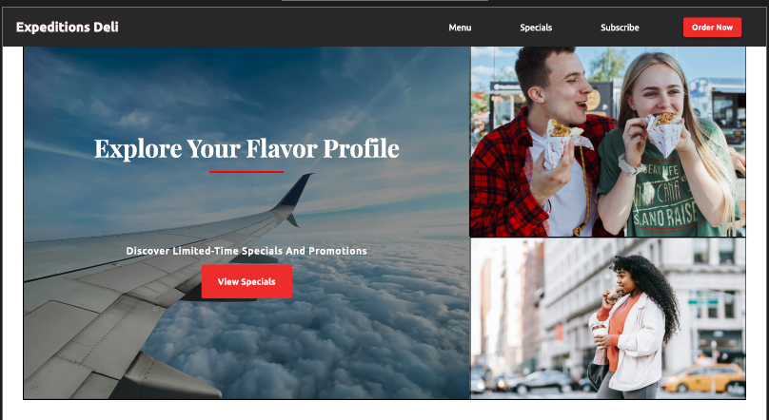
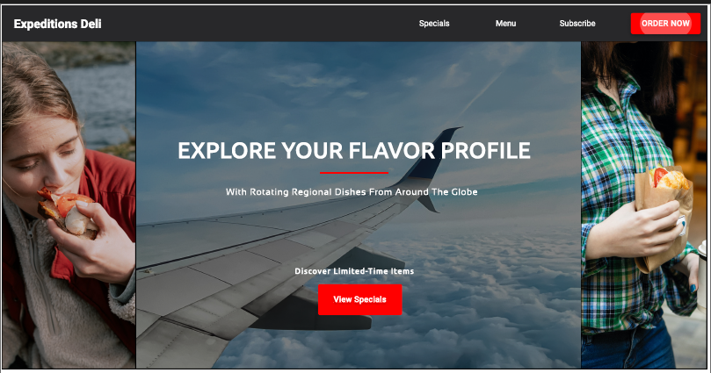
Useability Testing Process (2 of 4)
Iteration 1
Comments from Testing:
Likes the top-right image
Airplane image is distracting – difficult to stay focused on food
Eyes don’t gravitate towards text
Shapes make it appear less scrollable
Catering section is confusing

Slide 6
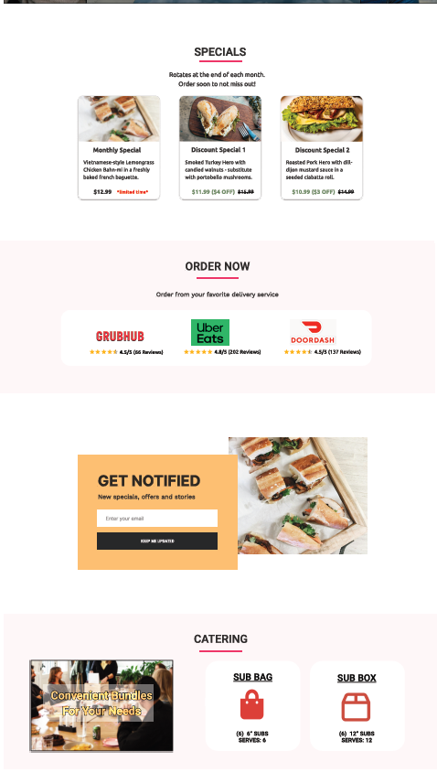
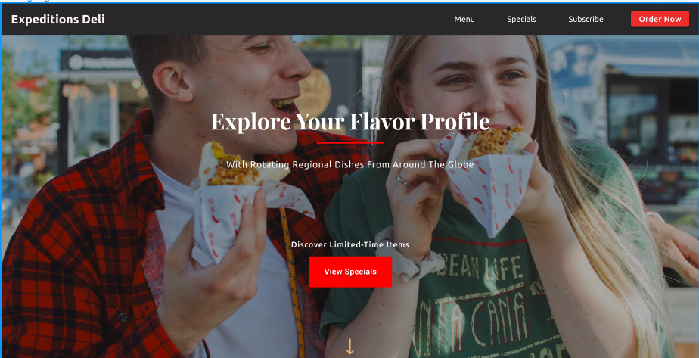
Useability Testing Process (3 of 4)
Iteration 2
Comments from Testing:
Likes the centered hero design
Does not like the white area below the hero
Prefers consistent background changes with full viewport width
Get notified section seems out of place
Cluttered appearance

Slide 7
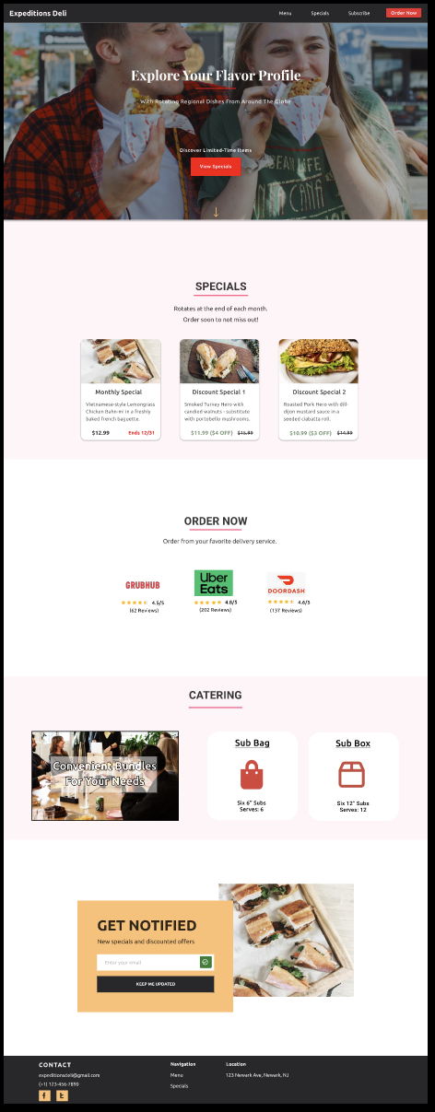
Useability Testing Process (4 of 4)
Final Figma Design: (Click Here)

Slide 8
Design Quality
Persuasion Methods
Scarcity – Limited time offers on unique sandwiches and sales
Reciprocity – Sales
Social Proof – Expeditions Deli ratings on each of the delivery platforms
Consistency – “Get Notified” section to engage customers with rotating deals
Liking – Hero image of happy couple
Key Design Considerations
Archetype
Simplicity
Technical requirements:
ReactJS component library – Material UI (MUI)
Cookie consent and privacy policy
Mailchimp
Notes:
NOTES:
Archetype: :
- #FFF5F8 (pinkish-white) background to evoke a gentle, modern approach that’s not distracting for users - Combined Playfair, Ubuntu, and roboto to strike a balance between modernity and elegance. This combination maintains readability and clarity while also introducing a sense of style and visual interest that aligns well with the Explorer archetype's spirit of curiosity and discovery.
Simplicity: Scrollable sections with 8px grid padding formatting so that elements are nicely spaced

Slide 9
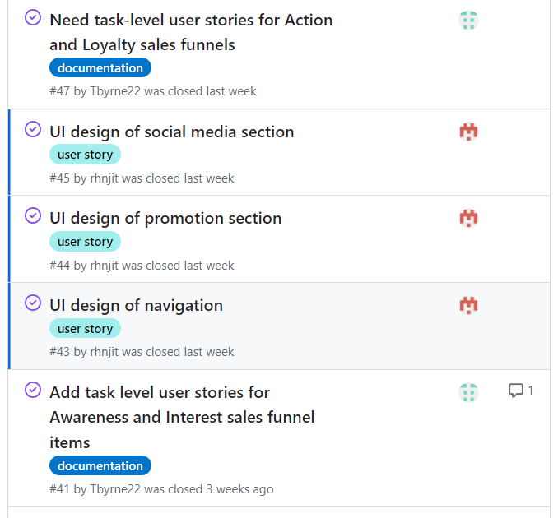
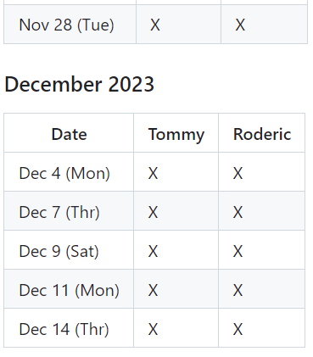
Teamwork and Collaboration
Communication Platforms
Discord – Direct Messages and Calls
GitHub – Commit messages, assignees, labels
Figma – Collaborative design edits
Bi-weekly Meetings

Slide 10
Technical Implementation
Demo: [Click Here]
Component usage
MailChimp Integration
Google Analytics
GitHub Repository: [Click Here]

Slide 11
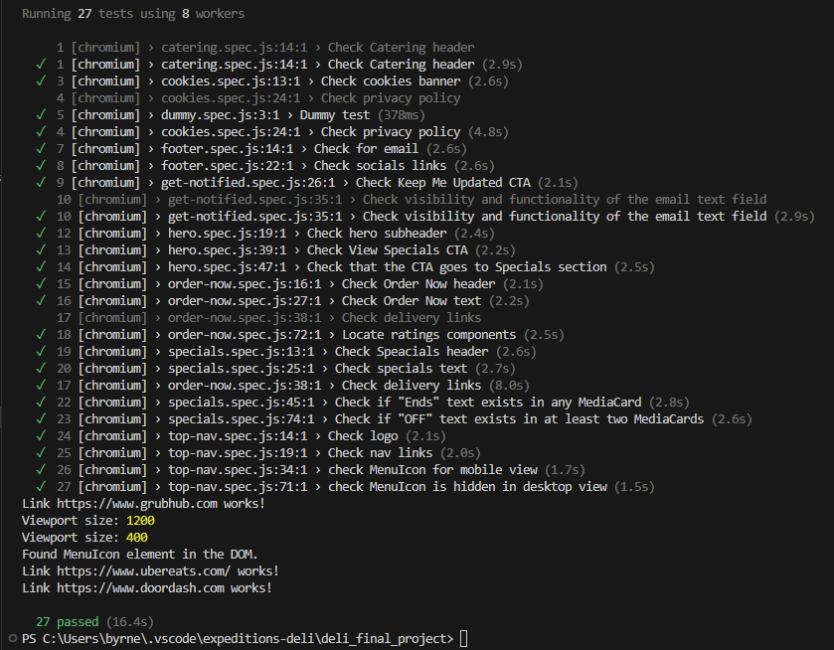
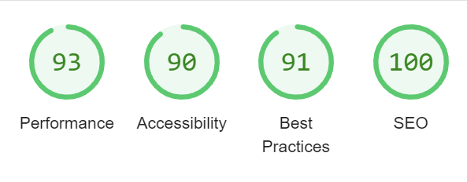
Quality Assurance
Playwright Testing
All landing page sections
Cookies consent
Manual Testing
Links
Local storage states from cookies consent
Lighthouse Testing

