Slide 1
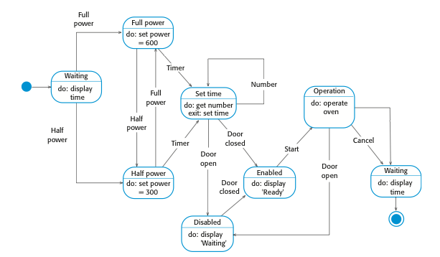
State diagram of a microwave oven
timeout

