Slide 1
Preview of course content for students
<P>Good morning,
<P>On Wedensday in class I will be providing an introduction to <a href="https://www.python.org/doc/essays/blurb/">Python 3</a> and <a href="https://jupyter-notebook-beginner-guide.readthedocs.io/en/latest/what_is_jupyter.html">Jupyter</a>. We will use Python 3 in the command prompt and Python 3 in the Jupyter web interface. The use of <a href="https://realpython.com/python-lists-tuples/">lists</a>, <a href="https://www.pythonforbeginners.com/dictionary/how-to-use-dictionaries-in-python/">dictionaries</a> (key-value pairs), and <a href="https://www.tutorialspoint.com/python/python_functions.htm">functions</a> will be the focus. My assumption for this class is that you have a laptop with Jupyter and can run Python 3 programs.
<P>As I mentioned in emails prior to the beginning of the semester, there is <a href="https://www.youtube.com/playlist?list=PL0-84-yl1fUnRuXGFe_F7qSH1LEnn9LkW">a series of videos showing use of Python 3</a>. The videos don't use Juptyer. Similarly, there are <a href="https://www.coursera.org/learn/python?specialization=python">online courses offered on Python from University of Michigan</a>. These videos and online courses are not required for Data 601; I'm providing the links if you want to improve your familiarity with Python 3.
<P>For books on coding Python 3, I've uploaded a free open-source textbook to <a href="https://blackboard.umbc.edu/">Blackboard</a>: Automate the Boring Stuff with Python (see Course Materials > Textbooks for Data 601). The relevant reading is chapter 1 . The reading is not an assignment or a requirement for the course. There's also a PDF available online, "<a href="https://www.cs.uky.edu/~keen/115/Haltermanpythonbook.pdf">Learning to Program with Python</a>" by Halterman; chapter 1 is relevant.
<P>Please let me know if you have questions.
<P>Kindly,
<P><a href="https://www.linkedin.com/in/john-h-wan/">John</a>

Slide 2
For Fall 2020
Stop Teaching Code, Solicit Predictions Instead (upperlinecode.com)
-class material aspiration
https://news.ycombinator.com/item?id=21619884 - discussion

Slide 3
General comments review
If you want feedback or have a question, please talk with me.
Include code you didn't get working in "raw" cells in Jupyter. Use a markdown cell to comment about what you tried. (https://stackoverflow.com/questions/47852733/what-are-raw-cells-in-jupyter-notebook)
There isn't one solution to the homework.
I will show "reference solutions" provided by students
I don't specify which student provided which solution
I will ask if the author wants to comment; I will say what I found useful

Slide 4

Python 3
Fall 2020
These notes are CC BY 4.0
Notes:
See also https://web.stanford.edu/class/stats101/intro/intro-lecture01.pdf for inspiration
Useful: https://arxiv.org/pdf/1503.05570.pdf
A Data Science Course for Undergraduates: Thinking With Data by Ben Baumer, The American Statistician Vol. 69 , Issue. 4
Timing in Fall 2018:
Slide 35 at minute 45
Bowling demo started at minute 63
Finished in 2 hours, 25 minutes

Slide 5
From previous week: Reading summarization
You are grouped in Blackboard to someone who was assigned the other article
Tell the other person one idea presented last week
Listen your partner's recollection from last week
Describe what you learned from reading the article
Ask what they learned reading their article
Activity: talk with a partner

Slide 6

Course schedule and outline (scope)
Overview of Data Science
Python in Jupyter
Getting data
Data cleanup
Automation, reports
Project 1 presentations
Math
Clustering
Scaling up
Regression
Property graphs
Elasticity, Cost/benefit
Ethics and Legality
Other Topics

Slide 7
Project 1: Data Characterization
First of three projects Three components:
Proposal
Jupyter notebook
In-class Presentation (by random selection)

Slide 8

You pick the data source for your project
from a list I provide, or you provide a suggestion in your proposal.
(accessible on Blackboard under course materials)
Data discovery is outside scope of course, so I provide you data sources
You should pick a data source you have some background knowledge in
--> Enables use of a model and generation of hypotheses

Slide 9
What I care about for the project
Challenge: determine relevant scope appropriate to your skills while still pushing your experience
Report: A description of research methods can be called “coherent” and “complete” when readers understand the process well enough to replicate it themselves. [citation]
Analysis
Applies methods learned in class
Uses Python 3 in Jupyter notebook
Demonstrates process of data science, from gathering data to telling story through characterization
Visualization: Intuitive, relevant
Notes:
Gray text is topics not yet covered in class

Slide 10

Now let's focus on this session

Slide 11
Outcomes for this evening
By the end of today's class, you should be able to do the following:
Describe examples of data structures like Scalars, Lists, Sets, Dictionaries
Explain the difference between vectorized and elementwise operations
Create and call functions in Python
Load data into Pandas and create a scatter plot
Decompose a complex function into multiple simpler functions
Lots of words, so we will need definitions

Slide 12
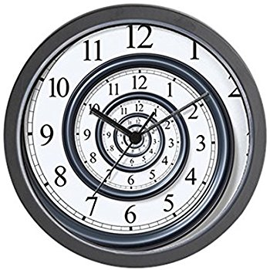
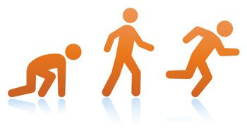
I won't be able to teach you all of Python
Notes:
http://www.padtinc.com/blog/the-focus/a-guide-to-crawling-walking-and-running-with-ansys-structural-analysis

Slide 13
Resources for learning Python
Online
Text – blue underscored text is hyperlinked in this presentation
https://nealcaren.github.io/python-tutorials/
Videos on Coursera
Books: see PDFs posted on Blackboard
Your instructor
Caveat: I'm not a programmer.
https://brohrer.github.io/imposter_syndrome.html
Linked from https://www.kdnuggets.com/2017/09/data-science-imposter-syndrome.html

Slide 14

Diversity of Software in Data Science
Diversity of Software in Data Science
Use of Python
EDA using Jupyter + Pandas
Visualization of data
Tips from the Trenches
Homework

Slide 15
Survey of "standard" software for Data Science
(not comprehensive)
Hive
MapReduce
Pig
JavaScript
Java
Orange
Rapid Miner
SAS
Enterprise Miner
JMP
Online services, ie from Azure, AWS, Google Compute, Snowflake
Matlab
Python
R
bash
Tensor Flow
Jupyter
Julia
Spark
SQL
Excel
PowerBI and other plugins
Tableau

Slide 16

Psychological consequences of diversity
Intimidation (fear) due to knowing you don't know

Slide 17
Psychological consequences of diversity
Intimidation (fear) due to knowing you don't know
When interacting with other people, lack of overlap causes issues
Communication
How you think about the problem
What the challenges are (cost, latency, scale)
How to collaborate
--> Each of these is a negotiation with other humans

Slide 18

Simplify by focusing on just Python
Since 1991
Python 3 is 10 years old!
Notes:
https://tinybuddha.com/blog/4-tiny-powerful-tips-reduce-stress-anxiety/

Slide 19
Survey of "standard" Python packages for Data Science
(not comprehensive)
Dask
Scikit-learn
Numpy
Scipy
Pandas
Matplotlib
Python Imaging Library (PIL)
NLTK
Beautifulsoup
Statsmodels
Seaborn
PyTorch
Keras
Theano
Gensim
Plotly
Bokeh
PySpark
Scrapy
Optional challenge: How many Python packages are there total?
Yes, this question is ill-defined. I'm happy to iterate with you after class
Notes:
The page https://pypi.org/ has a counter of projects – currently over 250k

Slide 20
Jargon alert!
Script = a file with extension .py containing Python code.
Application, aka Analytic, aka program = recipe of instructions
Library = generic term for code that was designed with the aim of being usable by many applications.
Module = a file with extension .py containing function definitions which can be referenced by other scripts. Use import to load these functions.
Package = a collection of modules.
All packages are modules, but not all modules are packages.
Overloading terms is common.
If you are confused during the semester, raise your hand during class or see me after class or write it under the Ask Me Anything discussion
Notes:
https://docs.python.org/3/tutorial/modules.html

Slide 21
Python package management
Two package managers: conda and pip
Conda is equivalent to pip+virtualenv in terms of capability.
Difference: conda is used for package management outside Python;
pip is only for Python
I'll advocate the simplicity of conda
I use pip
Notes:
https://stackoverflow.com/questions/20994716/what-is-the-difference-between-pip-and-conda

Slide 22
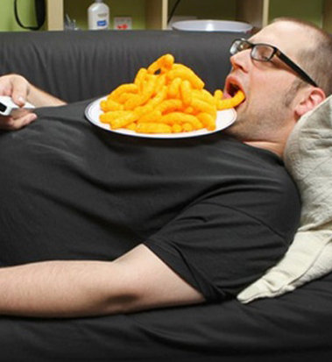
Virtues of a Data Scientist
Using libraries
enables laziness.
see http://blog.teamtreehouse.com/the-programmers-virtues
https://www.infoworld.com/article/3122803/application-development/the-power-of-lazy-programming.html
Notes:
https://www.infoworld.com/article/3122803/application-development/the-power-of-lazy-programming.html

Slide 23
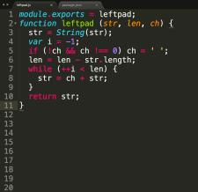
How one programmer broke the internet by deleting a tiny piece of code
A man in Oakland, California, disrupted web development around the world … by deleting 11 lines of code.
See (https://qz.com/646467/how-one-programmer-broke-the-internet-by-deleting-a-tiny-piece-of-code/)
Notes:
https://qz.com/646467/how-one-programmer-broke-the-internet-by-deleting-a-tiny-piece-of-code/

Slide 24
Use of Python
Building up from basics: the terminal
Diversity of Software in Data Science
Use of Python
EDA using Jupyter + Pandas
Tips from the Trenches
Homework

Slide 25
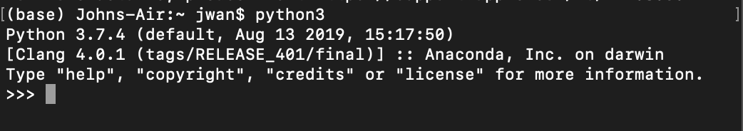
How to interact with Python
REPL (Read–eval–print loop): interactive command prompt
Scripts: files with .py extension
Text editors with syntax highlighting
IDEs like PyCharm, Visual Studio or others with autocompletion
Jupyter Notebook (via web browser)

Slide 26
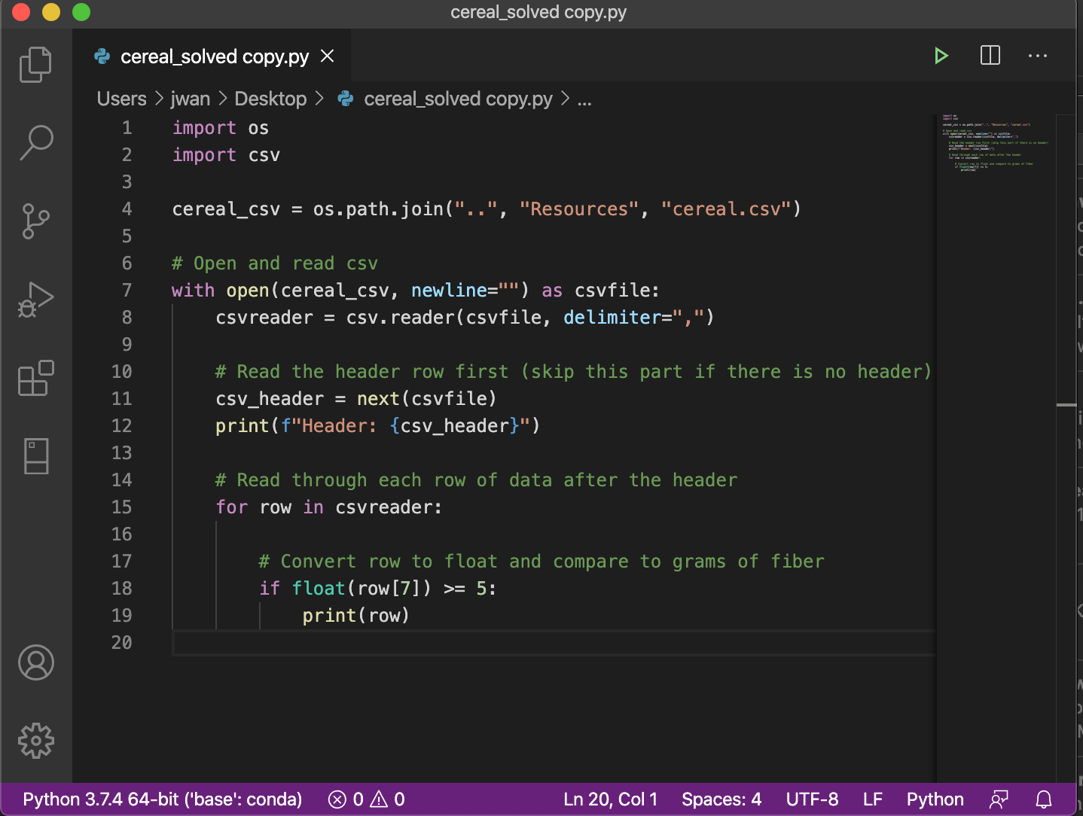
How to interact with Python
REPL (Read–eval–print loop): interactive command prompt
Scripts: files with .py extension
Text editors with syntax highlighting
IDEs like PyCharm, Visual Studio or others with autocompletion
Jupyter Notebook (via web browser)

Slide 27
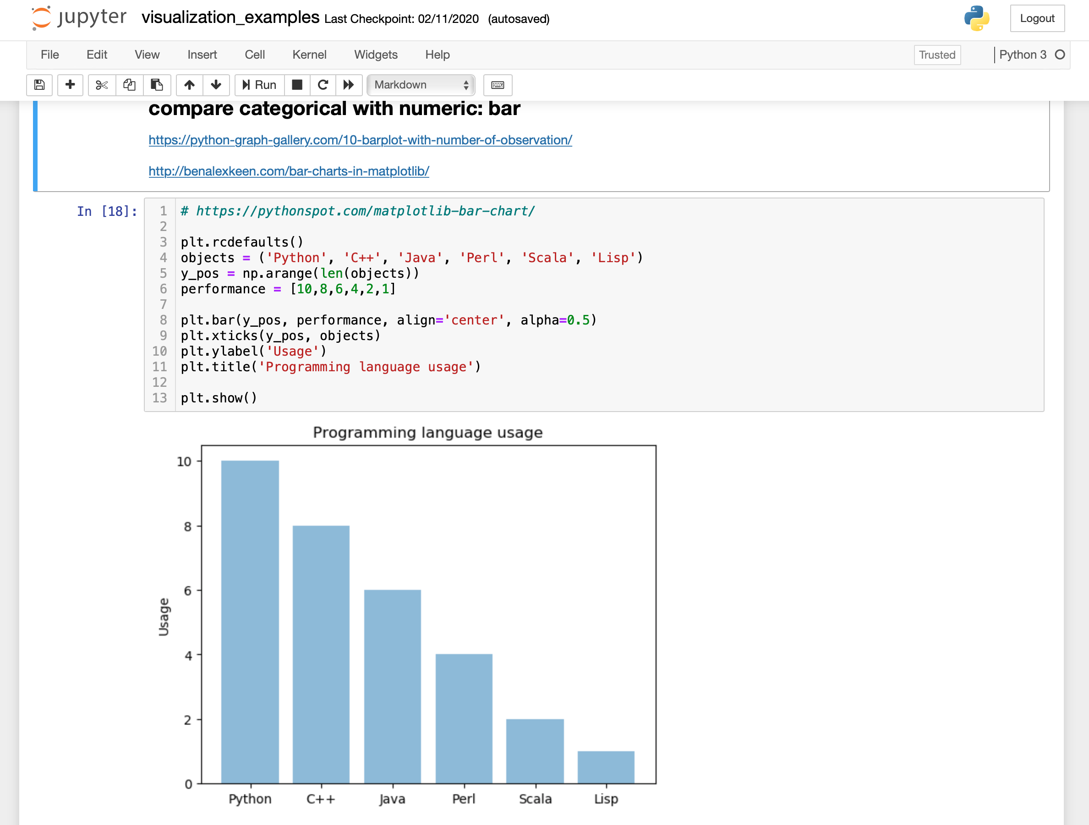
How to interact with Python
REPL (Read–eval–print loop): interactive command prompt
Scripts: files with .py extension
Text editors with syntax highlighting
IDEs like PyCharm, Visual Studio or others with autocompletion
Jupyter Notebook (via web browser)

Slide 28
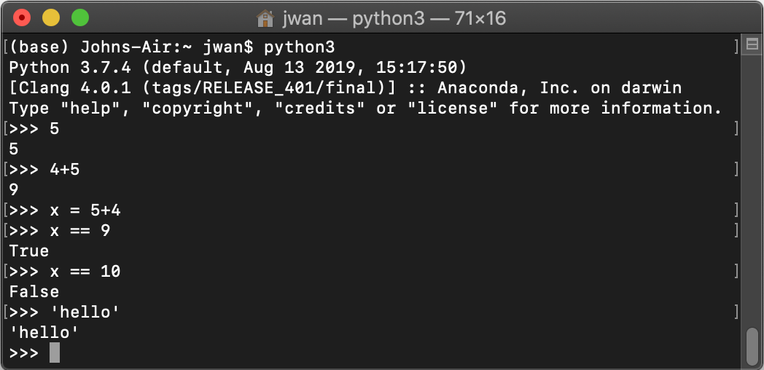
Shown in Python3 Interpreter (REPL)
Returns expected results, ie 5, 5+4, x = 5+4, x == 9, x == 10, 'hello'

Slide 29
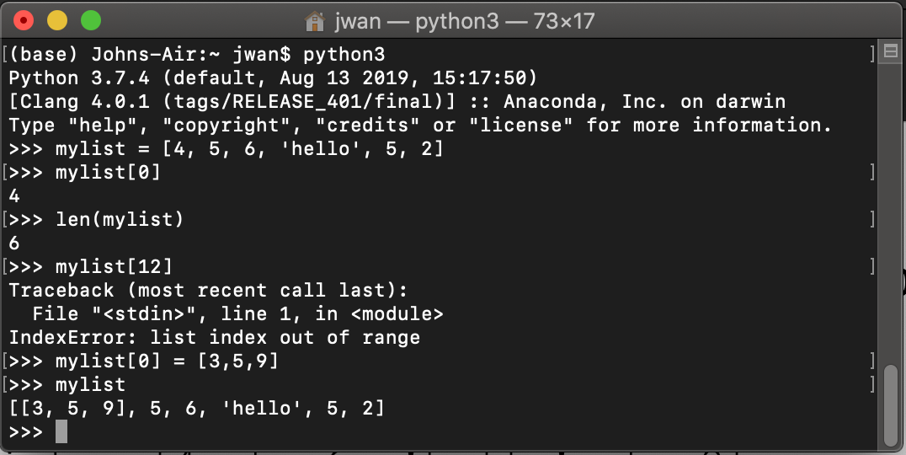
Shown in Python3 Interpreter (REPL)
Lists:
Accessing an element
Error
No warning when over-writing

Slide 30
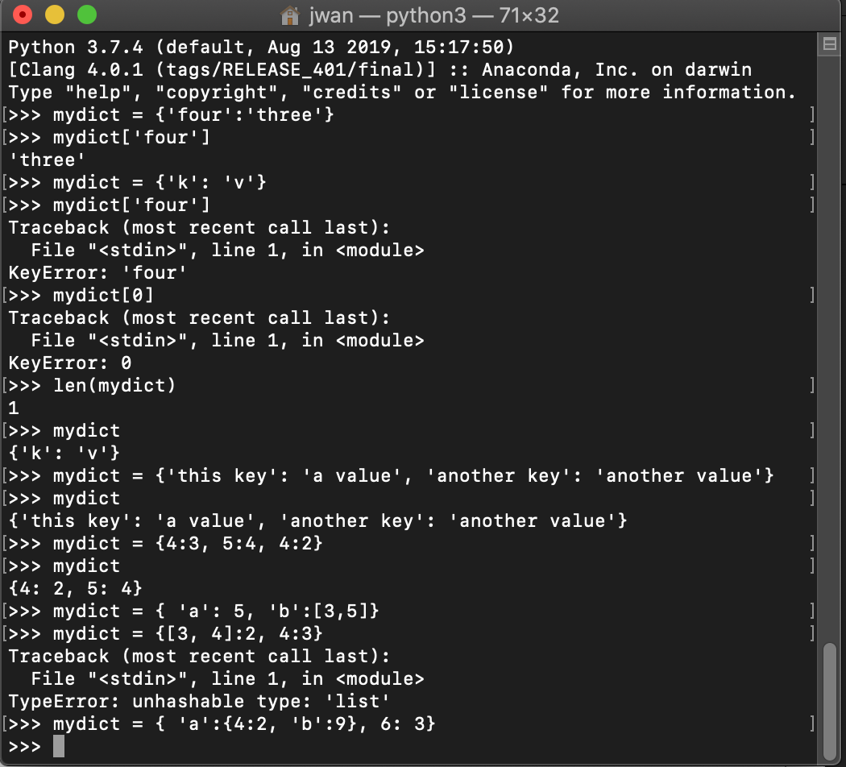
Shown in Python3 Interpreter (REPL)
Dictionaries:
Accessing error!

Slide 31
Shown in Python3 Interpreter (REPL)
Dictionaries:
Assigning error!

Slide 32
Programming exercise using the interpreter
On paper, write down a dictionary containing
when you ate today (the key)
what you ate today (the value)
Once completed, enter the dictionary in a Python3 REPL
Verify that you can select an entry by key
Measure the length of the dictionary
Activity: solo programming

Slide 33
Example dictionary
>>> mymeals={'breakfast':'apple', 'lunch':['beans', 'salmon'], 'dinner':['melon', 'salad', 'milk'}
File "<stdin>", line 1
mymeals={'breakfast':'apple', 'lunch':['beans', 'salmon'], 'dinner':['melon', 'salad', 'milk'}
^
SyntaxError: invalid syntax
>>> mymeals={'breakfast':'apple', 'lunch':['beans', 'salmon'], 'dinner':['melon', 'salad', 'milk']}
>>> mymeals['lunch']
['beans', 'salmon']

Slide 34
Generic Computing Language Essentials
Variable assignment
Control statements (if, else)
Loops (while, for)
Sets, tuples
Functions

Slide 35
Python functions bundle code
def myfunc(input):
# transform input to value
return value
If a line of code is a sentence,
then a function is a paragraph
Demo: show Python3 REPL

Slide 36
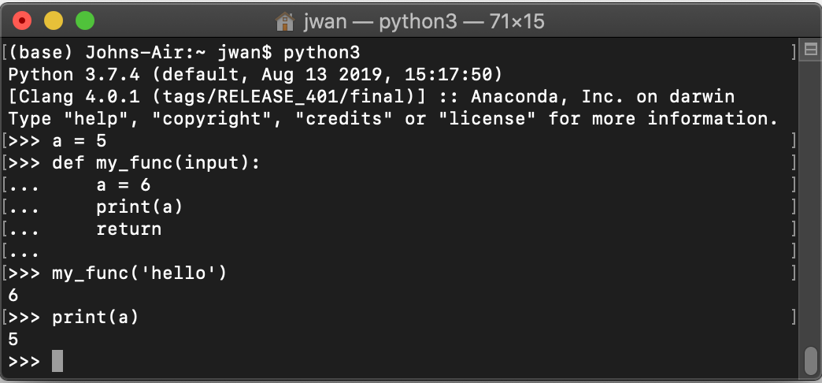
Shown in Python3 Interpreter (REPL)

Slide 37
Creating and editing .py scripts
On Windows, Notepad is available; Mac has textEdit
You will need to be able to view file extensions
There are many text editors and IDEs

Slide 38
Activity: Pair programming exercise
Find a partner who you have not yet collaborated with

Slide 39
Activity: Pair programming exercise
Find a partner who you have not yet collaborated with
Determine who is the less experienced programmer
The less experienced person creates a .py file that prints "hello"
Or, if both of you are not challenged by this,
create a .py file that prints all palindromic numbers with 7 digits (see this page)
4. Run the script using the Python interpreter in Jupyter
Notes:
https://en.wiktionary.org/wiki/aibohphobia

Slide 40
Idiosyncrasies of Python
Spaces – see style guide https://www.python.org/dev/peps/pep-0008/
--> 4 spaces per indentation level
no explicit type definitions in code (dynamic typing; types are resolved at runtime)
Python indexes from 0. This isn't consistent across languages.
Pro-tip: use a linter like pylint and flake8

Slide 41
Memorizing the nuances of a specific language
--> form pairs; each pair gets terms and definitions
Activity: match terms + definitions cards Activity: Blackboard - Week 2 - (in class exercise) - Memorizing the nuances of a specific language
Answers will be verified by consensus
When returning paper, please return term and definition in paired order: (term1, def1, term2, def2, term3, def3, …)
Source: https://www.brainscape.com/packs/python-1786943
for more, see https://www.brainscape.com/subjects/python
see also https://quizlet.com/subject/python/

Slide 42
Quiz on Python data structures
Given a list,
my_list = ['a', 'b', 'c', 'd']
What would the command
len(my_list)
return?
Do not shout out the answer. We will vote.

Slide 43
Quiz on Python data structures
Given a list,
my_list = ['a', 'b', 'c', 'd']
What would the command
len(my_list)
return?
Vote in BlackBoard
As a backup,
3: vote with blue card
4: vote with yellow card
NOT SURE: orange card

Slide 44
Quiz on Python data structures
Given a list,
my_list = ['a', 'b', 'c', 'd']
What would the command
len(my_list)
return?
1 2 3 4
3: vote with blue card
4: vote with yellow card
NOT SURE: orange card
len = length of list

Slide 45
Quiz on Python data structures
Given a list,
my_list = ['a', 'b', 'c', 'd']
What would the command
my_list[1]
return?
Vote in Blackboard
As a backup,
a: vote with blue card
b: vote with yellow card
NOT SURE: orange card

Slide 46
Quiz on Python data structures
Given a list,
my_list = ['a', 'b', 'c', 'd']
What would the command
my_list[1]
return?
0 1 2 3
a: vote with blue card
b: vote with yellow card
NOT SURE: orange card
Python indexes from 0

Slide 47
Essentials of Python for Exploratory Data Analysis (EDA)
Covered so far:
Loading files, ie CSV, JSON, XML (see previous week)
Use of the REPL
Data structures like lists, dictionaries
Pro-tip: What variables exist in the interpreter's memory? dir()

Slide 48
EDA using Jupyter + Pandas
Diversity of Software in Data Science
Use of Python
EDA using Jupyter + Pandas
Visualization of data
Tips from the Trenches
Homework

Slide 49
Jupyter for more than just learning and small scale analysis
Analyze video to detect 60 million faces
http://willcrichton.net/notes/rapid-prototyping-data-science-jupyter/
How Netflix uses Jupyter notebooks
https://medium.com/netflix-techblog/notebook-innovation-591ee3221233

Slide 50
Idiosyncrasies of Jupyter notebooks
Order of execution – designed to support non-linear exploration
Has syntax highlighting
Issues with Jupyter notebooks (comments)
Why Jupyter is data scientists’ computational notebook of choice (comments)

Slide 51
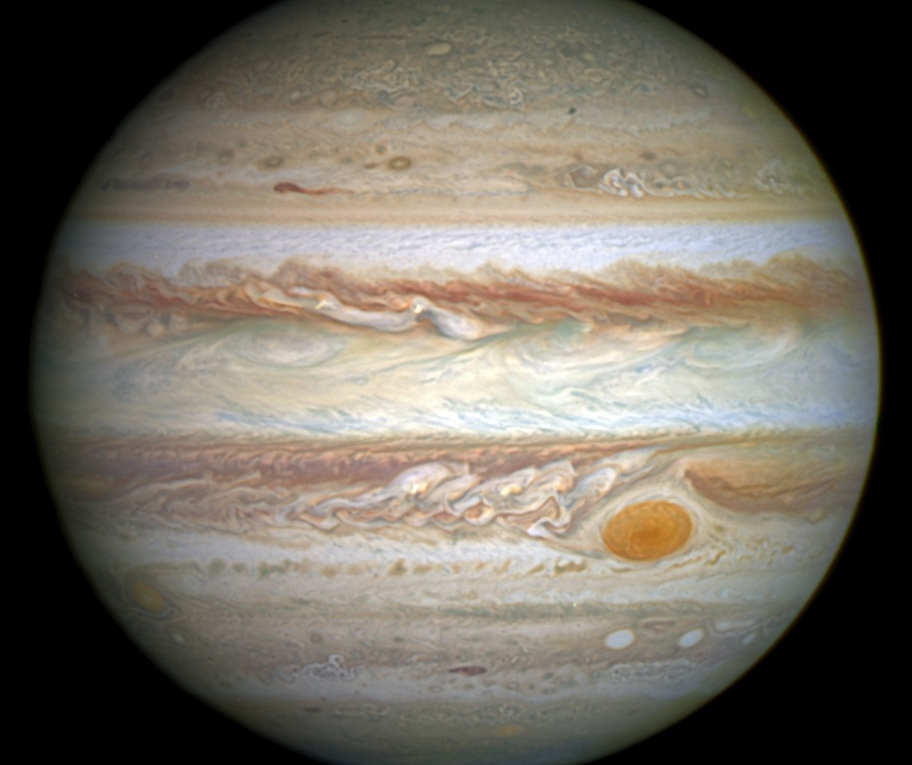
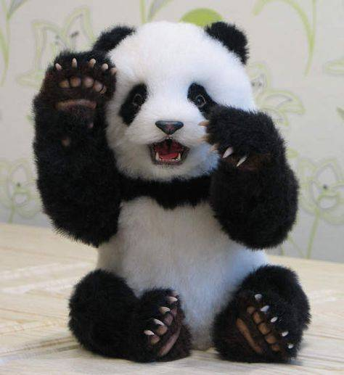

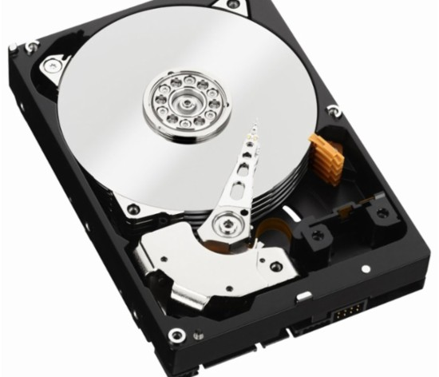
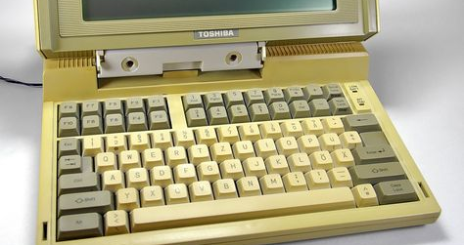
Pandas
A module for Python
Widely used in Data Science
Series
DataFrames for tables
Similar to data.frame in R
Uses NumPy
Many tutorials and documentation
Fancy operations like
groupby
Map, apply
Notes:
https://pandas.pydata.org/pandas-docs/stable/
https://upload.wikimedia.org/wikipedia/commons/2/2b/Jupiter_and_its_shrunken_Great_Red_Spot.jpg

Slide 52
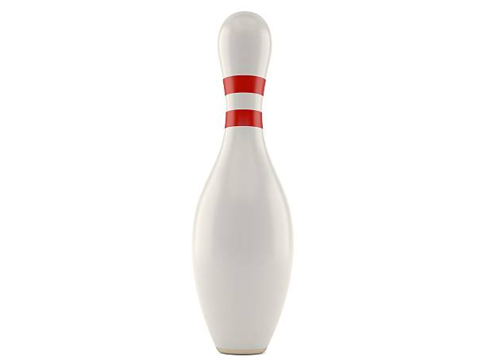
Bowling data from a webpage
Data source:
https://www.bowl.com/Open_Championships/Open_Championships_Home/Past_Results_and_History/
Linked from https://www.bowl.com/records/
Demo: bowling_visualization.ipynb
Activity: sketch your expectation
for time vs participation
Notes:
Hook: what's the motivator?
https://www.bowl.com/records/

Slide 53
Visualization of data
Diversity of Software in Data Science
Use of Python
EDA using Jupyter + Pandas
Visualization of data
Tips from the Trenches
Homework

Slide 54
Principles of Data Visualization
"Graphical excellence is that which gives to the viewer the greatest number of ideas in the shortest time with the least ink in the smallest space"
-- E. Tufte [citation]

Slide 55
Options for Visualizations
There are many options: https://datavizcatalogue.com/
There are many ways to go wrong: http://viz.wtf/
How to know when to use which?

Slide 56
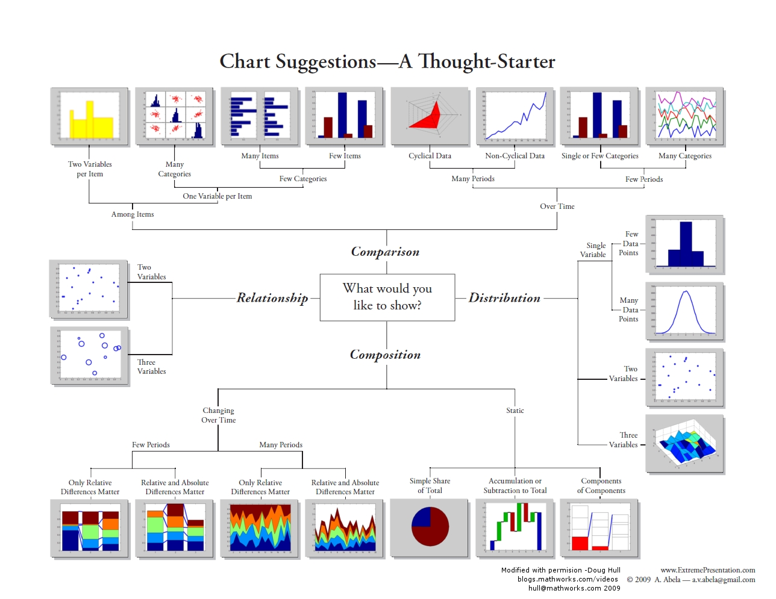
https://blogs.mathworks.com/videos/2012/04/26/choosing-a-visualization-in-matlab/

Slide 57
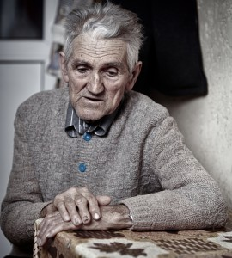
Data visualization may be useful, but it's old and no longer evolving

Slide 58
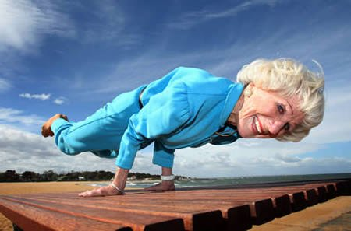
Data visualization may be useful, but it's old and no longer evolving
WRONG

Slide 59
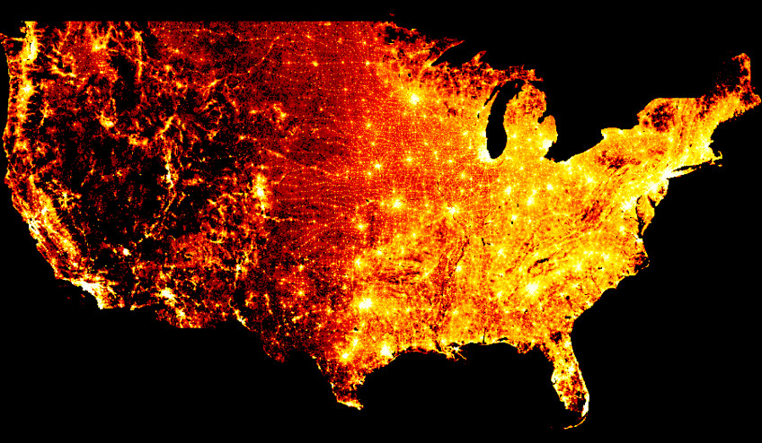
Visualization of data is advancing in multiple domains
Large-Scale data:
http://datashader.org/
Grammar of graphics
https://vega.github.io/vega/
https://altair-viz.github.io/
Interactivity
https://holoviews.org/
330+ million points of data (one per person in the USA) from the 2010 census
See https://www.youtube.com/watch?v=ms29ZPUKxbU
See https://www.youtube.com/watch?v=0jhUivliNSo
Notes:
http://datashader.org/topics/strange_attractors.html
https://anaconda.org/jbednar/census/notebook

Slide 60
Visualization of data is advancing in multiple domains
Large-Scale data:
http://datashader.org/
Grammar of graphics
https://vega.github.io/vega/
https://altair-viz.github.io/
Interactivity enables EDA
https://holoviews.org/
See https://www.youtube.com/watch?v=ms29ZPUKxbU
See https://www.youtube.com/watch?v=0jhUivliNSo

Slide 61
Start with the basics
Matplotlib - open source Python visualization similar to Matlab
To get started, find what you're interested in the gallery
Seaborn - built on top of matplotlib and closely integrated with pandas data structures.
tutorial

Slide 62
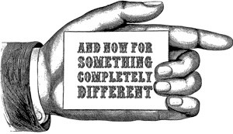
Notes:
http://whereverthewindblows.org/2018/04/25/and-now-for-something-completely-different/

Slide 63
Tips from the Trenches
Diversity of Software in Data Science
Use of Python
EDA using Jupyter + Pandas
Tips from the Trenches
Homework

Slide 64
Tip 1: Python Strings
this_str='a long sentence is fun'
another_str=this_str + ' to write.'
Consider a string a list of characters, except strings are immutable. Changing a string does not modify the string. It creates a new one.
source and this essay

Slide 65
Strings can be elements in a list
another_str.split(' ') # create a list
type(another_str.split(' '))
str_as_list = another_str.split(' ') # store output

Slide 66
String manipulation
this_str='a long sentence is fun'
this_str[:10] # first 10 characters
this_str[-10:] # last 10 characters
Strings are sliceable. Slicing a string gives you a new string from one point in the string, backwards or forwards, to another point, by given increments
source and this essay

Slide 67
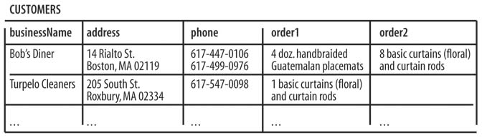
Tip 2: Not all CSVs are equivalent
There are best practices for what good tabular data looks like
Each variable must have its own column.
Each observation must have its own row.
Each value must have its own cell.
More observations on best practices
https://cran.r-project.org/web/packages/tidyverse/vignettes/manifesto.html
http://r4ds.had.co.nz/tidy-data.html
Notes:
https://www.safaribooksonline.com/library/view/fixing-access-annoyances/059600852X/ch04.html

Slide 68
Data cleaning as a showcase of skill
Example of data cleanup articles:
http://www.developintelligence.com/blog/2017/08/data-cleaning-pandas-python/
These usually don't bother to capture the frustration of exploration.

Slide 69

Real data is real dirty
See http://usbcongress.http.internapcdn.net/usbcongress/bowl/recordsstats/pdfs/PTIndividualRecordsState.pdf
From https://www.bowl.com/records/

Slide 70
Tip 3: Buzzwords as indicators
The Cloud
Machine Learning
Artificial Intelligence
Big Data
Predictive Modeling
Labeled Data
EDA
ETL
Training models
Deep Neural Network
Moonshot
Structured data
These words are not used by normal people

Slide 71
Question the speaker
What do you mean by that phrase?
Is the definition shared by speaker and audience?
What is an example of that?
What is the speaker's depth of experience?
What is the speaker's expectation of the audience?
What depth is expected for audience?

Slide 72
Pandas: Series and Dataframes
Series = one-dimensional labeled array capable of holding data of any type (integer, string, float, python objects, etc.). The axis labels are collectively called index.
https://www.tutorialspoint.com/python_pandas/python_pandas_series.htm
Based on Numpy array
Dataframe = Two-dimensional size-mutable, potentially heterogeneous tabular data structure with labeled axes (rows and columns). Arithmetic operations align on both row and column labels. Can be thought of as a dict-like container for Series objects. The primary pandas data structure.
https://pandas.pydata.org/pandas-docs/stable/generated/pandas.DataFrame.html

Slide 73
Pro-tip: When to write software and for how long
Writing a script takes time and focus
Flow state
Avoid interruptions and context switching

Slide 74
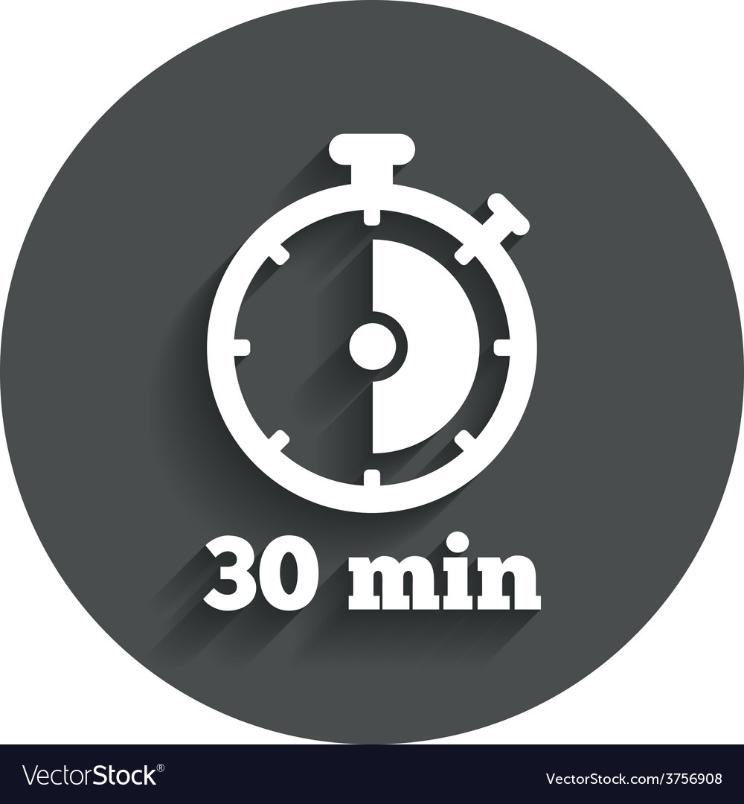
When to persist, When to change course, When to seek help
Try attacking the challenge for 30 minutes
Then seek help or do something else for a while
https://en.wikipedia.org/wiki/Pomodoro_Technique
Notes:
http://finalfantasy.wikia.com/wiki/Level_grinding
https://en.wikipedia.org/wiki/Grinding_(gaming)
https://www.vectorstock.com/royalty-free-vector/timer-sign-icon-30-minutes-stopwatch-symbol-vector-3756908

Slide 75
Homework
Building up from basics: the terminal
Diversity of Software in Data Science
Use of Python
EDA using Jupyter + Pandas
Tips from the Trenches
Homework

Slide 76
Watch https://www.youtube.com/watch?v=V0ucZ4ctof8
Summary of the video:
Goal: Find the Mario Maker level with the most plays and the most star ratings.
Problem: Collecting the data. Nintendo does not offer it in a giant spreadsheet. You can pull up a query that shows 100 or whatever at a time, but we need 10^6 rows to achieve the goal.
At around 4:35 or so he breaks down the query, explains how someone wrote a script to scrape the website (a polite script too, which is smart - it didn't overwhelm the servers or cause the IP address to get blocked) and then briefly explains some of the other neat things you can find within the data set before diving in to address the goal.

Slide 77
Homework for Week 2, assignment 1
Assignment: A string is provided to a function as an argument. Implement a function that returns two numeric values: the count of characters and count of words. Submit a .ipynb file via Blackboard.
Modification for advanced students:
Include error handling in the function. What happens if I don't pass a string?
Raise an exception (with an error message) when appropriate
Next week: code review
Notes:
Removed: Do not use the print() function to display the results.

Slide 78
Homework for Week 2, assignment 2
Assignment: Write a function that takes a list as the argument and returns a list with each element shifted right by one index.
For example, [3, 7, 4, 1] becomes [1, 3, 7, 4]
Submit a .ipynb file via Blackboard.
Modification for advanced students:
Include error handling in the function. What happens if I don't pass a list? Can you shift characters in a string?
Raise an exception (with an error message) when appropriate
https://www.hackerrank.com/challenges/
Next week: code review

Slide 79
Homework for Week 2, assignment 3
Assignment: Download data in CSV format from one of the following sites: here or here. Load the data into a Pandas dataframe. Use Pandas to count the number of rows of data and number of columns. Display the first 8 rows of the dataframe. Display the bottom 3 rows of the dataframe. Display the transpose of the first 4 rows.
Your selection of a CSV should have at least 2 columns and at least 10 rows. Include a link to the data source in the Juptyer notebook you submit.
Modification for advanced students:
Load CSV from URL using Pandas or request or another library
Next week: code review

Slide 80
Not enough homework?
Challenges abound:
https://www.hackerrank.com/challenges/
https://codesignal.com/interview-practice/
https://www.codewars.com/

Slide 81
For the first assignment,
Breakdown each Homework assignment, Part 1 of 2
"Write a function that returns the count of letters and words in a string. The string should be provided to the function as an argument. Submit a .ipynb file via Blackboard."
Draw or write down what you're starting with
Draw or write down what the outcome should look like

Slide 82
For the first assignment,
Design your approach to solving problem
"Write a function that returns the count of letters and words in a string. The string should be provided to the function as an argument. Submit a .ipynb file via Blackboard."
On a piece of paper, write down actions you'll need to take
Determine the dependencies among the actions you need to take
In what order should the steps be?
If you have time before leaving, take the listed actions using your computer

Slide 83
For the second assignment,
Breakdown each Homework assignment, Part 1 of 2
"Write a function that takes a list as the argument and returns a list with each element shifted right by one index.
For example, [3, 7, 4, 1] becomes [1, 3, 7, 4]"
Draw or write down what you're starting with
Draw or write down what the outcome should look like

Slide 84
For the second assignment,
Design your approach to solving problem
"Write a function that takes a list as the argument and returns a list with each element shifted right by one index.
For example, [3, 7, 4, 1] becomes [1, 3, 7, 4]"
On a piece of paper, write down actions you'll need to take
Determine the dependencies among the actions you need to take
In what order should the steps be?
If you have time before leaving, take the listed actions using your computer

Slide 85
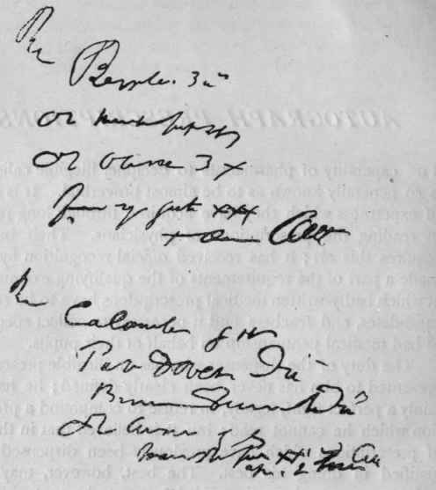
Activity: in-class anonymous survey
Write one or two sentences describing what you learned in this class
Write one or two sentences regarding a question you have about what you heard in this class
Please write legibly.
Purpose is for me to understand your perspective
Your responses are not graded
Your responses are anonymous
Turn in your paper before leaving class

