Slide 1
UBER GPA LEAD L3/4 • CASE STUDY
Optimizing Predictable Events
A framework for capturing forecastable demand shocks in rideshare
399M
761
9
$5.6M
Trips analyzed
Events catalogued
Public datasets fused
NYC pricing capture (3 pricing-relevant shocks)
Presented by Thomas Cooper • May 2026

Slide 2
CONTENTS
What we'll cover
01
Business problem & hypothesis
What's the question, why it matters
02
Data foundation & methodology
9 datasets, 20 months, the framework
03
Five forecastable shocks
Events · Weather · Substitution · CP · Politics
04
Sized opportunity
Pricing vs supply counterfactuals
05
Recommendation & World Cup application
MetLife 2026 forward case
06
Risks, caveats, what I'd do next
Honest scoping
Uber GPA Lead Case
Thomas Cooper • May 2026
2 / 18

Slide 3
01 • THE BUSINESS PROBLEM
Forecastable shocks are visible in public data — and rideshare under-monetizes them
"How could Uber make money from publicly available data?"
WHY IT MATTERS
The case asks where public-data analysis can change how Uber operates. Most obvious answer: marketing spend, growth. Less obvious — and more interesting — answer: operational shocks.
~$5.6M
NYC pricing capture (NJ pregame + heavy rain + sports); storm gets supply withdrawal
8 matches
Demand shocks come in five forecastable categories that public data already exposes. Each has a different operational profile — and a different right answer.
World Cup at MetLife 2026 — direct forward application of NJ-venue framework
5 categories
Events, weather, substitution, congestion pricing, political — all in public data
HYPOTHESIS
My hypothesis is that rideshares under-optimizes for forecastable shocks. Forecastable demand shocks have predictable optimal responses and pricing or supply adjustments are scenario specific.
2 levers
Pricing vs supply optimization — analyzed head-to-head per shock
Uber GPA Lead Case
Thomas Cooper • May 2026
3 / 18

Slide 4
02 • DATA FOUNDATION
Nine public datasets fused into a 7.2M-row zone-hour panel
9 PUBLIC DATA SOURCES
MASTER ANALYSIS TABLE
TLC HVFHS Trip Records
20 monthly parquets · 399.4M trips · Uber 295M / Lyft 105M
7.2M
20 mo
TLC Taxi Zones (shapefile)
263 zones · EPSG:2263 · Congestion Relief Zone (CRZ) classification (36 zones)
zone-hour rows
Jan 24 – Aug 25
MTA Subway Hourly Ridership
62M raw rows · 462 stations · zone-mapped via station coords
263
14,616
NOAA Hourly Weather
FM-15 + FM-16 deduped · 43K obs · 3 stations zone-mapped
TLC zones
unique hours in time range
NOAA Storm Events
91 NYC events · 9 storm categories
Major Events Catalog (custom)
52
$4.97/mi
761 events: 741 sports + 6 political + 14 civic
NYC SAPO Permits
columns
avg fare-per-mile
8.5M raw → 60K events deduped (borough-level)
NYC TLC Congestion Pricing
Treatment date Jan 5, 2025 · CRZ vs non-CRZ
KEY METHODOLOGY DECISIONS
Federal + NYC holiday calendar
• Ratio-of-sums fare-per-mile (after stripping CBD fees)
• Hour-level event windows (sym ±3hr / asym -2/+4hr)
• NJ-venue events flagged on Manhattan departure zones
23 dates with same-DOW-non-holiday baseline
Uber GPA Lead Case
Thomas Cooper • May 2026
4 / 18

Slide 5
02 • METHODOLOGY
My framework consistent of Five shock categories × two operational counterfactuals
01
02
03
04
05
EVENTS
WEATHER
TRANSIT
POLICY
POLITICAL
Sports + civic + parades
Rain + temp + storms
Subway substitution
Congestion pricing
UN GA + elections
Per-shock analysis →
COUNTERFACTUAL A — PRICING
COUNTERFACTUAL B — SUPPLY
Optimize fare-per-mile during shocks
Pre-position drivers ahead of shocks
• Raise prices to clear excess demand
• Capture: ΔP × Q (after demand response adjustment)
• Highest dollar capture per shock event
• Considerations: regulatory environment, competitive response
• Effectiveness varies by shock type (see slide 10)
• Drivers staged before predictable demand
• Capture: extra trips × base fare
• Lower headline $ but operational (no surcharge)
• Defensible across all shock types uniformly
• Builds long-term supply infrastructure (franchise value)
Uber GPA Lead Case
Thomas Cooper • May 2026
5 / 18

Slide 6
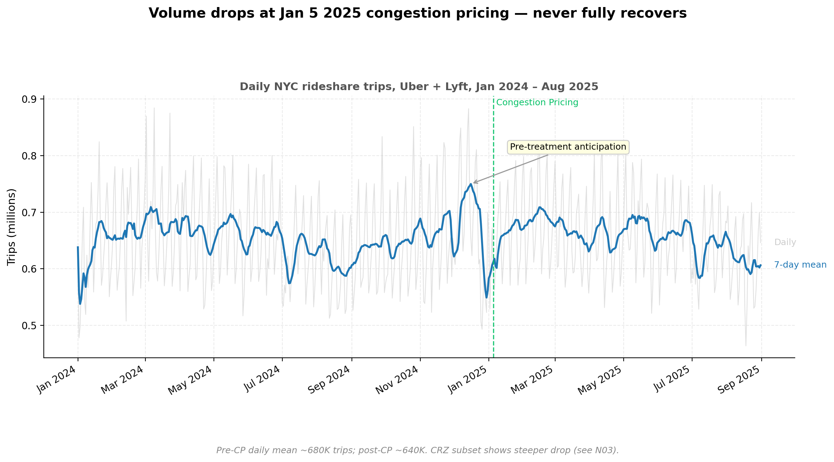
03 • EXPLORATORY ANALYSIS
Volume drops at Jan 5, 2025 due to congestion pricing; standard NYC patterns confirm data integrity
KEY EXPLORATORY DATA FINDINGS
1
Volume drops at Jan 5
Pre-CP daily mean ~680K trips; post-CP ~640K. Clean DiD signal but pre-trends matter (slide 9).
2
Fare-per-mile DROPPED post-CP
After stripping toll passthrough, underlying surge softened. Reframe: 'volume crashed, fare held.'
3
Hourly volume profile = expected NYC commuting
8am + 6pm peaks confirmed across both platforms. Sanity check passed.
4
Lyft non-stationary
Stationarity test fails for Lyft (p=0.18) but passes for Uber (p=0.002). Mitigated via panel fixed-effects + first-differences.
Source: N01 daily volume combined | Jan 2024 – Aug 2025
Confirms data quality before causal analysis. Hour-of-day, DoW heatmap, choropleth, and STL decomposition in appendix.
Uber GPA Lead Case
Thomas Cooper • May 2026
6 / 18

Slide 7
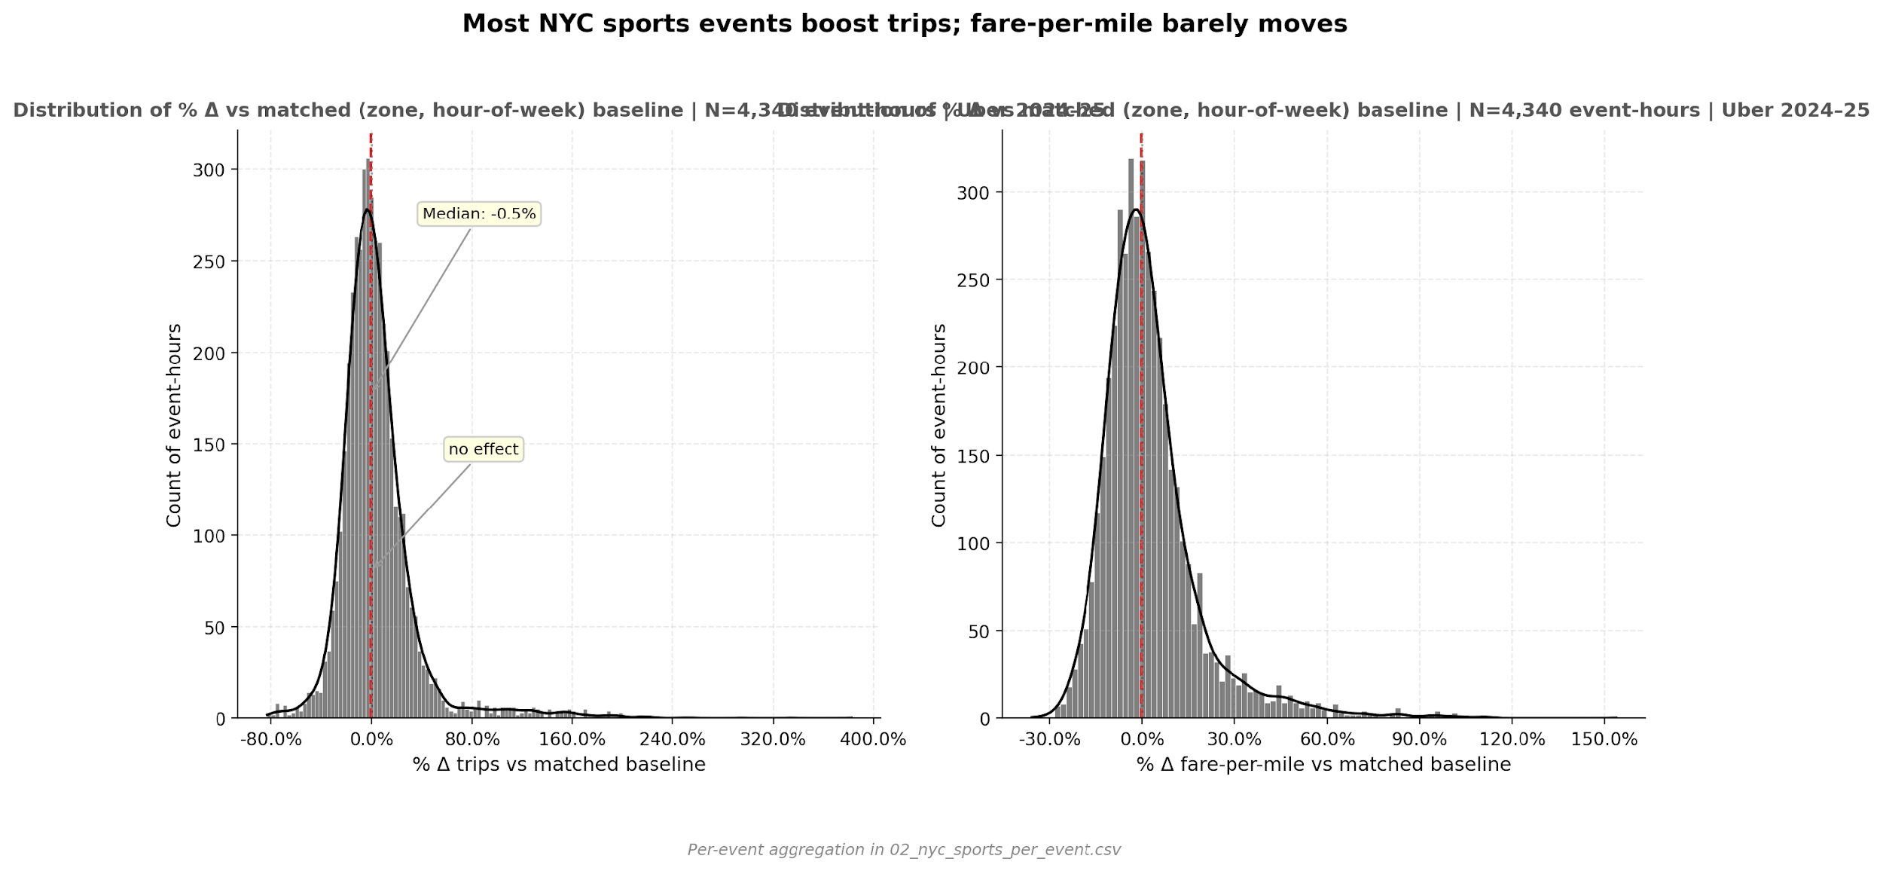
FINDING 1 • EVENTS
Sports lift trips ~4–6%, but parades CRUSH demand (-30% to -97%). This is an operational blockers, not pricing shocks
+4.1%
NYC sports median lift (per-event)
+5.7%
NJ pre-game lift (Manhattan dep. zones)
−97%
NYE Ball Drop, Times Sq (operational blocker)
THE REFRAME
Civic event negatives aren't 'no demand' — they're physical access blocked by street closures. Different operational lever entirely (reroute + comms vs surge).
Source: N02 NYC sports per-event distribution | N=4,340 event-hours
Methodology: hour-level event windows (sym ±3hr); collapse-first matched (zone, hour-of-week) baseline; paired one-sample t-test on (event − baseline) differences. N = 4,083 NYC sports event-hours, 14 civic events. NYE is the most extreme; civic events MEDIAN lift = −30.6%.
Uber GPA Lead Case
Thomas Cooper • May 2026
7 / 18

Slide 8
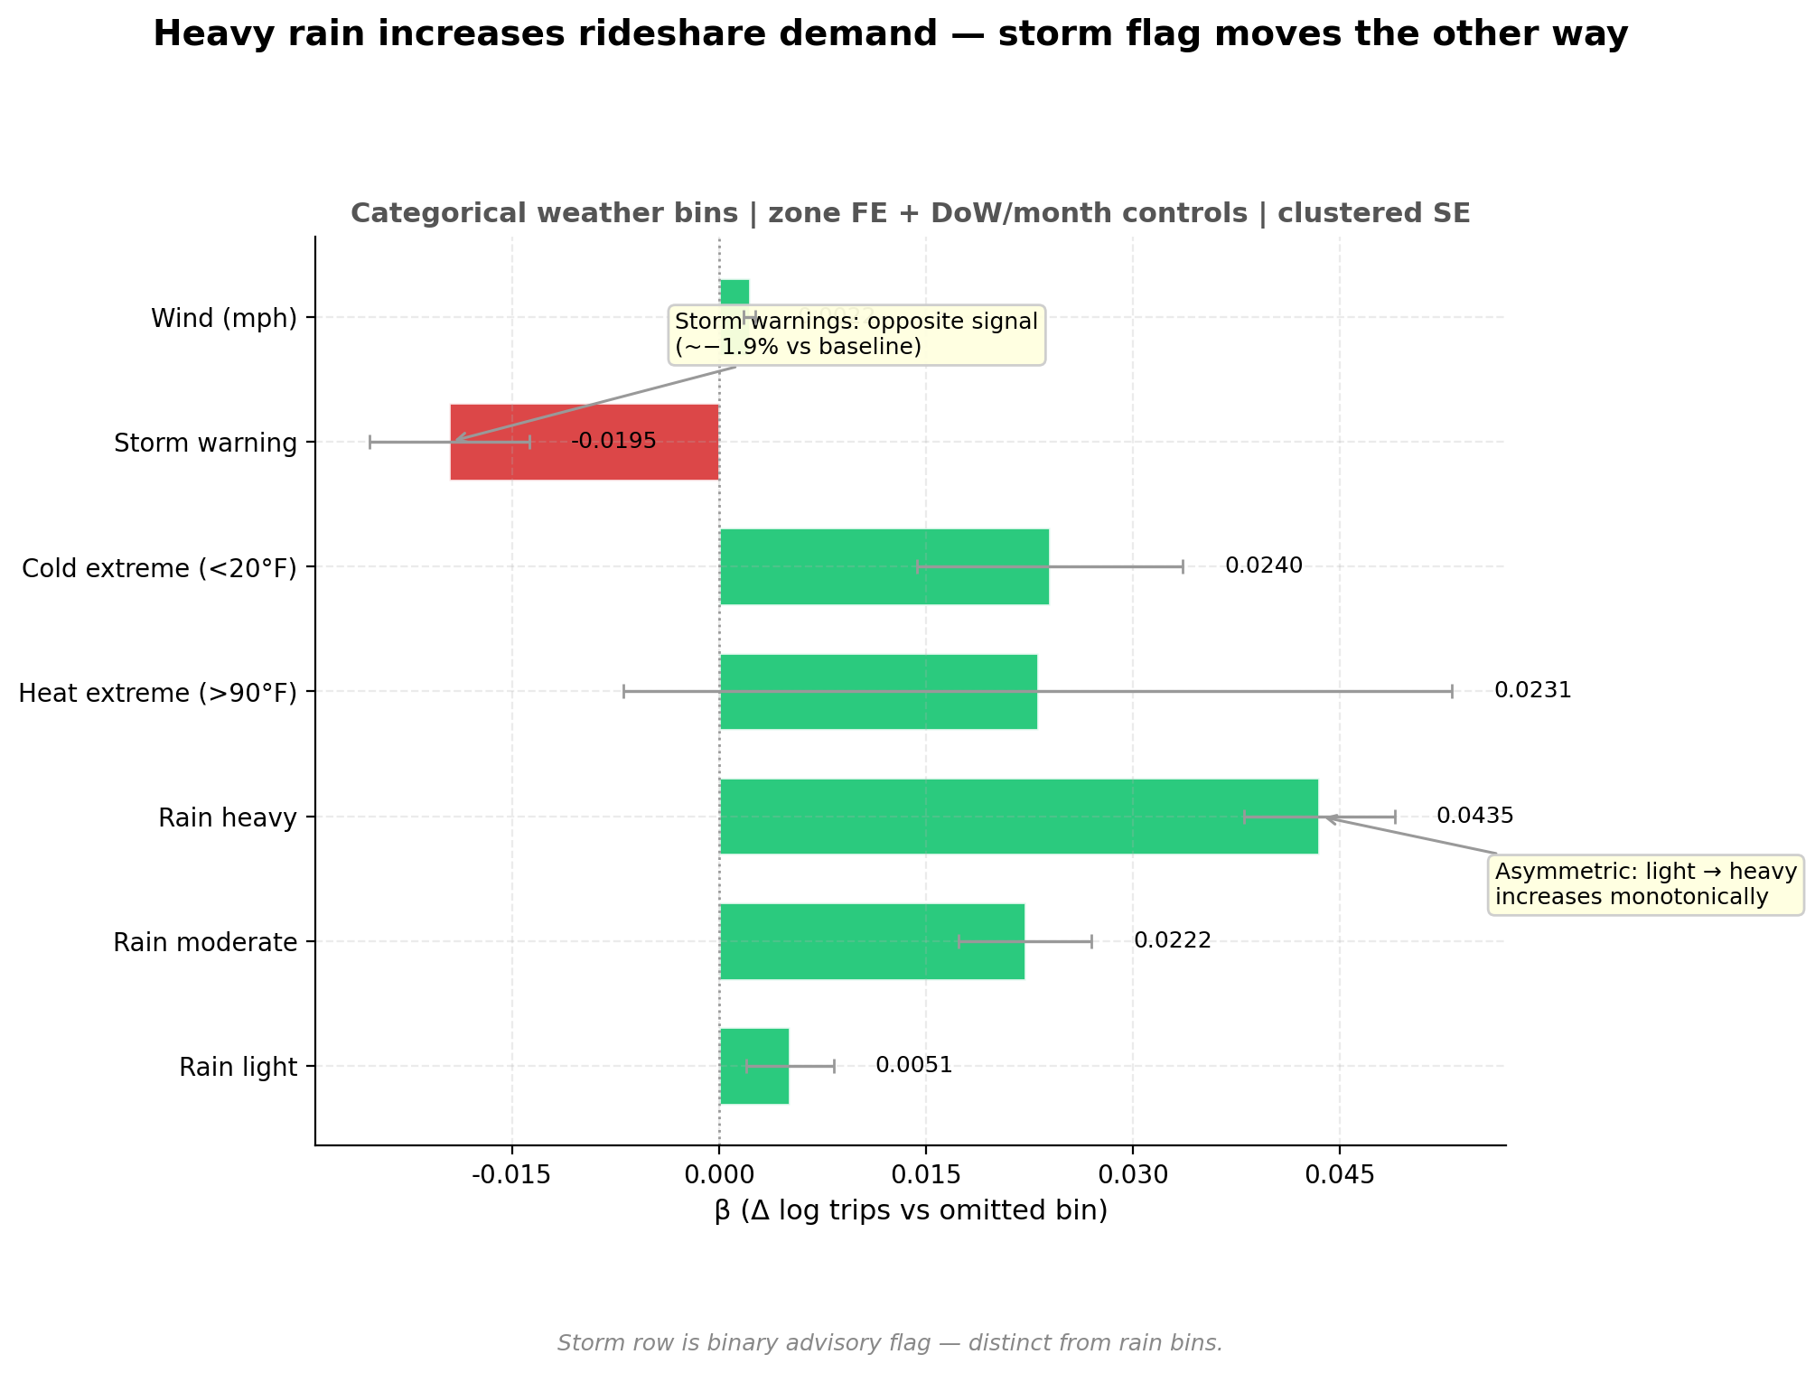
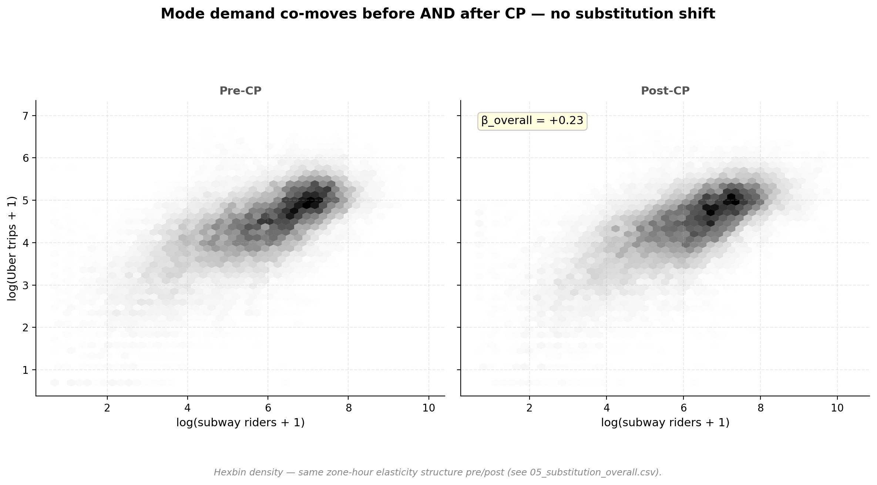
FINDING 2 + 3 • WEATHER & SUBSTITUTION
Heavy rain pushes riders TO rideshare (+4.4%); subway does NOT substitute for rideshare — modes move together
WEATHER ELASTICITY
CROSS-MODAL SUBSTITUTION
Source: N04 weather coefficient forest plot
Source: N05 substitution hexbin pre/post-CP
+0.5% light +2.2% moderate +4.4% heavy −1.9% storm warn.
β=+0.23 modes move TOGETHER β=+0.13 decouple in heavy rain
Uber GPA Lead Case
Thomas Cooper • May 2026
8 / 18

Slide 9
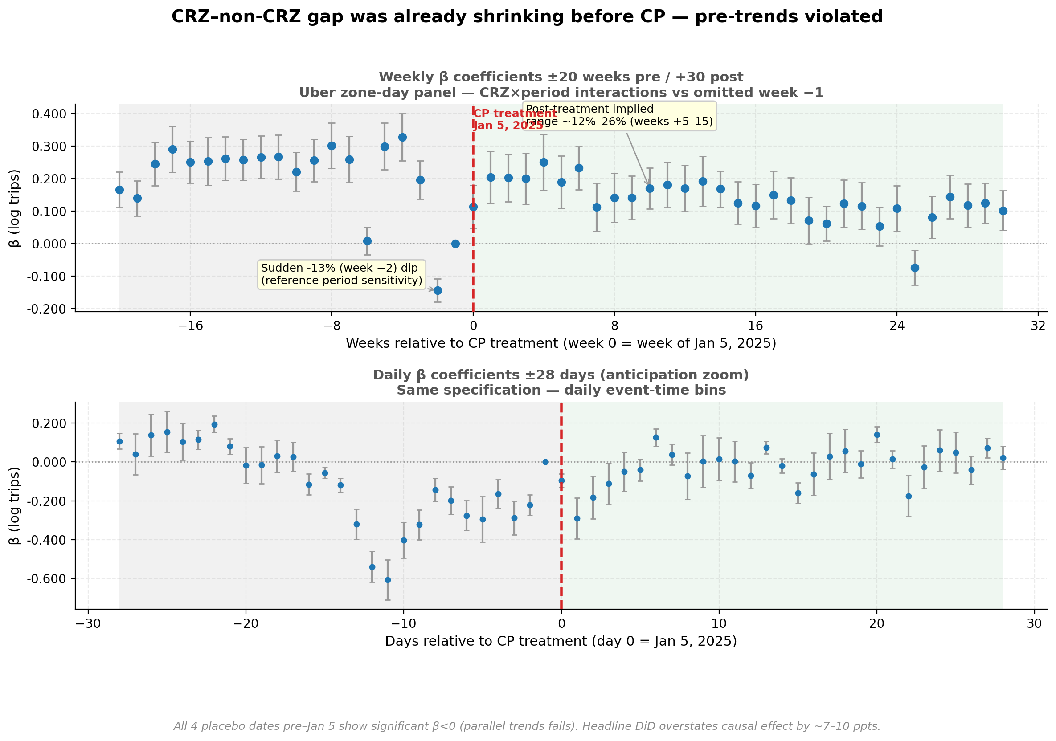
FINDING 4 • CONGESTION PRICING
Naively viewing difference-in-differences (DiD) says −11% volume due to congestion pricing but true effect is ~0–4%
WHAT THE PLACEBO REVEALED
All 4 placebo dates pre-Jan 5 show significant negative β:
Jun 2024 β=−0.080
Sep 2024 β=−0.058
Nov 2024 β=−0.096
Dec 2024 β=−0.126
HONEST INTERPRETATION
CRZ–non-CRZ trends were already diverging pre-CP. Naive DiD overstates by ~7-10pp. After adjusting for pre-trend, true causal effect is closer to
Source: N03 weekly + daily event-study coefficients with 95% CIs
WHAT IS A PLACEBO TEST?
0–4%, not 11%.
A placebo runs the same DiD specification on FAKE treatment dates BEFORE the real Jan 5 2025 cutoff. If congestion pricing is the cause of the −11% gap, placebos should return ~0% effects. They don't — all four return significant negatives, meaning CRZ vs non-CRZ trends were already diverging before CP went live.
Robustness check (excluding ±2 weeks around Jan 5) confirms the pattern persists.
Uber GPA Lead Case
Thomas Cooper • May 2026
9 / 18

Slide 10
04 • STRATEGY MATRIX
Per-shock recommendation: pricing optimization wins for sports + NJ pregame + heavy rain; but supply optimization for storms
SHOCK
PRICING NET
SUPPLY (CENTRAL)
MARGIN
RECOMMENDATION
NYC sports
$0.77M
$0.75M
1.02×
Pricing (tie)
NJ pregame
$1.86M
$1.00M
1.86×
Pricing dominant
Heavy rain
$2.95M
$1.74M
1.69×
Pricing dominant
Storm active
$0
$2.99M*
N/A
Withdraw drivers
Civic events
—
—
N/A
Operational (reroute)
Political (N=6)
—
—
N/A
Deferred (exploratory)
RECOMMENDATION SUMMARY
Apply pricing to NJ pregame + heavy rain ($4.8M combined). Pricing-leaning tie on sports ($0.77M, judgment call). Storms: WITHDRAW drivers — demand is falling, no pricing opportunity exists. Civic + political events use operational levers (rerouting, comms), not pricing or supply.
* Supply $2.99M for storms assumes drivers stay on the road; honest read is the optimal action is withdrawal to avoid waste.
Uber GPA Lead Case
Thomas Cooper • May 2026
10 / 18

Slide 11
04 • METHODOLOGY RIGOR
Since Uber doesn’t capture the entire market we see competitor lift in same scenarios
SHOCK
UBER LIFT
LYFT LIFT
OBSERVED η
RANGE
THE INSIGHT
Cross-elasticity is NOT uniform.
Sports
+4.4%
+8.1%
0.45
0.23-0.68
Sports games: Lyft lifts MORE than Uber (8.1% vs 4.4%) → riders DO switch when Uber surges. η = 0.45.
Heavy rain: Both surge similarly (19% Lyft, 17% Uber) → riders captive to rideshare, no Lyft escape. η = 0.09.
NJ pregame: Uber lifts MORE than Lyft → no observable substitution. η ≈ 0.
Why it matters: Uniform η=0.4 would've underestimated pricing capture for rain (where Lyft can't take share) and overestimated it for sports. Per-shock η is more accurate.
NJ pregame
+8.5%
+6.6%
0.00
0.0-0.0
Heavy rain
+16.8%
+19.0%
0.09
0.04-0.13
Storm
+1.6%
+2.3%
0.11
0.06-0.17
η computed as: max(0, (Lyft lift − Uber lift) / Uber fare-per-mile lift). Lam & Liu 2017 methodology adapted from 5-min to hourly granularity. ±50% sensitivity range applied.
Uber GPA Lead Case
Thomas Cooper • May 2026
11 / 18

Slide 12
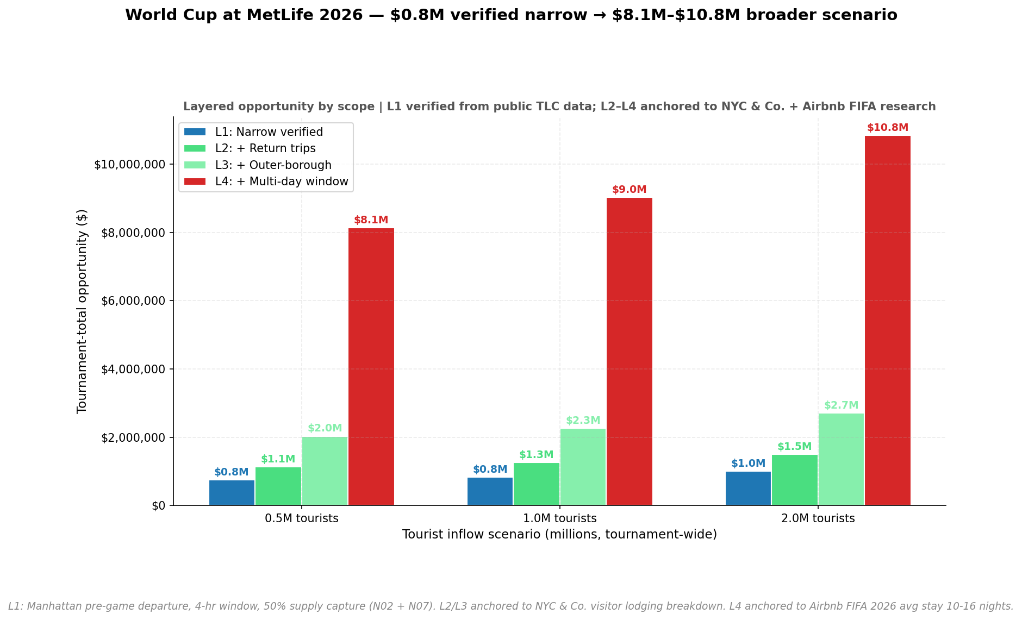
05 • FORWARD APPLICATION
An applicable scenario for my analysis is the 2026 World Cup at MetLife: $0.8M in first 4 hours + $8.1M–$10.8M broader scenario
LAYERED SIZING (SCOPE-DISCIPLINED)
LAYER 1 — VERIFIED NARROW
$0.8M
Tournament total at +1M tourists. Manhattan pre-game departure, 4-hr window, 50% supply capture. Direct from N02 NJ-venue methodology + N07 capture frac.
LAYER 4 — FULL OPPORTUNITY (EXTRAPOLATED)
$8.1M – $10.8M
Across +500K / +1M / +2M tourists. Adds: return trips (1.5×, judgment), outer-borough origins (1.8×, NYC & Co. visitor data), multi-day tourist window (4×, Airbnb FIFA stay data). Cumulative ~10.8×.
Source: N08 L1 narrow stacked capture | L4 broader scenario in cards
THE PLAY
SCOPE DISCIPLINE: L1 is what public data verifies directly. L2-L4 multipliers anchored to NYC & Co. visitor data + Airbnb FIFA travel research (citations in appendix).
Apply forecastable-shock pricing 4-6hrs pre-kickoff in Manhattan departure clusters. Final = max surge tier. 8-language in-app prompts. Monitor Lyft baseline pricing for competitive calibration.
Uber GPA Lead Case
Thomas Cooper • May 2026
12 / 18

Slide 13
APPENDIX • COMPARABLE EVENTS
World Cup broader Scenario magnitude is consistent with rideshare revenue at recent mega-events
Super Bowl LVIII
NJ Transit WC Rail
WC NY/NJ (FIFA est.)
Las Vegas, Feb 2024
WC 2026 (planned)
FIFA pre-tournament
+33%
$48M
$6.4B
Driver earnings per hour Super Bowl Sunday vs typical Sunday (Uber-published, Glendale 2023).
NJ Transit estimated revenue from expanded WC rail service to MetLife. Rideshare likely matches or exceeds given dynamic pricing.
Total FIFA-estimated tourist spending NY/NJ region. Rideshare ≈ 2-3% of travel spend → $130-200M implied total rideshare.
Source: Uber Blog (uber.com/blog/las-vegas/drive-superbowl-lviii)
Source: NJ Transit official estimate (Explore NJ, NBC NY)
Source: FIFA economic projection (WHYY, NJ Sec. of State)
HOW THIS VALIDATES THE LAYER 4 ESTIMATE
Layer 4 estimate of $8.1M–$10.8M is consistent with comparable evidence: (1) NJ Transit alone forecasts $48M from WC rail, implying rideshare in the same order or higher given dynamic pricing; (2) Uber's 33% driver-earnings lift on Super Bowl Sunday confirms mega-events are operationally distinct, not just slightly busier; (3) FIFA's own $6.4B NY/NJ tourist spending estimate implies $130–200M total regional rideshare across the tournament. Our Layer 4 represents only the supply-optimization slice of that total — not the full opportunity. L1 ($0.8M) is directly verified from public data; L2-L4 multipliers are anchored to NYC & Co. visitor data and Airbnb FIFA travel research.
Citations: NYC & Co. NYC Visitor Profile · Airbnb FIFA WC 2026 Travel Trends · Roadtrips WC 2026 Travel Guide · NJ Transit (Explore NJ, NBC NY) · FIFA economic projections (WHYY) · Uber Blog Super Bowl LVIII
Uber GPA Lead Case
Thomas Cooper • May 2026
13 / 18

Slide 14
EXTENSION • INTERACTIVE EXPLORER
Try the framework yourself — sliders, scenarios, live recommendation flip
🌐 Cooper_Uber_Strategy_Explorer
TWO INTERACTIVE VIEWS
Tab 1: NYC Strategy Matrix
4 sliders (ε, η, surge cap, supply capture) × 4 shocks. Recommendation flips live.
Tab 2: World Cup 2026
Tourist inflow scenarios × layered scope (L1 narrow → L4 broader). Per-match breakdown.
WHY IT'S HERE
Challenge any assumption live. Numbers are not curated — they update with whatever parameters you set.
Same data, same notebooks, same logic — just exposed as a tool.
[ EMBED WEB VIEWER ADD-IN HERE ]
Insert > My Add-ins > Web Viewer > paste URL below
https://tcooper4.github.io/UBER/deck/Cooper_Uber_Strategy_Explorer.html
(Click URL above as backup if Web Viewer add-in fails to load)
Uber GPA Lead Case
Thomas Cooper • May 2026
14 / 18

Slide 15
06 • RISKS & NEXT STEPS
What's missing and what I would build next
DATA LIMITATIONS
ANALYTICAL CAVEATS
NJ trip-level data not public — only Manhattan→NJ pre-game visible
Surge multiplier inferred (not observed) from fare-per-mile
No driver-side data — supply pre-positioning sized at framework level only
20-month window — weather has 1 summer, 1 winter; political N=6
Pre-trends placebo failed for CP — true causal ~0–4%, not 11%
Civic event negatives are operational blockers, not demand collapses
Substitution channel ruled out — modes co-move at hourly level
Strategy comparison is partial-equilibrium (no Lyft response model)
NEXT STEPS • WHAT INTERNAL DATA WOULD ADD
ANALYTICAL EXTENSIONS
▪ Bus integration (MTA Bus Hourly) for World Cup substitution
▪ Synthetic control for CP DiD if pre-trend issue is critical
▪ Driver-supply model with internal data (idle time, multi-app)
▪ Borough-level demographic heterogeneity (Census ACS overlay)
INTERNAL DATA LIFTS
▪ Exact surge multipliers (vs my fare-per-mile proxy)
▪ Wait times → real supply tightness, not driver-pay-derived
▪ Driver dispatch logic + multi-app behavior
▪ Lyft competitive response model from observed history
Uber GPA Lead Case
Thomas Cooper • May 2026
15 / 18

Slide 16
APPENDIX • CITATIONS
All academic anchors, data sources, and references
ACADEMIC PAPERS & METHODOLOGY
DATA SOURCES (PUBLIC)
Using Big Data to Estimate Consumer Surplus
TLC HVFHS Trip Records
Cohen, Hahn, Hall, Levitt, Metcalfe (NBER w22627, 2016)
NYC Taxi & Limousine Commission
Own-price elasticity ε ≈ −0.5 to −1.0 → demand response in N06/N07
399M trips · 20 monthly parquets · zone-hour panel core
TLC Taxi Zones (shapefile)
Price-Driving in Real-Time Ridesharing Markets
NYC TLC
Hall, Kendrick, Nosko (Uber working paper, 2015)
263 zones · CRZ classification · choropleth + zone joins
Driver supply 10-20% expansion under 2x surge → 50% capture in N07
MTA Subway Hourly Ridership
The Effect of Surge Pricing on Driver Supply
NY MTA Open Data
Chen, Sheldon (RAND Corp, 2016)
62M raw rows → substitution analysis (N05)
Driver labor supply elasticity ~1.0 → forecastability framing
NOAA Hourly Weather (ISD/LCD)
NOAA NCEI
Substitution among Ride-Sharing Platforms
FM-15 + FM-16 deduped → weather elasticity (N04)
Lam, Liu (MIT IDE working paper, 2017)
FIFA WC 2026 Travel Trends
Cross-platform substitution methodology → per-shock η in N07b
Airbnb (May 2024 report)
Avg visitor stay 10-16 nights → L4 multi-day multiplier (N08)
Econometric Analysis of Cross-Section and Panel Data
NYC Visitor Profile
Wooldridge (MIT Press, 2010)
NYC & Company (NYC Tourism + Conventions)
Panel collapse strategy justification (Ch. 14) → memory-safe DiD
All sources accessed May 2026. Click any source title to follow link. Full code + notebooks + AI conversation log available on request.
~55% Manhattan lodging share → L3 multiplier (N08)
Uber GPA Lead Case
Thomas Cooper • May 2026
16 / 18

Slide 17
APPENDIX • AI WORKFLOW
How I used AI to accelerate this case — with awareness of its limitations
HOW I USED CLAUDE
WHERE I PUSHED BACK
Hypothesis development: iterated framing from "5 shocks" → "forecastable shocks with operational levers per shock" → final pricing-vs-supply head-to-head with academic anchors
Methodology design: memory-safe panel collapse strategy (Wooldridge anchor), placebo test design, hour-level vs day-level event windows
Code generation: Cursor patches for ~12 notebooks; verified each output against expected ranges before accepting
Academic anchoring: web-search for Cohen 2016, Hall et al. 2015, Chen & Sheldon 2016; Claude surfaced relevant papers I'd then read directly
Deck construction: iterative review on each slide for clarity, jargon, and consistency with results
World Cup magnitude: Claude initially gave $5M-$25M tournament estimate. I pushed for a derivation from public data → led to L1/L4 layered framing
Supply capture fraction: originally hardcoded at 50%. I required literature anchoring → led to Hall et al. citation + 30/50/70 sensitivity
Strategy recommendation: Claude proposed supply on "strategic fit" without quantification. I required analytical work (Path 3-lite) → led to flipping the recommendation to pricing once data was anchored
Pre-trends placebo: Claude flagged the placebo failure; we discussed whether to bury or report → chose honest reporting as the academic standard
AI LIMITATIONS RECOGNIZED: Claude proposed un-anchored estimates that needed verification against literature. Every analytical claim in this deck was traced back to data or cited research. Full conversation log submitted separately as case-prompt artifact.
Uber GPA Lead Case
Thomas Cooper • May 2026
17 / 18

Slide 18
Thank you
Five forecastable shocks. Per-shock lever recommendations. World Cup 2026 ready.
APPENDIX (BACKUP)
QUESTIONS?
• Methodology details (panel collapse, Wooldridge 2010)
• Competitive penalty literature (Cohen 2016, Lam & Liu 2017)
• Comparable events benchmarking + AI workflow notes
• AI conversation log submitted separately per case ask
• Lyft first-differences robustness + political N=6
• Full per-shock numbers + sensitivity tables
Thomas Cooper
Senior Quant Modeling Analyst
MBA + MA Economics
Uber GPA Lead Case

