Slide 1
SLOT 1 REVIEW

Slide 2
CONTENT
Class & Class Components
Variables & Methods
OOP Concepts: Abstraction, Encapsulation, Inheritance, Polymorphism
Collections
Regular expressions
Exception handling
Basic I/O

Slide 3
OBJECTS: STATE & BEHAVIOR
OOP is a way to model real world objects, as software objects, which contain both data and code.
Real world objects have two major components:
State (characteristics about the item, that can describe it)
and Behavior (actions that can be performed by the object, or upon the object)
instance
variables
attributes
Computer
Size of RAM
Operating system
Size of hard drive
Size of monitor
Boot up
Shut down
Beep some sound
Display something
methods
behaviours

Slide 4
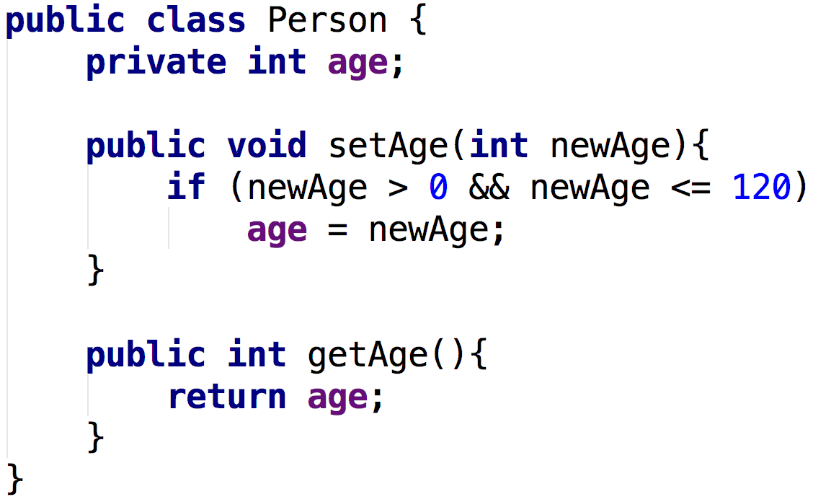
Class basics - Person class

Slide 5
BASIC CLASS STRUCTURE
public class Person { private int age; public void setAge(int newAge){ if(newAge > 0 && newAge <= 120) age = newAge; } public int getAge(){ return age; } }
[access modifier] class ClassName {
}
// instance variable(s)
1
// mutator/setter
methods
// accessor/getter
2
// other methods
5

Slide 6
Inside class
Outside of any methods
Declaration Syntax:
private datatype varName;
Instance variable
Method
6

Slide 7
VARIABLES
A keyword is any one of a number of reserved words, that have a predefined meaning in the Java language.
Variables are a way to store information in computers – named memory locations
An expression is a coding construct, that evaluates to a single value.

Slide 8
DATA TYPES
Primitive data types
Reference data types
Whole number | Real number (floating point or decimal)
byte short int long | float double
Single character | Boolean value
char | boolean

Slide 9
WRAPPER CLASSES
A wrapper class provides simple operations, as well as some basic information about the primitive data type, which cannot be stored on the primitive itself.
Primitive | Wrapper Class
byte | Byte
short | Short
char | Character
int | Integer
long | Long
float | Float
double | Double
boolean | Boolean

Slide 10
METHOD
A method declares executable code that can be invoked, passing a fixed number of values as arguments.
A method is a way of reducing code duplication

Slide 11
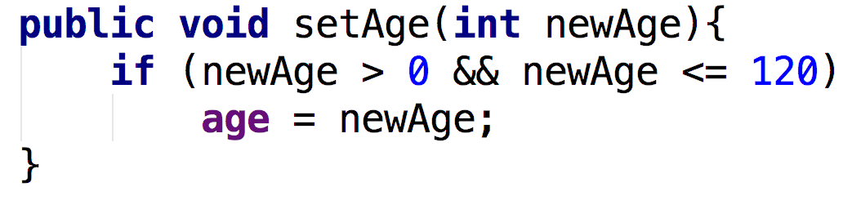
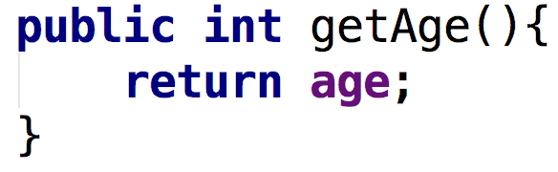
[modifier] returnType methodName([para list]){
// method body goes here
}
private int age;
Mutator/Setter
Accessor/Getter
Instance variable
Method
11

Slide 12
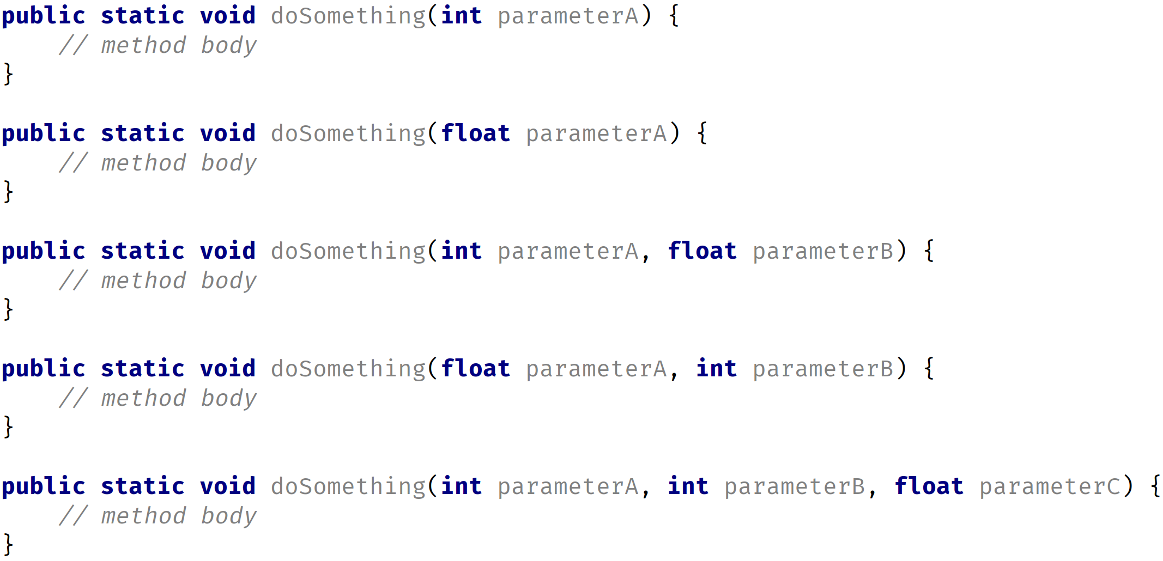
METHOD OVERLOADING
Same class, same method name, different set of parameters

Slide 13
CLASSES: BASIC CLASS STRUCTURE
Class header {
Instance variables (who uses these variables?)
Constructors (who uses these constructors?)
Accessors (who uses these accessors?)
Mutators (who uses these mutators?)
Other methods (who uses these other methods?)
}
– the class itself (private)
– outsiders (public)
– outsiders (public)
– outsiders (public)
– depends – can be used internally or externally (i.e. can be private or public)

Slide 14
CLASS AS A BLUEPRINT
Class
Instance members
Static members
Fields
Methods
Fields
Methods

Slide 15
CLASS AS A BLUEPRINT
The class describes the data (fields), and the behavior (methods), that are relevant to the real-world object we want to describe. These are called class members.
A class member can be a field, or a method, or some other type of dependent element.
If a field is static, there is only one copy in memory, and this value is associated with the class, or template, itself.
If a field is not static, it's called an instance field, and each object may have a different value stored for this field.
A static method can't be dependent on any one object's state, so it can't reference any instance members.
In other words, any method that operates on instance fields, needs to be non-static.
Sample code

Slide 16
PACKAGE
Classes can be organized into logical groupings, which are called packages.
You declare a package name in the class using the package statement.
If you don't declare a package, the class implicitly belongs to the default package.

Slide 17
ACCESS MODIFIERS: for CLASS
A class is said to be a top-level class, if it is defined in the source code file, and not enclosed in the code block of another class, type, or method.
A top-level class has only two valid access modifier options: public, or none.
Access keyword | Description
public | public means any other class in any package can access this class.
 | When the modifier is omitted, this has special meaning, called package access, meaning the class is accessible only to classes in the same package.

Slide 18
ACCESS MODIFIERS: for CLASS MEMBERS
Access keyword | Description
public | public means any other class in any package can access this class.
protected | protected allows classes in the same package, and any subclasses in other packages, to have access to the member.
 | When the modifier is omitted, this has special meaning, called package access, meaning the member is accessible only to classes in the same package
private | private means that no other class can access this member
Sample code

