Slide 1
SLOT 2 REVIEW

Slide 2
CONTENT
Class & Class Components
Variables & Methods
OOP Concepts: Abstraction, Encapsulation, Inheritance, Polymorphism
Collections
Regular expressions
Exception handling
Basic I/O

Slide 3
ABSTRACTION
Abstraction is one of the main ways that we deal with complexity. It is the idea of simplifying a concept in the problem domain.
Abstraction breaks a concept down into a simplified description that emphasizes the essentials needed for the concept, within some context.
DeliveryDriver
deliveryArea: DeliveryArea eyeColor: Color height: int
takeOrder()
You were asked to create a DeliveryDriver class. You thought about the problem, and reduced it to its most essential aspects… things like takeOrder, DeliveryArea, etc. Irrelevant things in the context (e.g., driver's height or eye colour) are ignored.

Slide 4
ABSTRACTION
Abstract Classes and Interfaces:
Abstraction is often achieved through abstract classes and interfaces in Java. Abstract classes can have abstract (unimplemented) methods, and interfaces can declare method signatures without providing implementations.
Defining Common Characteristics:
Abstract classes and interfaces define common characteristics and behaviors that subclasses or implementing classes must adhere to. This promotes code reuse and standardization.

Slide 5
abstract CLASS
The abstract class is declared with the abstract modifier.
Here we are declaring an abstract class called Animal.
An abstract class is a class that's incomplete.
We cannot create an instance of an abstract class.
An abstract class can still have a constructor, which will be called by its subclasses, during their construction.

Slide 6
abstract CLASS
The purpose of an abstract class is to define the behavior its subclasses are required to have, so it always participates in inheritance.
A class that extends an abstract class, can also be abstract itself.
An abstract class can extend a concrete class.

Slide 7
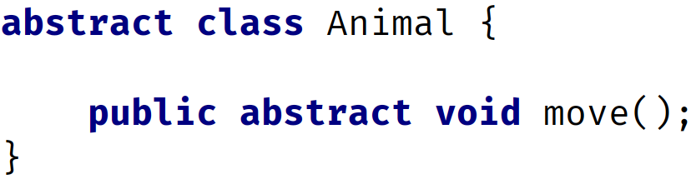
abstract METHOD
Abstract methods can only be declared on an abstract class or interface.
There is no concrete method for a subclass to inherit code from.
the subclass must provide a concrete method for any abstract method declared on its parent.
The subclass won't compile if it doesn't implement the abstract methods.

Slide 8
ENCAPSULATION
Encapsulation in OOP usually has two meanings.
One is the bundling of behavior and attributes on a single object.
The other is the practice of hiding fields, and some methods, from public access.
Access keyword | Description
public | public means any other class in any package can access this class.
protected | protected allows classes in the same package, and any subclasses in other packages, to have access to the member.
 | When the modifier is omitted, this has special meaning, called package access, meaning the member is accessible only to classes in the same package
private | private means that no other class can access this member

Slide 9
INHERITANCE
Animal
Vertebrates
Warm-blooded
Cold-blooded
Mammal
Bird
Fish
Reptiles
Dog
Cat
Goldfish
Salmon

Slide 10
INHERITANCE
Animal
type: String size: String weight: double
move(String speed) makeNoise()
Dog inherits from Animal.
Dog "is-a" type of Animal.
When a Dog object is created, it will inherit Animal's attributes (type, size and weight) & Animal's methods.
Dog class’ specific fields and behavior can also be specialised
Keywords: extends, super()
Method overriding
Dog
earShape: String tailShape: String
bark() run() walk() wagTail()

Slide 11
POLYMORPHISM
Polymorphism = many forms.
Method’s behavior that occurs, while the program is executing, depends on the runtime type of the object.
Movie
title: String
watchMovie()
Adventure
Comedy
Comedy
Sample code
Movie & its subclasses
Main.java

Slide 12
COLLECTIONS

Slide 13
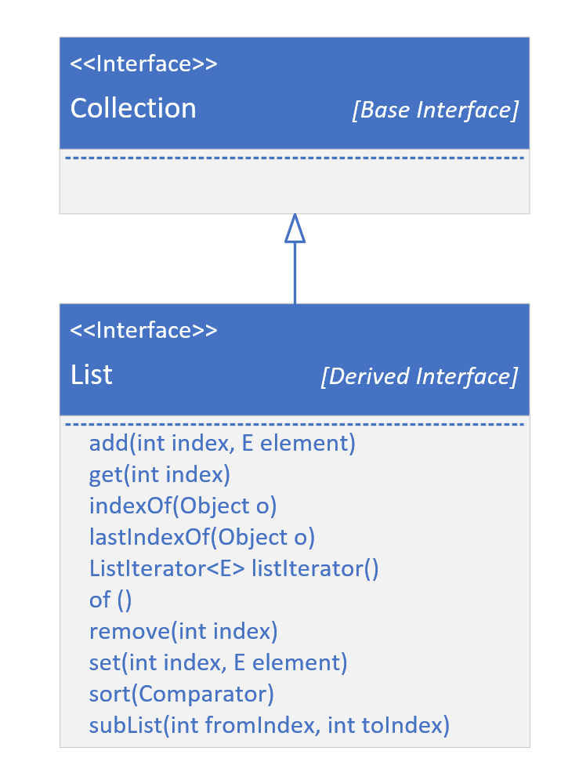
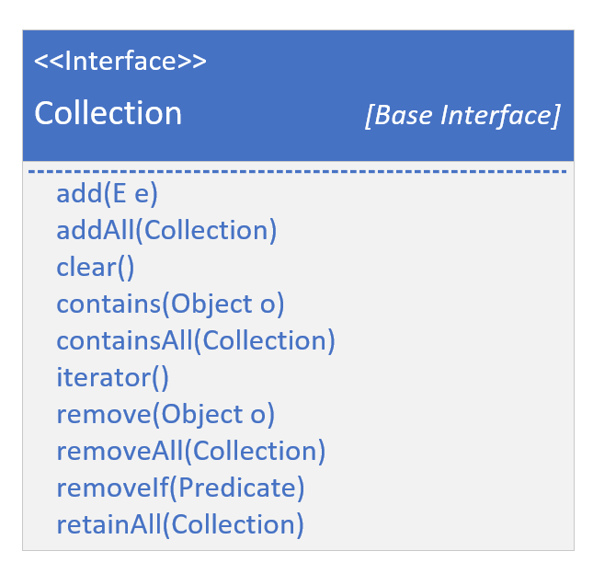
COLLECTIONS

Slide 14
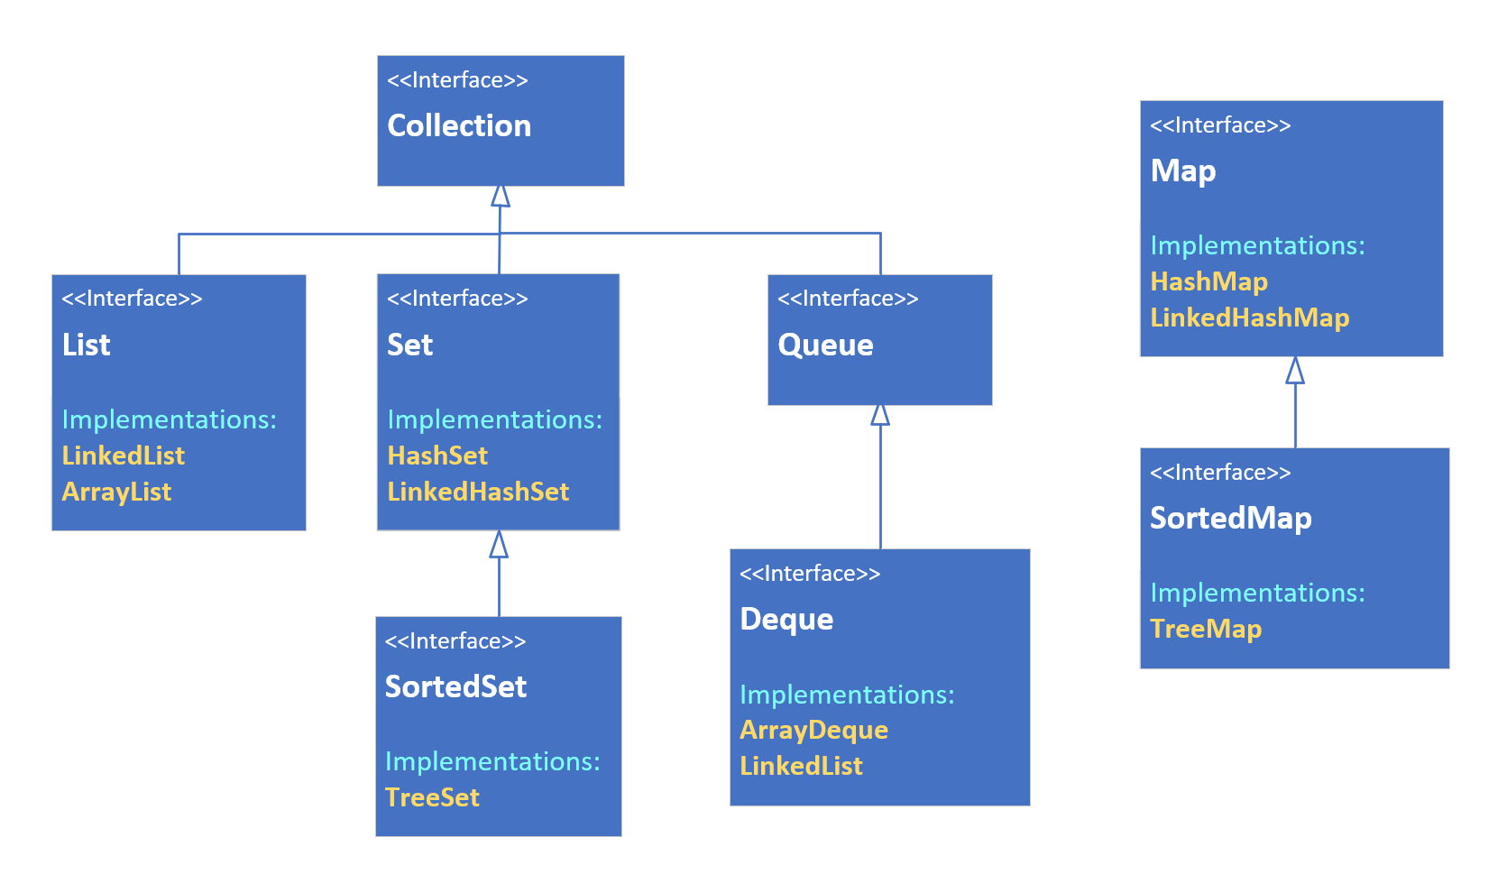
COLLECTIONS: a Big Picture

Slide 15
COLLECTIONS: some common classes
A List is An ordered collection (also known as a sequence).
These can be sequenced in memory like an ArrayList, or maintain links to the next and previous values, as a LinkedList.
A Set is a collection conceptually based off of a mathematical set.
Importantly, it contains no duplicate elements, and isn't naturally sequenced or ordered.
A Map is a collection that stores key and value pairs.
Keys need to be unique, but values don't.

