Slide 1
SLOT 3 REVIEW

Slide 2
CONTENT
Class & Class Components
Variables & Methods
OOP Concepts: Abstraction, Encapsulation, Inheritance, Polymorphism
Collections
Regular expressions
Exception handling
Basic I/O

Slide 3
REGULAR EXPRESSIONS

Slide 4
REGULAR EXPRESSIONS
A regular expression is simply text.
It may contain characters or character combinations that have special meaning.
These are called metacharacters.
These combinations are interpreted by a regular expression pattern processor.
Some common uses of regular expressions.
Verify something is formatted correctly.
Find occurrences of patterns in text.
Replace matching occurrences of patterns in text.
Extract matching occurrences from the text.
Split your text by a pattern.

Slide 5
REGULAR EXPRESSIONS in JAVA
There are classes with methods that take regular expression strings or patterns as parameters.
String, Scanner, Formatter, DateTimeFormatter, Duration.
String's methods which use regular expressions
Result | Method Name
boolean | matches(String regex)
String | replaceAll(String regex, String replacement)
String | replaceFirst(String regex, String replacement)
String[] | split(String regex)
String[] | split(String regex, int limit)

Slide 6
REGULAR EXPRESSION CONSTRUCTS
A regular expression can be made up of combinations of the following:
Literals – have no additional meaning & are a one-to-one match.
Character classes – some are predefined, others you can define.
Quantifiers – metacharacters which identify the number of occurrences of a character class or literal, required to make a match.
Boundary matchers, or anchors – specify the position in the text (e.g., at the start of the text or the end).
Groups – identify and allow for the capturing of subexpressions.

Slide 7
REGULAR EXPRESSION CONSTRUCTS
Some common metacharacters that fall into these categories You can find these examples and more by looking at Java's Pattern Class API
Type | Examples
Character Classes | . [abc] [a-g] [A-Z] [0-9] [^abc] \d \s \w
Quantifiers | * + ?
Boundary matchers (or anchors) | ^ $ \b
Groups | ()

Slide 8
QUANTIFIERS
Six different quantifiers regular expressions
Quantifier | Meaning | Pattern Example | Match Examples
* | pattern appears zero or more times | b* | empty string, b, bb, bbb
+ | pattern appears one or more times | b+ | b, bb, bbb
? | pattern appears zero or one time | colou?r | color, colour
{ n } | pattern must appear exactly n times | b{3} | bbb
{ n, } | pattern must appear at least n times | b{2,} | bb, bbb, bbbb
{ n, m } | pattern must appear at least n but not more than m times | b{3, 4} | bbb, bbbb

Slide 9
BOUNDARY MATCHERS
Three common boundary matchers or anchors.
Metacharacter | Meaning | Pattern Example | Match Notes
^ | matches to start of text | "^." | Matches first character in a string
$ | matches to end of text | ".$" | Matches last character in a string
\b | matches to word | "\\b" | Matches first word in a string.

Slide 10
EXAMPLE
public static void findAndDisplayResult(String type, Matcher matcher){ System.out.println("\n" + type); boolean found = false; while (matcher.find()) { System.out.printf("I found the text" + " \"%s\" starting at " + "index %d and ending at index %d.%n", matcher.group(), matcher.start(), matcher.end()); found = true; } if(!found){ System.out.println("No match found.%n"); } }
Pattern phonePattern =
Pattern.compile("\\([0-9]{3}\\) [0-9]{3}-[0-9]{4}");
String input = "ababab"; // Greedy quantifier Pattern greedyPattern = Pattern.compile(".*b"); Matcher greedyMatcher = greedyPattern.matcher(input); findAndDisplayResult("Greedy quantifier", greedyMatcher);
Notes:
https://regex101.com/

Slide 11
EXCEPTION HANDLING

Slide 12
TYPES OF EXCEPTION
Exceptions are unexpected events or errors that occur during the execution of a program. Two main types of exceptions in Java: checked exceptions and unchecked exceptions.
Checked Exceptions:
These are exceptions that are checked at compile time. They are subclasses of Exception but not subclasses of RuntimeException.
Examples: IOException, SQLException
Unchecked Exceptions:
These are exceptions that are not checked at compile time. They are subclasses of RuntimeException.
Examples: ArithmeticException, NullPointerException

Slide 13
CHECKED EXCEPTIONS
A Checked exception must be caught, or specified in the containing method's throws clause
Two options:
Wrap the statement that throws a checked exception, in a try-catch block, and then handle the situation in the catch block.
Or, alternately, you can change the method signature, declaring a throws clause, and specifying this exception type.

Slide 14
finally CLAUSE
A finally clause is used in conjunction with a try statement.
A traditional try statement requires either a catch or a finally clause, or can include both.
The finally clause is always declared after the catch block if one is declared.
The finally block's code is always executed, regardless of what happens in the try or catch blocks.
The finally block does not have access to either the try or catch block's local variables.

Slide 15
Sample code
CheckedExample.java
CheckedExample.java

Slide 16
FILE I/O

Slide 17
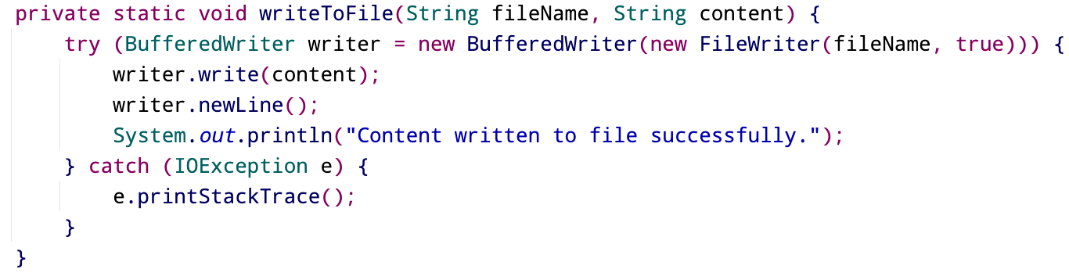
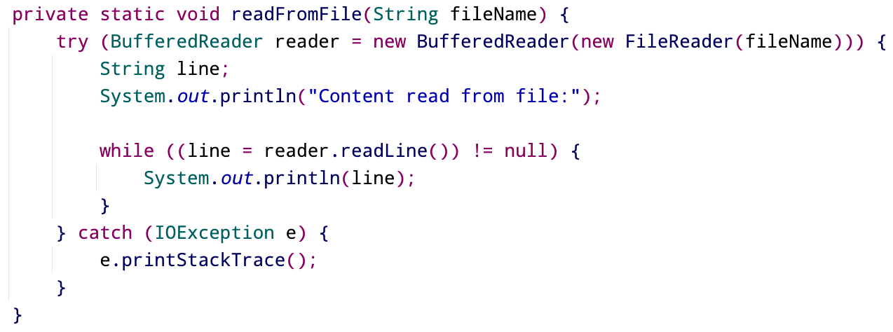
TEXT FILES

Slide 18
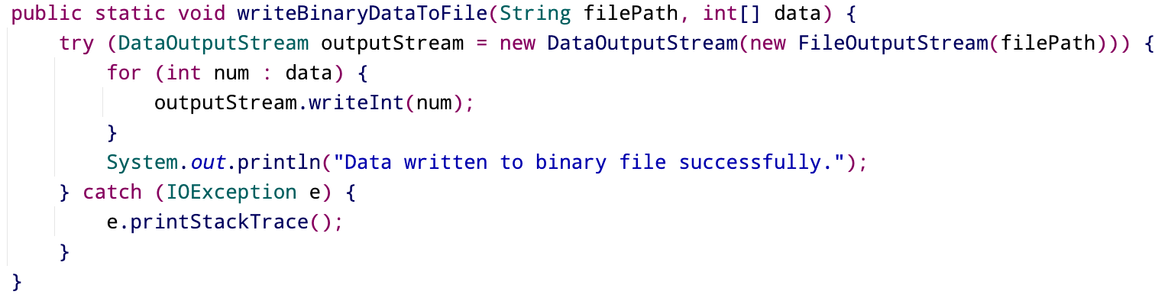
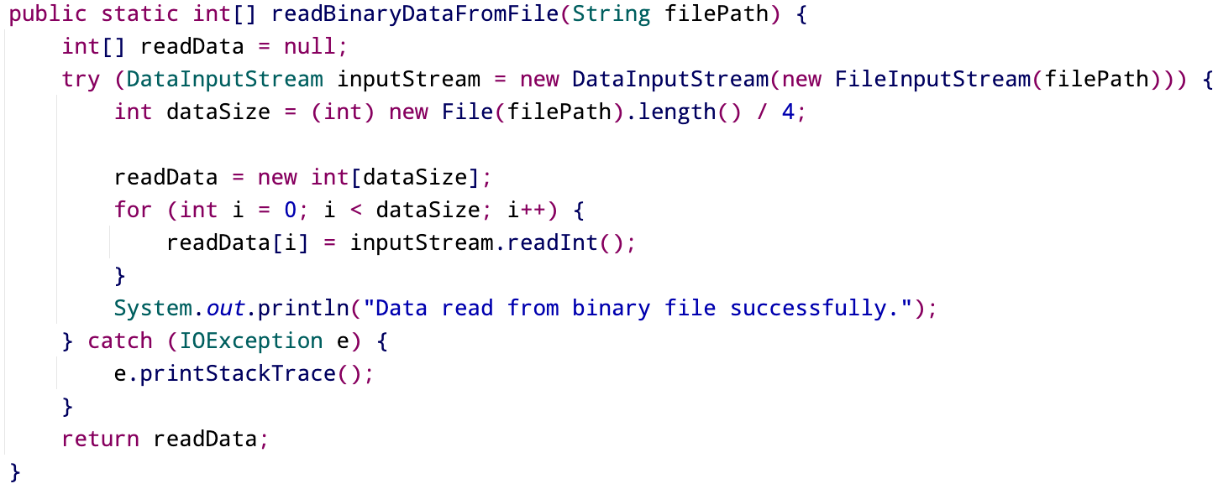
BINARY FILES

