Slide 1
Memory Game With Python Using Pygame
Trent Krogman

Slide 2
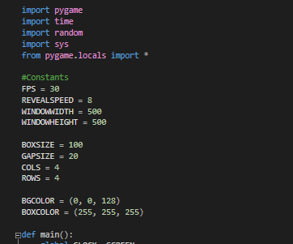
Imports and Constants
Start with importing needed modules
Keep constants in one place for ease of changing/reference
Much easier to remember a word than a number or set of numbers

Slide 3
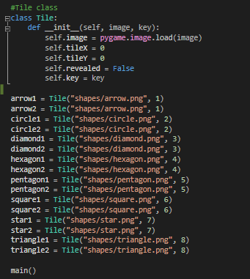
Tile class
5 properties
image- holds the image
tileX- holds the X axis tile coordinate
tileY- holds the y axis tile coordinate
revealed- holds the revealed status
key- used to check for match

Slide 4
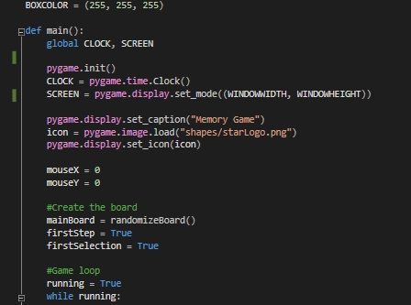
main() Function
Pygame has to be initialized with the init() function before anything from pygame can be used
Clock() creates the clock, set_mode() creates the screen, set_caption() sets the window name, and set_icon() sets the icon displayed on the window tab and title bar
mouseX and mouseY hold the latest mouse coordinates passed to them
randomizeBoard() returns a randomized list of tile objects

Slide 5
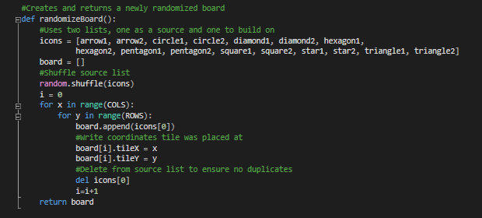
randomizeBoard() Function
Returns a randomized board
Uses two lists, one as the source and one to build on.
Starts by shuffling source list
Uses an external index to work with a 1 dimensional list and 2 dimensional coordinates
Delete from source list before looping to ensure each tile is only used once

Slide 6
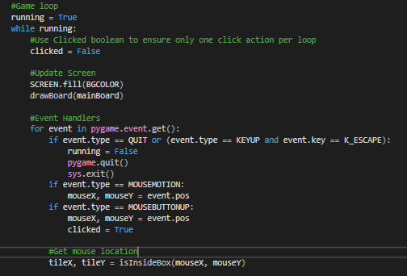
main() Function: Game Loop
Set clicked Boolean back to false
Update the screen using the drawBoard() function
Event handlers
This program uses a set of pseudo-coordinates referred to as tile coordinates, representing tiles position

Slide 7
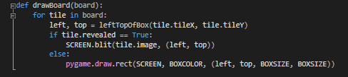
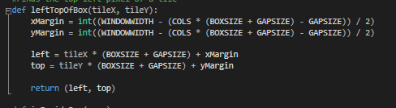
drawBoard() and leftTopOfBox() Functions
drawBoard() uses the leftTopOfBox() function to find the top and left pixel coordinates
Uses the tile’s revealed property to determine which side to draw
leftTopOfBox calculates how large the margins are, then finds the left and top pixel coordinate for whichever tile coordinate it was passed

Slide 8
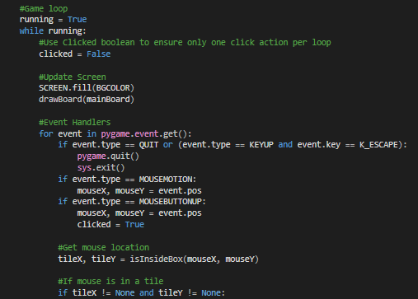
main() Function: Game loop cont…
tileX and tileY hold the tile coordinates returned by the isInsideBox() function
Passes the current pixel coordinates of the mouse

Slide 9
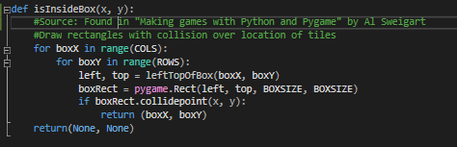
isInsideBox() Function
Found in “Making games with Python and Pygame” by Al Sweigart
isInsideBox() creates rectangles with collision over top of where the tiles are located.
Uses leftTopOfBox()
Returns ([0-3], [0-3]) if inside a box, and (None, None) if not

Slide 10
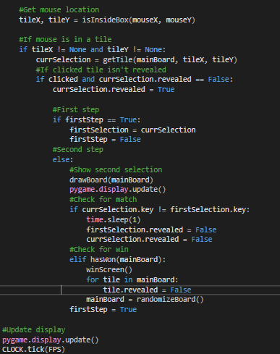
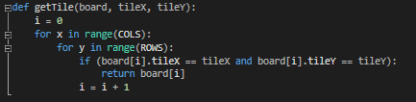
Decision Logic
If tileX and tileY are both not None then mark down current selection with getTile() function.
getTile() is passed board, tileX, and tileY
getTile() searches through the board until it finds which tile’s tileX and tileY properties match the tileX and tileY that were passed

Slide 11
Decision Logic cont…
If current selection isn’t revealed, then reveal it, then check which step we are on.
If firstStep is True:
Save the current selection
Set firstStep to False
If firstStep is False:
Update the board
Check for a mismatch
If mismatched change both tiles’ revealed property back to false
If match, check for win
If win, call winScreen() function, reset all revealed properties back to false and shuffle board
Set firstStep back to True
End of game loop, refresh screen

Slide 12
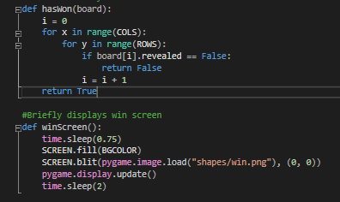
hasWon() and winScreen() functions
hasWon() searches the board for any tiles with a revealed property of false before returning true
winScreen pauses for a second to let you see the completed board, then briefly shows a congratulations message

Slide 13
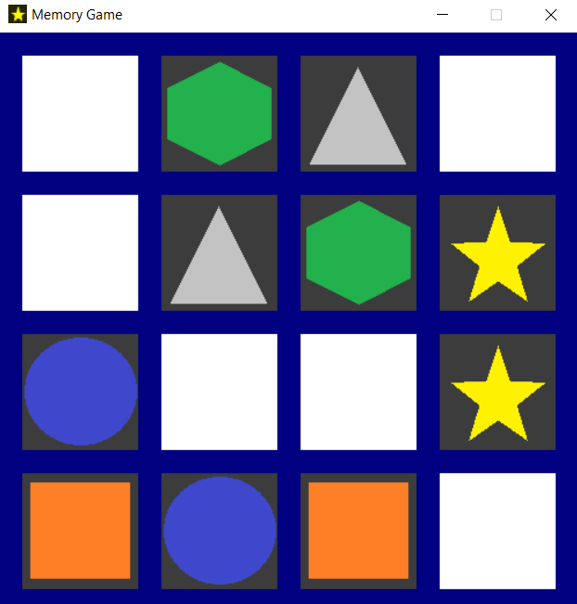
End

