Slide 1
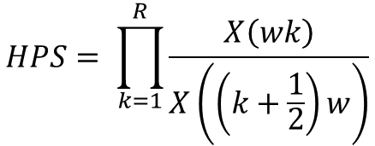








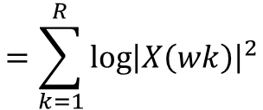




Window
$$↓1$$
$$↓2$$
Signal
X
Harmonic Product Spectrum (HPS)
$${\left|FFT\right|}^{2}$$
$$↓3$$
X
$$⋮$$
$$HPS= \prod_{k=1}^{R}{\frac{X\left(wk\right)}{X\left(\left(k+\frac{1}{2}\right)w\right)}}$$
$$↓R$$
Window
Harmonic Product Spectrum as the antilogarithm of the sum of harmonically compressed log spectra?
$$↓1$$
$$↓2$$
Signal
X
Log(${\left|FFT\right|}^{2})$
$$↓3$$
+
$$⋮$$
$$=\sum_{k=1}^{R}{{\log\left|X\left(wk\right)\right|}^{2}}$$
$$↓R$$
https://surveillance9.sciencesconf.org/data/151173.pdf

Slide 2
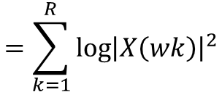








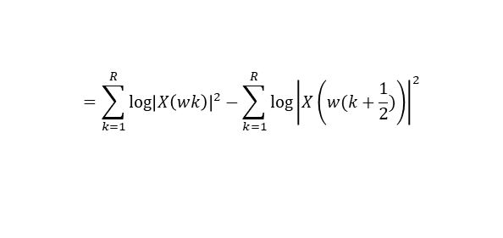



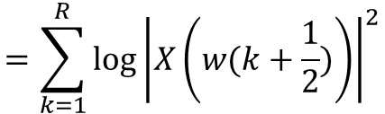
Window
$$=\sum_{k=1}^{R}{{\log\left|X\left(wk\right)\right|}^{2}}$$
$$↓1$$
$$↓2$$
Signal
X
Log(${\left|FFT\right|}^{2})$
$$↓3$$
+
$$⋮$$
$$↓R$$
$$=\sum_{k=1}^{R}{{\log\left|X\left(wk\right)\right|}^{2}}−\sum_{k=1}^{R}{{\log\left|X\left(w(k+\frac{1}{2})\right)\right|}^{2}}$$
+
-
$$↓1.5$$
$$↓2.5$$
$↓3$.5
+
$$⋮$$
$$=\sum_{k=1}^{R}{{\log\left|X\left(w(k+\frac{1}{2})\right)\right|}^{2}}$$
$↓R$+0.5

