Slide 1
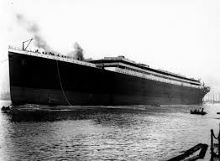
Titanic Challenge on Kaggle
Predicting Who will survive?
Teo Jun Yean
U1430978J
CE9010 Project

Slide 2

Step 1: Project Goal
Goal: Predict who will survive based on 12 features including:
Gender
Age
Name
Fare
Etc …

Slide 3


Step 2: Data Acquisition
Goal: Retrieve Data from Kaggle Website
Based on instructions from Kaggle API…

Slide 4
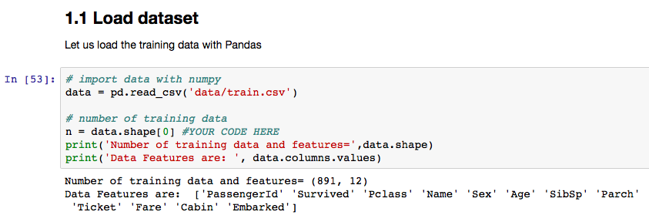
Step 2: Data Acquisition
Goal: Retrieve Data from Kaggle Website

Slide 5
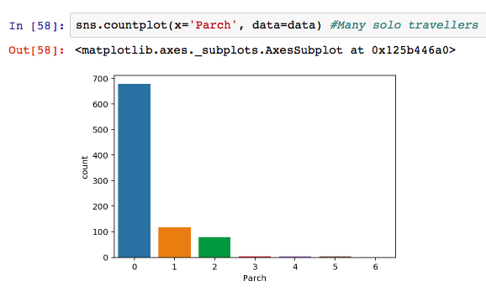
Step 3: Data Exploration with Seaborn
Goal: Visualise our Dataset: Parch

Slide 6
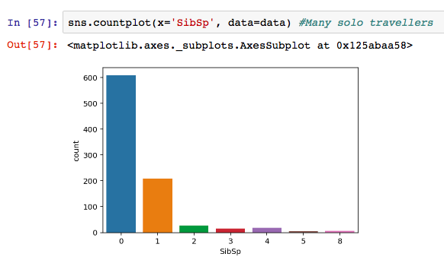
Step 3: Data Exploration with Seaborn
Goal: Visualise our Dataset: SibSp

Slide 7
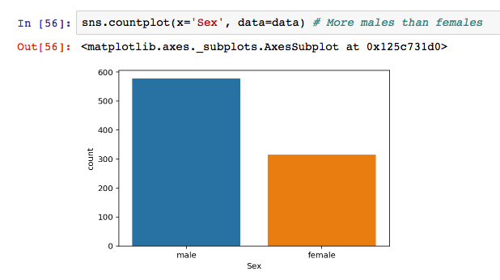
Step 3: Data Exploration with Seaborn
Goal: Visualise our Dataset: Gender

Slide 8
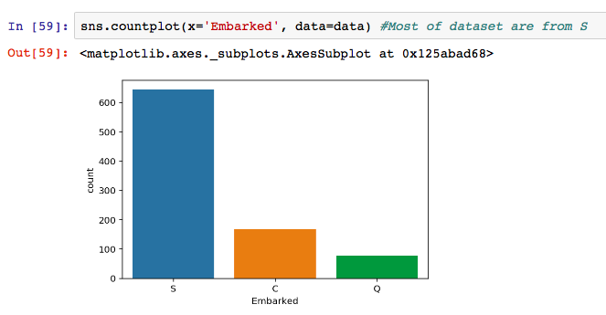
Step 3: Data Exploration with Seaborn
Goal: Visualise our Dataset: Embarked
Notes:
Clearly, some features are skewed.

Slide 9
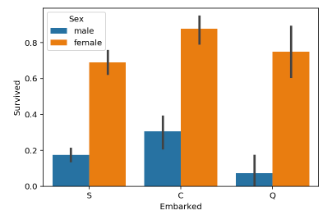
Step 3: Data Exploration with Seaborn
Goal: Visualise our Dataset: X-Y relationships

Slide 10
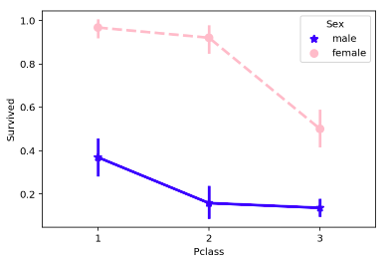
Step 3: Data Exploration with Seaborn
Goal: Visualise our Dataset: X-Y relationships

Slide 11
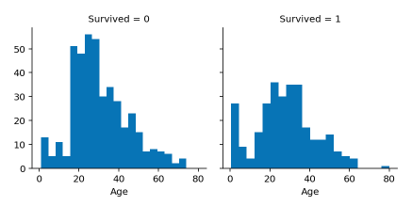
Step 3: Data Exploration with Seaborn
Goal: Visualise our Dataset: X-Y relationships

Slide 12
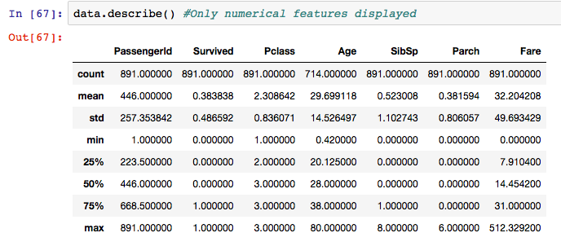
Step 3: Data Exploration with Seaborn
Goal: Visualise our Dataset: Statistics
Notes:
Missing values, large variance

Slide 13
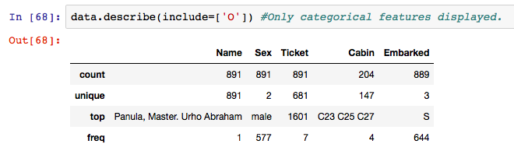
Step 3: Data Exploration with Seaborn
Goal: Visualise our Dataset: Statistics
Notes:
Too many unique values for categorical features, missing values for Cabin

Slide 14
Step 4: Data Pre-processing
Goal: 1) Complete missing values
Fill in Missing Age values with a random number within 1 std dev of the mean of combined dataset
Fill in Missing Cabin values (only 3) with the most frequent occurrence
** No more NULL Values

Slide 15
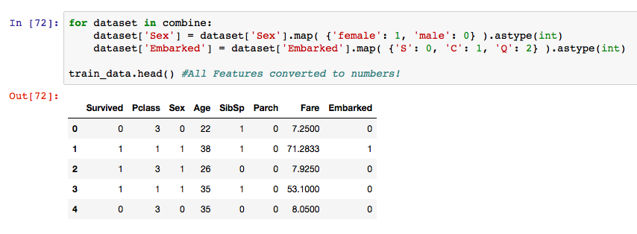
Step 4: Data Pre-processing
Goal: 2) Convert variables to numbers
Notes:
Instead of one-hot, I did as Ordinal variables.

Slide 16
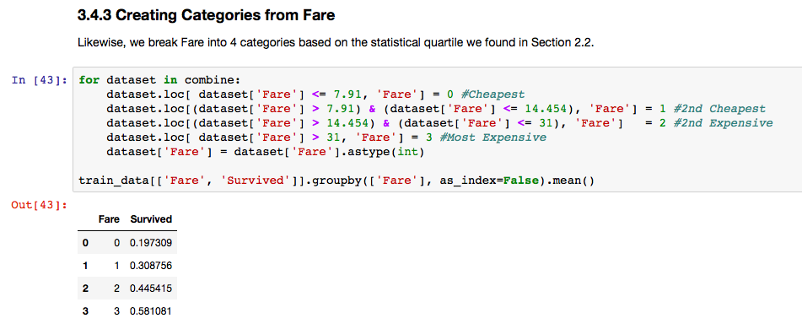
Step 4: Data Pre-processing
Goal: 3) Create New Features e.g. Fare
Notes:
Also Family Size, Age

Slide 17
Step 4: Data Pre-processing
Goal: 4) Drop complex features that may overfit
Notes:
Also Family Size, Age

Slide 18
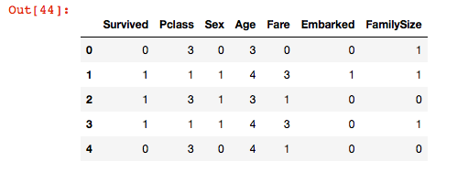
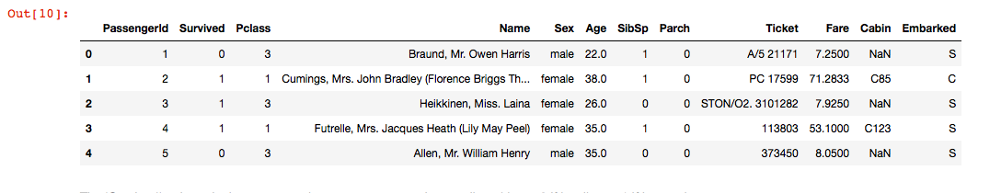
Step 4: Data Pre-processing
After: Neat data-set
Before: Messy data-set
Notes:
12 -> 6 Features.

Slide 19
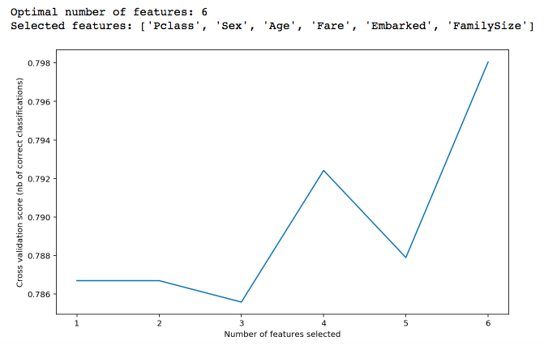
Step 4: Data Pre-processing
After: Optimal number of features using RFE
Notes:
12 -> 6 Features.

Slide 20
Step 5: Algorithms
3 Models Investigated:
- Logistic Regression
- Random Forest
- Neural Network
Notes:
Classification question: use classification algorithms

Slide 21
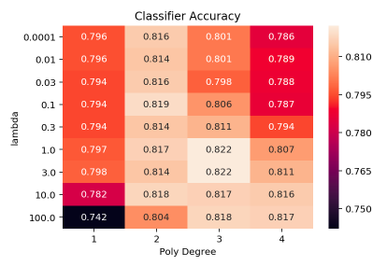
Step 5: Algorithms
Model 1: Logistic Regression
First, I do a k-fold CV to optimise the sklearn algorithm
Notes:
Problem: every k-fold gives a different optimised hyper parameter. I took the average of 5 tries. However, I had trouble with selecting the optimal range of hyperparameters for the k-fold to choose from.

Slide 22
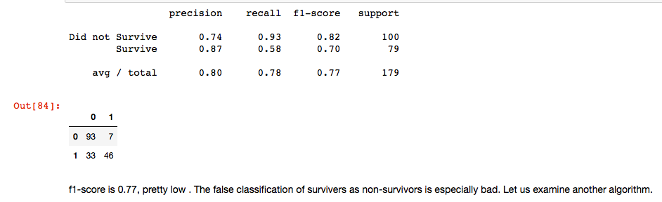
Step 5: Algorithms
Model 1: Logistic Regression
Using the tuned hyper-parameters, I fit the model with all the data and submitted it.
Notes:
Problem, every k-fold gives a different optimised hyper parameter. I took the average of 5 tries. Problem: Too many false negatives.

Slide 23
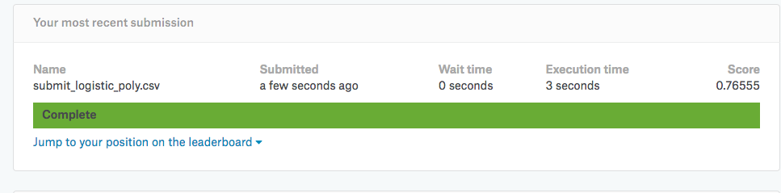
Step 5: Algorithms
Model 1: Logistic Regression
Kaggle Results:
Notes:
Problem, every k-fold gives a different optimised hyper parameter. I took the average of 5 tries. Problem: Too many false negatives.

Slide 24
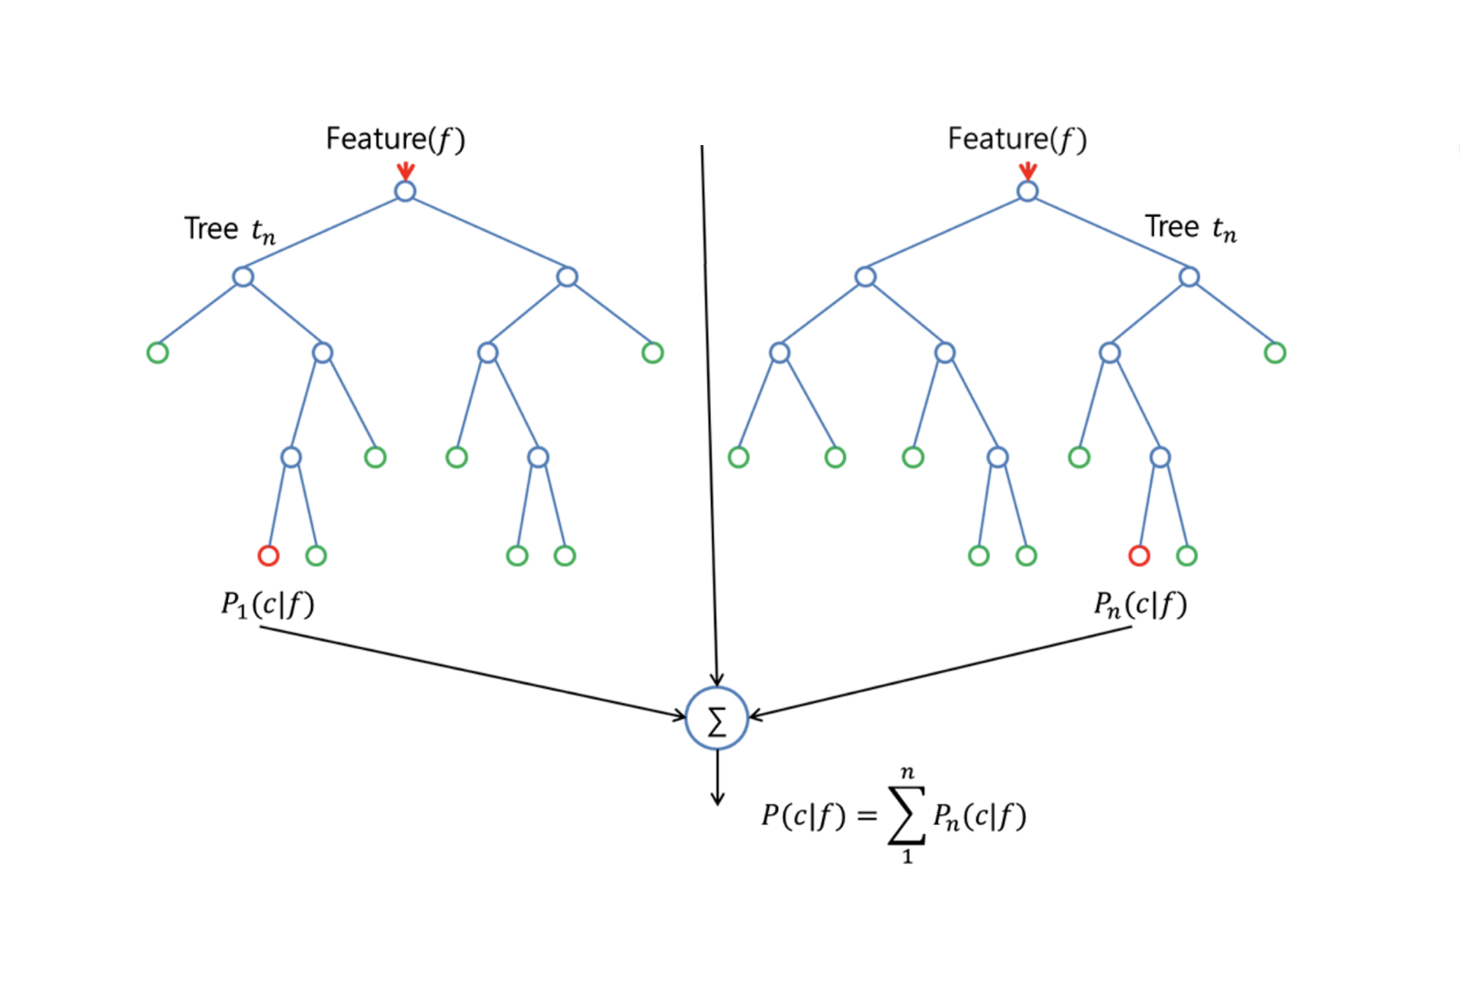
Step 5: Algorithms
Model 2: Random Forest
Based on online opinions, I tried a Random Forest Model
Notes:
Problem, every k-fold gives a different optimised hyper parameter. I took the average of 5 tries. Problem: Too many false negatives. I already did all the steps. Perhaps we need a better model.

Slide 25
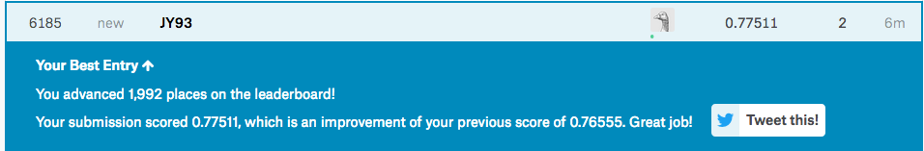
Step 5: Algorithms
Model 2: Random Forest
Using an unoptimised model from sklearn, this is how I scored:

Slide 26
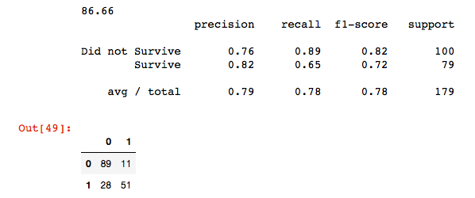
Step 5: Algorithms
Model 2: Random Forest
Using an unoptimised model from sklearn, this is how I scored:

Slide 27
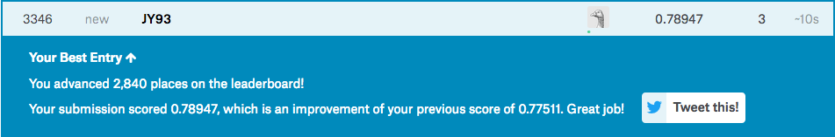
Step 5: Algorithms
Model 2: Random Forest
Doing an optimised Random Forest Model now, this is how I scored:
Notes:
Problem, every k-fold run gives a different optimised hyper parameter. I also tried a NN, but probably because the dataset was small, or I did not find the optimal combination of layers, it did not perform as well as a Random Forest.

Slide 28
Step 6: Analysis
What could be better:
1) Feature Engineering **
I didn’t explore enough, understand the context of these features better, dropped features too hastily.
2) Algorithms
Having a better feel for what is the optimal range of hyper parameters for each algorithm
Notes:
In hindsight, based on the RFE, I should create as many features as possible, then select the optimal ones based on the RFE. Based on the confusion matrix, both Log Reg and Random Forests have similar F1 scores. Perhaps the problem is with Feature Engineering instead of Algorithms

