Slide 1
數位系統實驗
陳培殷老師
國立成功大學 資訊工程系

Slide 2
LAB - 02
陳培殷老師
國立成功大學 資訊工程系

Slide 3
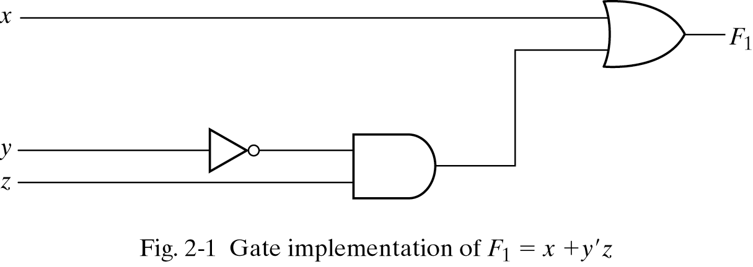
Three representations for a circuit
1. Boolean Algebra
2. Truth Table
真值表
n input variables ➔ 2^{n} combinations
F₁=x+y’z
Inputs
3. Circuit Diagram

Slide 4
Equipment
Names | Amount
Solerless Breadboard | ×1
74LS00 | ×1
74LS04 | ×1
74LS08 | ×1
74LS32 | ×1

Slide 5
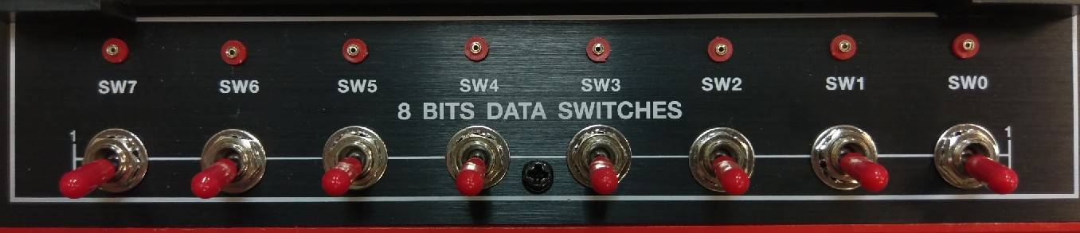
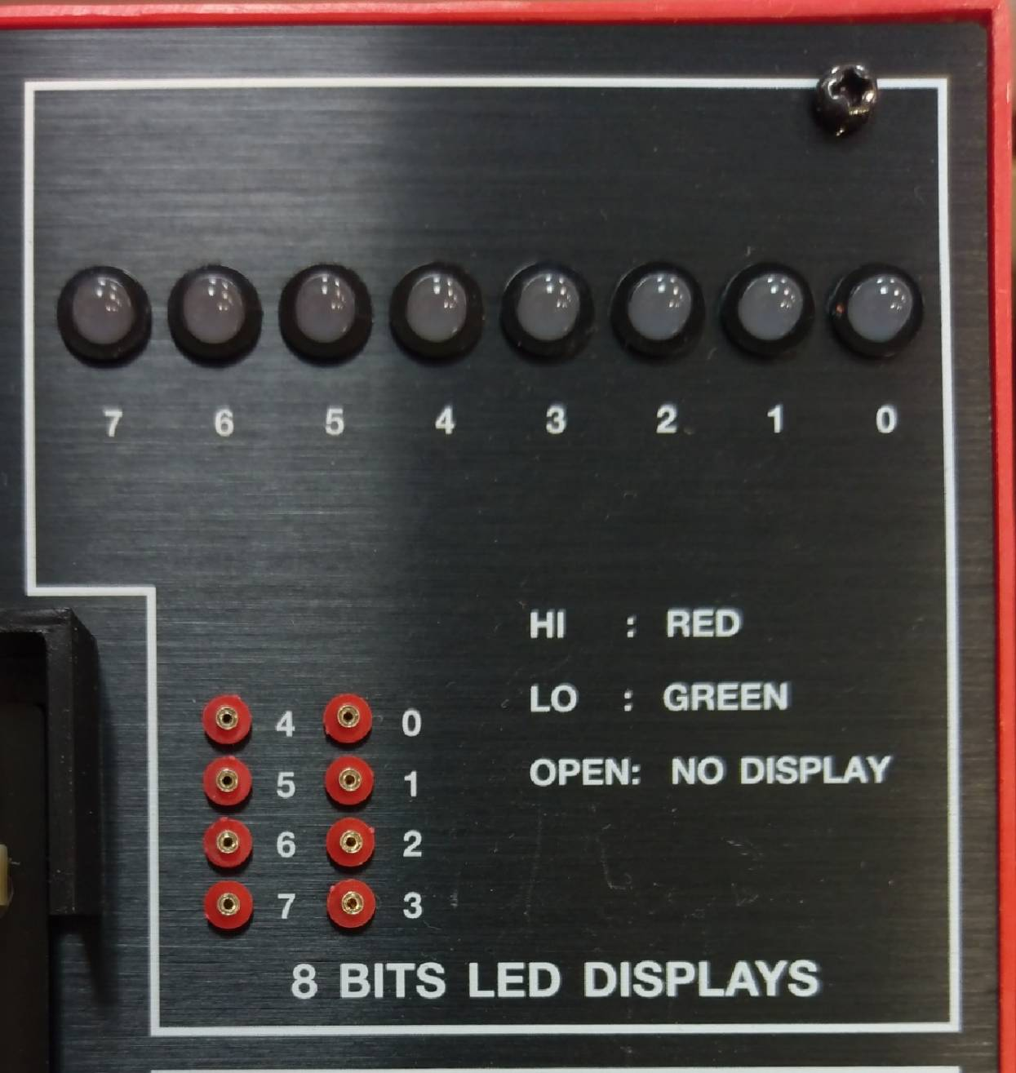
Lab notice
Input
Output

Slide 6
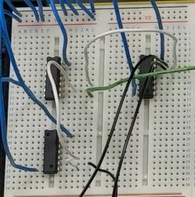
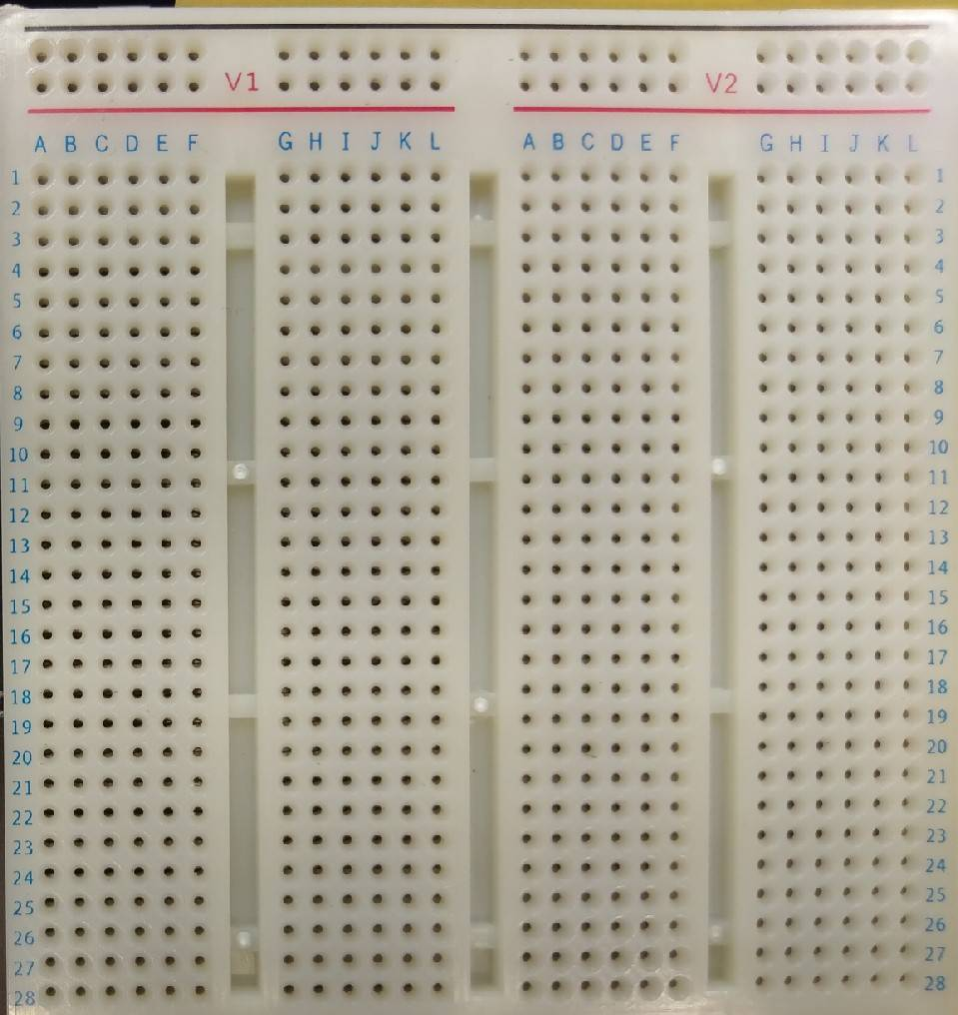
Lab notice
Correct
VCC：
GND：

Slide 7
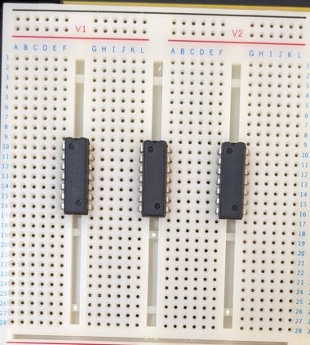
Lab notice
Wrong
Overlap

Slide 8
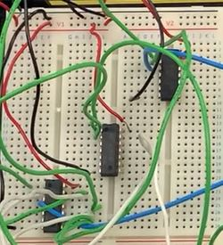
Lab notice
Correct
VCC：
GND：

Slide 9
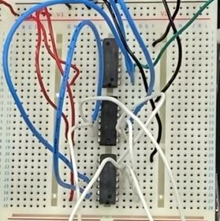
Lab notice
Correct
VCC：
GND：

Slide 10
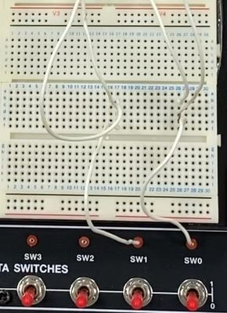
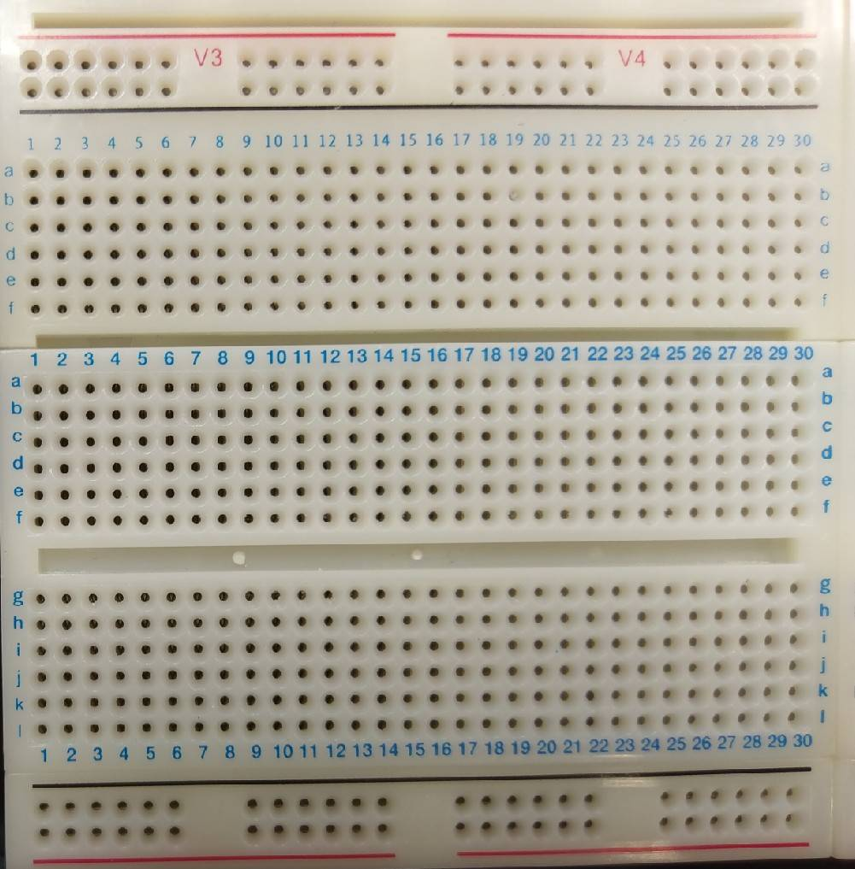
Lab notice
A
B
A
B

Slide 11
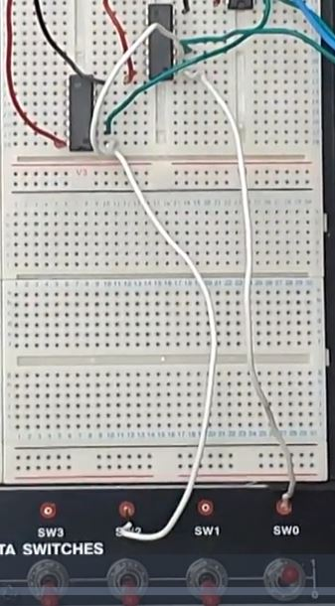
Lab notice
A
A
B

Slide 12
Lab 02_1
Please draw their Truth Tables and implement the circuits with breadboard.
F₁(A, B) = (A + B)’(A’ + B’)
F₂(A, B) = A’+ AB
A | B | F₁
0 | 0 | 1
0 | 1 | 0
1 | 0 | 0
1 | 1 | 0
A | B | F₂
0 | 0 | 1
0 | 1 | 1
1 | 0 | 0
1 | 1 | 1
Notes:
錯誤：此時不需化簡(已修正)

Slide 13
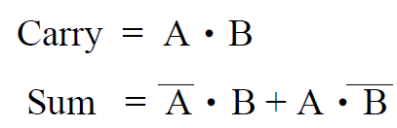
Lab 02_2 - Half Adder (1/2)
A half adder (HA) consists of two inputs (A and B) and two outputs (Sum and Carry). “A” denotes the summand and “B” is the addend. Sum and Carry mean the output sum and carry for input “A” and “B”. The truth table and Boolean algebra for the half adder are as follows.
A | B | Sum | Carry
0 | 0 | 0 | 0
0 | 1 | 1 | 0
1 | 0 | 1 | 0
1 | 1 | 0 | 1
F(A, B) = A’B’ + A’B + AB’ + AB

Slide 14
Lab 02_2 - Half Adder (2/2)
Please
(a) draw the circuit diagram of the half adder according
to the truth table shown in previous page.
(b) implement the circuit on the breadboard.

Slide 15
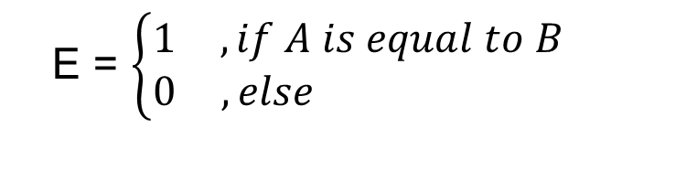
Lab 02_3 – Comparator(1/2)
There are two inputs denoted as A and B. Both A and B are 1-bit value. A comparator is designed to determine whether A is equal to B or not. The output results are represented with E .
The function and truth table of the comparator is described as follows.
E = $\left\{\begin{matrix}1 & , if A is equal to B \\ 0 & ,else \end{matrix}\right.$

Slide 16
Lab 02_3 – Comparator(2/2)
Please
(a) draw the truth table of the comparator.
(b) draw the circuit diagram of the comparator.
(c) implement the circuit on the breadboard.
A | B | F
0 | 0 | 1
0 | 1 | 0
1 | 0 | 0
1 | 1 | 1
F(A, B) = (A’B’) + (AB)
F(A, B) = A’B’ + A’B + AB’ + AB

