Slide 1
數位系統實驗
陳培殷老師
國立成功大學 資訊工程系

Slide 2
LAB - 03
陳培殷老師
國立成功大學 資訊工程系

Slide 3
Lab I -- Constant Multiplier (1/3)
MSB
There is a 2-bit input X (represented as X1 and X0). A constant multiplier is designed to multiply the input by 3. Finally, show the result with decimal format (0, 1, 2, …..,9) on Digital Display in the breadboard.
Hint-1:
The output digital number is 0, 3, 6 or 9, respectively, for four different inputs (0, 1, 2, 3).

Slide 4
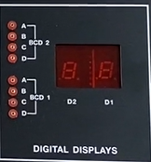
Lab I -- Constant Multiplier (2/3)
Hint-2:
Function of the Digital Display in the breadboard is as follows.
D | C | B | A | DIGITAL DISPLAY
0 | 0 | 0 | 0 | 0
0 | 0 | 0 | 1 | 1
0 | 0 | 1 | 0 | 2
0 | 0 | 1 | 1 | 3
0 | 1 | 0 | 0 | 4
0 | 1 | 0 | 1 | 5
0 | 1 | 1 | 0 | 6
0 | 1 | 1 | 1 | 7
1 | 0 | 0 | 0 | 8
1 | 0 | 0 | 1 | 9

Slide 5
Lab I -- Constant Multiplier (3/3)
Please
(a) draw the truth table of the constant multiplier where two input bits are X1 and X0, and four output bits are A, B, C and D, respectively.
(b) simplify the circuit with K-map (SOP format) and draw the simplified circuit diagram of the constant multiplier.
(c) implement the circuit on the breadboard.

Slide 6
Components needed for LAB I
Names | Amount
Solerless Breadboard | ×1
74LS04 | ×1
74LS08 | ×1
74LS32 | ×1

Slide 7

Lab II – Comparator(1/2)
LSB
There are a 3-bit input X (represented as X2, X1 and X0) and two 1-bit outputs A and B. The comparator is designed to let output A be 1 if X>3 and output B be 1 if X>4.
The function of the comparator is described as follows.
MSB
A = $\left\{\begin{matrix}1 & , if X is greater than 3 \\ 0 & ,else \end{matrix}\right.$
B = $\left\{\begin{matrix}1 & , if X is greater than 4 \\ 0 & ,else \end{matrix}\right.$

Slide 8
Lab II – Comparator(2/2)
Please
(a) draw the truth table of the comparator where three input bits are X2, X1 and X0, and two output bits are A and B, respectively.
(b) simplify the circuit with K-map and draw the simplified SOP-format circuit diagram of the constant multiplier. Finally, implement the circuit on the breadboard.
(c) repeat (b) by using the POS format.

Slide 9
Components needed for LAB II
Names | Amount
Solerless Breadboard | ×1
74LS08 | ×1
74LS32 | ×1

Slide 10
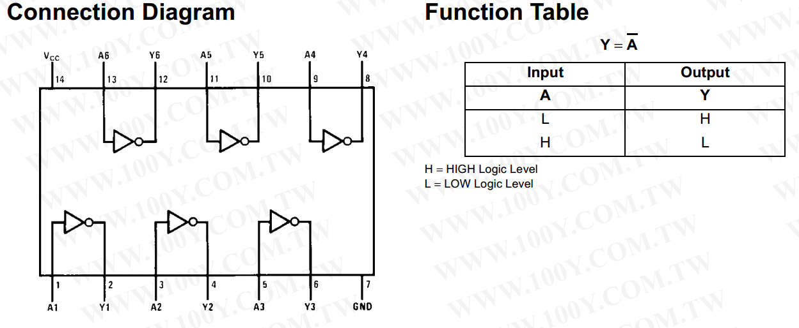
74LS04

Slide 11
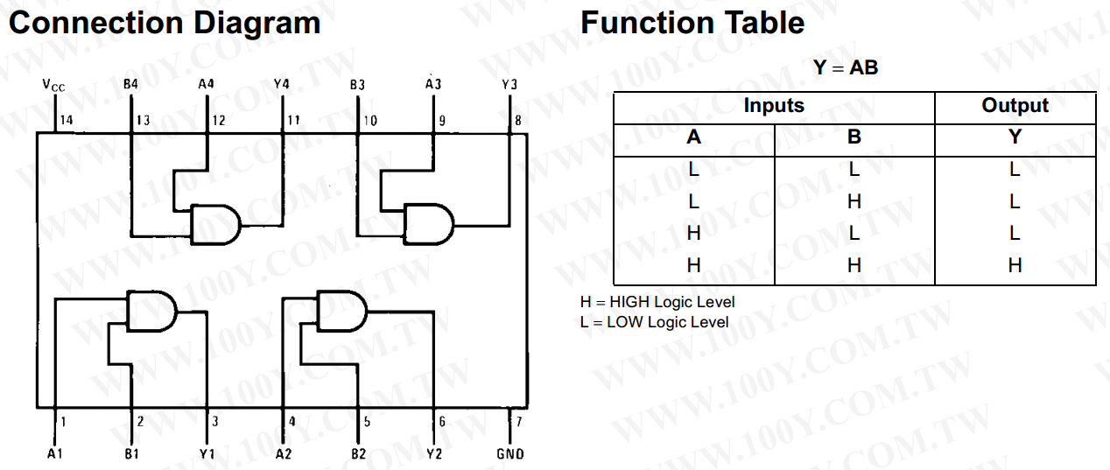
74LS08
Notes:
1.上排的VCC並不是整排連在一起
2.實驗三的A、B只要接右上角的output

Slide 12
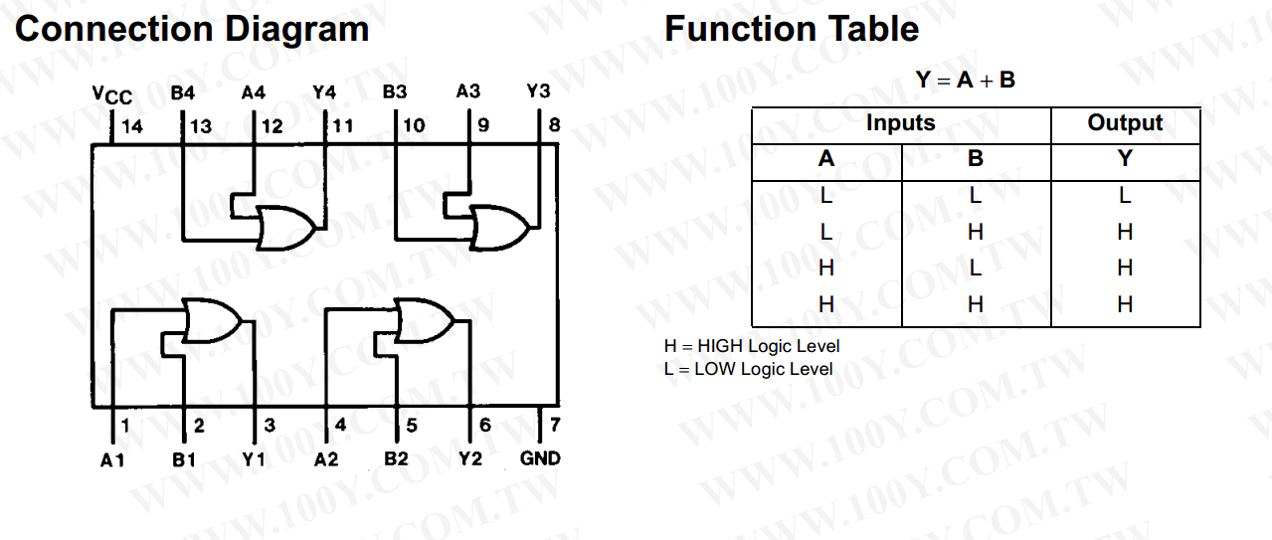
74LS32

