Slide 1


Kammavari Sangham (R) 1952
K.S. GROUP OF INSTITUTIONS
K.S. SCHOOL OF ENGINEERING AND MANAGEMENT
Approved by AICTE, New Delhi, Affiliated to VTU, Belagavi, Karnataka; Accredited by NAAC
www.kssem.edu.in
DEPARTMENT OF ARTIFICIAL INTELLIGENCE & DATA SCIENCE
PARTNERING WITH CSE, CS&BS AND ECE
IN ASSOCIATION WITH MEVI TECHNOLOGIES
HACKATHON-24
THE FINAL PRESENTATION

Slide 2
HACKATHON G-13 TEAM HASH#
Harishree S
R Alekhya
Harshitha
Vijaya Nikilesh Y M

Slide 3
Problem statement:
EdTech
AI-Driven Adaptive Learning: Create a platform that personalizes learning materials based on a student’s progress and performance.

Slide 4
Overview of solution
Traditional education has a tendency to neglect the needs of most students. Every learner has different strengths, weaknesses, and learning styles. Therefore, many disengage in standardized curricula and suffer in their outcomes. The desire is to create personalized learning environments that adapt to individualized needs for better engagement and effectiveness.
Proposed solution: To create a platform which tracks the user progress on the domains the user has chosen ,by answering the questions presented by the platform which will determine the level of knowledge they have on the subject.
By this we determine the progress score and recommend the books or courses on online platforms that the student has to read or enroll into.

Slide 5
Key features
User Authentication:
Login: Users can log in using their username and password.
Sign Up: New users can create an account by providing their full name, username, and password.
Course Selection:
After logging in or signing up, users can select a course from a dropdown menu. The available courses include: Data Science, Machine Learning , AI Fundamentals etc
Quiz Functionality: Users can take a quiz related to the selected course.
The quiz consists of multiple-choice questions, and users can select answers using radio buttons.

Slide 6
Score Calculation:
After submitting the quiz, the application calculates the user's score based on the number of correct answers.
The score is displayed along with a pie chart that visualizes the number of correct and incorrect answers.
Quiz Performance Dashboard:
Users can view their quiz performance dashboard, which includes:
Total quizzes taken.
Total correct answers out of all questions answered.
A bar chart visualizing the user's performance (total correct answers vs. total questions).
A list of correct answers for the quiz taken.
Responsive Design:
The application is designed to be responsive, adapting to different screen sizes using CSS flexbox.
Chart Visualization:
The application uses Chart.js to create visual representations of quiz results and performance metrics.

Slide 7
FUNCTIONALITIES
Form Handling:
The application handles form submissions for both login and signup, preventing default behavior and managing the display of different sections based on user actions.
Dynamic Content Rendering:
The quiz questions are dynamically generated based on a predefined set of questions stored in an array. This allows for easy updates and modifications to the quiz content.
Score Tracking:
The application maintains a history of quiz performances in an array (quizHistory), allowing users to track their progress over time.
User Interaction:
The application provides a user-friendly interface with clear navigation between different sections (login, signup, course selection, quiz, results, and dashboard).

Slide 8
Data Display:
After completing the quiz, users can view their score, a pie chart of their performance, and a detailed performance dashboard that summarizes their quiz history.
Restart Functionality:
Users can restart the course selection process after viewing their quiz results or performance dashboard, allowing for repeated practice.

Slide 9
DEVELOPMENT PROCESS
Tools and Technologies
HTML (Hyper Text Markup Language):
Used for structuring the content of the web application, including forms, containers, and elements for user interaction.
CSS (Cascading Style Sheets):
Employed for styling the application, providing a clean and modern user interface. It includes layout management, colors, fonts, and responsive design using flexbox.
JavaScript:
The primary programming language used for implementing the interactive features of the application. It handles user input, form submissions, dynamic content rendering, and quiz logic.
Chart.js:
A JavaScript library used for creating visual representations of data, such as pie charts and bar charts. It is utilized to display quiz results and performance metrics.
Backend :
For the backend we have used PHP to connect the database and the frontend code. MySQL for the database storage.

Slide 10
APPROACH
Client-Side Rendering:
The application primarily operates on the client side, meaning that all the logic for displaying content and handling user interactions is executed in the user's browser. This approach allows for a more responsive user experience.
Dynamic Content Generation:
The quiz questions and options are generated dynamically from a JavaScript array, allowing for easy updates and modifications without changing the HTML structure.
Event-Driven Programming:
The application uses event listeners to respond to user actions, such as form submissions and button clicks. This approach enhances interactivity and user engagement.
Single Page Application (SPA) Concept:
The application mimics a single-page application by dynamically showing and hiding different sections (login, signup, course selection, quiz, results, and dashboard) without reloading the page.
Data Visualization:
The use of Chart.js for visualizing quiz performance data provides users with an intuitive understanding of their results, enhancing the learning experience.

Slide 11
PROTOTYPE LINK :
https://www.figma.com/proto/y47x1wRGCBETvTJps2bk88/hackathon?node-id=19-16&node-type=canvas&t=ETX5EQPbQOQdwBBG-1&scaling=min-zoom&content-scaling=fixed&page-id=0%3A1&starting-point-node-id=1%3A2

Slide 12
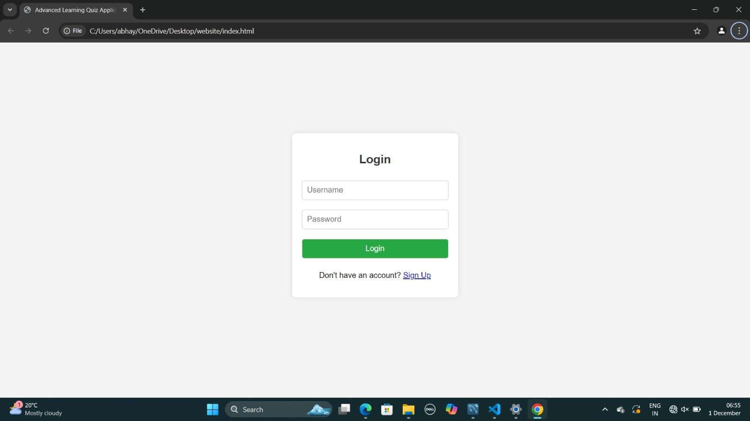
DEMO

Slide 13
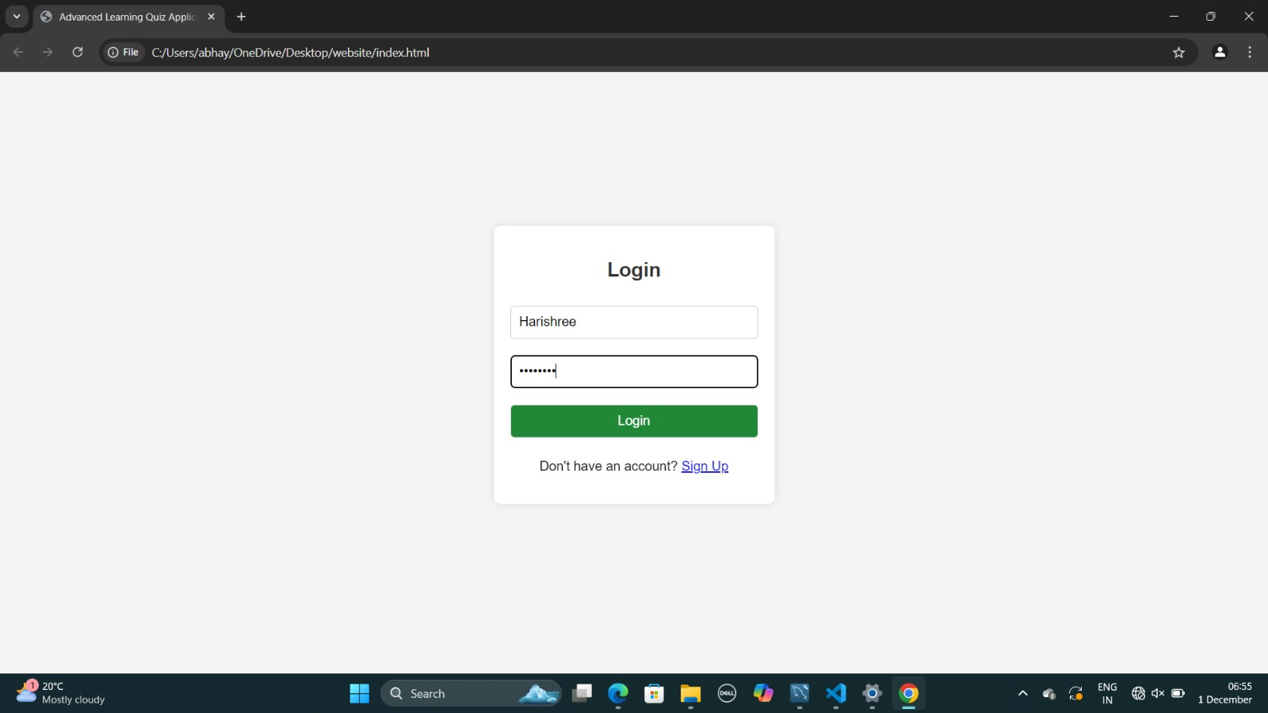

Slide 14
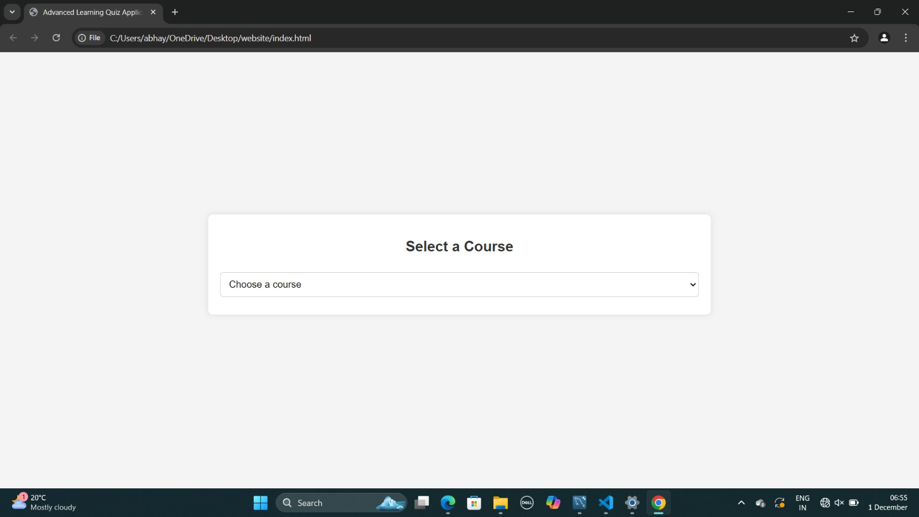

Slide 15
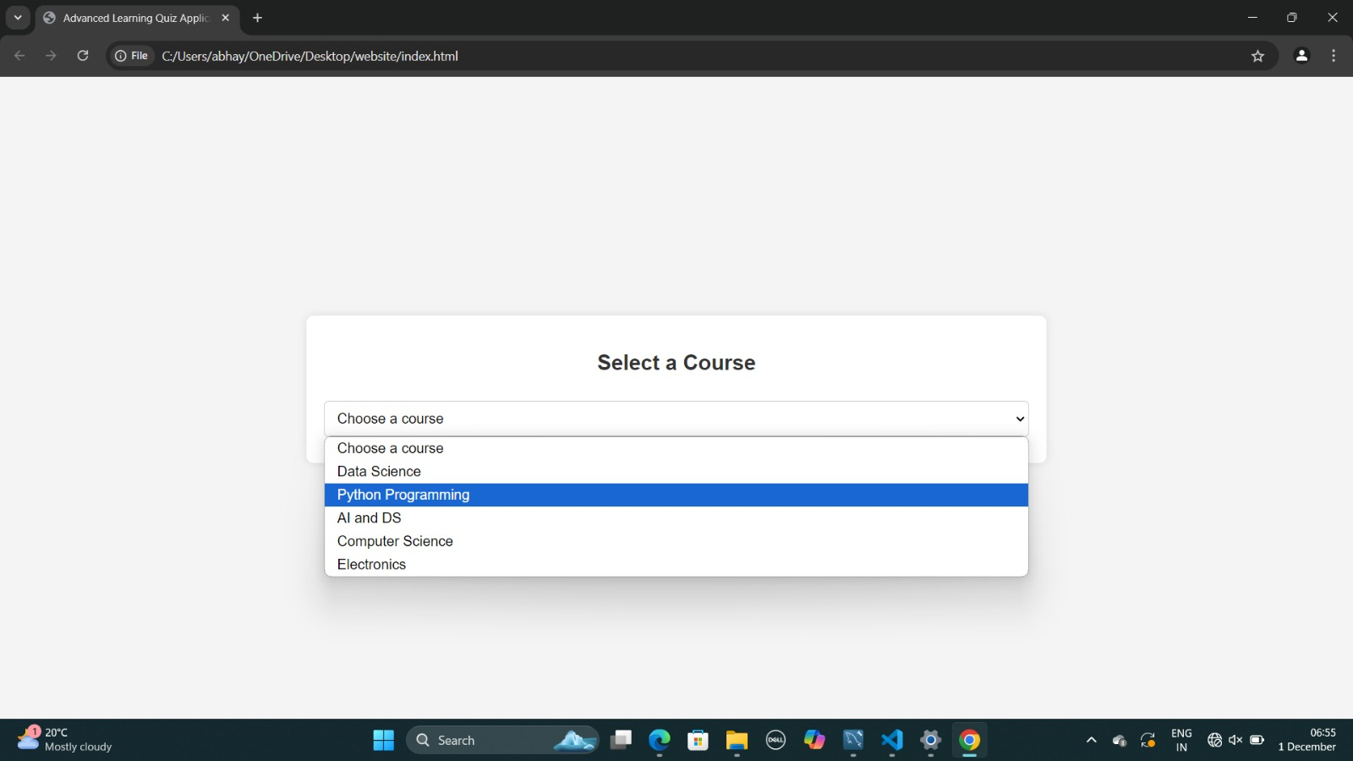

Slide 16
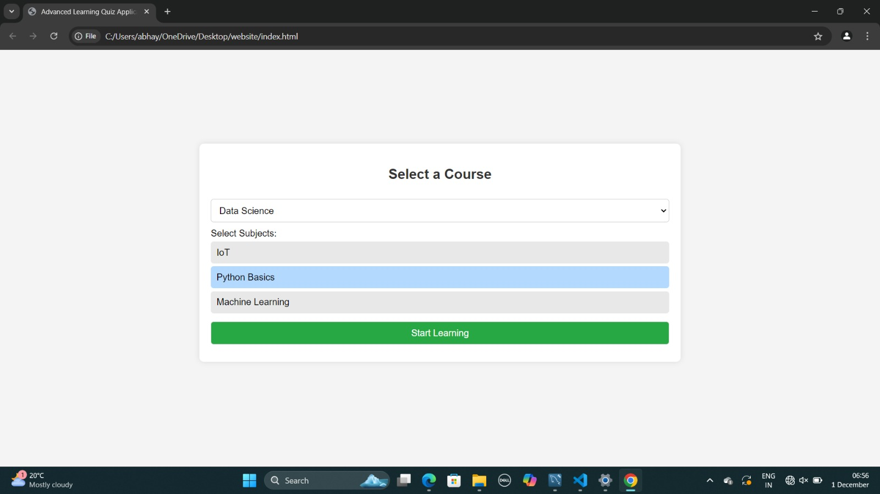

Slide 17
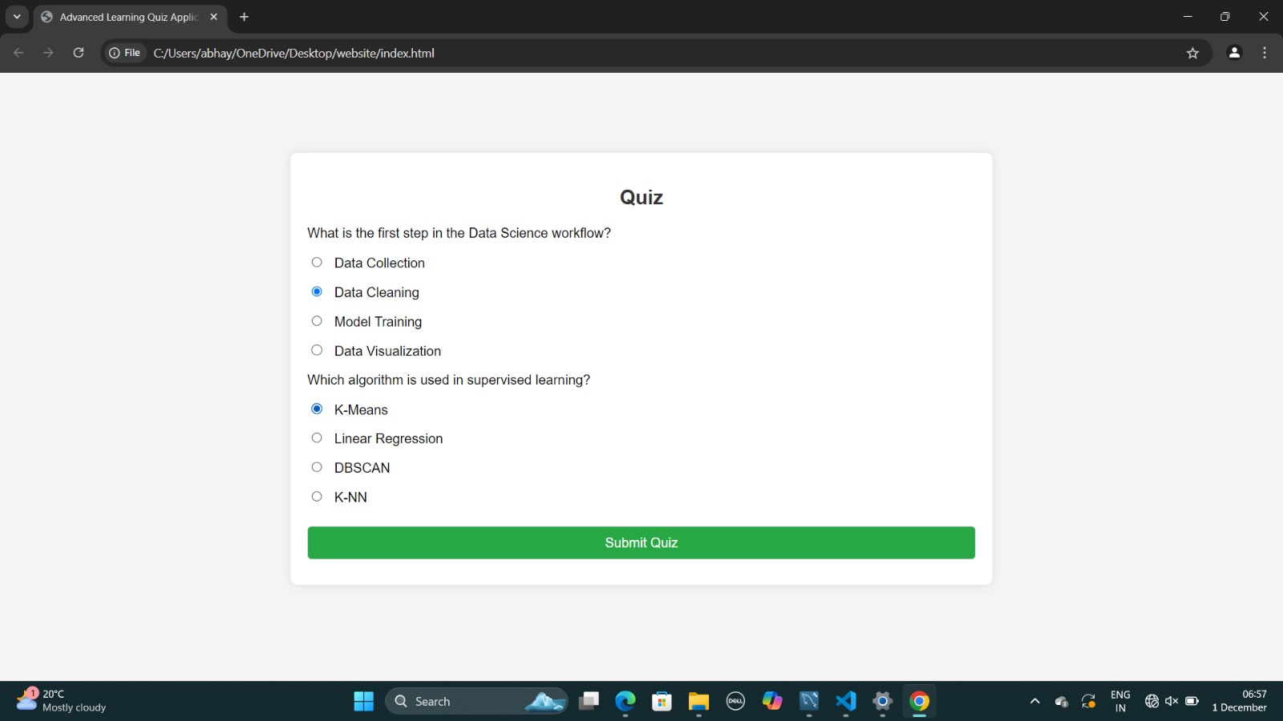

Slide 18
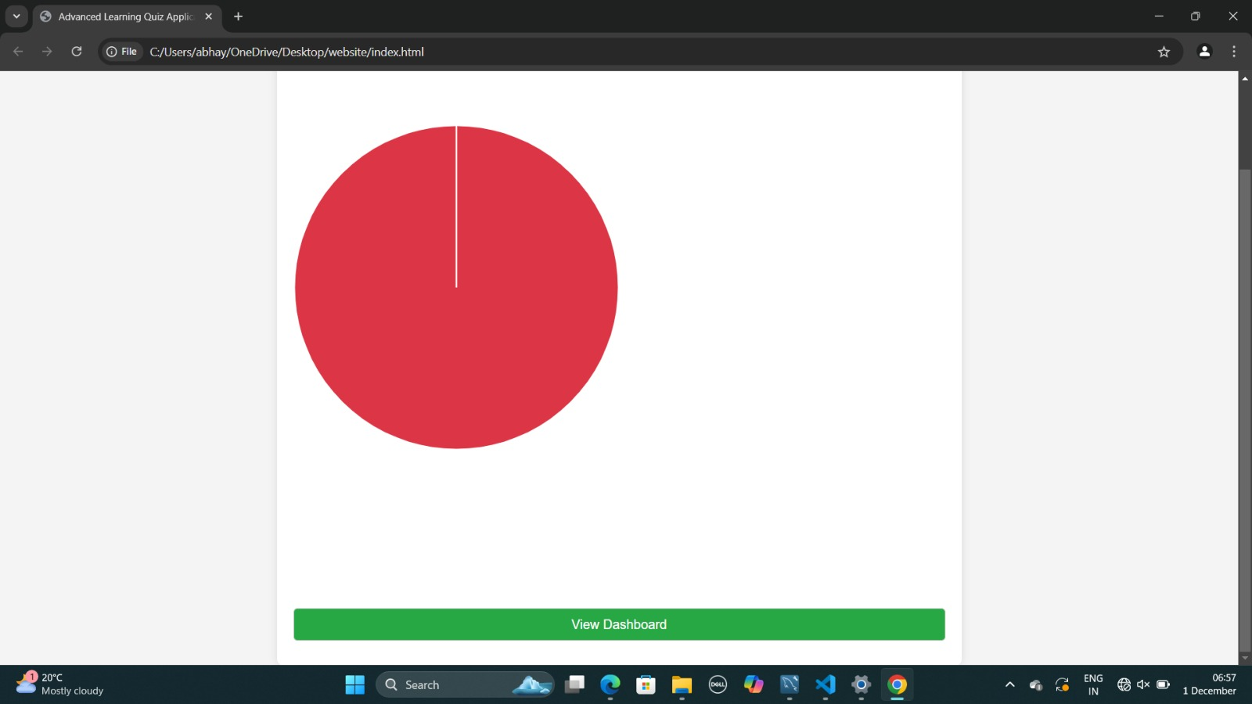

Slide 19
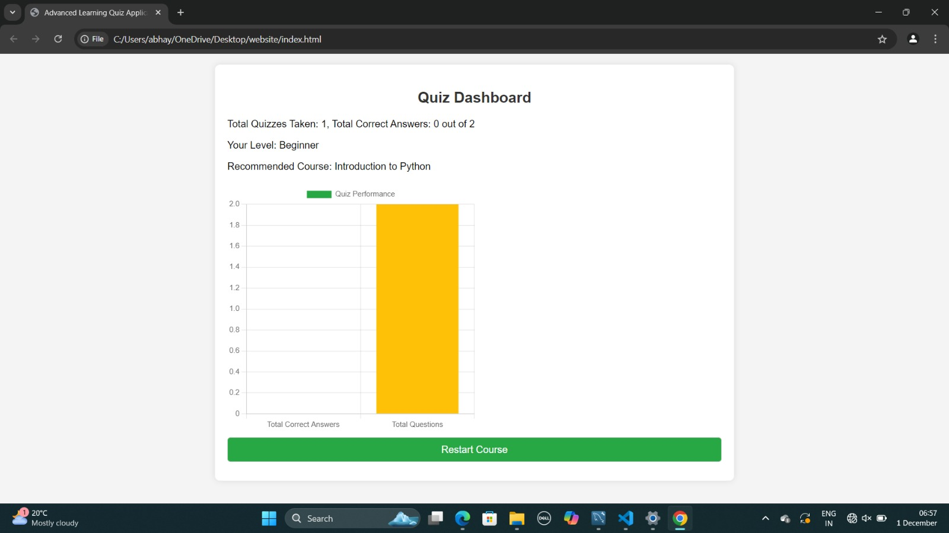

Slide 20
FUTURE SCOPE
The AI-driven adaptive learning platform described in the provided code has significant potential for future development and enhancement. Here are some areas for future scope and improvement:
1. Enhanced User Authentication and Security
Implementation of OAuth: Integrate third-party authentication methods (e.g., Google, Facebook) to simplify the login process.
Password Recovery: Add functionality for users to reset their passwords securely.
Two-Factor Authentication (2FA): Implement 2FA for added security during the login process.
2. Personalized Learning Experience
Adaptive Learning Algorithms: Develop algorithms that adapt the quiz difficulty based on user performance, providing a more tailored learning experience.
Learning Pathways: Create personalized learning pathways based on user interests and performance history, guiding users through courses in a structured manner.

Slide 21
3. Expanded Course Offerings
Additional Subjects: Introduce more courses and subjects to cater to a wider audience, such as programming languages, web development, or soft skills.
Multimedia Content: Incorporate videos, articles, and interactive content to enhance the learning experience.
4. Advanced Quiz Features
Timed Quizzes: Implement timed quizzes to add an element of challenge and urgency.
Feedback Mechanism: Provide instant feedback on quiz answers, explaining why an answer is correct or incorrect.
Question Bank: Create a question bank that allows for randomization of questions in quizzes to ensure varied assessments.
5. Community and Collaboration Features
Discussion Forums: Implement forums or discussion boards where users can ask questions, share knowledge, and collaborate on projects.
Peer Reviews: Allow users to review each other’s work or quizzes, fostering a collaborative learning environment.

Slide 22
Software and hardware requirements
Frontend Development:
Frameworks/Libraries: React or Angular for building a responsive user interface.
HTML/CSS/JSON: For structuring and styling the web application.
Backend Development:
Programming Languages: Python for server-side logic.
Frameworks: Django (Python) for building RESTful APIs.
Database Management System:
Relational Database: MySQL for structured data storage.
Data Analytics:
Analytics Tools: Google Analytics or custom analytics solutions for tracking user engagement and performance metrics.

Slide 23
Thank you

