Slide 1
TWIRL GROUP TALK
TWIRL
A 200 s TESS white-dwarf transit survey, scoped through the S56 vertical slice.
Goal for this meeting: agree on what the project is, what S56 proves, and where Michelle's search/vetting work should connect.
scope
S56
joint
200 s FFIs, Sector >= 56, Gaia-first WDs
controlled test run with WD 1856 as benchmark
light curves, BLS, LEO, injections, follow-up gates
45 minutes, with planned interruptions
01

Slide 2
TALK PLAN
The talk is structured around decisions, not a finished-result claim.
0-12 MIN
12-28 MIN
28-45 MIN
Define the survey boundary
Interrogate S56
Set the collaboration interface
What event class, sample, and cadence regime are we actually signing up for?
What did the WD 1856 benchmark, v2-vs-v3 LC product, and vetting stack prove?
Where should Michelle's BLS/LEO work attach, and what do Andrew/Kevin need before scale-out?
pause for input
pause for input
pause for input
Source: user talk brief plus TWIRL sprint plan.
02

Slide 3
SCOPE
TWIRL searches a narrow observable class before it makes occurrence-rate claims.
In scope for the core survey
Not a first-pass claim
200 s TESS FFIs only: Sector >= 56.
No sectors 1-55 as primary survey input.
Gaia DR3 source_id as the scientific identifier.
No Earth-size or habitable-zone occurrence-rate claim before completeness.
White dwarfs from the GF21 parent catalog; Pwd > 0.75 as current high-confidence reference.
No ML-first discovery engine.
Any transiting or occulting object around a WD.
No survey denominator freeze until LC QA and sample cuts are explicit.
Interpretable periodic search plus a later dip-search branch.
No S57+ search results in this talk unless they are clearly separated from S56.
Room input: should the first paper claim be framed as large periodic occultations, debris/dips, or both with separate completeness functions?
Source: doc/twirl_plan.md; doc/ideas.md used only for open questions.
03

Slide 4
CADENCE REGIME
White-dwarf transits compress the search into minutes.
The cadence choice is not cosmetic: a 10-minute WD event has about three TESS 200 s samples, but becomes effectively invisible in 30-minute cadence.
2-15 min WD occultation window
PCEB / larger-body tail
0
200 s
400 s
10 min
15 min
3 samples
0-1 samples
not enough
for a 10-minute event at 200 s cadence
for the same event at 30-minute cadence
WD 1856 recovery is a benchmark, not completeness
Source: doc/ideas.md scientific motivation; doc/twirl_plan.md design drivers.
04

Slide 5
PIPELINE
Light curves are the shared substrate for every later result.
Gaia WD seed
TESS coverage
MIT TGLC HDF5
TWIRL HLSP
GF21 catalog; Gaia DR3 source_id
Sector/orbit/camera/CCD map
1x1, 3x3, 5x5 decontaminated apertures
Flux-space detrend; QLP-compatible schema
Search
Vetting
Injections
Science products
BLS now; dip branch later
Heuristic classes + LEO-WD tuning
End-to-end completeness, not just detection
Candidates, occurrence limits, follow-up targets
Talk discipline: every downstream result should be traceable to a versioned light-curve product and a documented search/vetter configuration.
Source: doc/twirl_plan.md Stage 1-5 structure.
05

Slide 6
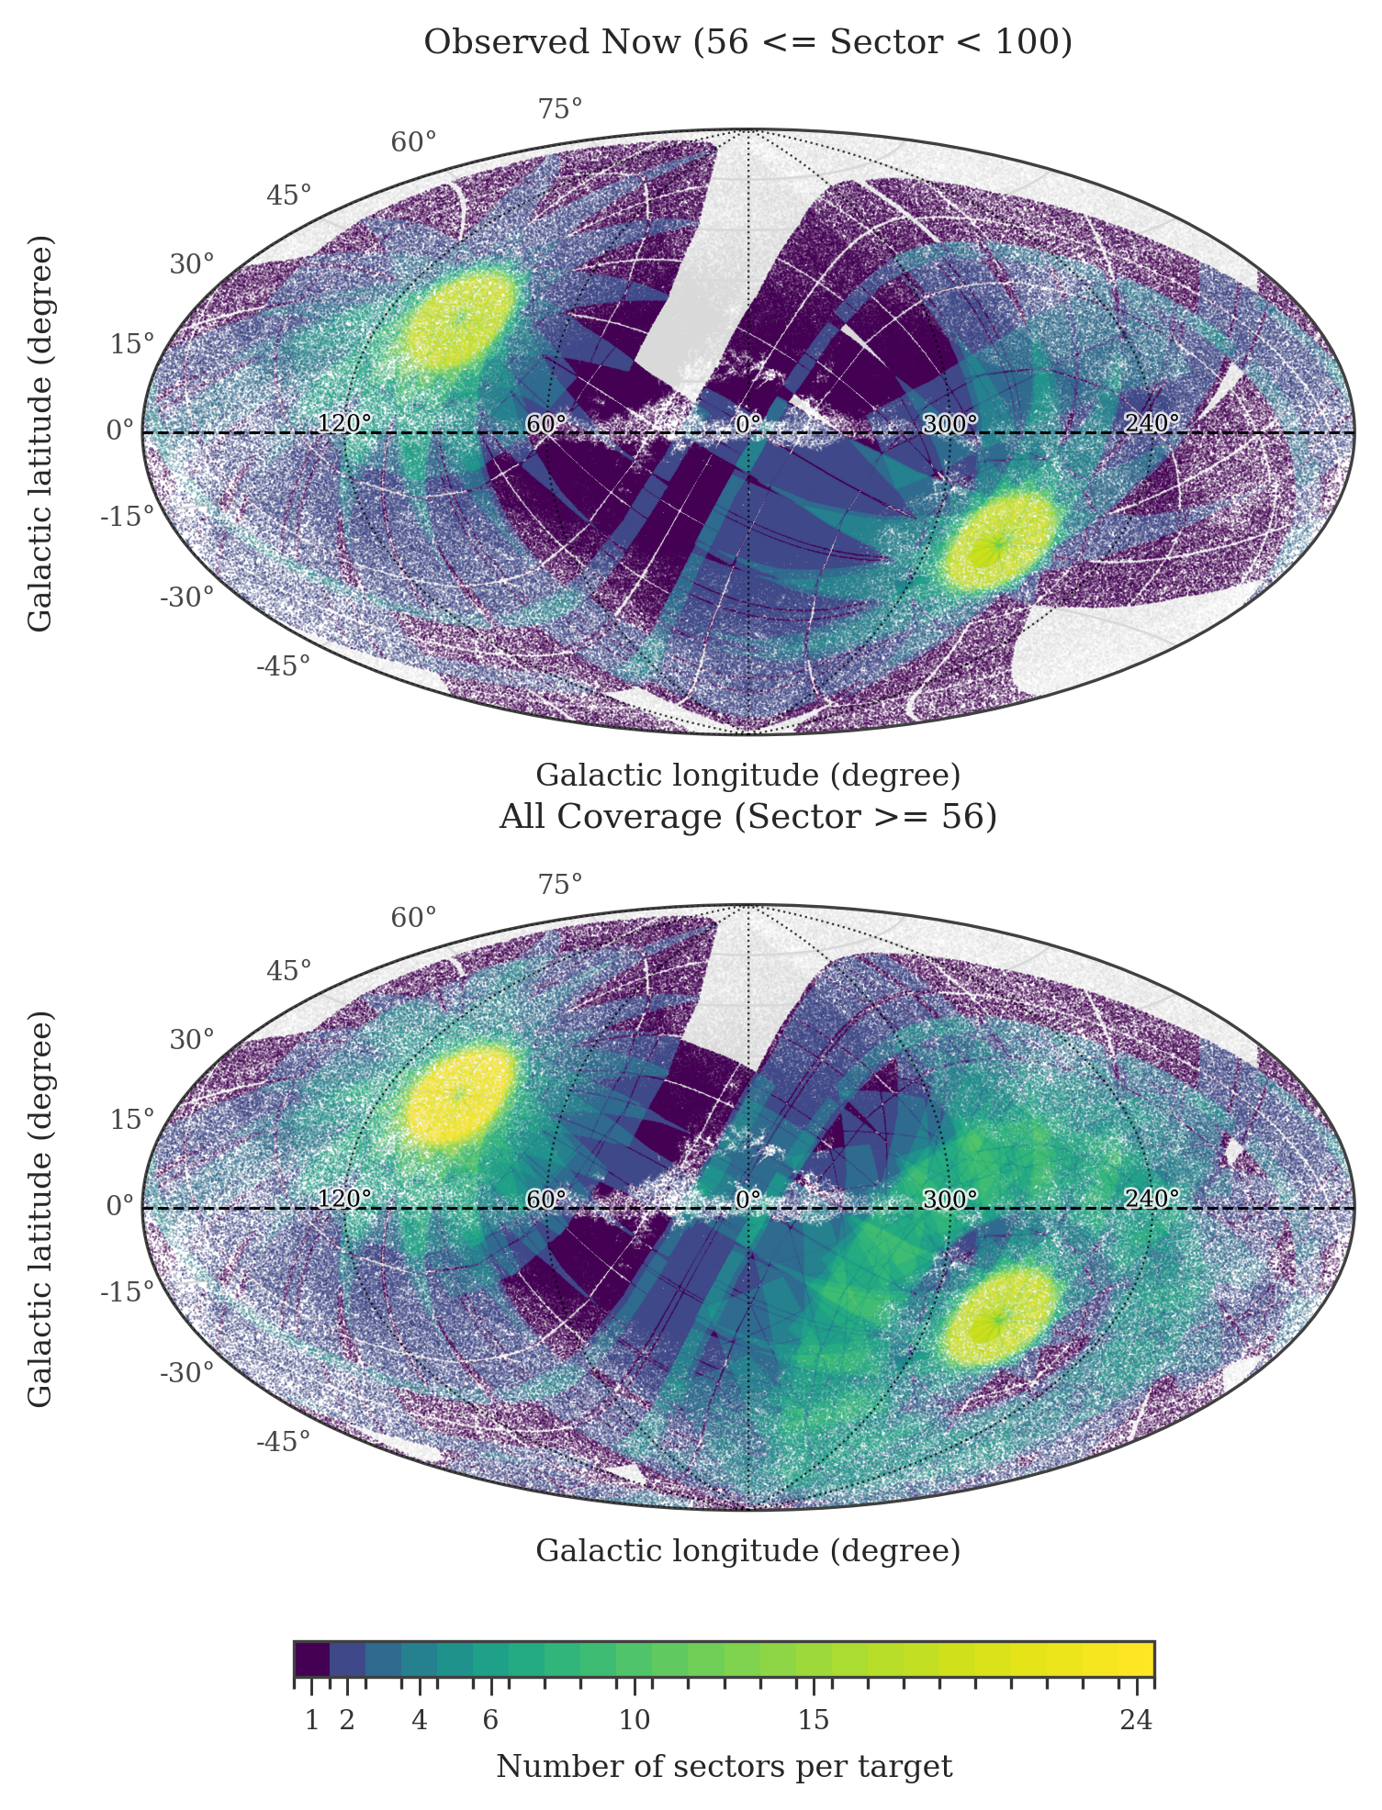
PARENT SAMPLE
The denominator is Gaia-first, but it is not frozen yet.
359,073
339,292
high-confidence WDs at Pwd > 0.75
high-confidence WDs with Sector >= 56 footprint
320,049
Gaia DR3
high-confidence WDs observed before Sector 100
authoritative target id; TIC is operational metadata
The exact occurrence-rate denominator should be locked only after light-curve collection, QA, and parent-sample cuts are explicit.
Coverage map shows repeated 200 s-sector access; it is not a finalized statistical denominator.
Source: doc/twirl_progress_log.md 2026-04-01; coverage diagnostic PNG.
06

Slide 7
S56 VERTICAL SLICE
S56 is a controlled vertical slice, not a mini-survey.
c1
1
c1
2
c1
3
c1
4
19,068 / 19,086
4 / 19086
S56 GPU-production HLSP FITS written
validation issues in new tree
c2
1
c2
2
c2
3
c2
4
orbits 119 + 120
cam4 / ccd1
c3
1
c3
2
c3
3
c3
4
fixed WD 1856 benchmark sector geometry
WD 1856 detector location highlighted at left
c4
1
c4
2
c4
3
c4
4
Why this slice works: it is fully processed, cadence-aligned, and contains the mandatory ground truth. Why it is not enough: one sector cannot establish completeness or a denominator.
All 16 CCDs
Source: doc/twirl_plan.md current status snapshot.
07

Slide 8
PRODUCTION SCALING
GPU ePSFs helped, but the production risk moved to orchestration and QA.
The ePSF stage went from a multi-hour CPU bottleneck to a GPU step, but full-sector production still depends on catalogs, cutouts, light curves, detrending, HLSP export, and QC.
CPU baseline
4:01:31
7.9x
ePSF speedup on S56 cam4/ccd1
GPU path
QA gate
30:42
per-sector PDFs and validation after HLSP
Talk framing: scale-out is credible only if the LC product and QA labels stay explicit sector by sector.
Source: doc/twirl_progress_log.md 2026-04-27; doc/twirl_plan.md scale-out notes.
08

Slide 9
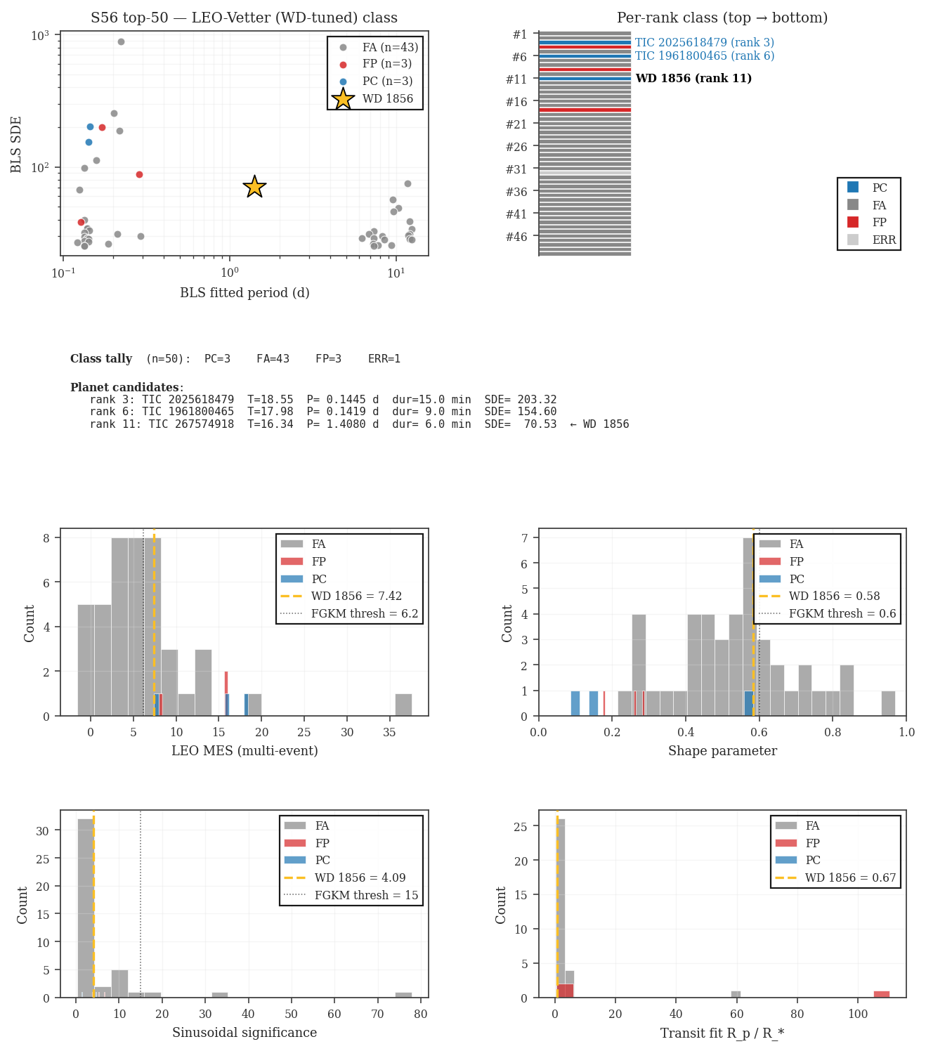
S56 SEARCH
WD 1856 survives blind ranking after WD-specific vetting.
BLS v1 blind
1.407955 d
1258 / 19,040
BLS period for WD 1856 in S56 v2
BLS v2 blind
560 / 19,012
6 min
Heuristic class
fitted duration in BLS candidate row
5 / 3,188
LEO-WD top 50
SDE 70.5
PC, rank 11
representative BLS signal strength
LEO-WD classifies WD 1856 as PC in the top-50 S56 v2 run. The top-N FP mix is exactly where the group should intervene.
Source: data_local/stage2/bls_first_pass_v2; reports/stage5_validation/leo_vetter_s56_top50_v2.
09

Slide 10
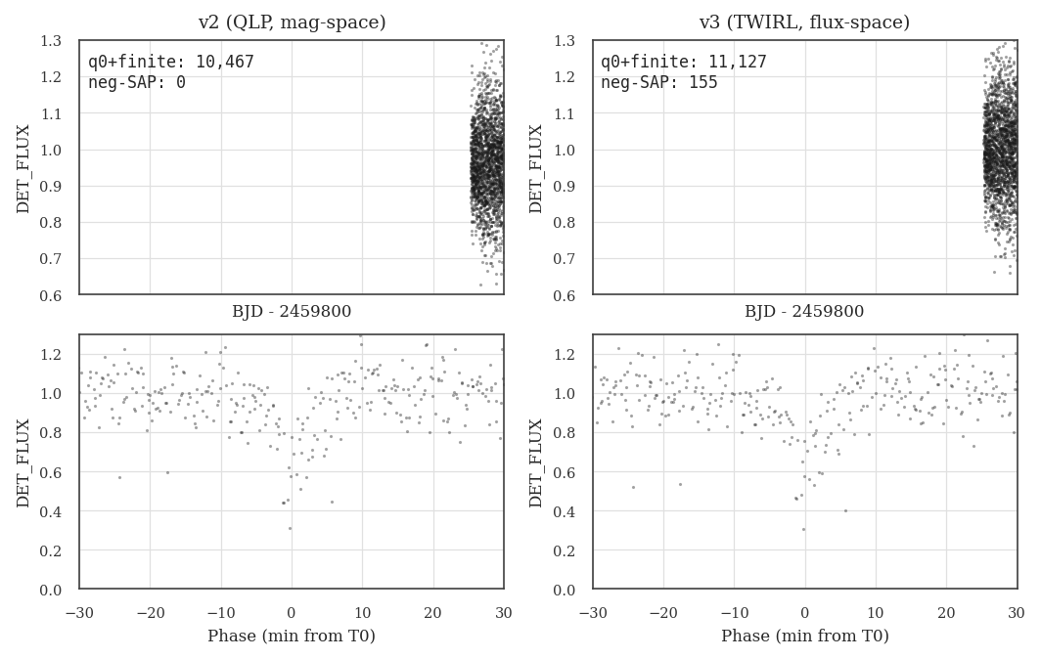
LIGHT-CURVE PRODUCT
Negative-flux clipping was a light-curve product risk.
+155
previously lost negative SAP cadences preserved
+6.3%
usable q=0 cadence count for WD 1856
same shape
phase-folded transit remains intact
Patch logic: keep linear RawFlux / RawFluxError through TGLC, then detrend in flux space instead of relying on magnitude-space products that clipped flux <= 0.
Source: data_local/stage2/wd1856_v3_sanity; doc/twirl_progress_log.md 2026-05-13.
10

Slide 11
DETRENDING EXPERIMENT
Robust-auto subtractive scaling is the current faint-end candidate.
Production candidate: DET = 1 + (flux - spline) / positive_scale, where positive_scale falls back to a robust absolute-flux scale near zero median flux.
variant
real RMS
depth retention
synthetic failures
negative q0 kept
divisive
9.07
-0.86
3 / 8
41,839 / 41,839
sub_median
0.223
-1.41
3 / 8
41,839 / 41,839
sub_median_abs
0.223
1.41
3 / 8
41,839 / 41,839
sub_auto
0.135
0.98
0 / 8
41,839 / 41,839
11 real cases
10-min injection
next gate
T=18.5+ S56 sample plus WD 1856 control
median retention 0.98 for sub_auto
larger random faint sample before relabeling product
Source: reports/stage1_lightcurves/detrend_experiments/*/summary.md.
11

Slide 12
INTERPRETATION
S56 produced testable decisions, not a survey-wide occurrence result.
Credible now
Still open before scaling claims
A full S56 light-curve product can be generated and validated.
End-to-end injection-recovery through the real search and vetter.
WD 1856 is recoverable in a blind S56 stack with WD-specific vetting.
Parent denominator freeze and no-TIC bridge policy.
Negative-flux preservation is a real LC-product issue.
False-alarm model and WD-specific FP taxonomy.
Robust-auto detrending has passed the first faint-end stress test.
Dip-search branch for WD 1145-like debris systems.
Discussion cue: what evidence would make Andrew/Kevin comfortable that the benchmark has moved from demo to acceptance test?
Source: doc/twirl_plan.md acceptance logic; doc/ideas.md referee risks.
12

Slide 13
COLLABORATION MODEL
The Michelle collaboration should separate substrate, search, vetting, and validation.
Te Han / TWIRL
Light-curve production, v3 HLSP tree, data stewardship, heuristic vetter, LC-side completeness comparison.
Michelle's group
Production BLS, search-statistic variants, LEO-Vetter domain expertise, comparison against TWIRL reference search.
Michelle student + Franklin
Independent WD-host LEO tuning, threshold experiments, top-N comparison with TWIRL fork.
Andrew + Kevin + room
Benchmark standards, false-positive discrimination, follow-up path, validation realism.
Shared
Joint output for this phase: a v3 S56 candidate list, a WD 1856 blind-recovery statement, and a completeness experiment everyone trusts.
Source: doc/twirl_plan.md Collaboration & Ownership, scientific lanes only.
13

Slide 14
ROOM INPUT
Ask for contributions where expertise changes the answer.
Andrew
Kevin
What recovery evidence makes WD 1856 a credible benchmark rather than only a demo?
Which WD false positives are most dangerous for faint TESS candidates, and where does fast photometry change the game?
Michelle
Everyone
What schema and candidate-table contract lets the tuned BLS and LEO stacks consume TWIRL HLSPs cleanly?
What first observable event class should the project claim before the occurrence-rate denominator is frozen?
14

Slide 15
PRE-TALK SPRINT
The next three weeks are a three-part stress test.
Week 1
Week 2
Week 3
v3 tree and comparison table
injection-recovery plus LEO tuning
WD 1856 joint blind recovery
Hand off S56 TWIRL HLSPs; run reference BLS + heuristic + LEO; populate v2-vs-v3 table.
Shared exploration: LC-side v2-vs-v3 completeness delta; parallel LEO-WD tuning comparison.
Confirm WD 1856 as PC in at least one search x vetter combination; classify top false-positive families.
Freeze the talk result on S56. Use S57+ production status only as pipeline scale context, not as search evidence.
Source: doc/twirl_plan.md Three-Week Pre-Talk Vertical Slice.
15

Slide 16
MEETING OUTPUT
By the end, the project should have one narrow target and one shared test plan.
Scope phrase and non-goals for the S56-to-survey path
Injection grid, metrics, and success definition
1
4
WD 1856 benchmark acceptance criteria
False-positive taxonomy and follow-up responsibilities
2
5
BLS / LEO candidate-table interface
Next meeting owners and artifacts
3
6
Closing line: I do not need this to be final today; I need the next test to be the right one.
16

