Slide 1
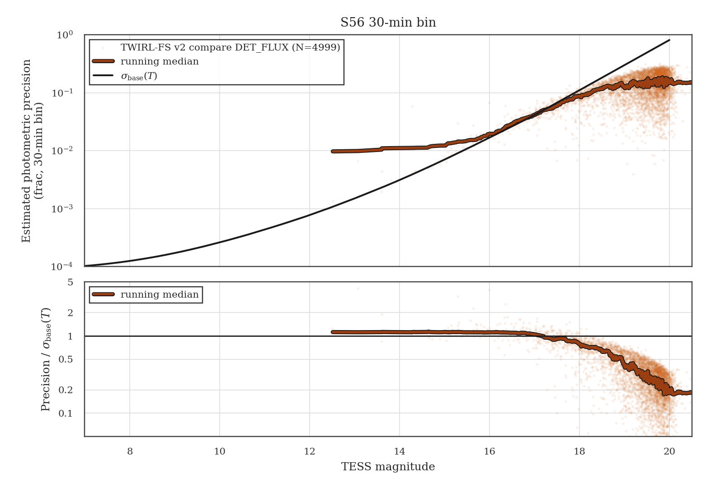
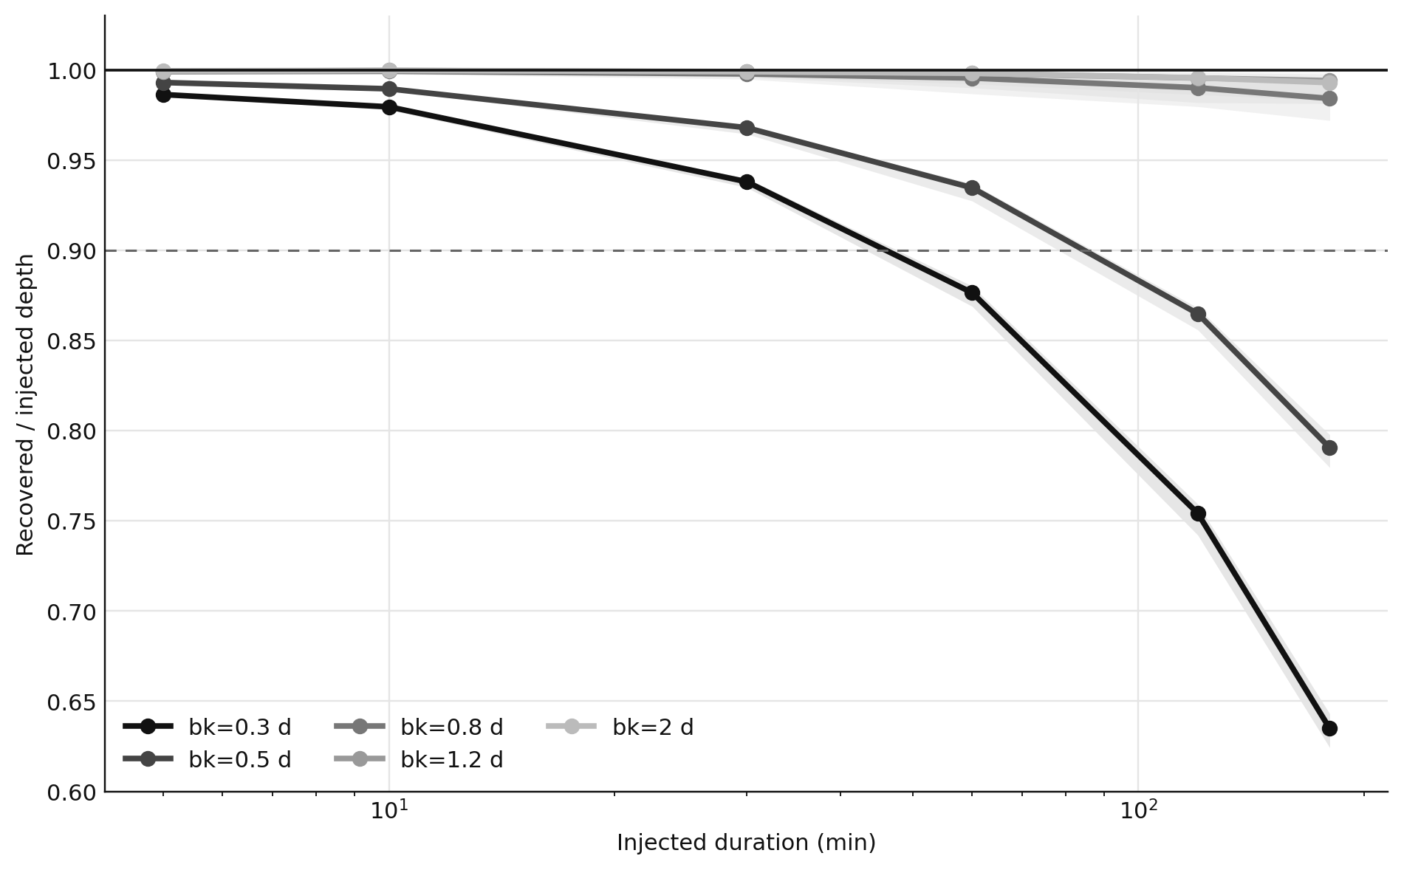
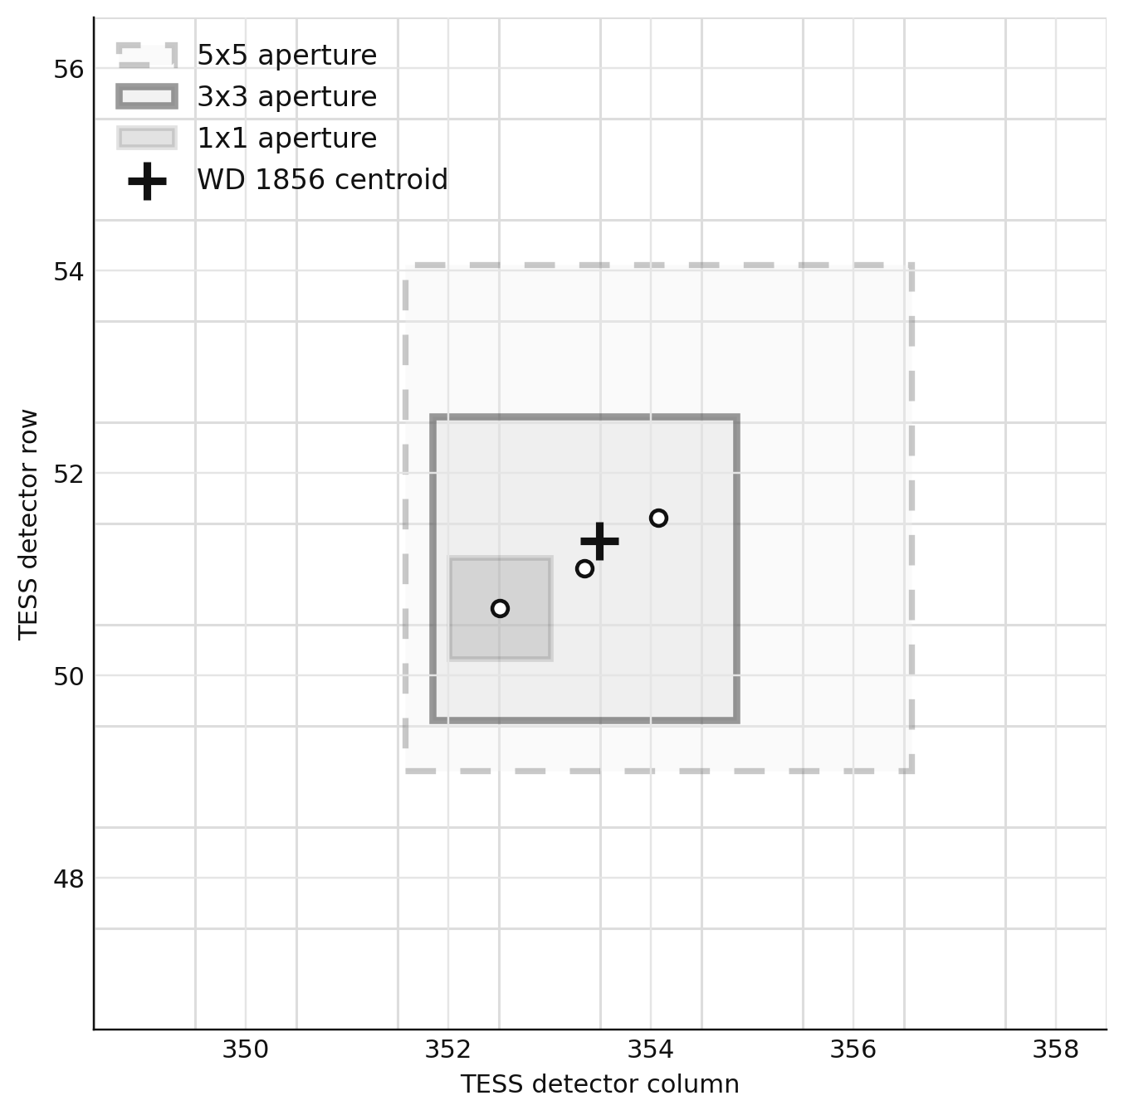
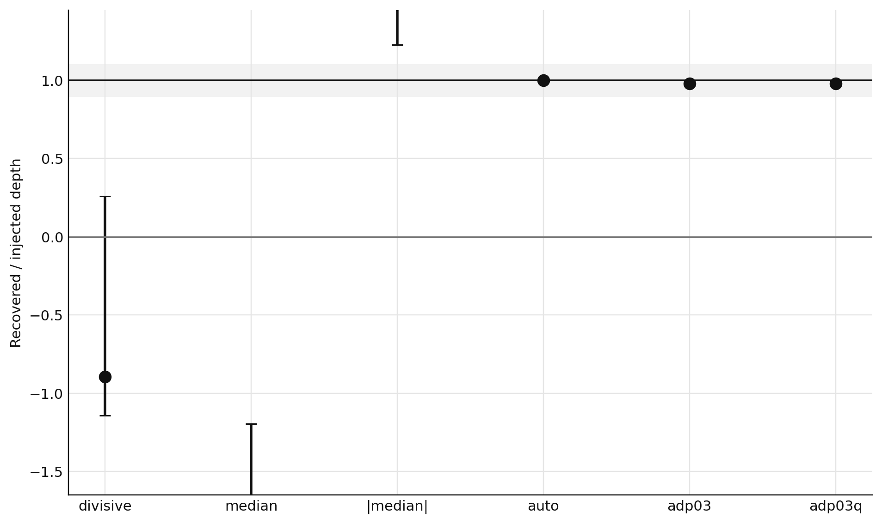
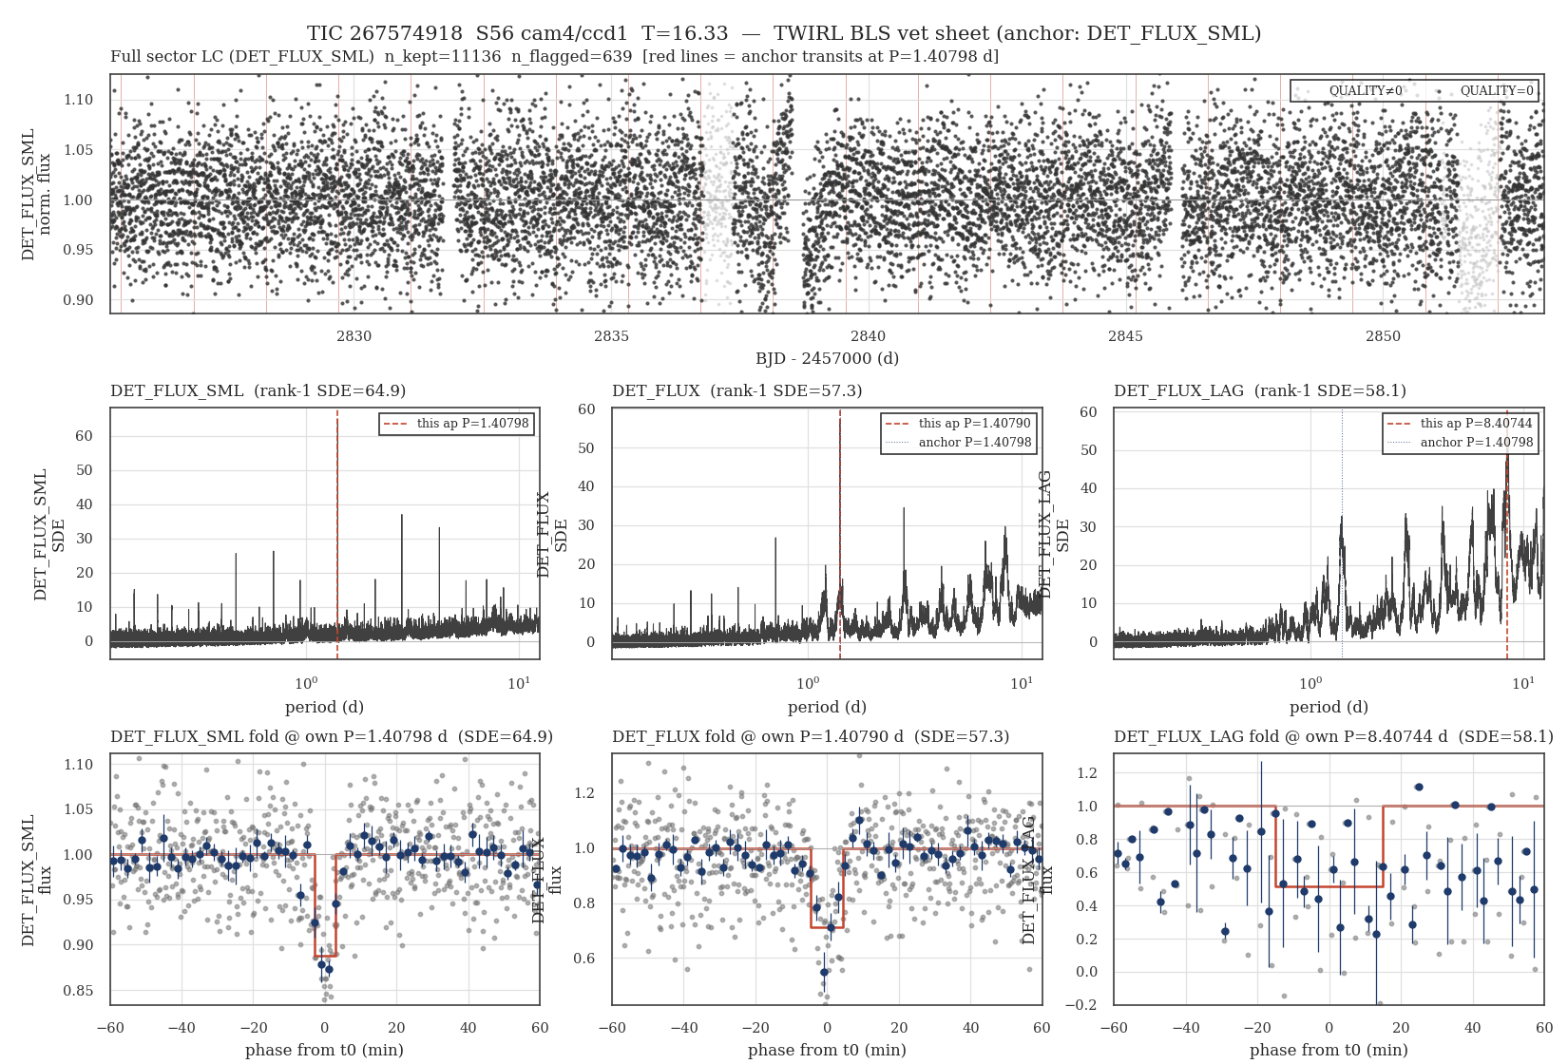
GRAPHICS BANK
Optional plots for the WD 1856 / detrending discussion.
Use these as insert slides or backup discussion slides. The main talk can stay sparse while this bank gives you alternatives for questions.
old metric caveat
injection retention
pixel footprint
variant comparison
Franklin BLS
14 optional graphics-first slides
chooser
01 / 14

Slide 2
WD 1856 BENCHMARK
The aperture footprint is a useful pixel-scale anchor.
Generated from the local S56 HDF5 centroid and aperture centers for TIC 267574918.
S56 cam4/ccd1
1x1 / 3x3 / 5x5 apertures
not a cutout intensity image
I did not find a pre-made WD 1856 cutout pixel-intensity map locally.
pixel map
02 / 14

Slide 3
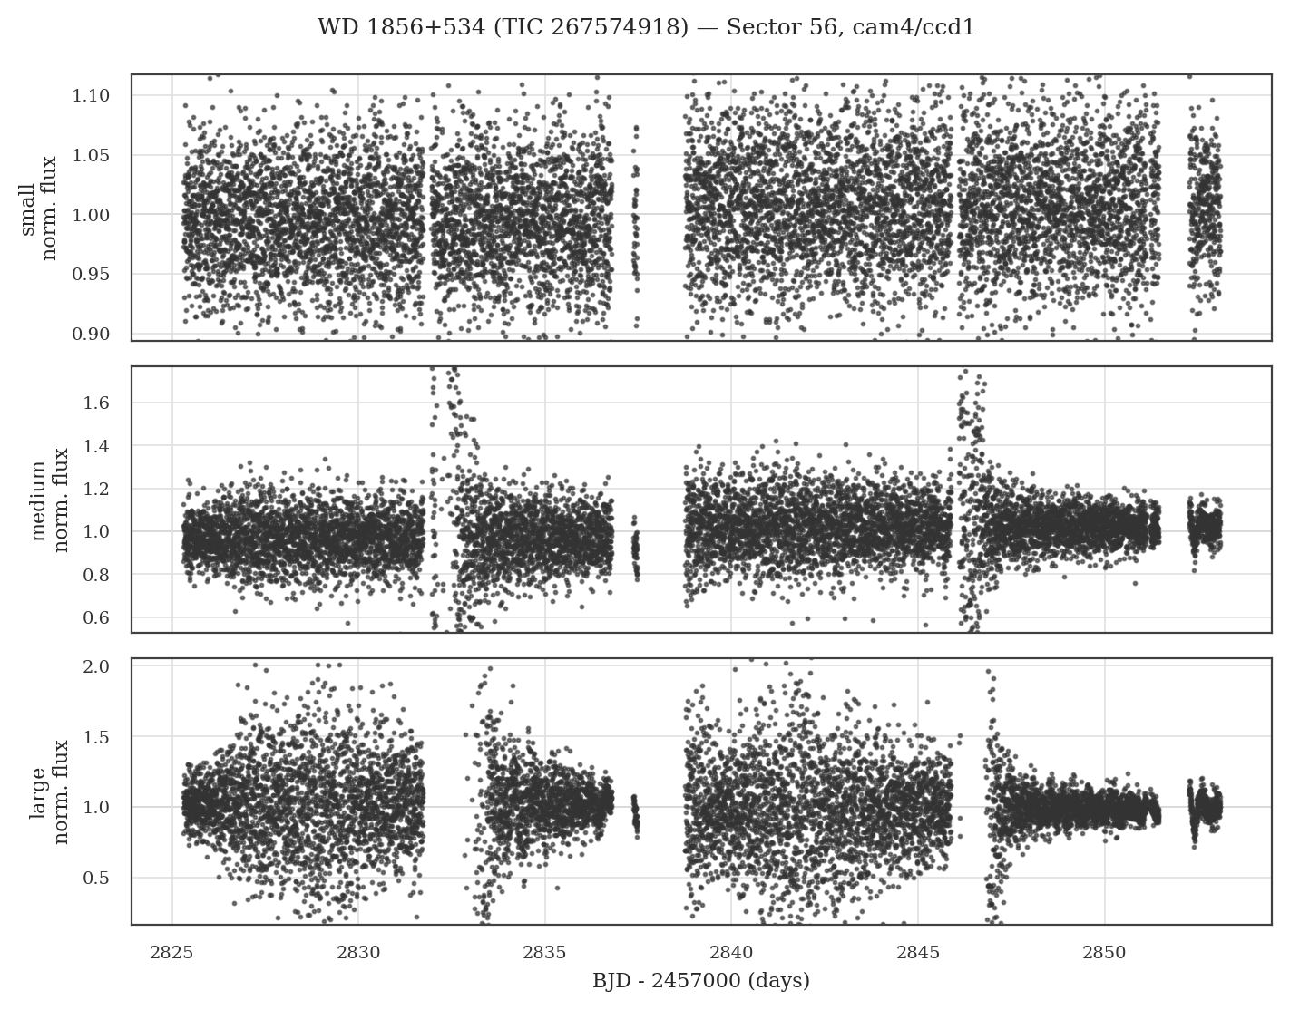
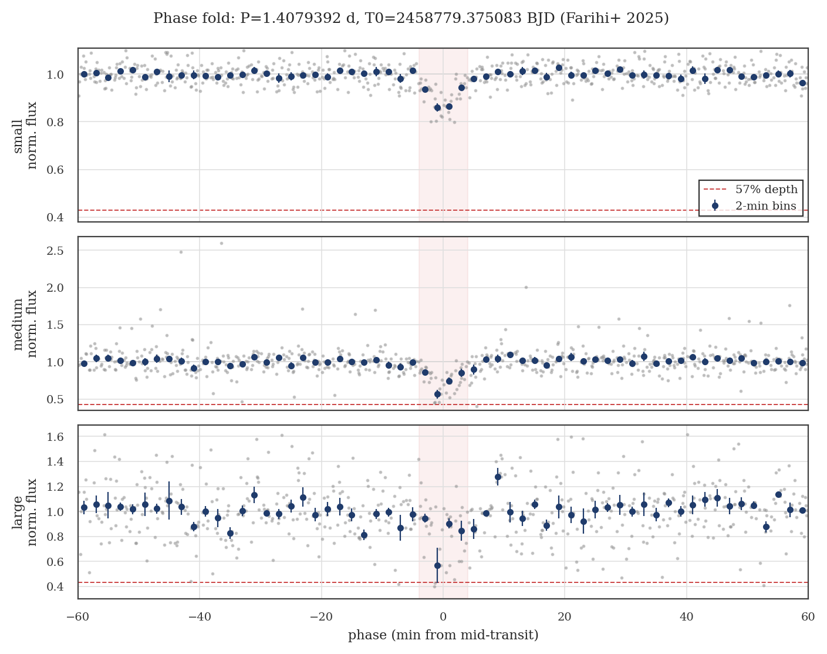
WD 1856 BENCHMARK
Keep one simple slide that shows both the sector view and the event.
full S56 light curve
phase-folded benchmark event
benchmark context
03 / 14

Slide 4
DETRENDING QA
The old precision diagnostic should be shown as a caveat, not a result.
unphysical faint-end flattening
likely denominator / clipping issue
use for QA motivation only
This slide tees up why precision has to be recomputed from an expected-flux denominator and non-clipped residuals.
old metric problem
04 / 14

Slide 5
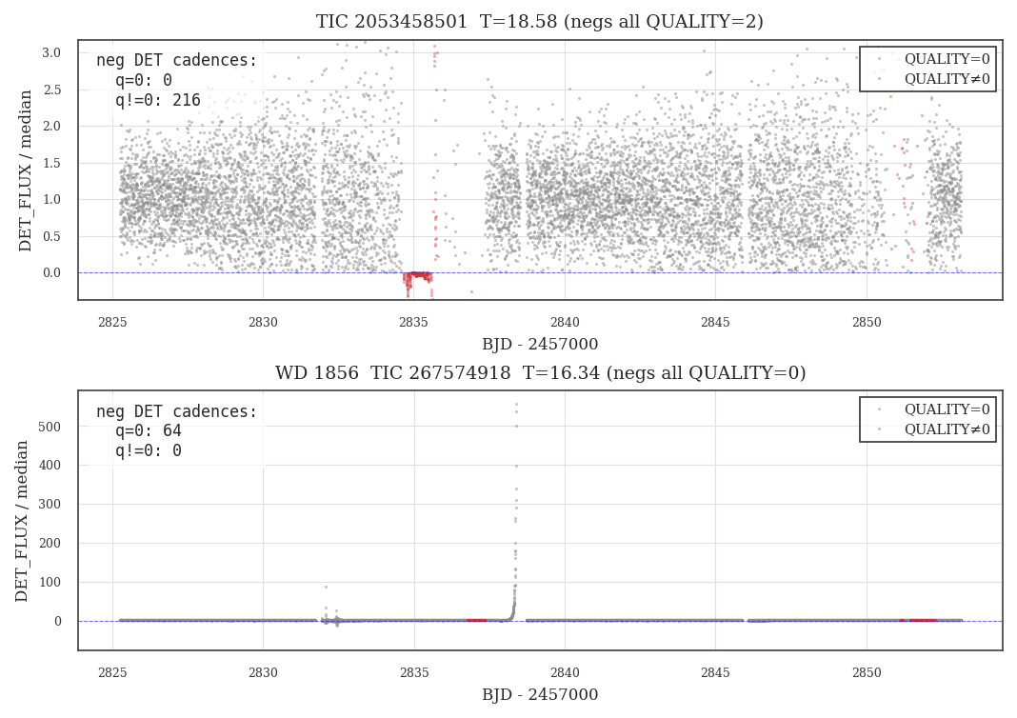
DETRENDING QA
Negative and near-zero flux cadences are the stress case.
do not clip legitimate residuals
avoid fragile flux / spline ratios
audit QUALITY behavior separately
Useful if Andrew or Kevin asks why the faint-end precision curve was not trusted.
old metric problem
05 / 14

Slide 6
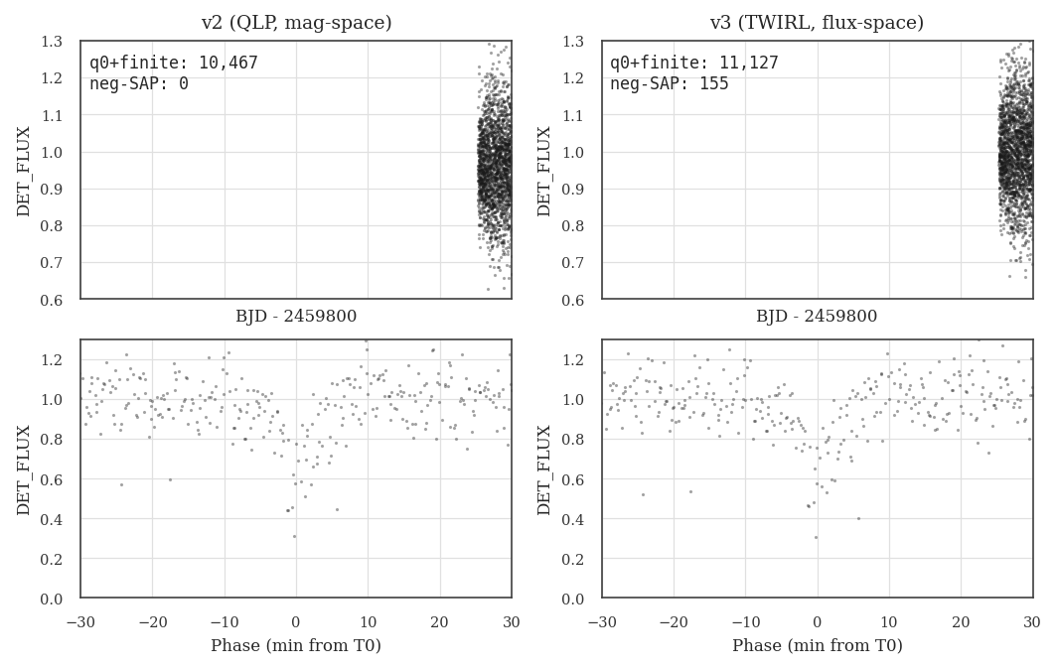
COMPARISON ANCHOR
WD 1856 still needs aperture and product-to-product comparison.
QLP mag-space
TWIRL flux-space
event timing + depth
This is a concise benchmark slide for the comparison work already done before claiming production readiness.
what we compare to
06 / 14

Slide 7
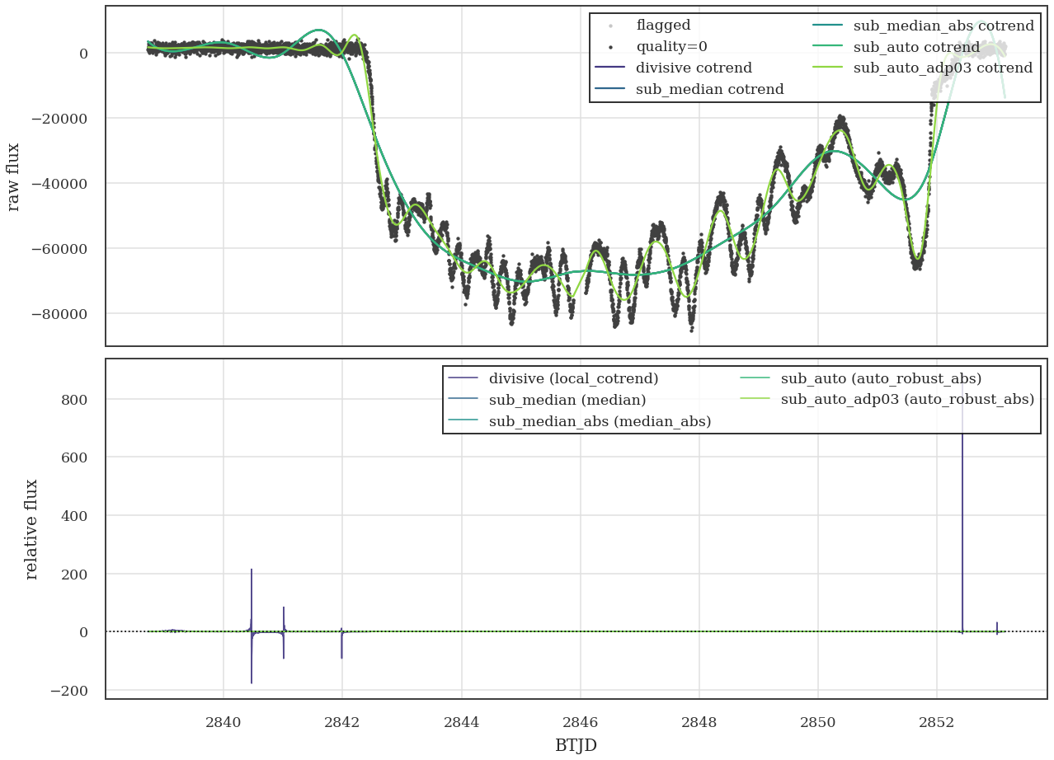
DETRENDING EXPERIMENTS
The comparison runs show where ratio-style detrending breaks.
divisive cotrend can explode
subtractive variants stay finite
adp03/adp03q were comparison variants
Good optional slide when the group wants evidence behind the flux-space choice.
what we tried
07 / 14

Slide 8
DETRENDING EXPERIMENTS
Variant-level retention makes the comparison easier to discuss.
auto robust scaling near unity
divisive and median variants are unstable
adp03/adp03q are sanity checks
This is a cleaner black-and-white alternative to the raw diagnostic panels.
what we tried
08 / 14

Slide 9
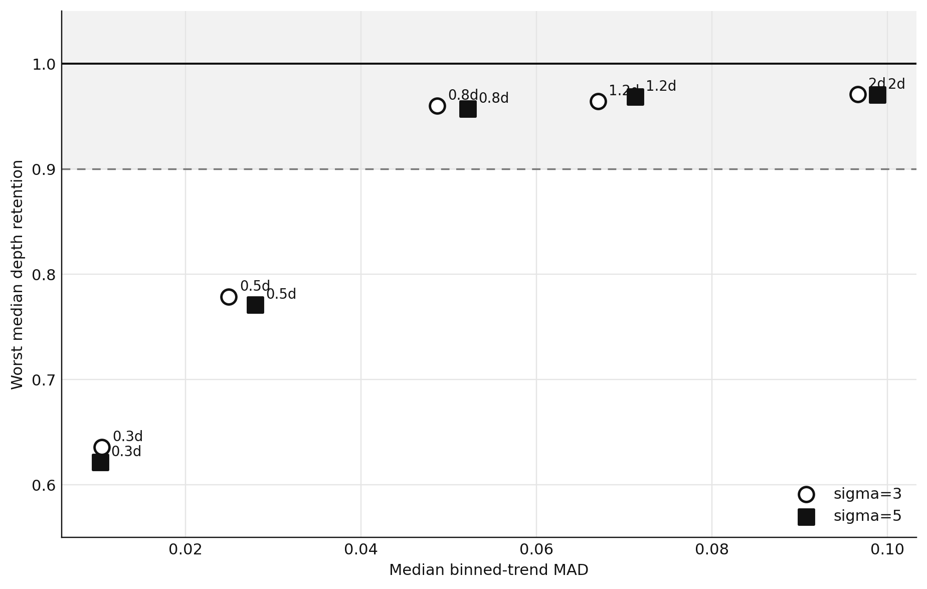
DETRENDING EXPERIMENTS
Smooth trends alone do not define the best detrending choice.
x-axis: old smoothness metric
y-axis: injected-depth retention
bkspace around 0.8d is a compromise
This is the compact version of the parameter sweep argument.
metric tradeoff
09 / 14

Slide 10
INJECTION RECOVERY
Short-event injections are the tuning test.
10% injected depth
5-200 minute duration grid
fast LC-level sweep
Use this to invite discussion on the duration grid and first-pass acceptance threshold.
LC-level injections
10 / 14

Slide 11
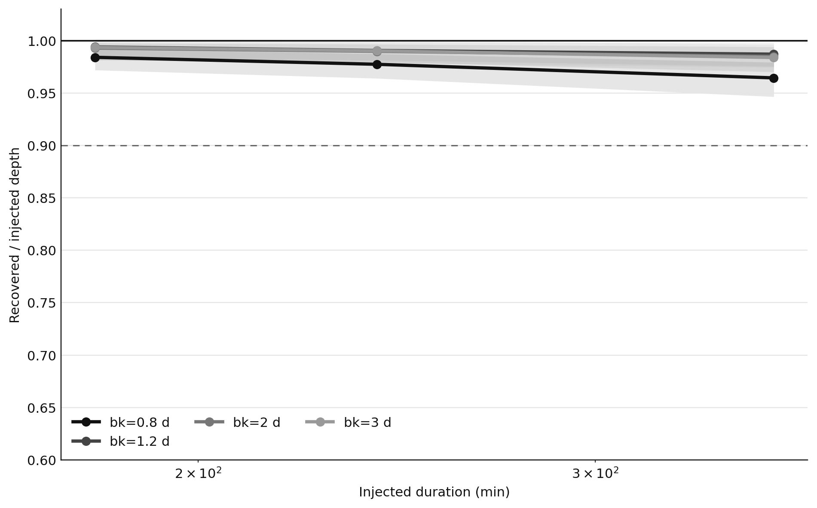
INJECTION RECOVERY
Long-event injections test whether the spline starts eating signal.
180-360 minute durations
retention stays above 90%
different failure mode than WD 1856
Useful backup if the room pushes on broad occultations or longer-duration dips.
LC-level injections
11 / 14

Slide 12
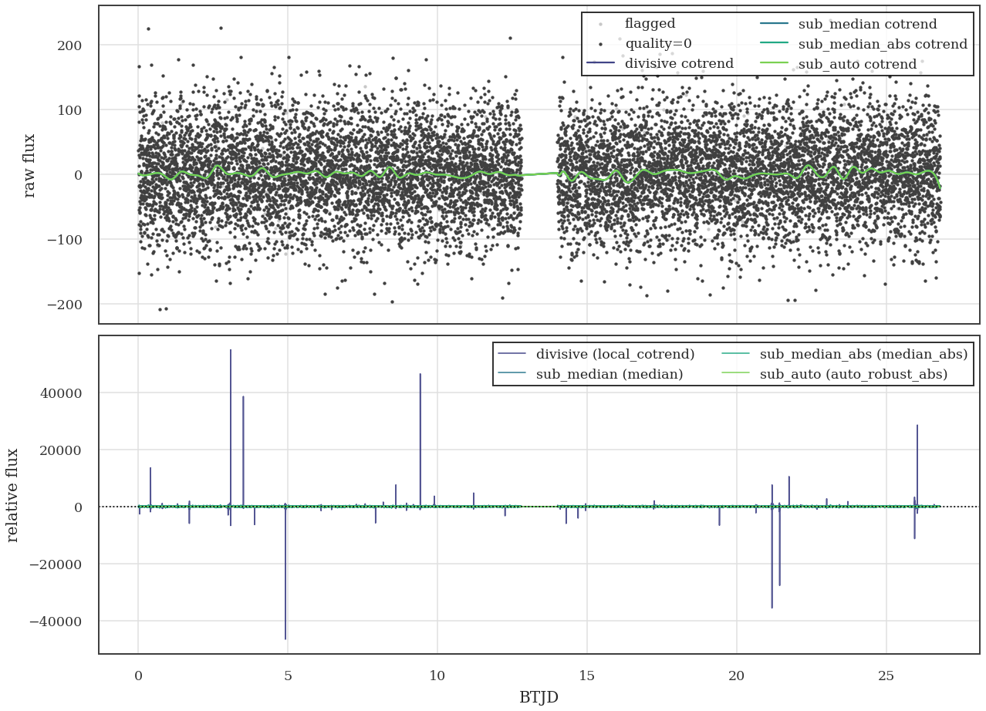
INJECTION RECOVERY
Synthetic zero-crossing cases are the cleanest ratio-failure demo.
controlled input
negative / near-zero residuals
ratio path visibly unstable
This is a good explanatory slide before showing real S56 faint-end examples.
stress tests
12 / 14

Slide 13
INJECTION RECOVERY
Use LC-level injections for tuning; reserve pixel-level for completeness.
LC-level
observed HDF5 / HLSP LC
->
inject transit model
->
detrend + search
->
rank recovery metrics
pixel-level
inject into pixels / scene
->
TGLC extraction
->
detrend + search
->
end-to-end completeness
LC-level: cheap, fast, good for parameter sweeps
pixel-level: expensive, needed for aperture and crowding failures
Discussion hook: first decide what the LC-level tests must prove, then spend pixel-level compute only where it changes the science claim.
test design
13 / 14

Slide 14
UNDERGRADUATE PROGRESS
Franklin's BLS run is a strong progress artifact, before vetting.
BLS diagnostic
SDE 64.9
not yet a vetting sheet
Frame this as undergraduate search progress: benchmark recovered, vetting next.
search progress
14 / 14

