Slide 1
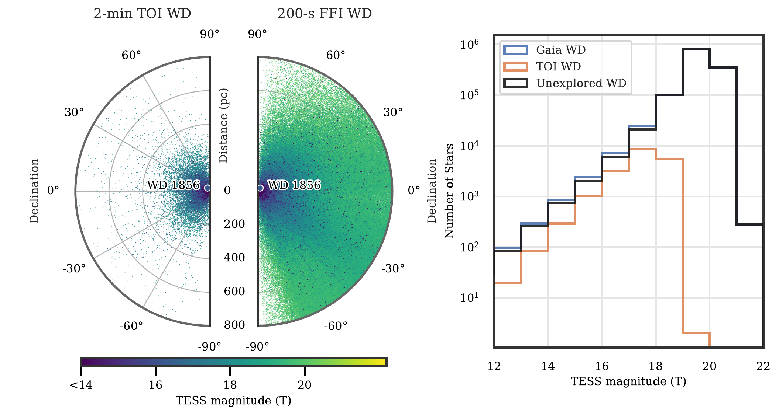
PROPOSAL START
Most unexplored white dwarfs are a 200 s FFI problem.
proposal plot: WD sample by declination and TESS magnitude
proposal plots
01 / 19

Slide 2
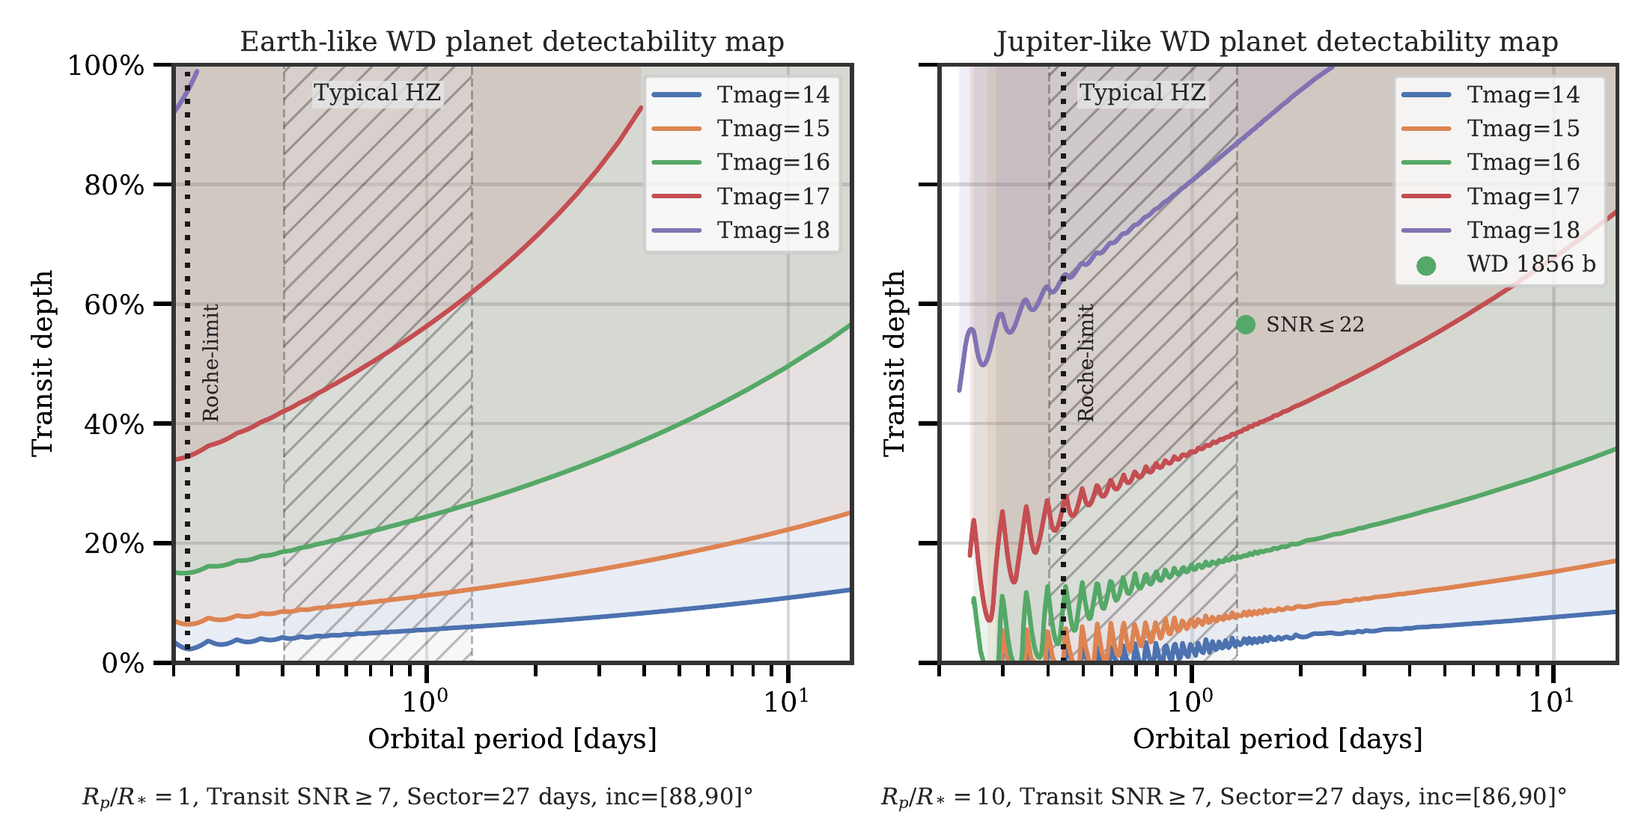
PROPOSAL START
The first pass is tuned to deep, short events.
proposal plot: depth versus period by Tmag
proposal plots
02 / 19

Slide 3
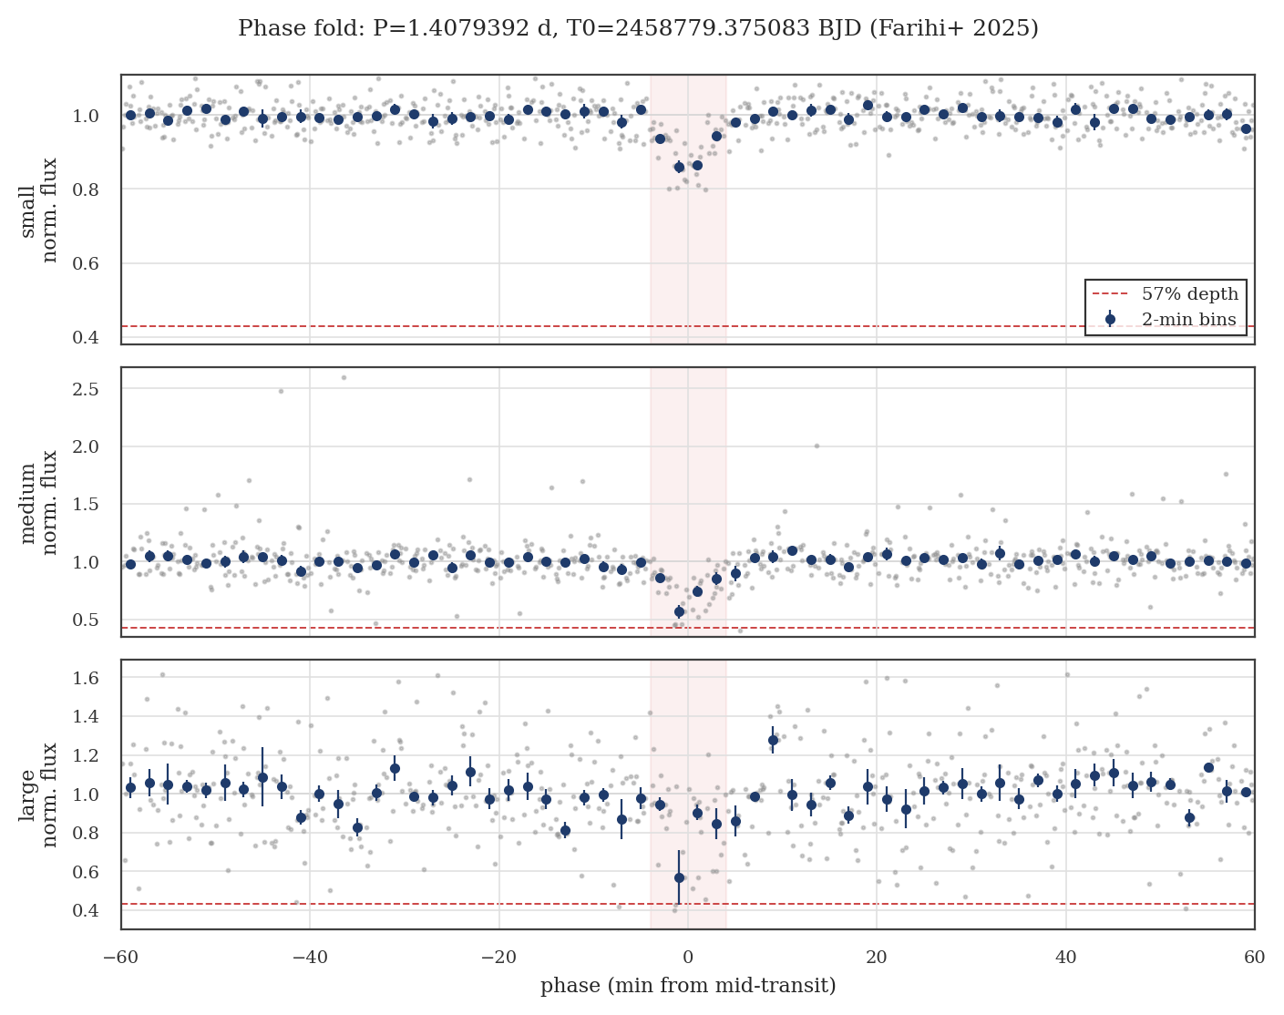
TALK CORE
Use S56 / WD 1856 as the gate before scaling.
WD 1856
mandatory benchmark
S56
first 200 s pilot sector
PRODUCT
Do we keep the event and enough cadences?
DETREND
Do faint and negative-flux cases behave?
SEARCH
Does it survive ranking and vetting?
WD 1856 S56 phase-fold benchmark
benchmark logic
03 / 19

Slide 4
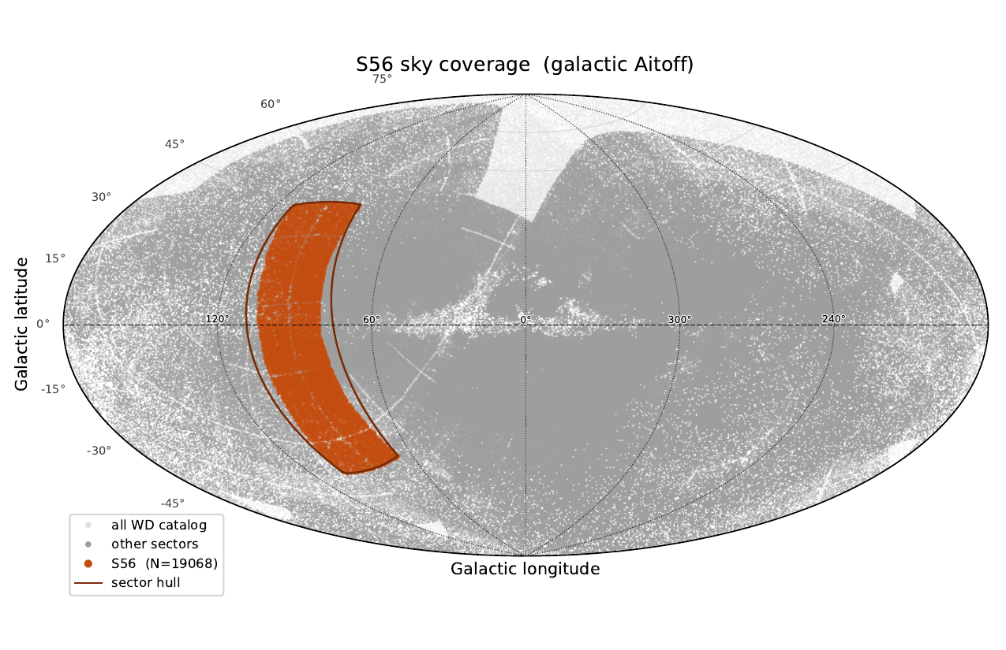
S56 PILOT
The pilot covers real sector geometry.
S56 TWIRL QC PDF, page 2
S56 QC
04 / 19

Slide 5
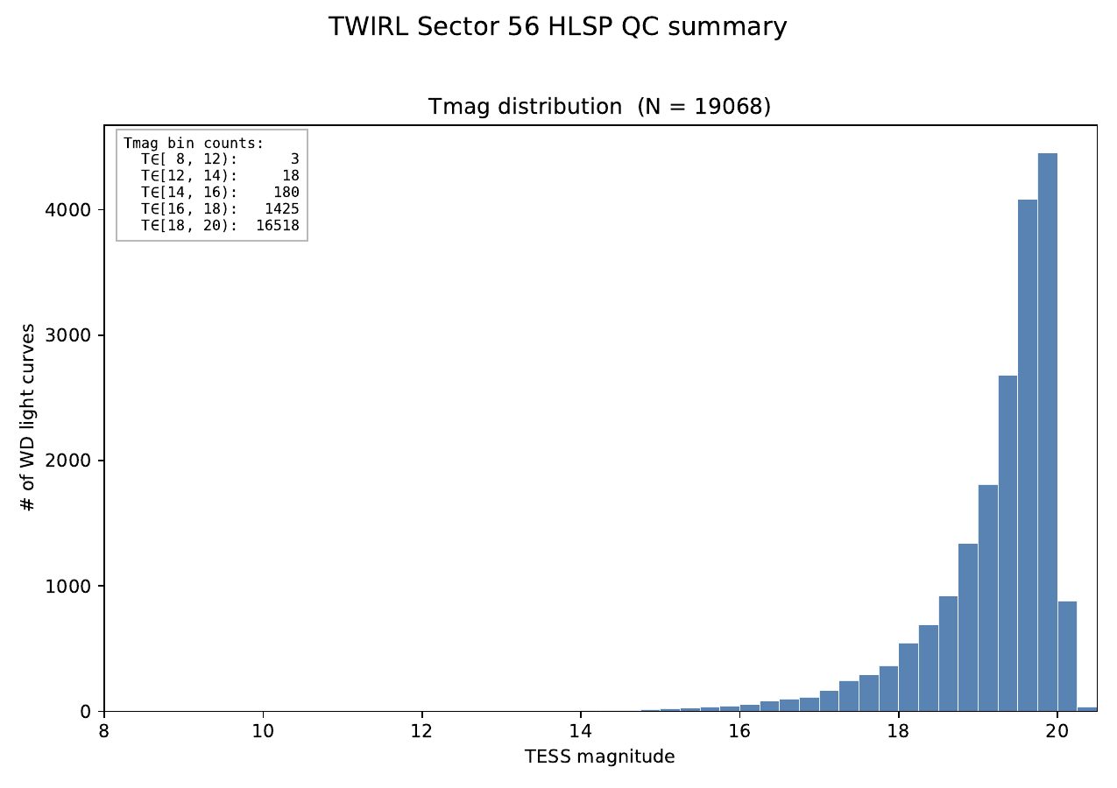
S56 PILOT
The useful stress test lives at the faint end.
S56 TWIRL QC PDF, page 1
S56 QC
05 / 19

Slide 6
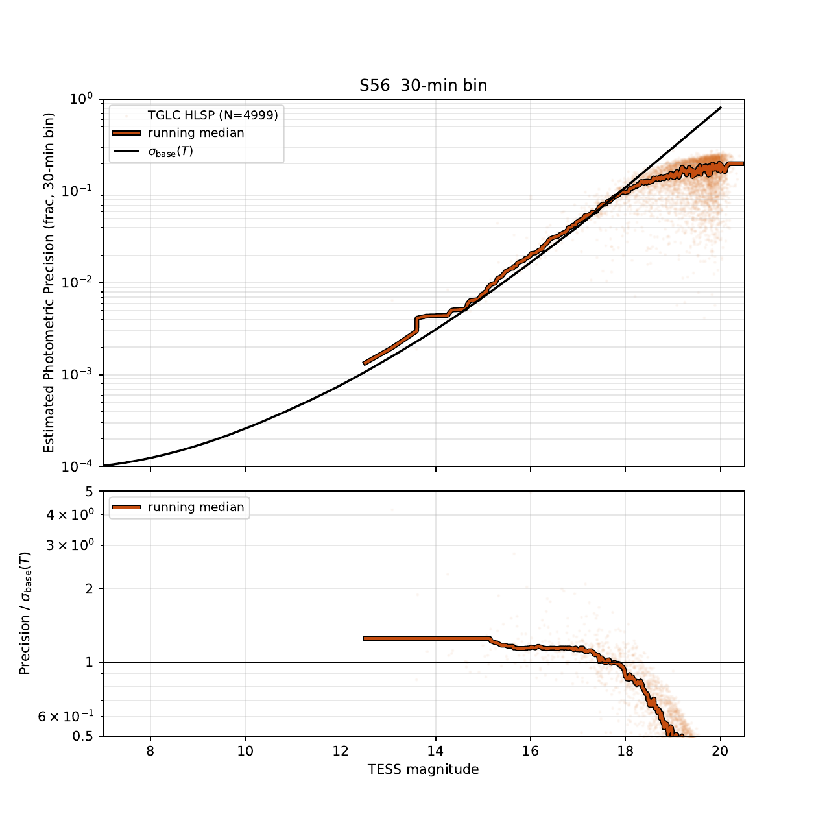
S56 PILOT
Precision QA needs the expected-flux denominator.
open
Regenerate with expected stellar flux.
do not claim
Current DET_FLUX scatter is robust-scale normalized.
next
Use this as a product-gate plot once fixed.
Current precision diagnostic; not yet a final physical precision claim
S56 QC
06 / 19

Slide 7
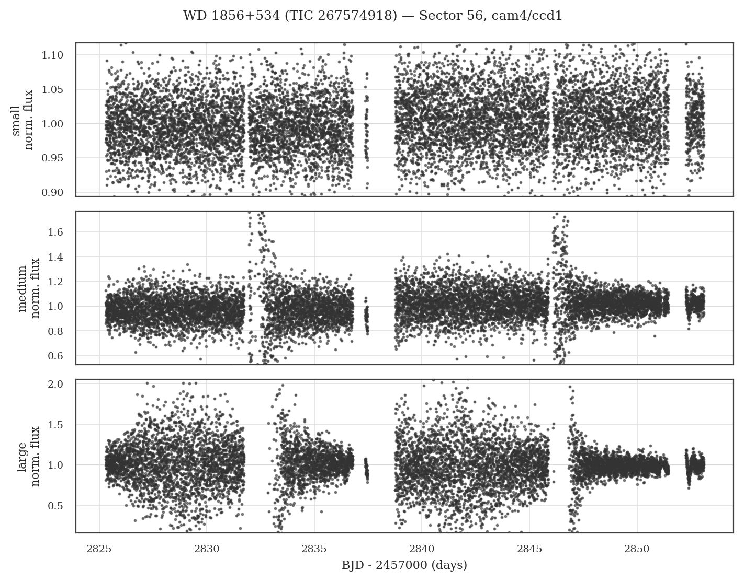
WD 1856
The benchmark event is visible in the S56 product.
WD 1856 S56 full light curve
WD 1856 core
07 / 19

Slide 8
WD 1856
Phase-folding turns recovery into an aperture test.
WD 1856 S56 phase-fold
WD 1856 core
08 / 19

Slide 9
WD 1856
The event is deep, short, and aperture-visible.
57%
published benchmark depth line appears in the plot
3 apertures
small, medium, and large aperture panels
question
what level of aperture agreement is enough?
phase-fold benchmark, S56 TWIRL product
WD 1856 core
09 / 19

Slide 10
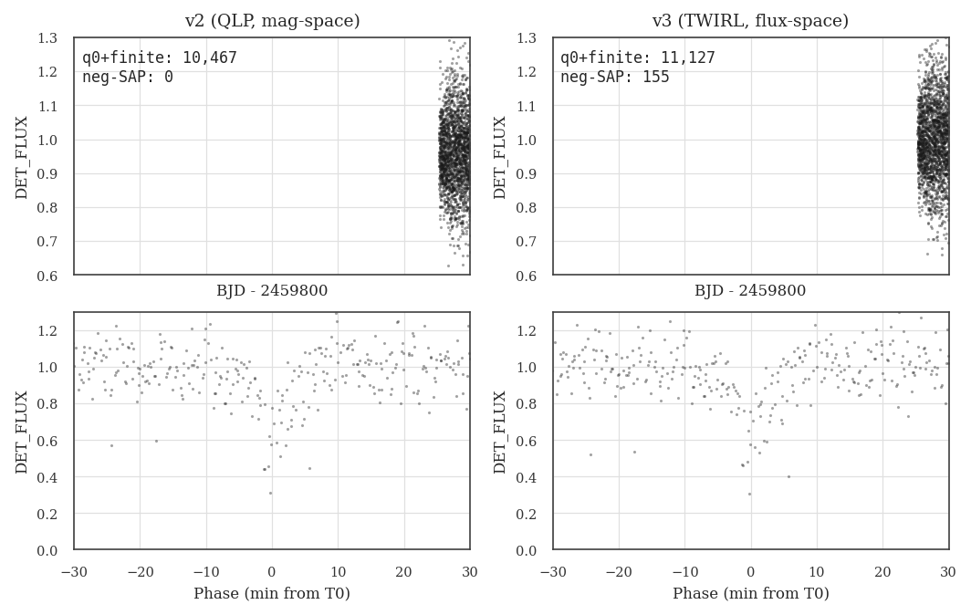
WD 1856
TWIRL keeps more usable benchmark cadences than QLP.
product
cadence retention matters before search
benchmark
compare event timing and depth directly
acceptance
document failures before production sectors
WD 1856 v2/v3 comparison
WD 1856 core
10 / 19

Slide 11
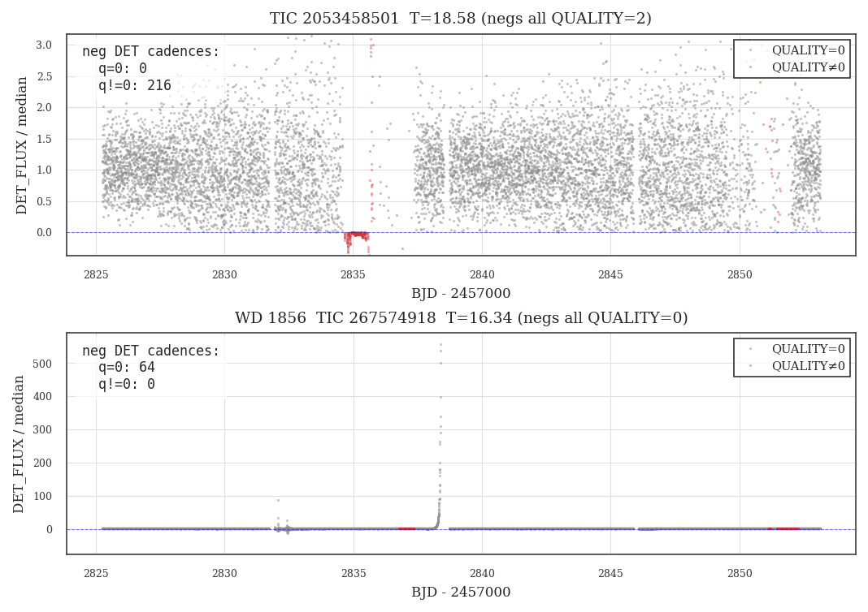
DETRENDING RISK
Negative and near-zero fluxes are the scaling risk.
preserve
do not clip legitimate low-flux cadences
normalize
separate search-scale stability from physical precision
audit
check faint-end behavior before scale-up
negative-flux quality diagnostic
detrending risk
11 / 19

Slide 12
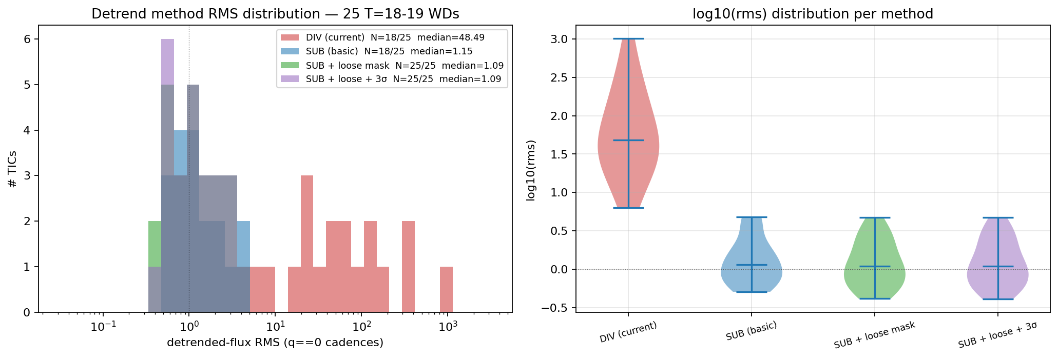
DETRENDING RISK
Subtractive detrending is safer at low flux.
detrend RMS summary
detrending risk
12 / 19

Slide 13
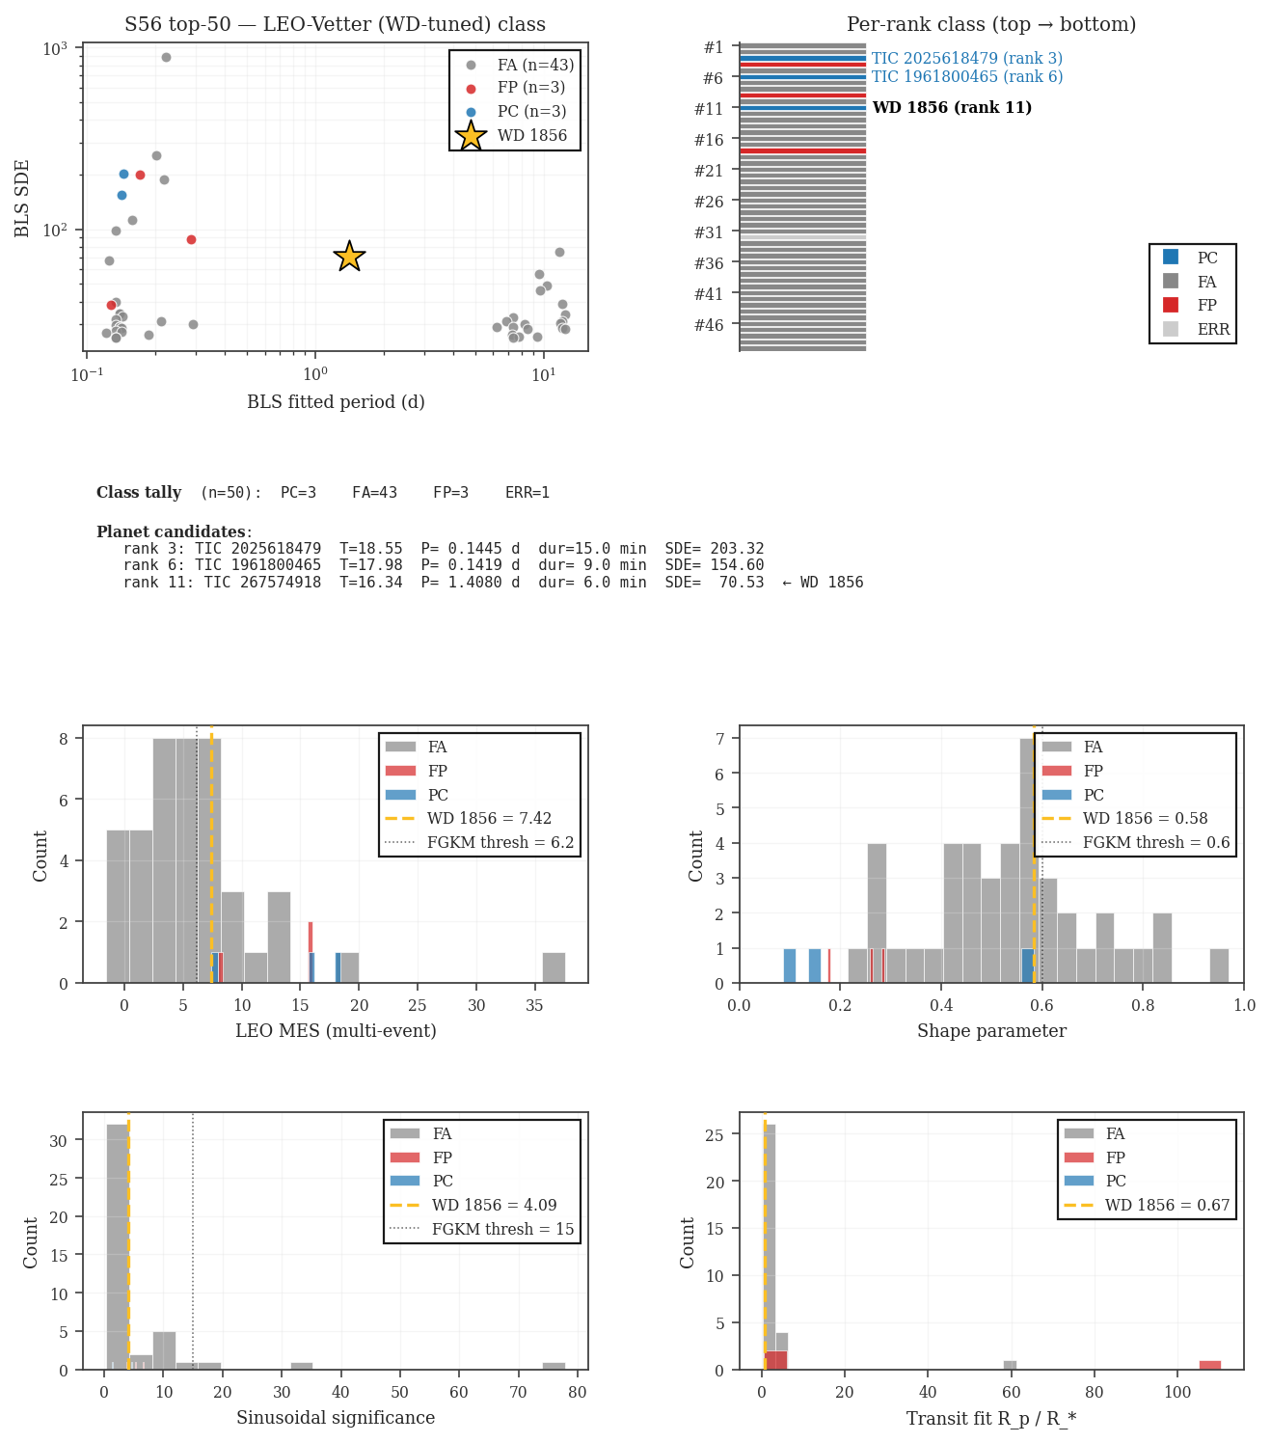
SEARCH + VETTING
Recovery becomes a ranking problem.
rank 11
LEO-vetter top-50 run
TIC 267574918
WD 1856 benchmark target
1.408 d
period recovered near expectation
LEO-vetter S56 top-50 summary
search and vetting
13 / 19

Slide 14
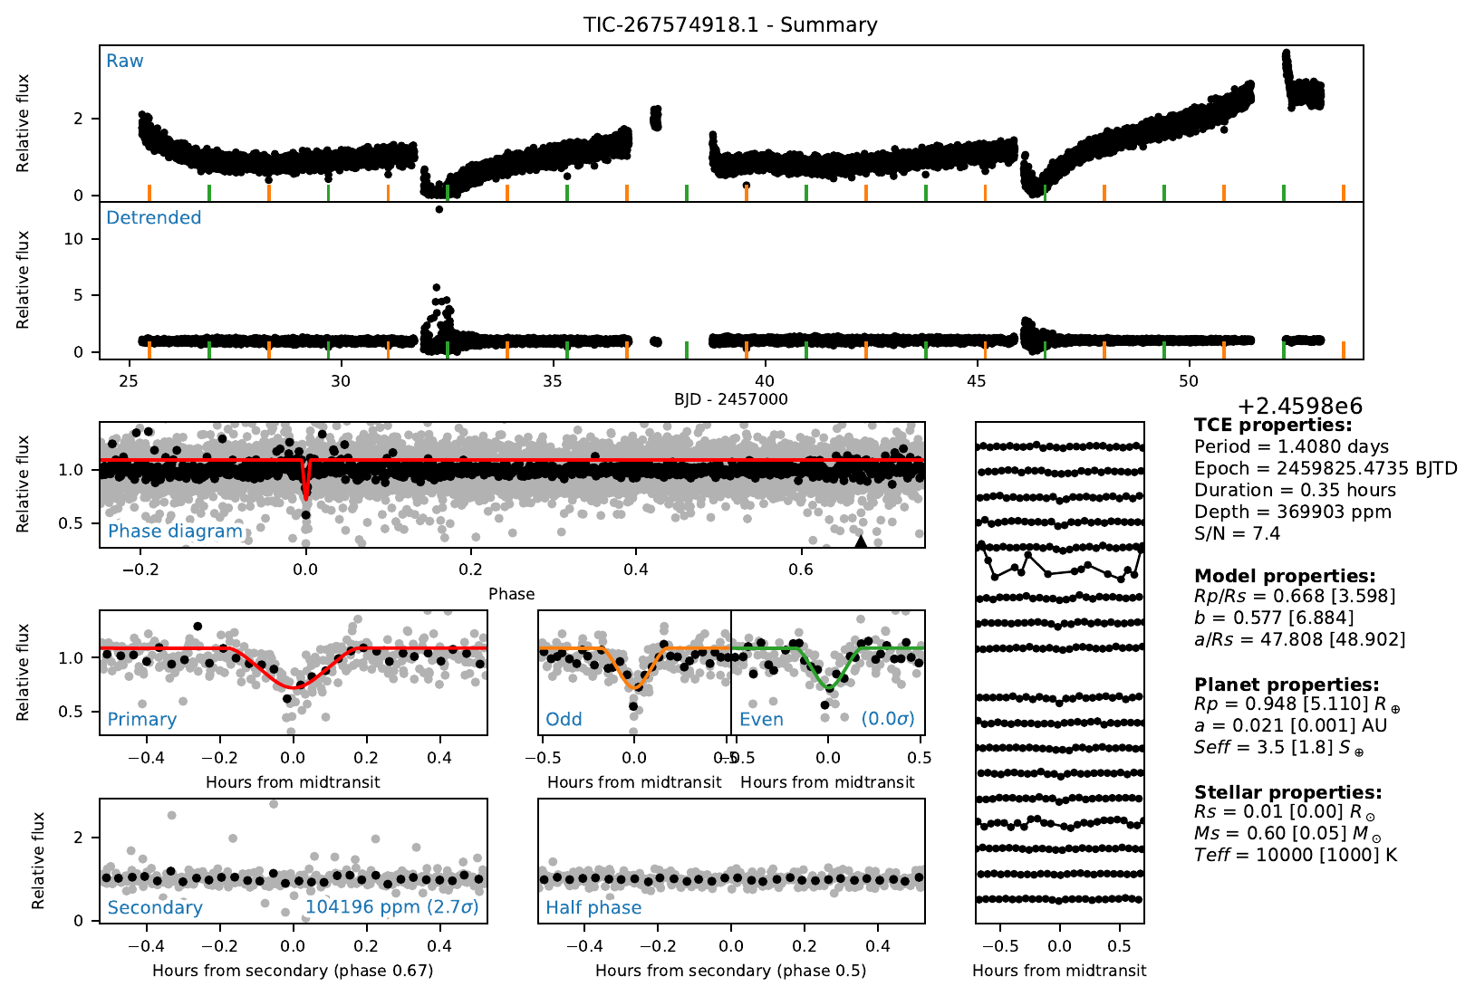
SEARCH + VETTING
The vet sheet is the collaboration audit surface.
PC_rank11_tic0267574918 vet sheet
search and vetting
14 / 19

Slide 15
DECISION
Scope this phase around the benchmark loop.
benchmark
photometric QA
vetter audit
IN NOW
NEXT
NOT YET
S56 product QA, WD 1856 recovery, faint-end detrend decision
labeled HLSP refresh, v2-vs-v3 tables, BLS and LEO checks
occurrence claims, ML-first triage, broad follow-up commitments
benchmark, photometric QA, and vetter audit artifacts
project scope
15 / 19

Slide 16
COLLABORATION
Attach collaboration to benchmark artifacts.
TeHan
Michelle
Group
PRODUCT
REVIEW
CRITERIA
labeled S56 products and provenance
independent validation path
what evidence unlocks scale-up
PLOTS
INTERPRET
AUDIT
benchmark evidence and failure modes
candidate and false-positive context
which vetter failures matter
HANDOFF
FOLLOW-UP
CLAIMS
clear artifacts for review
realistic observing constraints
where to draw the paper boundary
Meeting goal: agree on the benchmark evidence, not the whole survey.
working scope for TeHan, Michelle, and group feedback
collaboration
16 / 19

Slide 17
COMPLETENESS DESIGN
Injections answer two different questions.
LC-level injections
fast dense grid
Pixel-level injections
slower calibration
HLSP/HDF5
->
detrend
->
BLS + vetter
pixels
->
ePSF + LC
->
same stack
Tests detrending, search, and vetting on current products.
Inject before extraction to include aperture choice and deblending.
Cheap enough for dense grids over depth, duration, period, and Tmag.
Captures centroid and crowded-field failures.
Does not include extraction, crowding, or deblending failures.
Needed before publication-grade occurrence rates.
Dense grid now -> pixel calibration next -> occurrence-rate claim later
TWIRL Stage 3 design framing
injection-recovery
17 / 19

Slide 18
DISCUSSION
Questions to ask in the room.
Andrew / Kevin
What would convince you that WD 1856 is recovered well enough?
Michelle
Where should independent validation enter the loop?
Group
Which failure modes block scaling from S56 to production sectors?
meeting prompts
discussion
18 / 19

Slide 19
TAKEAWAY
Scale only after the benchmark evidence is stable.
WD 1856 is the gate.
plot evidence first
benchmark
expected-flux precision fix
product QA
scale criteria
group decision
close
19 / 19

