Slide 1
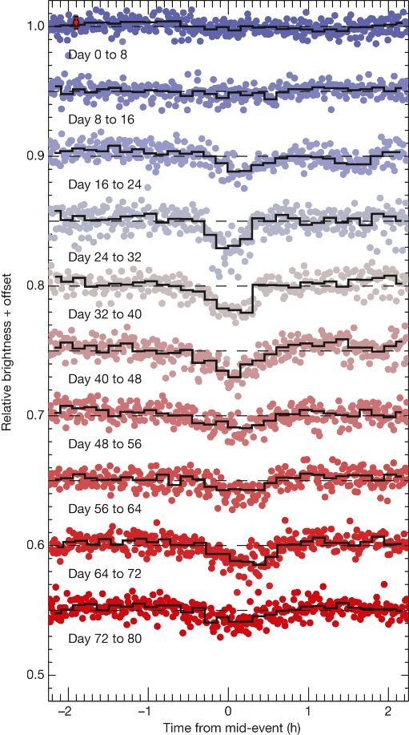

Evolution of the K2 transit light curve
over 80 days of observations.
A Vanderburg et al. Nature 526, 546-549 (2015) doi:10.1038/nature15527

