Slide 1
TWIRL · CANDIDATE + MODEL UPDATE
S56–S62 candidates
and model status
Julien team meeting · 6 August 2026
Human morphology, teacher models, and leakage-safe SSL
Notes:
Open with the honest framing: this is a candidate-enrichment and model-development update. It is not a discovery announcement or occurrence-rate result.
[Sources]
- /Users/tehan/PycharmProjects/TWIRL/reports/stage5_validation/s56_s62_morphology_corpus_teacher_v3_v1/accepted_signal_rereview.csv (frozen S56–S62 signal review)
- /Users/tehan/PycharmProjects/TWIRL/doc/twirl_plan.md (project scope and claim boundaries)

Slide 2
TWIRL · S56–S62
We have an auditable review system—not a final classifier.
Ready to show: uniform current-ADP sheets, frozen human decisions, and a calibrated Teacher v3 enrichment result. Active now: matched development evaluation of the five SSL encoders.
509
80
5×20
human-reviewed top-signal observations
493 unique TICs
Planet-like + broad/wide-transit morphologies
75 unique TICs
full-pool SSL fold encoders × epochs
100 completed epochs
Not yet claimable: confirmed objects, survey-wide classification, completeness, or occurrence.
2
Notes:
Use this as the one-slide status summary. Emphasize the distinction between completed human/model evidence and unfinished scientific validation.
[Sources]
- /Users/tehan/PycharmProjects/TWIRL/reports/stage5_validation/s56_s62_morphology_corpus_teacher_v3_v1/accepted_signal_rereview.csv (509 reviewed observations; 493 TICs)
- /Users/tehan/PycharmProjects/TWIRL/reports/stage5_validation/s56_s62_morphology_corpus_teacher_v3_v1/summary.json (final labels)
- ORCD read-only status snapshot, 2026-08-06 10:59 EDT: five 20-epoch encoders validated; matched development evaluation running as job 19773235.

Slide 3
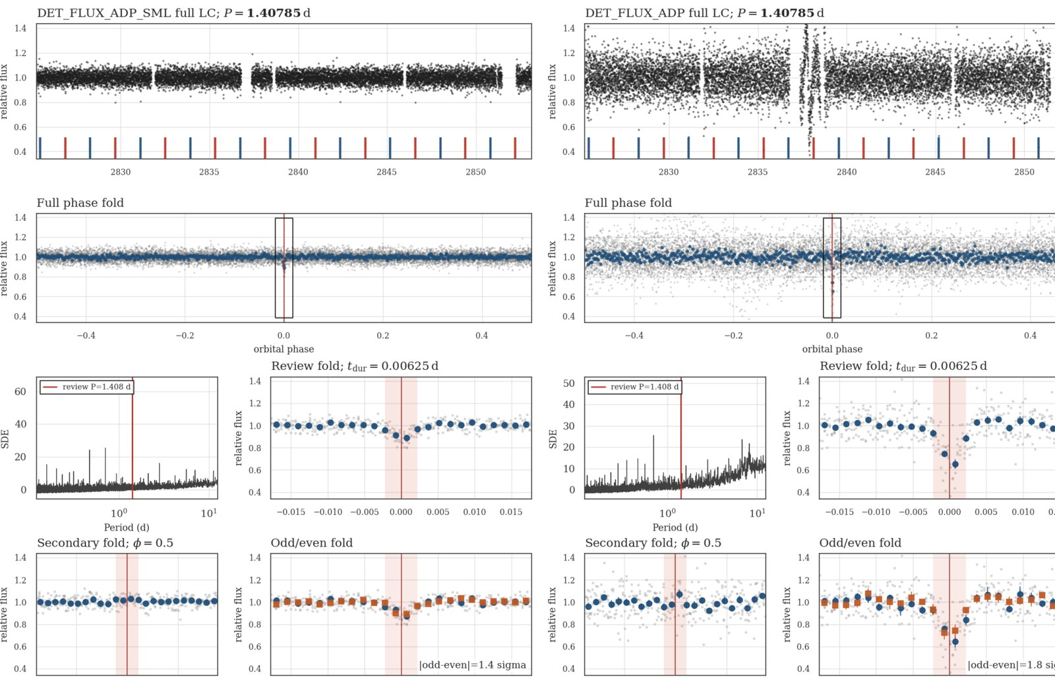
TWIRL · S56–S62
WD 1856 b is recovered in both active ADP apertures.
KNOWN BENCHMARK
1.407845 d
displayed current-ADP period
Rank one in both active ADP apertures.
S56 product contains 31,450 target FITS files.
31,446 targets pass the paired-teacher usability contract.
A benchmark recovery verifies one favorable system—not survey completeness.
TIC 267574918 · S56 · current A2v1 ADP-small + ADP primary
3
Notes:
This is the mandatory engineering benchmark. Do not generalize the benchmark recovery into a completeness claim.
[Sources]
- /Users/tehan/PycharmProjects/TWIRL/data_local/label_reviews/s56_s62_signal_rereview/vet_sheets_s56_s62_a2v1_current_adp_v1/s0056-signal-final-fa319f28ac03d711_twirl_twoap_current_adp.png (uniform current-ADP sheet)
- /Users/tehan/PycharmProjects/TWIRL/doc/twirl_plan.md (S56 QA and paired-teacher eligibility)

Slide 4
TWIRL · JULIEN COMPARISON
Julien’s ten-system comparison already improved A2v1.
The comparison was useful twice: it confirmed period-level agreement for the available products and exposed a real faint-target emission defect in the legacy extraction.
9/10
9/9
1
legacy S56 light-curve products existed
available periods matched directly or by an integer harmonic
old Tmag<20 target-emission gap
now fixed at extraction level
The tenth system has not yet been rerendered against Julien’s period; two of the original nine remain aperture-disagreement discussion cases.
4
Notes:
Frame this as a concrete collaboration win. The period comparison is not astrophysical confirmation. The old missing product was a selection failure, and A2v1 fixed target emission, but the tenth signal comparison remains to be rerun.
[Sources]
- /Users/tehan/PycharmProjects/TWIRL/reports/stage5_validation/julien_s56_10_systems_compare/summary.md
- /Users/tehan/PycharmProjects/TWIRL/reports/stage5_validation/julien_s56_10_systems_compare/julien_twirl_s56_10_comparison_human_label_fullphase_binmatch.csv
- /Users/tehan/PycharmProjects/TWIRL/doc/twirl_progress_log.md (A2v1 no-cap extraction history)

Slide 5
TWIRL · S56–S62
The final review gives us a concrete candidate atlas.
509 / 493
reviewed observations / TICs
70 + 10
Planet-like + broad/wide morphologies
419
EB/PCEB morphologies · 408 TICs
Enriched morphology review—not an unbiased sector sample and not a confirmed-object catalog.
5
Notes:
The appendix contains every final Planet-like and broad/wide-transit observation. The companion folder links to all 509 full-resolution sheets. Keep observation counts separate from unique TIC counts.
[Sources]
- /Users/tehan/PycharmProjects/TWIRL/reports/stage5_validation/s56_s62_morphology_corpus_teacher_v3_v1/accepted_signal_rereview.csv (final 509-row signal review)
- /Users/tehan/PycharmProjects/TWIRL/reports/stage5_validation/s56_s62_morphology_corpus_teacher_v3_v1/summary.json (label counts)

Slide 6
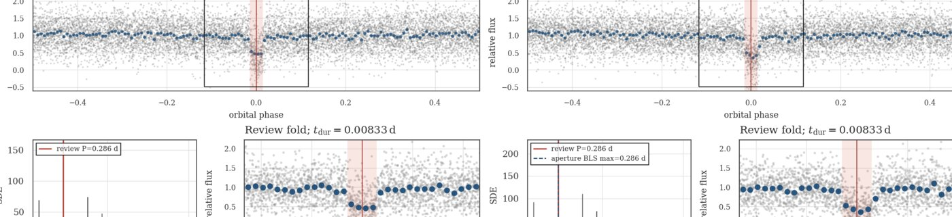
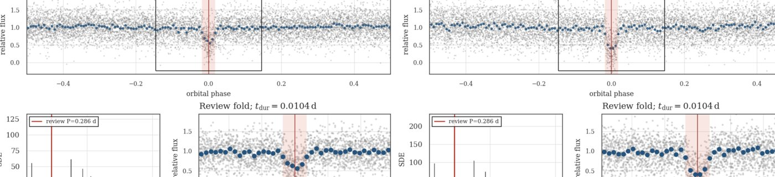
TWIRL · S56–S62
Five Planet-like hosts repeat across S56 and S57.
S56 · TIC 1201294971 · P = 0.286004 d
Repeated Planet-like TICs
160520962 0.201802 / 0.201781 d
1201294971 0.286004 / 0.286041 d
1400739415 0.127764 / 0.127759 d
1400704733 0.363707 / 0.363705 d
1400855795 0.134018 / 0.134001 d
S57 · TIC 1201294971 · P = 0.286041 d
Priority for independent re-extraction and localization—not yet a multi-sector confirmation. Three hosts carry explicit morphology caveats.
6
Notes:
Use the repeated-host list to choose concrete follow-up discussion cases. The pipeline does not yet merge multi-sector evidence, and repeated morphology is not confirmation.
[Sources]
- /Users/tehan/PycharmProjects/TWIRL/reports/stage5_validation/s56_s62_morphology_corpus_teacher_v3_v1/accepted_signal_rereview.csv (five repeated Planet-like TICs)
- /Users/tehan/PycharmProjects/TWIRL/data_local/label_reviews/s56_s62_signal_rereview/vet_sheets_s56_s62_a2v1_current_adp_v1/s0056-signal-final-3998c7adefa6536a_twirl_twoap_current_adp.png
- /Users/tehan/PycharmProjects/TWIRL/data_local/label_reviews/s56_s62_signal_rereview/vet_sheets_s56_s62_a2v1_current_adp_v1/s0057-signal-final-2ef8c3bacdf529f3_twirl_twoap_current_adp.png

Slide 7
TWIRL · TEACHER MODELS
Each teacher answered a different development question.
TEACHER V1 · S56
TEACHER V2 · EXPLORATORY
TEACHER V3 · S56–S62
Proved active-learning value
Exposed injection–real tradeoff
Frozen leakage-safe enrichment
Balanced accuracy 0.750, macro F1 0.757—but only two real Planet-like test examples.
77.21% injection retention conditional on BLS, but missed the 80% gate and degraded real morphology. Rejected.
Same v1 architecture, larger audited corpus, grouped splits, calibration, and one fixed-test opening.
Teacher v3 is the current operational enrichment release; v2 is not a production ranker or pseudo-label generator.
7
Notes:
Teacher v3 is not a new architecture; it is the frozen seven-sector data/training release of the v1 architecture. The rejected v2 result is useful evidence that injection retention alone is not sufficient.
[Sources]
- /Users/tehan/PycharmProjects/TWIRL/doc/twirl_progress_log.md (Teacher v1/v2/v3 results)
- /Users/tehan/PycharmProjects/TWIRL/reports/stage5_validation/teacher_v3_s56_s62_a2v1_current_adp/performance/README.md

Slide 8
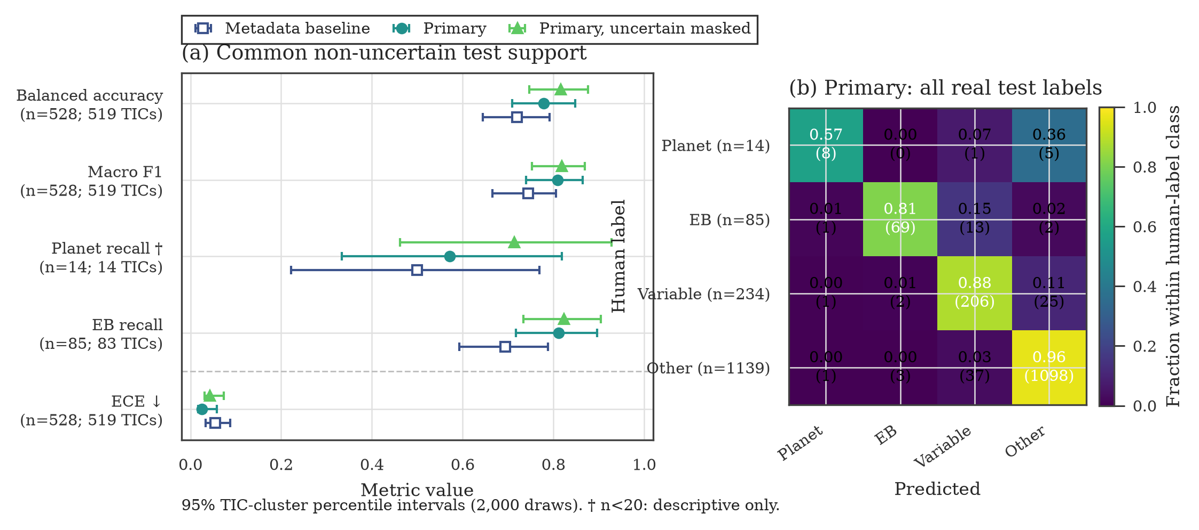
TWIRL · TEACHER V3
Teacher v3 adds useful shape information.
Shared 528-row real non-uncertain fixed-test support: balanced accuracy 0.720 → 0.779; macro F1 0.744 → 0.809.
Planet-like recall is 8/14 and remains descriptive; uncertain-masked retraining improves BA to 0.817, so label policy is a central uncertainty.
8
Notes:
Lead with the improvement over the metadata-only control, then immediately state the small Planet-like support and the uncertain-label sensitivity. Teacher v3 is frozen for enrichment only.
[Sources]
- /Users/tehan/PycharmProjects/TWIRL/reports/stage5_validation/teacher_v3_s56_s62_a2v1_current_adp/performance/teacher_v3_performance.png
- /Users/tehan/PycharmProjects/TWIRL/reports/stage5_validation/teacher_v3_s56_s62_a2v1_current_adp/performance/teacher_v3_performance_metrics.csv
- /Users/tehan/PycharmProjects/TWIRL/reports/stage5_validation/teacher_v3_s56_s62_a2v1_current_adp/performance/teacher_v3_performance.provenance.json

Slide 9
TWIRL · S56–S62
Why this is not yet an all-around survey classifier.
Rare positive support
Label policy changes the answer
Only 14 real Planet-like rows sit on the Teacher v3 non-uncertain fixed-test support.
Masking the dominant uncertain class materially improves the matched metrics.
Search scope is still narrow
Prospective validation is sealed
Models see periodic rank-one BLS views. The dip branch and multi-sector inference are not production-ready.
S63 remains unopened; no pseudo-labels or student model exist; end-to-end completeness is not frozen.
Current role: rank and enrich human review—not automatically classify the survey.
9
Notes:
This slide answers the user's concern directly. The model is useful without being described as general-purpose. Student pseudo-labeling remains blocked.
[Sources]
- /Users/tehan/PycharmProjects/TWIRL/doc/twirl_plan.md (model and search gates)
- /Users/tehan/PycharmProjects/TWIRL/doc/ideas.md (rare-factor and validation questions)
- /Users/tehan/PycharmProjects/TWIRL/reports/stage5_validation/teacher_v3_s56_s62_a2v1_current_adp/performance/README.md

Slide 10
TWIRL · TEACHER V4-SSL
SSL pretraining is complete; transfer evaluation is live.
Teacher v4-SSL uses the harmonic encoder with VICReg over the broad, leakage-safe S56–S62 real-light-curve pool. It is a representation experiment—not yet a survey classifier.
175,366
175,347
5 / 100
audit observations
125,630 TICs
model-eligible observations
19 locked exclusions
validated encoders / completed epochs
20 epochs per fold
Pretraining excluded labels, injections, whole-TIC fixed-test hosts, and S63 tensors. As of 10:59 EDT, matched development transfer evaluation was running; no v4 transfer metric is quoted here.
10
Notes:
State the exact current status. Five encoders are complete and validated. The downstream development-only comparison was still running at the status snapshot, so this deck intentionally does not quote incomplete v4 metrics.
[Sources]
- /Users/tehan/PycharmProjects/TWIRL/src/twirl/vetting/teacher_ssl_fullpool.py (full-pool contract)
- /Users/tehan/PycharmProjects/TWIRL/src/twirl/vetting/teacher_ssl_fullpool_evaluation.py (matched development evaluation)
- ORCD read-only status snapshot, 2026-08-06 10:59 EDT: job 19773235 running; five-fold completion release validated 5 folds × 20 epochs.

Slide 11
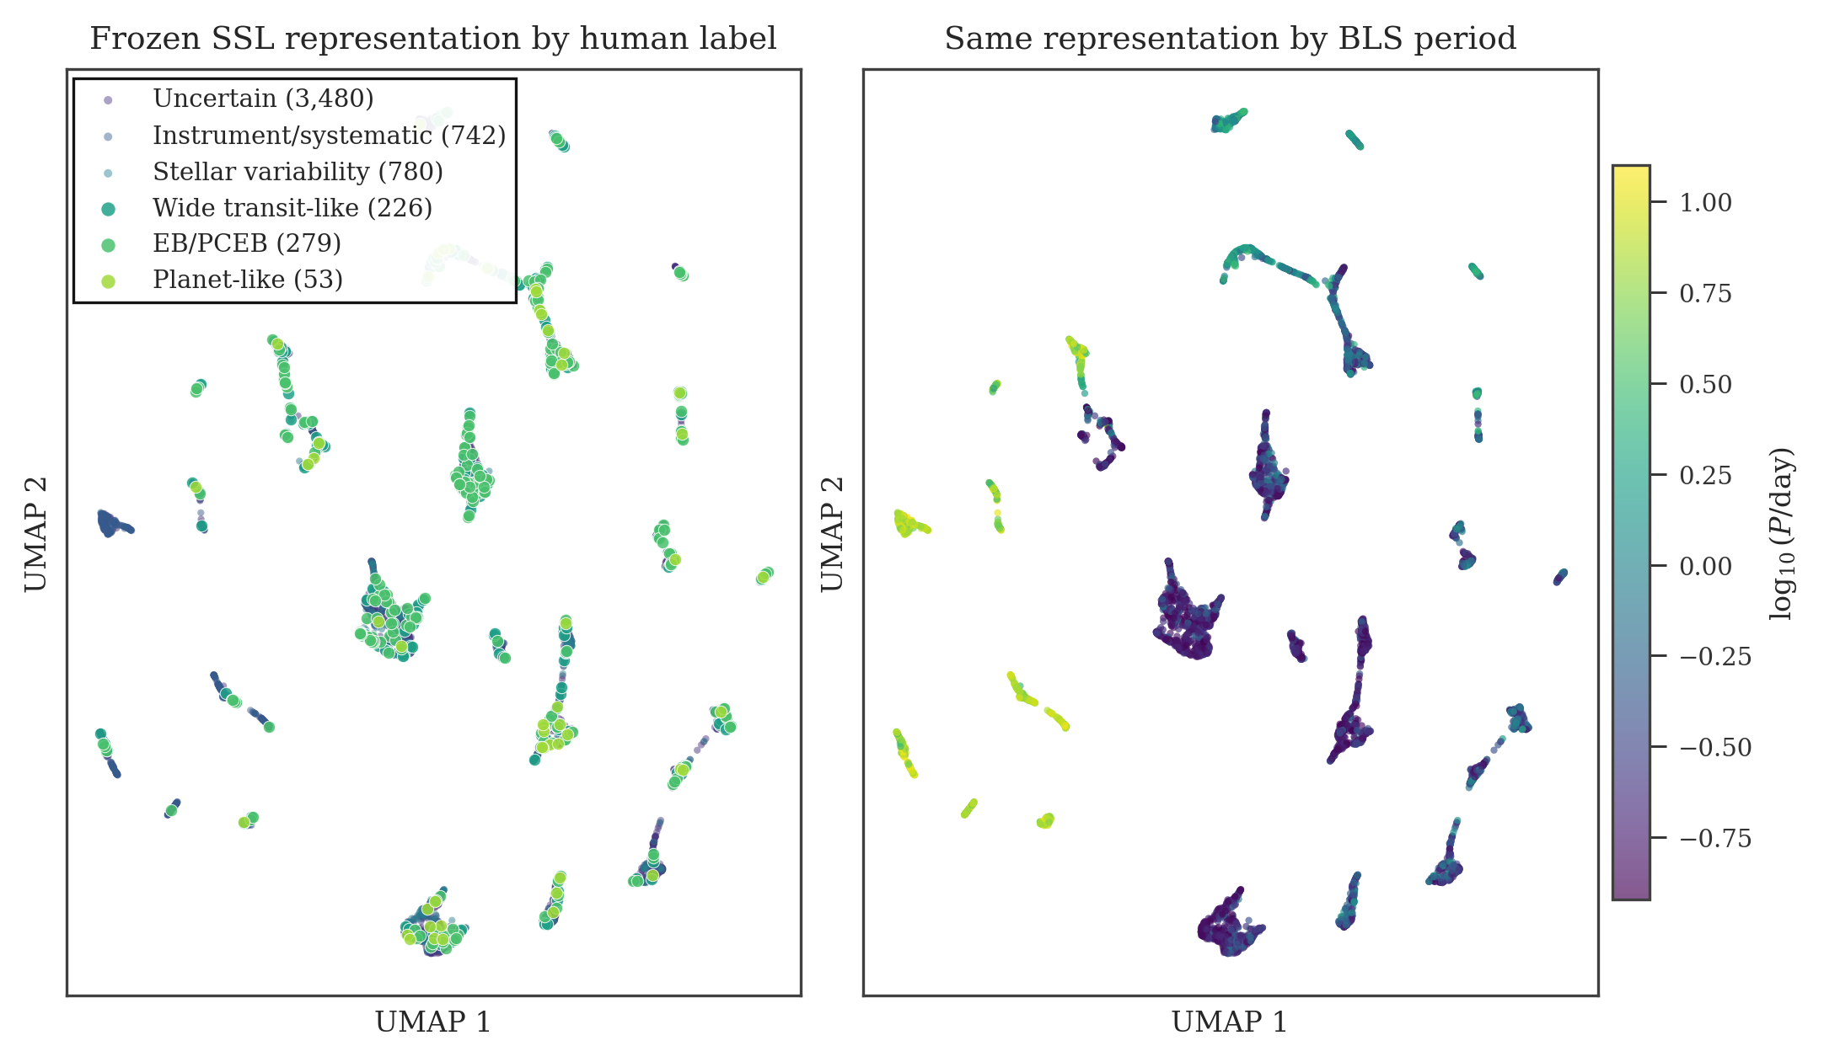
TWIRL · REPRESENTATION DIAGNOSTIC
SSL learned structure—but much of it tracks BLS period.
ONE-FOLD EXPLORATORY VIEW
5,560 labeled development rows overlaid on frozen fold-0 embeddings.
The geometry is highly structured; human labels still overlap.
Strong period ordering makes this a useful confound diagnostic.
UMAP is not a transfer-performance estimate.
The matched Teacher v3 comparison—not the embedding picture—decides whether SSL helps.
11
Notes:
Do not read class separation or accuracy from this figure. It is one reference embedding used to inspect representation and confounding. The period-colored view shows why the matched transfer evaluation is necessary.
[Sources]
- /Users/tehan/PycharmProjects/TWIRL/reports/stage5_validation/teacher_ssl_fullpool_v4_development_performance/teacher_ssl_fullpool_reference_umap.png (exploratory fold-0 visualization, generated 2026-08-05)
- /Users/tehan/PycharmProjects/TWIRL/reports/stage5_validation/teacher_ssl_fullpool_v4_development_performance/reference_fold_0_umap.summary.json

Slide 12
MEETING DECISIONS
Agree on a candidate shortlist
and one prospective test.
1. Shortlist 10–20 of the 80 transit/dip-like morphologies; prioritize repeated hosts and aperture-consistent signals.
2. Validate divide independent extraction, pixel localization, crowding, and archival checks.
3. Test prospectively freeze the S63 queue, thresholds, random control, and metrics before blind review.
No discovery, all-around classifier, or occurrence claim is needed for this meeting.
Notes:
End with decisions Julien's team can help make. Candidate validation and a sealed prospective test are the most useful next contributions.
[Sources]
- /Users/tehan/PycharmProjects/TWIRL/doc/twirl_plan.md (immediate priorities and S63 prospective gate)
- /Users/tehan/PycharmProjects/TWIRL/doc/ideas.md (candidate validation and follow-up questions)

Slide 13
APPENDIX · HUMAN MORPHOLOGY ATLAS
All 80 transit/dip-like
observations
70 Planet-like + 10 broad/wide-transit morphologies · S56–S62
Full-resolution sheets and an 80-row index are in the companion folder. These are morphology decisions, not confirmed astrophysical classes.
13
Notes:
Use the slide sorter to jump into the atlas. Each panel shows the uniform current-ADP full-phase and review-fold region for both active apertures.
[Sources]
- /Users/tehan/PycharmProjects/TWIRL/reports/stage5_validation/s56_s62_morphology_corpus_teacher_v3_v1/accepted_signal_rereview.csv
- /Users/tehan/PycharmProjects/TWIRL/data_local/label_reviews/s56_s62_signal_rereview/vet_sheets_s56_s62_a2v1_current_adp_v1 (509 verified 2176×2304 PNG sheets)

Slide 14
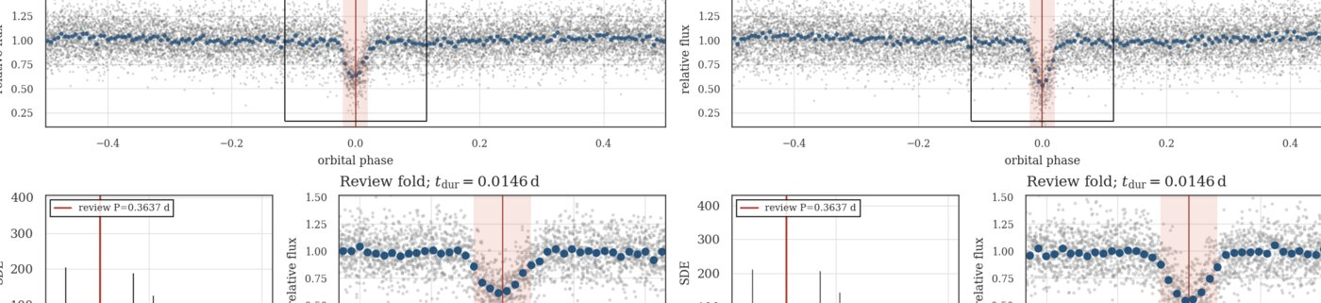
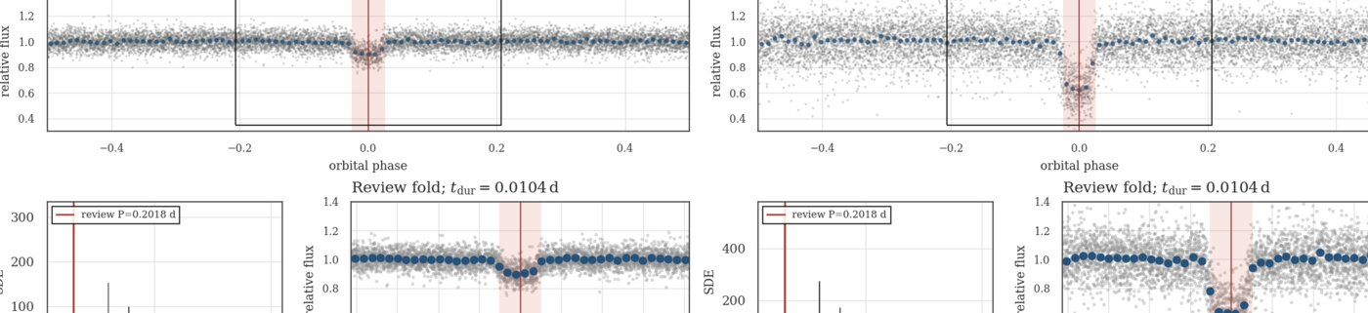
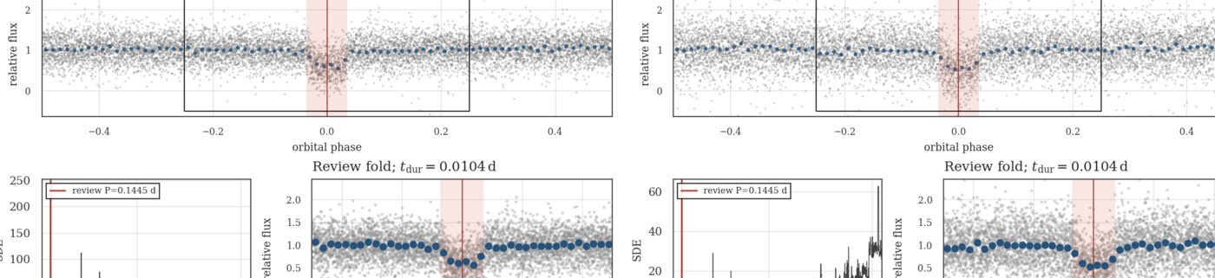
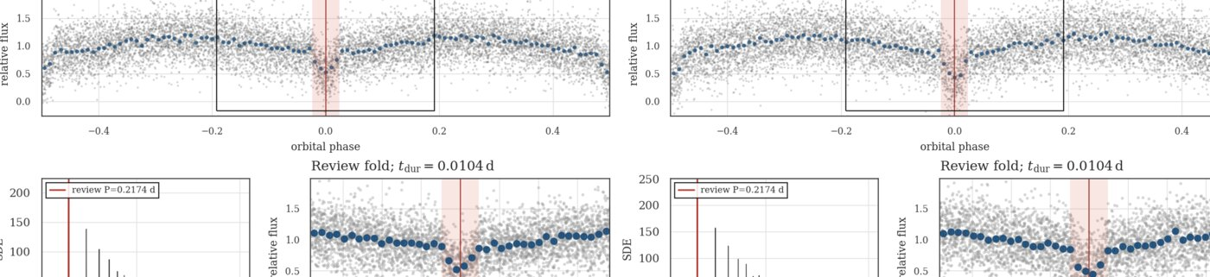
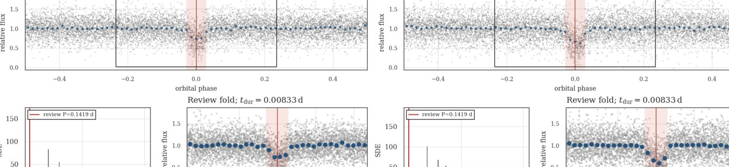
APPENDIX · 1/14
Transit/dip-like morphology atlas · S56
S56 · TIC 1400704733 · Planet-like · P 0.363707 d
S56 · TIC 160520962 · Planet-like · P 0.201802 d
S56 · TIC 2025618479 · Planet-like · P 0.144461 d
S56 · TIC 2025450802 · Planet-like · P 0.217371 d
S56 · TIC 1961800465 · Planet-like · P 0.141931 d
S56 · TIC 1201294971 · Planet-like · P 0.286004 d
Morphology label only · use the linked full-resolution vet sheet for detailed review
14
Notes:
Atlas page. Open the corresponding full-resolution PNG from transit_like_vet_sheets/ when the group wants to inspect a specific signal.
[Sources]
- /Users/tehan/PycharmProjects/TWIRL/reports/stage5_validation/s56_s62_morphology_corpus_teacher_v3_v1/accepted_signal_rereview.csv
- /Users/tehan/PycharmProjects/TWIRL/data_local/label_reviews/s56_s62_signal_rereview/vet_sheets_s56_s62_a2v1_current_adp_v1/s0056-signal-final-31edc7bc5fd7311d_twirl_twoap_current_adp.png
- /Users/tehan/PycharmProjects/TWIRL/data_local/label_reviews/s56_s62_signal_rereview/vet_sheets_s56_s62_a2v1_current_adp_v1/s0056-signal-final-b49a8ea0b5026d93_twirl_twoap_current_adp.png
- /Users/tehan/PycharmProjects/TWIRL/data_local/label_reviews/s56_s62_signal_rereview/vet_sheets_s56_s62_a2v1_current_adp_v1/s0056-signal-final-b9878c04761d81f5_twirl_twoap_current_adp.png
- /Users/tehan/PycharmProjects/TWIRL/data_local/label_reviews/s56_s62_signal_rereview/vet_sheets_s56_s62_a2v1_current_adp_v1/s0056-signal-final-ac9456ad58274d7e_twirl_twoap_current_adp.png
- /Users/tehan/PycharmProjects/TWIRL/data_local/label_reviews/s56_s62_signal_rereview/vet_sheets_s56_s62_a2v1_current_adp_v1/s0056-signal-final-6249fb8f79329475_twirl_twoap_current_adp.png
- /Users/tehan/PycharmProjects/TWIRL/data_local/label_reviews/s56_s62_signal_rereview/vet_sheets_s56_s62_a2v1_current_adp_v1/s0056-signal-final-3998c7adefa6536a_twirl_twoap_current_adp.png

Slide 15
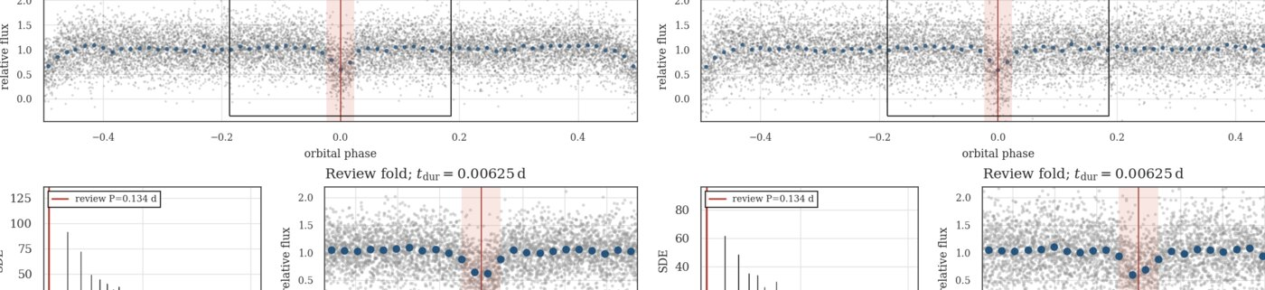
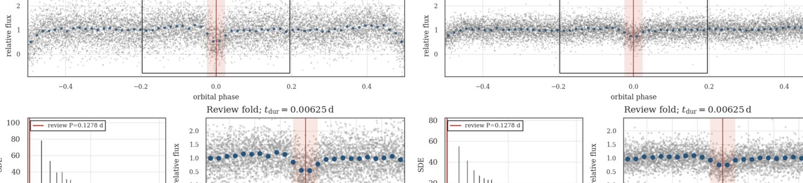
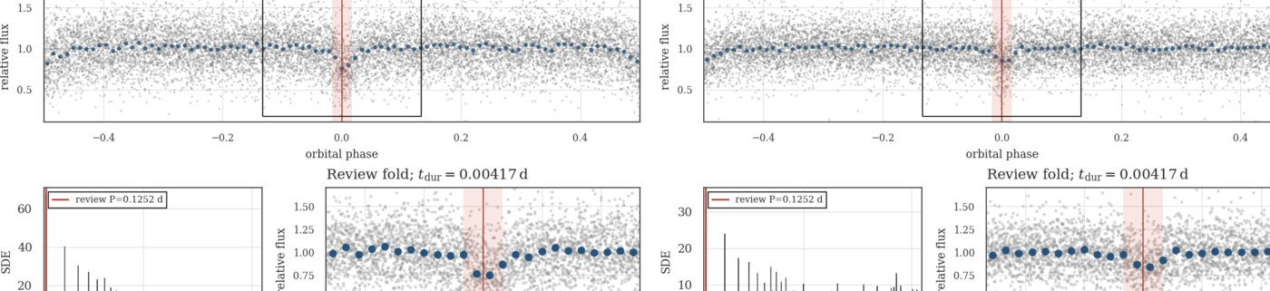
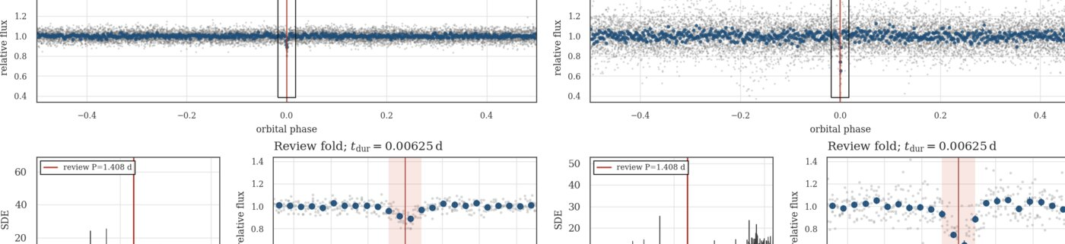
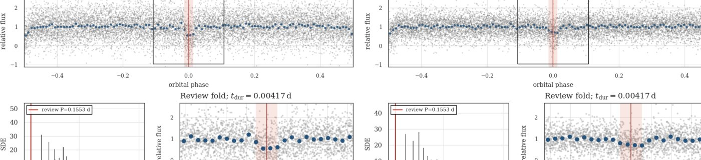
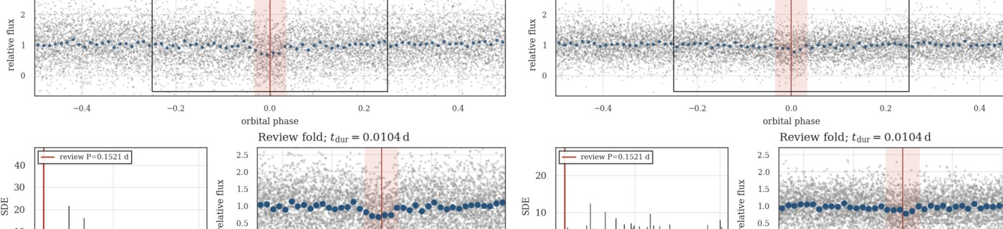
APPENDIX · 2/14
Transit/dip-like morphology atlas · S56
S56 · TIC 1400855795 · Planet-like · P 0.134018 d
S56 · TIC 1400739415 · Planet-like · P 0.127764 d
S56 · TIC 1883349930 · Planet-like · P 0.125189 d
S56 · TIC 267574918 · Planet-like · P 1.407845 d
S56 · TIC 2002732115 · Planet-like · P 0.155253 d
S56 · TIC 1979515854 · Planet-like · P 0.152124 d
Morphology label only · use the linked full-resolution vet sheet for detailed review
15
Notes:
Atlas page. Open the corresponding full-resolution PNG from transit_like_vet_sheets/ when the group wants to inspect a specific signal.
[Sources]
- /Users/tehan/PycharmProjects/TWIRL/reports/stage5_validation/s56_s62_morphology_corpus_teacher_v3_v1/accepted_signal_rereview.csv
- /Users/tehan/PycharmProjects/TWIRL/data_local/label_reviews/s56_s62_signal_rereview/vet_sheets_s56_s62_a2v1_current_adp_v1/s0056-signal-final-224ca258bb689cb3_twirl_twoap_current_adp.png
- /Users/tehan/PycharmProjects/TWIRL/data_local/label_reviews/s56_s62_signal_rereview/vet_sheets_s56_s62_a2v1_current_adp_v1/s0056-signal-final-4fa7b88399c2da0b_twirl_twoap_current_adp.png
- /Users/tehan/PycharmProjects/TWIRL/data_local/label_reviews/s56_s62_signal_rereview/vet_sheets_s56_s62_a2v1_current_adp_v1/s0056-signal-final-30728c379acf5b98_twirl_twoap_current_adp.png
- /Users/tehan/PycharmProjects/TWIRL/data_local/label_reviews/s56_s62_signal_rereview/vet_sheets_s56_s62_a2v1_current_adp_v1/s0056-signal-final-fa319f28ac03d711_twirl_twoap_current_adp.png
- /Users/tehan/PycharmProjects/TWIRL/data_local/label_reviews/s56_s62_signal_rereview/vet_sheets_s56_s62_a2v1_current_adp_v1/s0056-signal-final-a6f2a9615fe1660b_twirl_twoap_current_adp.png
- /Users/tehan/PycharmProjects/TWIRL/data_local/label_reviews/s56_s62_signal_rereview/vet_sheets_s56_s62_a2v1_current_adp_v1/s0056-signal-final-2765f59917273bd4_twirl_twoap_current_adp.png

Slide 16
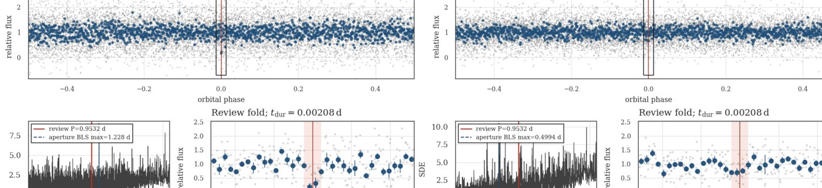
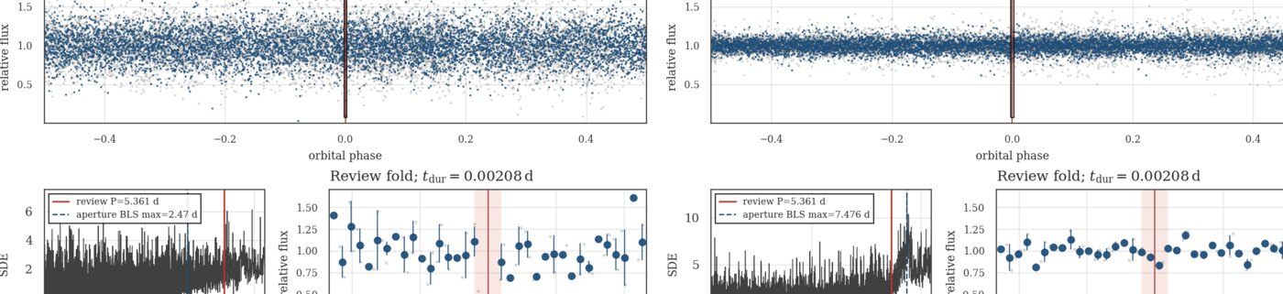
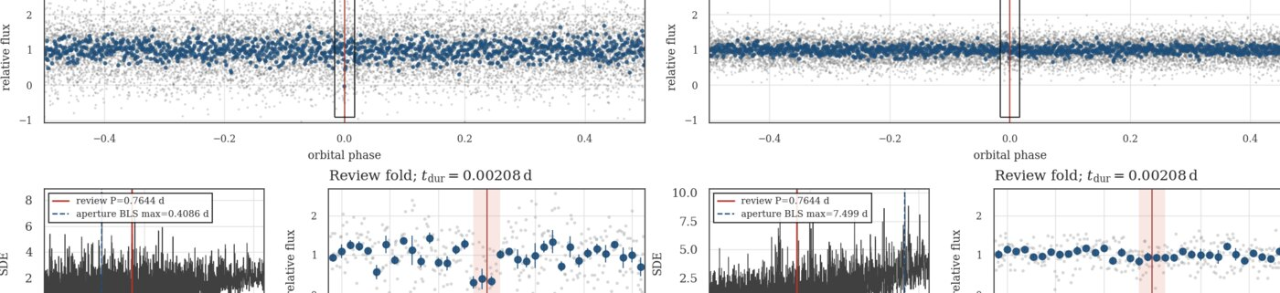
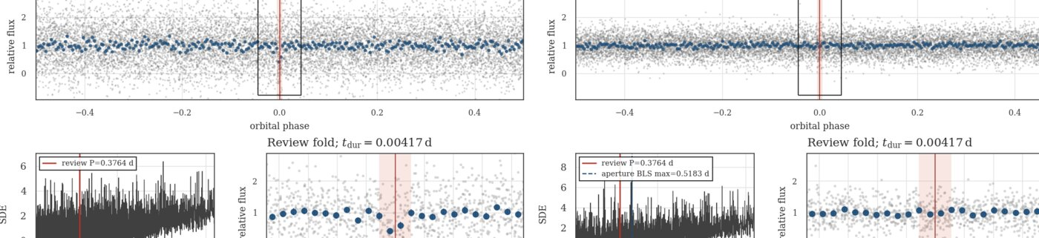
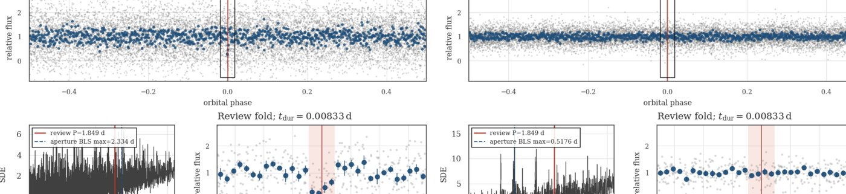
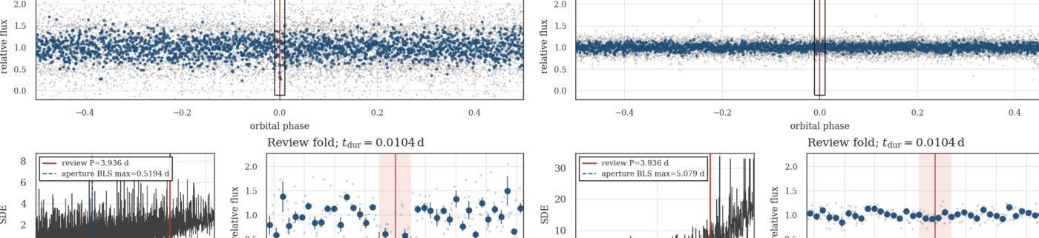
APPENDIX · 3/14
Transit/dip-like morphology atlas · S56
S56 · TIC 2003242089 · Planet-like · P 0.953244 d
S56 · TIC 2013972572 · Planet-like · P 5.360859 d
S56 · TIC 2040434684 · Planet-like · P 0.764402 d
S56 · TIC 2040712491 · Planet-like · P 0.376448 d
S56 · TIC 2040327472 · Planet-like · P 1.849160 d
S56 · TIC 2001332736 · Planet-like · P 3.935513 d
Morphology label only · use the linked full-resolution vet sheet for detailed review
16
Notes:
Atlas page. Open the corresponding full-resolution PNG from transit_like_vet_sheets/ when the group wants to inspect a specific signal.
[Sources]
- /Users/tehan/PycharmProjects/TWIRL/reports/stage5_validation/s56_s62_morphology_corpus_teacher_v3_v1/accepted_signal_rereview.csv
- /Users/tehan/PycharmProjects/TWIRL/data_local/label_reviews/s56_s62_signal_rereview/vet_sheets_s56_s62_a2v1_current_adp_v1/s0056-signal-final-64f323ad5bcc0e36_twirl_twoap_current_adp.png
- /Users/tehan/PycharmProjects/TWIRL/data_local/label_reviews/s56_s62_signal_rereview/vet_sheets_s56_s62_a2v1_current_adp_v1/s0056-signal-final-13d7e6193aaf70eb_twirl_twoap_current_adp.png
- /Users/tehan/PycharmProjects/TWIRL/data_local/label_reviews/s56_s62_signal_rereview/vet_sheets_s56_s62_a2v1_current_adp_v1/s0056-signal-final-20a4b01701676324_twirl_twoap_current_adp.png
- /Users/tehan/PycharmProjects/TWIRL/data_local/label_reviews/s56_s62_signal_rereview/vet_sheets_s56_s62_a2v1_current_adp_v1/s0056-signal-final-c4f2d4208d391924_twirl_twoap_current_adp.png
- /Users/tehan/PycharmProjects/TWIRL/data_local/label_reviews/s56_s62_signal_rereview/vet_sheets_s56_s62_a2v1_current_adp_v1/s0056-signal-final-baf88c7738af9da0_twirl_twoap_current_adp.png
- /Users/tehan/PycharmProjects/TWIRL/data_local/label_reviews/s56_s62_signal_rereview/vet_sheets_s56_s62_a2v1_current_adp_v1/s0056-signal-final-5c3dced678c5e54b_twirl_twoap_current_adp.png

Slide 17
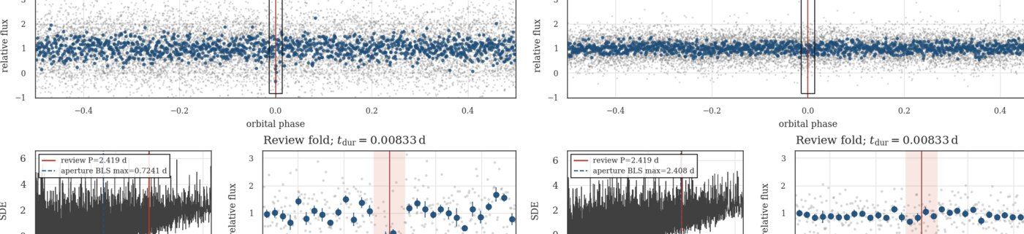
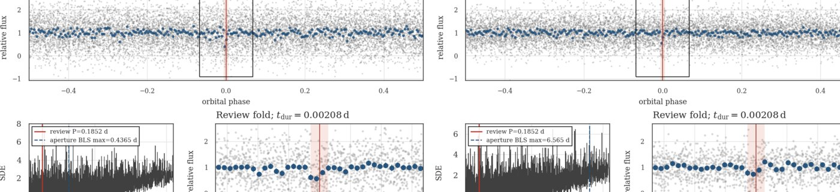
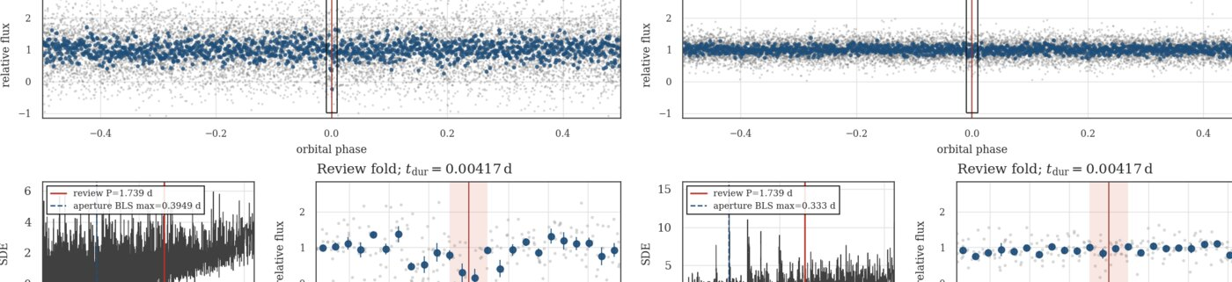
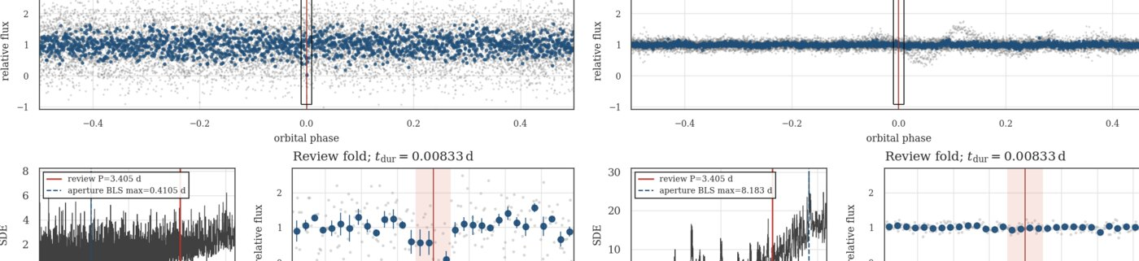
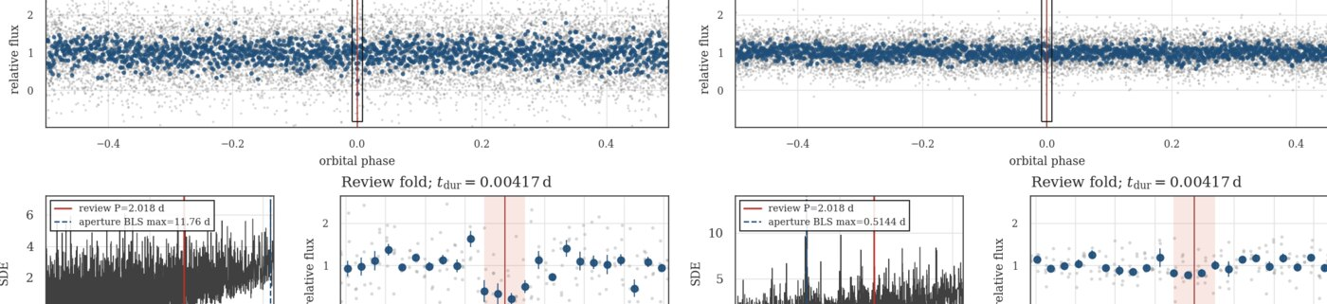
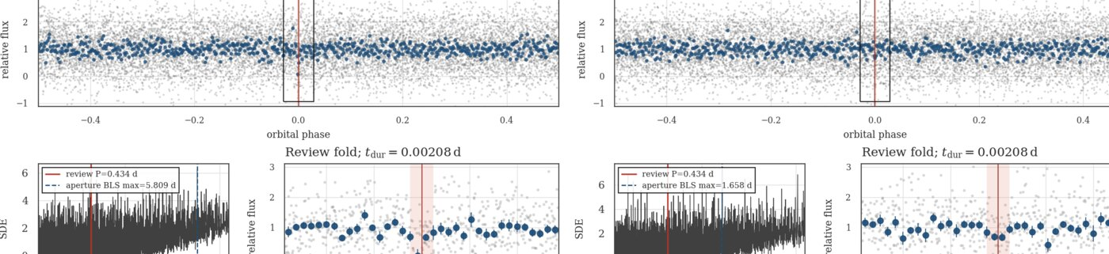
APPENDIX · 4/14
Transit/dip-like morphology atlas · S56
S56 · TIC 1978545466 · Planet-like · P 2.419498 d
S56 · TIC 1884114805 · Planet-like · P 0.185226 d
S56 · TIC 2040583203 · Planet-like · P 1.739015 d
S56 · TIC 1971892020 · Planet-like · P 3.404675 d
S56 · TIC 2040459567 · Planet-like · P 2.017771 d
S56 · TIC 1979188354 · Planet-like · P 0.433977 d
Morphology label only · use the linked full-resolution vet sheet for detailed review
17
Notes:
Atlas page. Open the corresponding full-resolution PNG from transit_like_vet_sheets/ when the group wants to inspect a specific signal.
[Sources]
- /Users/tehan/PycharmProjects/TWIRL/reports/stage5_validation/s56_s62_morphology_corpus_teacher_v3_v1/accepted_signal_rereview.csv
- /Users/tehan/PycharmProjects/TWIRL/data_local/label_reviews/s56_s62_signal_rereview/vet_sheets_s56_s62_a2v1_current_adp_v1/s0056-signal-final-060b4c2d8bad4424_twirl_twoap_current_adp.png
- /Users/tehan/PycharmProjects/TWIRL/data_local/label_reviews/s56_s62_signal_rereview/vet_sheets_s56_s62_a2v1_current_adp_v1/s0056-signal-final-32e75056806c74d0_twirl_twoap_current_adp.png
- /Users/tehan/PycharmProjects/TWIRL/data_local/label_reviews/s56_s62_signal_rereview/vet_sheets_s56_s62_a2v1_current_adp_v1/s0056-signal-final-5dfe82fc87d06ebf_twirl_twoap_current_adp.png
- /Users/tehan/PycharmProjects/TWIRL/data_local/label_reviews/s56_s62_signal_rereview/vet_sheets_s56_s62_a2v1_current_adp_v1/s0056-signal-final-996797a6718fe524_twirl_twoap_current_adp.png
- /Users/tehan/PycharmProjects/TWIRL/data_local/label_reviews/s56_s62_signal_rereview/vet_sheets_s56_s62_a2v1_current_adp_v1/s0056-signal-final-c40b5454d226d391_twirl_twoap_current_adp.png
- /Users/tehan/PycharmProjects/TWIRL/data_local/label_reviews/s56_s62_signal_rereview/vet_sheets_s56_s62_a2v1_current_adp_v1/s0056-signal-final-0eb5f3be4489bca2_twirl_twoap_current_adp.png

Slide 18
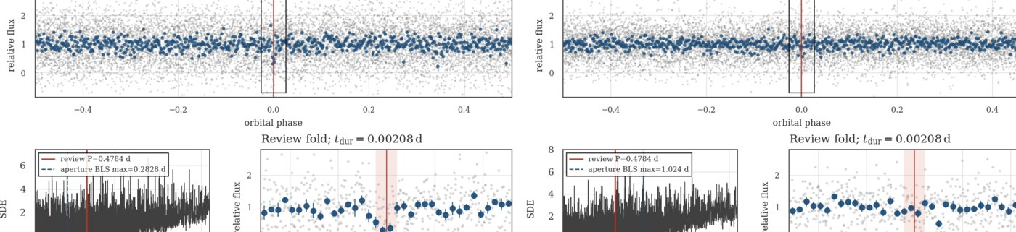
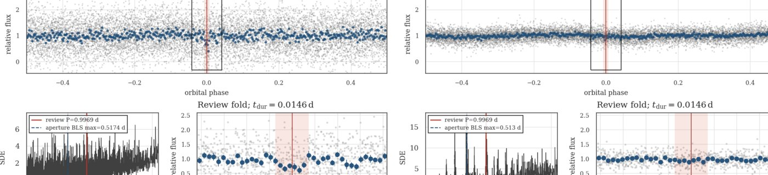
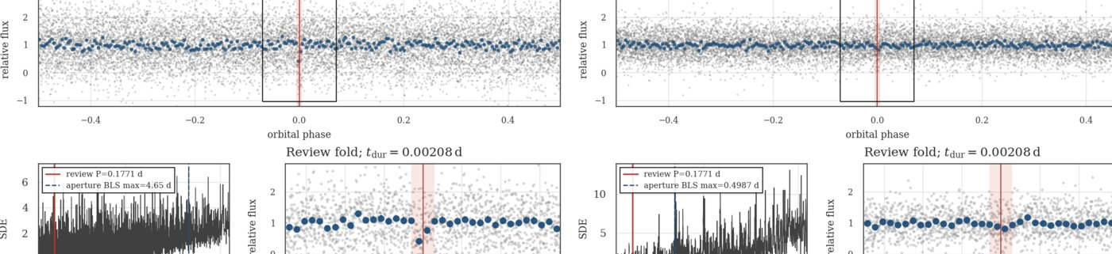
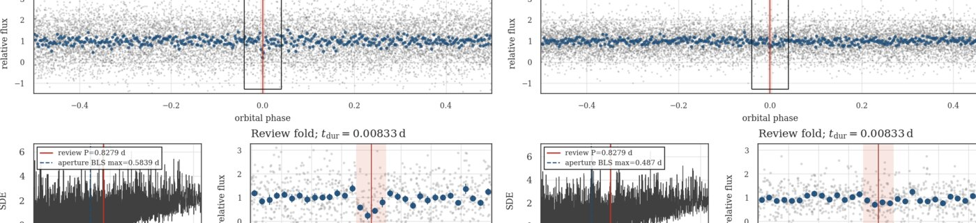
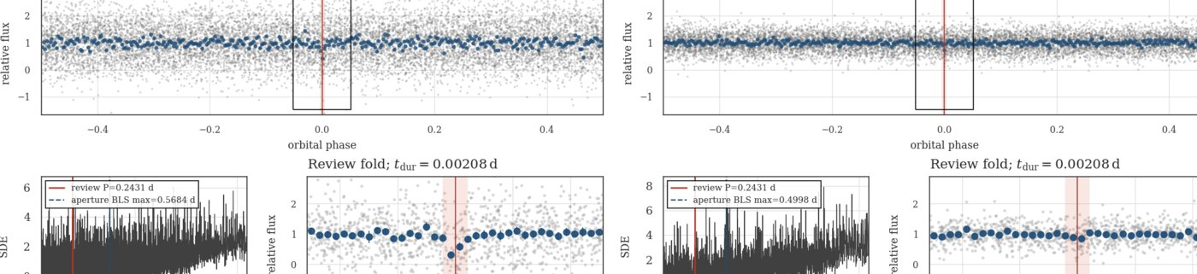
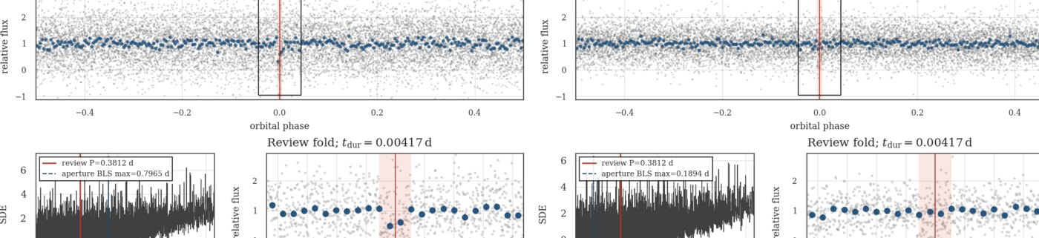
APPENDIX · 5/14
Transit/dip-like morphology atlas · S56
S56 · TIC 2001273871 · Planet-like · P 0.478421 d
S56 · TIC 2040364939 · Planet-like · P 0.996935 d
S56 · TIC 1882050598 · Planet-like · P 0.177125 d
S56 · TIC 2003515304 · Planet-like · P 0.827946 d
S56 · TIC 2011415393 · Planet-like · P 0.243089 d
S56 · TIC 2003344337 · Planet-like · P 0.381233 d
Morphology label only · use the linked full-resolution vet sheet for detailed review
18
Notes:
Atlas page. Open the corresponding full-resolution PNG from transit_like_vet_sheets/ when the group wants to inspect a specific signal.
[Sources]
- /Users/tehan/PycharmProjects/TWIRL/reports/stage5_validation/s56_s62_morphology_corpus_teacher_v3_v1/accepted_signal_rereview.csv
- /Users/tehan/PycharmProjects/TWIRL/data_local/label_reviews/s56_s62_signal_rereview/vet_sheets_s56_s62_a2v1_current_adp_v1/s0056-signal-final-9feeb542c31650d9_twirl_twoap_current_adp.png
- /Users/tehan/PycharmProjects/TWIRL/data_local/label_reviews/s56_s62_signal_rereview/vet_sheets_s56_s62_a2v1_current_adp_v1/s0056-signal-final-b6f5f50e065449fb_twirl_twoap_current_adp.png
- /Users/tehan/PycharmProjects/TWIRL/data_local/label_reviews/s56_s62_signal_rereview/vet_sheets_s56_s62_a2v1_current_adp_v1/s0056-signal-final-7eaf546568eb9e50_twirl_twoap_current_adp.png
- /Users/tehan/PycharmProjects/TWIRL/data_local/label_reviews/s56_s62_signal_rereview/vet_sheets_s56_s62_a2v1_current_adp_v1/s0056-signal-final-81cebad1b6515654_twirl_twoap_current_adp.png
- /Users/tehan/PycharmProjects/TWIRL/data_local/label_reviews/s56_s62_signal_rereview/vet_sheets_s56_s62_a2v1_current_adp_v1/s0056-signal-final-6566a055758275ca_twirl_twoap_current_adp.png
- /Users/tehan/PycharmProjects/TWIRL/data_local/label_reviews/s56_s62_signal_rereview/vet_sheets_s56_s62_a2v1_current_adp_v1/s0056-signal-final-ea5ef5e0a20cf690_twirl_twoap_current_adp.png

Slide 19
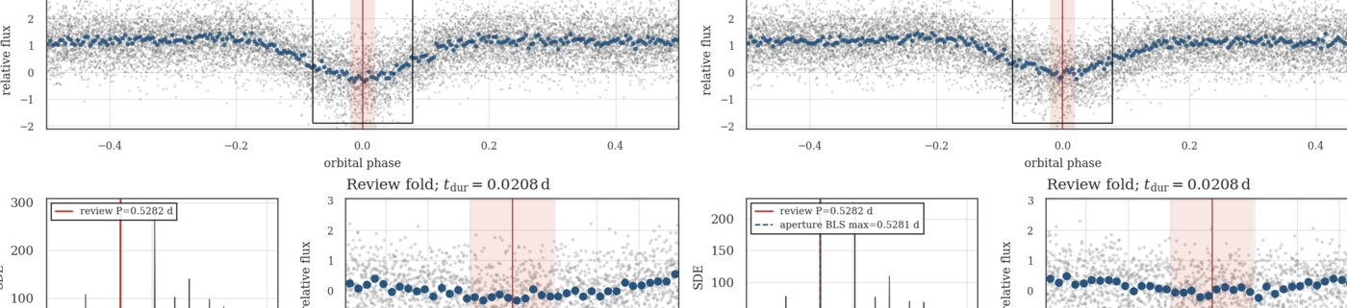
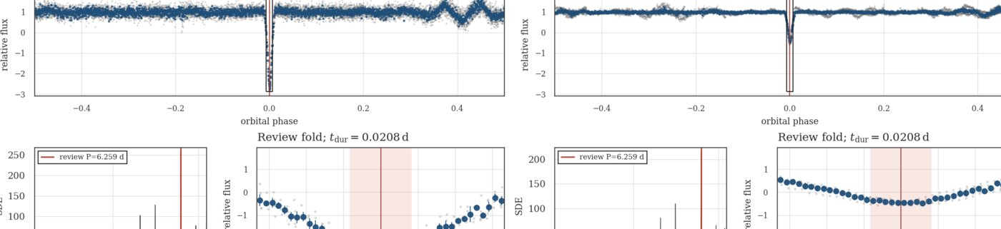
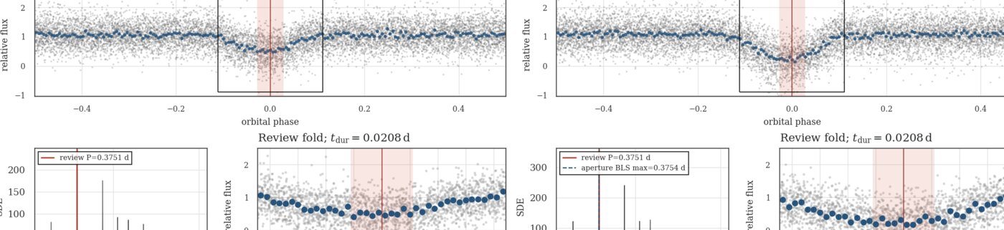
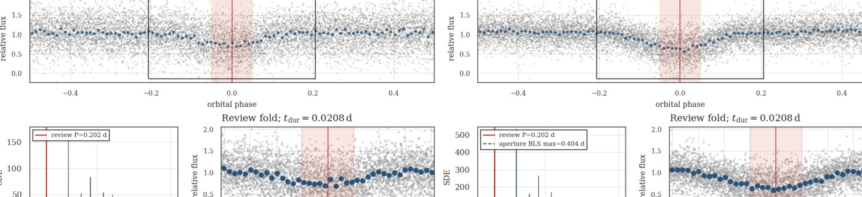
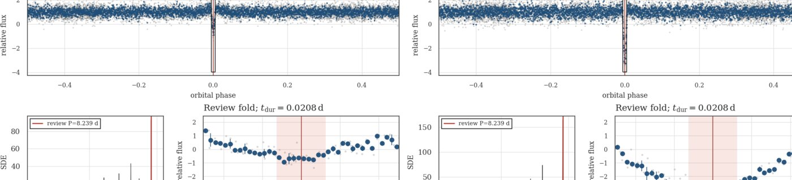
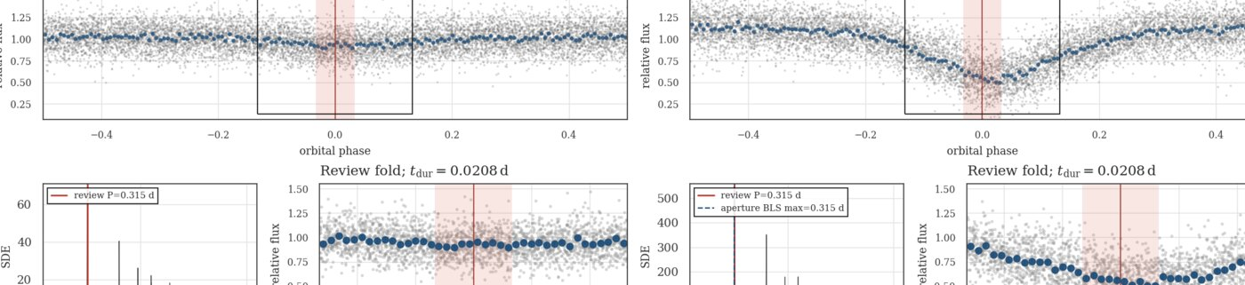
APPENDIX · 6/14
Transit/dip-like morphology atlas · S56
S56 · TIC 1977017648 · Broad/wide · P 0.528231 d
S56 · TIC 2003932333 · Broad/wide · P 6.259449 d
S56 · TIC 1961669845 · Broad/wide · P 0.375137 d
S56 · TIC 1883654820 · Broad/wide · P 0.202020 d
S56 · TIC 2004663882 · Broad/wide · P 8.238690 d
S56 · TIC 2002584084 · Broad/wide · P 0.315005 d
Morphology label only · use the linked full-resolution vet sheet for detailed review
19
Notes:
Atlas page. Open the corresponding full-resolution PNG from transit_like_vet_sheets/ when the group wants to inspect a specific signal.
[Sources]
- /Users/tehan/PycharmProjects/TWIRL/reports/stage5_validation/s56_s62_morphology_corpus_teacher_v3_v1/accepted_signal_rereview.csv
- /Users/tehan/PycharmProjects/TWIRL/data_local/label_reviews/s56_s62_signal_rereview/vet_sheets_s56_s62_a2v1_current_adp_v1/s0056-signal-final-522da810c5ade45f_twirl_twoap_current_adp.png
- /Users/tehan/PycharmProjects/TWIRL/data_local/label_reviews/s56_s62_signal_rereview/vet_sheets_s56_s62_a2v1_current_adp_v1/s0056-signal-final-11292c034b5c8f16_twirl_twoap_current_adp.png
- /Users/tehan/PycharmProjects/TWIRL/data_local/label_reviews/s56_s62_signal_rereview/vet_sheets_s56_s62_a2v1_current_adp_v1/s0056-signal-final-a43ac5e4d65dfce9_twirl_twoap_current_adp.png
- /Users/tehan/PycharmProjects/TWIRL/data_local/label_reviews/s56_s62_signal_rereview/vet_sheets_s56_s62_a2v1_current_adp_v1/s0056-signal-final-b06d3830712d14a4_twirl_twoap_current_adp.png
- /Users/tehan/PycharmProjects/TWIRL/data_local/label_reviews/s56_s62_signal_rereview/vet_sheets_s56_s62_a2v1_current_adp_v1/s0056-signal-final-6756b7eaf1ce8d9a_twirl_twoap_current_adp.png
- /Users/tehan/PycharmProjects/TWIRL/data_local/label_reviews/s56_s62_signal_rereview/vet_sheets_s56_s62_a2v1_current_adp_v1/s0056-signal-final-14d6bc027f6b4134_twirl_twoap_current_adp.png

Slide 20
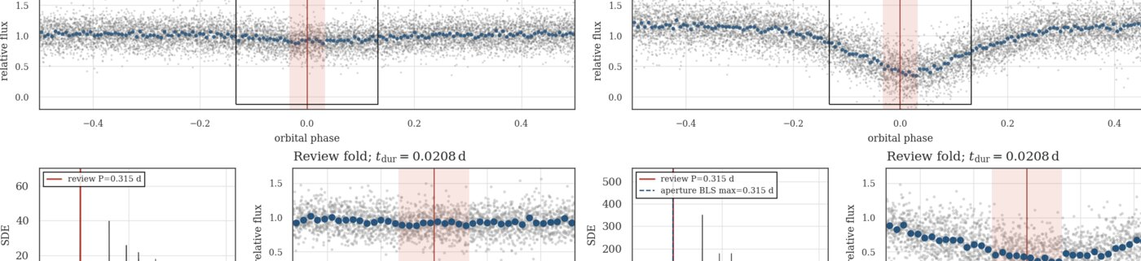
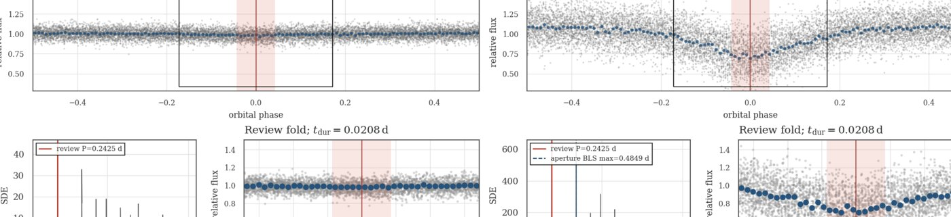
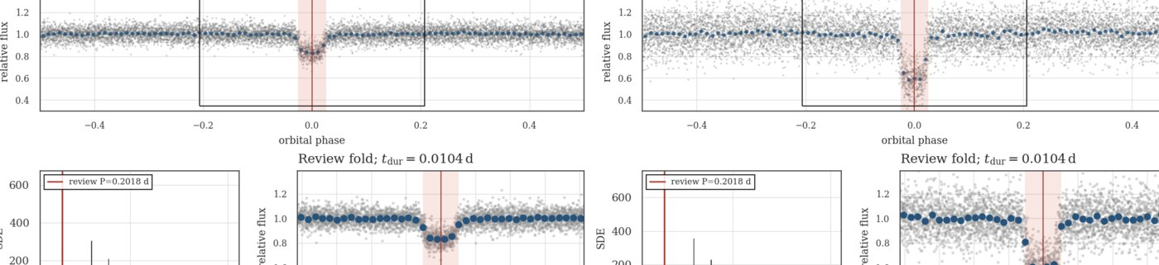
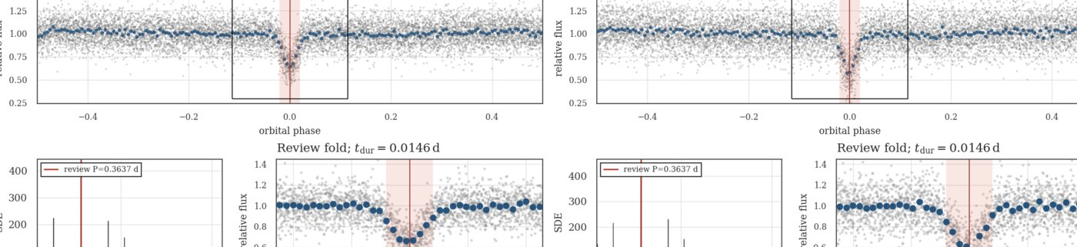
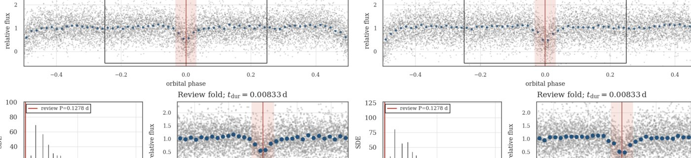
APPENDIX · 7/14
Transit/dip-like morphology atlas · S56–S57
S56 · TIC 2002584079 · Broad/wide · P 0.315005 d
S56 · TIC 365613123 · Broad/wide · P 0.242472 d
S57 · TIC 160520962 · Planet-like · P 0.201781 d
S57 · TIC 1400704733 · Planet-like · P 0.363705 d
S57 · TIC 1201294971 · Planet-like · P 0.286041 d
S57 · TIC 1400739415 · Planet-like · P 0.127759 d
Morphology label only · use the linked full-resolution vet sheet for detailed review
20
Notes:
Atlas page. Open the corresponding full-resolution PNG from transit_like_vet_sheets/ when the group wants to inspect a specific signal.
[Sources]
- /Users/tehan/PycharmProjects/TWIRL/reports/stage5_validation/s56_s62_morphology_corpus_teacher_v3_v1/accepted_signal_rereview.csv
- /Users/tehan/PycharmProjects/TWIRL/data_local/label_reviews/s56_s62_signal_rereview/vet_sheets_s56_s62_a2v1_current_adp_v1/s0056-signal-final-e6acb48592ebf324_twirl_twoap_current_adp.png
- /Users/tehan/PycharmProjects/TWIRL/data_local/label_reviews/s56_s62_signal_rereview/vet_sheets_s56_s62_a2v1_current_adp_v1/s0056-signal-final-b2b2d1518e3af891_twirl_twoap_current_adp.png
- /Users/tehan/PycharmProjects/TWIRL/data_local/label_reviews/s56_s62_signal_rereview/vet_sheets_s56_s62_a2v1_current_adp_v1/s0057-signal-final-c97a102144f72af2_twirl_twoap_current_adp.png
- /Users/tehan/PycharmProjects/TWIRL/data_local/label_reviews/s56_s62_signal_rereview/vet_sheets_s56_s62_a2v1_current_adp_v1/s0057-signal-final-57eea28a68f9c06a_twirl_twoap_current_adp.png
- /Users/tehan/PycharmProjects/TWIRL/data_local/label_reviews/s56_s62_signal_rereview/vet_sheets_s56_s62_a2v1_current_adp_v1/s0057-signal-final-2ef8c3bacdf529f3_twirl_twoap_current_adp.png
- /Users/tehan/PycharmProjects/TWIRL/data_local/label_reviews/s56_s62_signal_rereview/vet_sheets_s56_s62_a2v1_current_adp_v1/s0057-signal-final-384c4261adaef816_twirl_twoap_current_adp.png

Slide 21
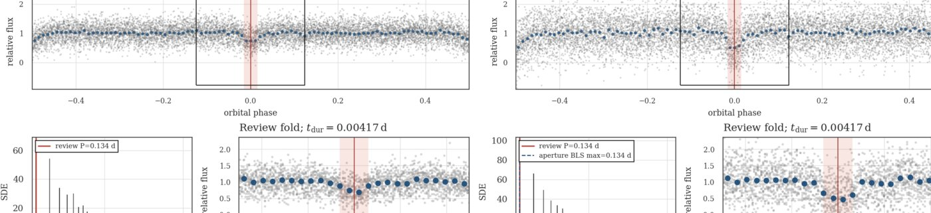
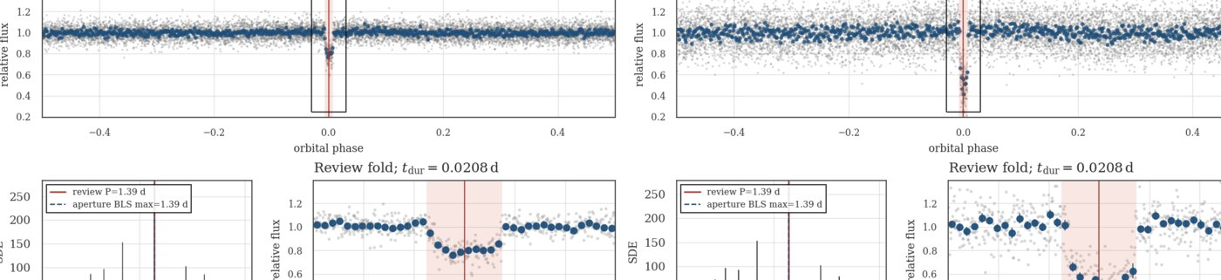
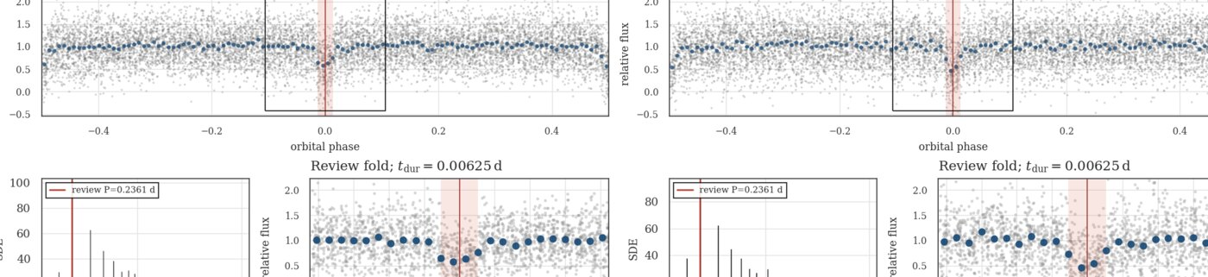
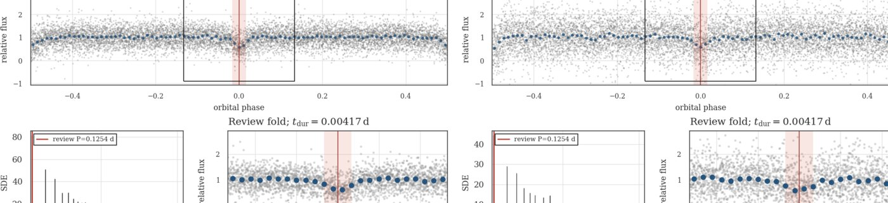
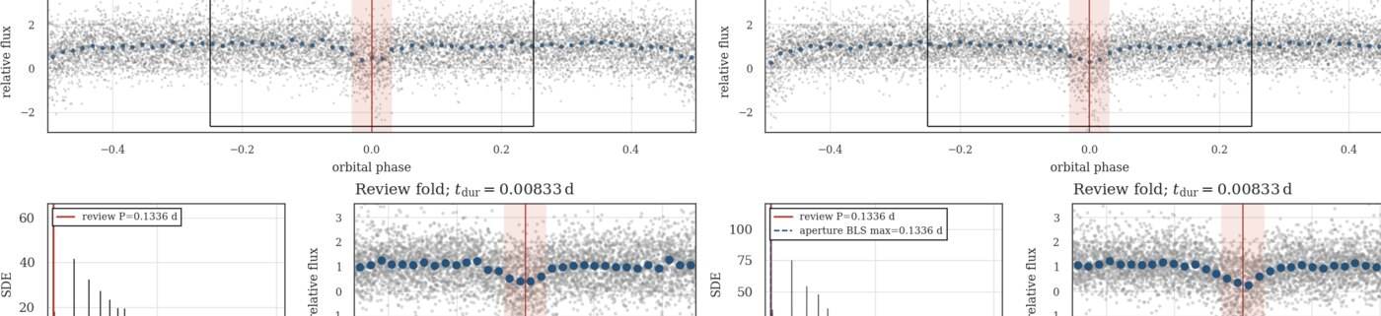

APPENDIX · 8/14
Transit/dip-like morphology atlas · S57–S58
S57 · TIC 1400855795 · Planet-like · P 0.134001 d
S58 · TIC 445187975 · Planet-like · P 1.390106 d
S58 · TIC 2023941305 · Planet-like · P 0.236138 d
S58 · TIC 646374542 · Planet-like · P 0.125426 d
S58 · TIC 2045881230 · Planet-like · P 0.133586 d
S58 · TIC 620393380 · Planet-like · P 0.382644 d
Morphology label only · use the linked full-resolution vet sheet for detailed review
21
Notes:
Atlas page. Open the corresponding full-resolution PNG from transit_like_vet_sheets/ when the group wants to inspect a specific signal.
[Sources]
- /Users/tehan/PycharmProjects/TWIRL/reports/stage5_validation/s56_s62_morphology_corpus_teacher_v3_v1/accepted_signal_rereview.csv
- /Users/tehan/PycharmProjects/TWIRL/data_local/label_reviews/s56_s62_signal_rereview/vet_sheets_s56_s62_a2v1_current_adp_v1/s0057-signal-final-18f75d68009cb1a3_twirl_twoap_current_adp.png
- /Users/tehan/PycharmProjects/TWIRL/data_local/label_reviews/s56_s62_signal_rereview/vet_sheets_s56_s62_a2v1_current_adp_v1/s0058-signal-final-9f0eb559d0aa75f7_twirl_twoap_current_adp.png
- /Users/tehan/PycharmProjects/TWIRL/data_local/label_reviews/s56_s62_signal_rereview/vet_sheets_s56_s62_a2v1_current_adp_v1/s0058-signal-final-ec4718c3ba7ed920_twirl_twoap_current_adp.png
- /Users/tehan/PycharmProjects/TWIRL/data_local/label_reviews/s56_s62_signal_rereview/vet_sheets_s56_s62_a2v1_current_adp_v1/s0058-signal-final-e9af42d8d207531d_twirl_twoap_current_adp.png
- /Users/tehan/PycharmProjects/TWIRL/data_local/label_reviews/s56_s62_signal_rereview/vet_sheets_s56_s62_a2v1_current_adp_v1/s0058-signal-final-4eb9ed2197c15746_twirl_twoap_current_adp.png
- /Users/tehan/PycharmProjects/TWIRL/data_local/label_reviews/s56_s62_signal_rereview/vet_sheets_s56_s62_a2v1_current_adp_v1/s0058-signal-final-cbfa7bf15e68c005_twirl_twoap_current_adp.png

Slide 22






APPENDIX · 9/14
Transit/dip-like morphology atlas · S58–S60
S58 · TIC 1201247611 · Planet-like · P 0.138082 d
S59 · TIC 170963213 · Planet-like · P 0.307170 d
S59 · TIC 670722447 · Planet-like · P 0.141500 d
S59 · TIC 1201319601 · Planet-like · P 0.129296 d
S59 · TIC 662750122 · Planet-like · P 0.164293 d
S60 · TIC 188819697 · Planet-like · P 0.179418 d
Morphology label only · use the linked full-resolution vet sheet for detailed review
22
Notes:
Atlas page. Open the corresponding full-resolution PNG from transit_like_vet_sheets/ when the group wants to inspect a specific signal.
[Sources]
- /Users/tehan/PycharmProjects/TWIRL/reports/stage5_validation/s56_s62_morphology_corpus_teacher_v3_v1/accepted_signal_rereview.csv
- /Users/tehan/PycharmProjects/TWIRL/data_local/label_reviews/s56_s62_signal_rereview/vet_sheets_s56_s62_a2v1_current_adp_v1/s0058-signal-final-1e9d12a02d51c383_twirl_twoap_current_adp.png
- /Users/tehan/PycharmProjects/TWIRL/data_local/label_reviews/s56_s62_signal_rereview/vet_sheets_s56_s62_a2v1_current_adp_v1/s0059-signal-final-aee7105ecca4cb47_twirl_twoap_current_adp.png
- /Users/tehan/PycharmProjects/TWIRL/data_local/label_reviews/s56_s62_signal_rereview/vet_sheets_s56_s62_a2v1_current_adp_v1/s0059-signal-final-feb938a3701ffd5b_twirl_twoap_current_adp.png
- /Users/tehan/PycharmProjects/TWIRL/data_local/label_reviews/s56_s62_signal_rereview/vet_sheets_s56_s62_a2v1_current_adp_v1/s0059-signal-final-8b4b89564b1b4635_twirl_twoap_current_adp.png
- /Users/tehan/PycharmProjects/TWIRL/data_local/label_reviews/s56_s62_signal_rereview/vet_sheets_s56_s62_a2v1_current_adp_v1/s0059-signal-final-718b31a6890d0f11_twirl_twoap_current_adp.png
- /Users/tehan/PycharmProjects/TWIRL/data_local/label_reviews/s56_s62_signal_rereview/vet_sheets_s56_s62_a2v1_current_adp_v1/s0060-signal-final-1cda1187a36be0c3_twirl_twoap_current_adp.png

Slide 23






APPENDIX · 10/14
Transit/dip-like morphology atlas · S60–S61
S60 · TIC 55502089 · Planet-like · P 0.142435 d
S60 · TIC 1883504789 · Planet-like · P 0.157433 d
S60 · TIC 802667130 · Planet-like · P 0.159244 d
S60 · TIC 444988803 · Planet-like · P 0.291881 d
S60 · TIC 81104679 · Planet-like · P 0.341019 d
S61 · TIC 270679102 · Planet-like · P 0.149439 d
Morphology label only · use the linked full-resolution vet sheet for detailed review
23
Notes:
Atlas page. Open the corresponding full-resolution PNG from transit_like_vet_sheets/ when the group wants to inspect a specific signal.
[Sources]
- /Users/tehan/PycharmProjects/TWIRL/reports/stage5_validation/s56_s62_morphology_corpus_teacher_v3_v1/accepted_signal_rereview.csv
- /Users/tehan/PycharmProjects/TWIRL/data_local/label_reviews/s56_s62_signal_rereview/vet_sheets_s56_s62_a2v1_current_adp_v1/s0060-signal-final-a8c4e6a5d35c2827_twirl_twoap_current_adp.png
- /Users/tehan/PycharmProjects/TWIRL/data_local/label_reviews/s56_s62_signal_rereview/vet_sheets_s56_s62_a2v1_current_adp_v1/s0060-signal-final-707936b0cc0c31c8_twirl_twoap_current_adp.png
- /Users/tehan/PycharmProjects/TWIRL/data_local/label_reviews/s56_s62_signal_rereview/vet_sheets_s56_s62_a2v1_current_adp_v1/s0060-signal-final-a488a62f6b863225_twirl_twoap_current_adp.png
- /Users/tehan/PycharmProjects/TWIRL/data_local/label_reviews/s56_s62_signal_rereview/vet_sheets_s56_s62_a2v1_current_adp_v1/s0060-signal-final-8ee2ae5deb452c4b_twirl_twoap_current_adp.png
- /Users/tehan/PycharmProjects/TWIRL/data_local/label_reviews/s56_s62_signal_rereview/vet_sheets_s56_s62_a2v1_current_adp_v1/s0060-signal-final-d25c09306316acac_twirl_twoap_current_adp.png
- /Users/tehan/PycharmProjects/TWIRL/data_local/label_reviews/s56_s62_signal_rereview/vet_sheets_s56_s62_a2v1_current_adp_v1/s0061-signal-final-d7e962bd542384b4_twirl_twoap_current_adp.png

Slide 24






APPENDIX · 11/14
Transit/dip-like morphology atlas · S61
S61 · TIC 452954413 · Planet-like · P 0.158242 d
S61 · TIC 803489769 · Planet-like · P 0.120974 d
S61 · TIC 96852226 · Planet-like · P 0.147185 d
S61 · TIC 835734923 · Planet-like · P 0.198186 d
S61 · TIC 36085812 · Planet-like · P 0.225686 d
S61 · TIC 767706310 · Planet-like · P 0.130795 d
Morphology label only · use the linked full-resolution vet sheet for detailed review
24
Notes:
Atlas page. Open the corresponding full-resolution PNG from transit_like_vet_sheets/ when the group wants to inspect a specific signal.
[Sources]
- /Users/tehan/PycharmProjects/TWIRL/reports/stage5_validation/s56_s62_morphology_corpus_teacher_v3_v1/accepted_signal_rereview.csv
- /Users/tehan/PycharmProjects/TWIRL/data_local/label_reviews/s56_s62_signal_rereview/vet_sheets_s56_s62_a2v1_current_adp_v1/s0061-signal-final-8c4f3126f3b247a9_twirl_twoap_current_adp.png
- /Users/tehan/PycharmProjects/TWIRL/data_local/label_reviews/s56_s62_signal_rereview/vet_sheets_s56_s62_a2v1_current_adp_v1/s0061-signal-final-489b659113ee2047_twirl_twoap_current_adp.png
- /Users/tehan/PycharmProjects/TWIRL/data_local/label_reviews/s56_s62_signal_rereview/vet_sheets_s56_s62_a2v1_current_adp_v1/s0061-signal-final-6702bf3cb82f5acc_twirl_twoap_current_adp.png
- /Users/tehan/PycharmProjects/TWIRL/data_local/label_reviews/s56_s62_signal_rereview/vet_sheets_s56_s62_a2v1_current_adp_v1/s0061-signal-final-6645add727430105_twirl_twoap_current_adp.png
- /Users/tehan/PycharmProjects/TWIRL/data_local/label_reviews/s56_s62_signal_rereview/vet_sheets_s56_s62_a2v1_current_adp_v1/s0061-signal-final-1f4111dacd5c5a1d_twirl_twoap_current_adp.png
- /Users/tehan/PycharmProjects/TWIRL/data_local/label_reviews/s56_s62_signal_rereview/vet_sheets_s56_s62_a2v1_current_adp_v1/s0061-signal-final-b03bd3e612aea73a_twirl_twoap_current_adp.png

Slide 25






APPENDIX · 12/14
Transit/dip-like morphology atlas · S61
S61 · TIC 255756592 · Planet-like · P 0.148665 d
S61 · TIC 675201170 · Planet-like · P 0.157268 d
S61 · TIC 806590905 · Planet-like · P 0.203978 d
S61 · TIC 771109695 · Planet-like · P 0.150074 d
S61 · TIC 772365221 · Planet-like · P 0.204052 d
S61 · TIC 270555414 · Broad/wide · P 0.153126 d
Morphology label only · use the linked full-resolution vet sheet for detailed review
25
Notes:
Atlas page. Open the corresponding full-resolution PNG from transit_like_vet_sheets/ when the group wants to inspect a specific signal.
[Sources]
- /Users/tehan/PycharmProjects/TWIRL/reports/stage5_validation/s56_s62_morphology_corpus_teacher_v3_v1/accepted_signal_rereview.csv
- /Users/tehan/PycharmProjects/TWIRL/data_local/label_reviews/s56_s62_signal_rereview/vet_sheets_s56_s62_a2v1_current_adp_v1/s0061-signal-final-bd78a5e92aa19d0b_twirl_twoap_current_adp.png
- /Users/tehan/PycharmProjects/TWIRL/data_local/label_reviews/s56_s62_signal_rereview/vet_sheets_s56_s62_a2v1_current_adp_v1/s0061-signal-final-d72816d197938fce_twirl_twoap_current_adp.png
- /Users/tehan/PycharmProjects/TWIRL/data_local/label_reviews/s56_s62_signal_rereview/vet_sheets_s56_s62_a2v1_current_adp_v1/s0061-signal-final-966ef3d6859cb9f3_twirl_twoap_current_adp.png
- /Users/tehan/PycharmProjects/TWIRL/data_local/label_reviews/s56_s62_signal_rereview/vet_sheets_s56_s62_a2v1_current_adp_v1/s0061-signal-final-b39de7583409c73b_twirl_twoap_current_adp.png
- /Users/tehan/PycharmProjects/TWIRL/data_local/label_reviews/s56_s62_signal_rereview/vet_sheets_s56_s62_a2v1_current_adp_v1/s0061-signal-final-fe526bc4cdcd6398_twirl_twoap_current_adp.png
- /Users/tehan/PycharmProjects/TWIRL/data_local/label_reviews/s56_s62_signal_rereview/vet_sheets_s56_s62_a2v1_current_adp_v1/s0061-signal-final-6cfa6b58ca3a8ad9_twirl_twoap_current_adp.png

Slide 26






APPENDIX · 13/14
Transit/dip-like morphology atlas · S62
S62 · TIC 124573902 · Planet-like · P 0.332852 d
S62 · TIC 841641318 · Planet-like · P 0.185968 d
S62 · TIC 192991819 · Planet-like · P 0.150850 d
S62 · TIC 101433897 · Planet-like · P 0.206697 d
S62 · TIC 826164830 · Planet-like · P 0.150910 d
S62 · TIC 808364853 · Planet-like · P 0.175903 d
Morphology label only · use the linked full-resolution vet sheet for detailed review
26
Notes:
Atlas page. Open the corresponding full-resolution PNG from transit_like_vet_sheets/ when the group wants to inspect a specific signal.
[Sources]
- /Users/tehan/PycharmProjects/TWIRL/reports/stage5_validation/s56_s62_morphology_corpus_teacher_v3_v1/accepted_signal_rereview.csv
- /Users/tehan/PycharmProjects/TWIRL/data_local/label_reviews/s56_s62_signal_rereview/vet_sheets_s56_s62_a2v1_current_adp_v1/s0062-signal-final-54778fef7ed7f3f5_twirl_twoap_current_adp.png
- /Users/tehan/PycharmProjects/TWIRL/data_local/label_reviews/s56_s62_signal_rereview/vet_sheets_s56_s62_a2v1_current_adp_v1/s0062-signal-final-78c29ad638c1a3d6_twirl_twoap_current_adp.png
- /Users/tehan/PycharmProjects/TWIRL/data_local/label_reviews/s56_s62_signal_rereview/vet_sheets_s56_s62_a2v1_current_adp_v1/s0062-signal-final-0d68a2cc0ca40d20_twirl_twoap_current_adp.png
- /Users/tehan/PycharmProjects/TWIRL/data_local/label_reviews/s56_s62_signal_rereview/vet_sheets_s56_s62_a2v1_current_adp_v1/s0062-signal-final-feba5ba5cfe17583_twirl_twoap_current_adp.png
- /Users/tehan/PycharmProjects/TWIRL/data_local/label_reviews/s56_s62_signal_rereview/vet_sheets_s56_s62_a2v1_current_adp_v1/s0062-signal-final-39fb8deeea5ae6c1_twirl_twoap_current_adp.png
- /Users/tehan/PycharmProjects/TWIRL/data_local/label_reviews/s56_s62_signal_rereview/vet_sheets_s56_s62_a2v1_current_adp_v1/s0062-signal-final-a7f6c4a025af3a55_twirl_twoap_current_adp.png

Slide 27


APPENDIX · 14/14
Transit/dip-like morphology atlas · S62
S62 · TIC 874726613 · Planet-like · P 0.154176 d
S62 · TIC 874383420 · Broad/wide · P 0.179632 d
Morphology label only · use the linked full-resolution vet sheet for detailed review
27
Notes:
Atlas page. Open the corresponding full-resolution PNG from transit_like_vet_sheets/ when the group wants to inspect a specific signal.
[Sources]
- /Users/tehan/PycharmProjects/TWIRL/reports/stage5_validation/s56_s62_morphology_corpus_teacher_v3_v1/accepted_signal_rereview.csv
- /Users/tehan/PycharmProjects/TWIRL/data_local/label_reviews/s56_s62_signal_rereview/vet_sheets_s56_s62_a2v1_current_adp_v1/s0062-signal-final-fc0d4e8de5089c70_twirl_twoap_current_adp.png
- /Users/tehan/PycharmProjects/TWIRL/data_local/label_reviews/s56_s62_signal_rereview/vet_sheets_s56_s62_a2v1_current_adp_v1/s0062-signal-final-16da6841c945070f_twirl_twoap_current_adp.png

