Slide 1
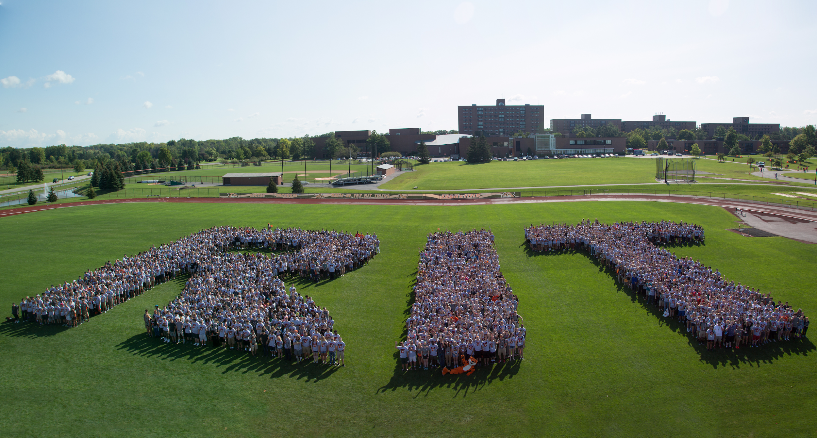
Publishing for all: Using LaTeX to help improve the accessibility of an open access journal
Todd Pagano - National Technical Institute for the Deaf,
Suhas Chikkanaravangala Vijayakumar- Open@RIT,
Rahul Jaiswal - Open@RIT,
Mike Nolan - Open@RIT

Slide 2
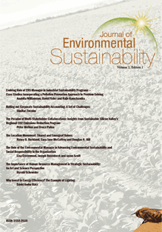
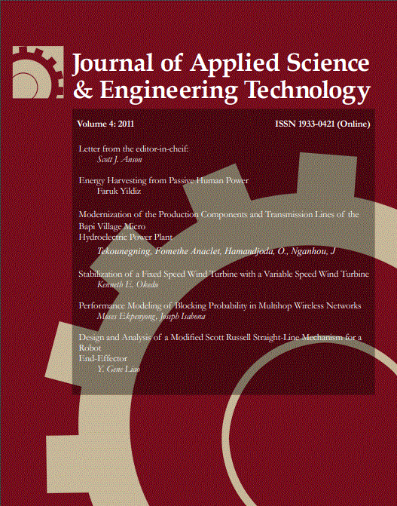
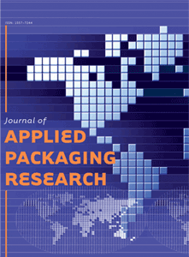
Open Access (OA) Publishing at RIT?
OA publishing provides a cost-free (to the reader...and sometimes to the author) avenue for authors to disseminate their work.
RIT’s publishes several OA journals
Notes:
Often with less restrictive copyright licenses.

Slide 3
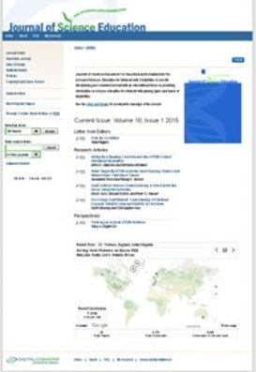
JSESD
The Journal of Science Education for Students with Disabilities (JSESD).
JSESD is a peer-reviewed journal that was first published in the early 1990's.
Notes:
The Journal of Science Education for Students with Disabilities (JSESD) provides a venue for the dissemination of information on science education for students with varying types of disabilities
It is the scholarly publication of the National Science Teachers Association's special interest group, Science Education for Students with Disabilities (SESD), and had always been produced in print version.
JSESD is a peer-reviewed journal that was first published in the early 1990's.
All editing has been performed voluntary and production has been accomplished on a "shoe-string" budget (or no budget at all).

Slide 4
JSESD- an OA Journal
  JSESD was moved to an OA journal in 2007.
  Reasons for the change included:
  cost,
  wide-spread dissemination,
  publishing/printing logistics.
  Published under Creative Commons copyright licenses.
  JSESD is free to both the author and reader/audience.
Notes:
In an attempt to give a needed facelift to the journal, a decision was made to move JSESD to an OA journal in 2007. ​
Reasons for the change include cost, wide-spread dissemination, and publishing/printing logistics. ​
Published under JSESD Creative Commons copyright licenses. ​
JSESD is free to both the author and reader/audience.​

Slide 5
Open Access does not mean Equal (nor Universal) Access
  The goal of OA is to provide broad access to scholarly research.
  56 million Americans live with disabilities (National Organization of Disabilities, 2013).
  Digital technology and open access offer new opportunities for the education of students with disabilities, but there’s still a divide.
    Equal access is critical for advancing educational and career opportunities for students with disabilities (a goal of JSESD).
Notes:
The goal of OA is to provide broad access to scholarly research.
But even when we succeed at removing price and permission barriers, others remain in place, namely access for individuals with disabilities.
Open Access = unrestricted access to scholarly research
Universal Access = inclusive access for individuals with disabilities.
56 million Americans live with disabilities (National Organization of Disabilities, 2013).
Participating in the work force, education system, or entertainment venues can be difficult.
Standards like ADA provide greater access to buildings and public spaces.
Web Standards and assistive technologies have provided increased access.
However, a fully accessible digital environment is far from complete.
Digital technology and open access offer new opportunities for the education of students with disabilities, but there’s still a divide.
Equal access is critical for advancing educational and career opportunities for students with disabilities (a goal of JSESD).
Beyond captioning for D/HH users, it is possible to create a web page compliant with Web Standards that is still largely inaccessible to blind users
Ex) guidelines suggest labeling graphics in order to provide a blind user with a textual equivalent of a graphical element
But if the graphic is an illustration of a chemical reaction, and the web author labels it “science,” it is of little use for increasing the users’ comprehension

Slide 6
What is Open@RIT?
Our goals are to discover, and grow the footprint, of RIT’s impact on all things Open
Notes:
Open@RIT is dedicated to fostering the collaborative engine of "Open Across The University" for Faculty, Staff and Students. Its goals are to discover, and grow the footprint, of RIT’s impact on all things Open including, but not limited to, Open-Source Software, Open Data, Open Science, Open Hardware, Open Educational Resources and Creative Commons licensed efforts, what we like to refer to in aggregate as Open Work.

Slide 7



Our Fellowship
Fellows run open projects at the university.
They apply to receive help to make their projects more open.
We provide a team of developers and designers to help them do that.
Notes:
Open@RIT created a team of students and staff called LibreCorps, dedicated to expanding the use of RIT Faculty and Staff Open Work and associated communities. The Open@RIT Fellows Program awards the services of that team to provide consultation and assistance to our Fellows in order to foster the creation or expansion of contributor communities around their projects. We believe that this work can enhance the visibility, impact, and translation of our Fellows’ efforts.​
​
One of our fellows, Dr. Todd Pagano, came to us hoping to improve the accessibility of his open access journal. ​
​
​

Slide 8
Accessible Open Publishing
Dr. Pagano approached Open@RIT looking for assistance on making his journal more accessible to screen readers.
Having a team of developers and designers, we gladly accepted him into our fellowship program.
Notes:
Dr. Pagano was interested seeing if we could use our team of technologists to convert his PDF publications into something that is more accessible to screen reader applications. For Open@RIT this seemed like an incredibly valuable project.
We hope that this project will help us ensure that open access also means equal access at our university. So our team set off into experimenting into a variety of ways of accomplishing this.​

Slide 9


Converting PDF → HTML
Tested a variety of tools
Pandoc
ConvertApi
Pdf2htmlEX
End-result HTML extremely inaccessible due to PDF format
Notes:
we tested numerous tools for converting pdf to html.
The three major tools Pandoc, convertApi and pdf2htmlEx served our purposes to some extent by extracting the texts from pdf,
However they failed to correctly recognize tables, figures, equations and they did not follow the proper HTML semantics.
Thus the HTML obtained from these tools were extremely inaccessible.

Slide 10
Adobe InDesign Accessibility Features
Defining typographic styles
Adding Alt Text to images/tables
Exporting to PDF/HTML
Creating Tags
Order the content

Slide 11
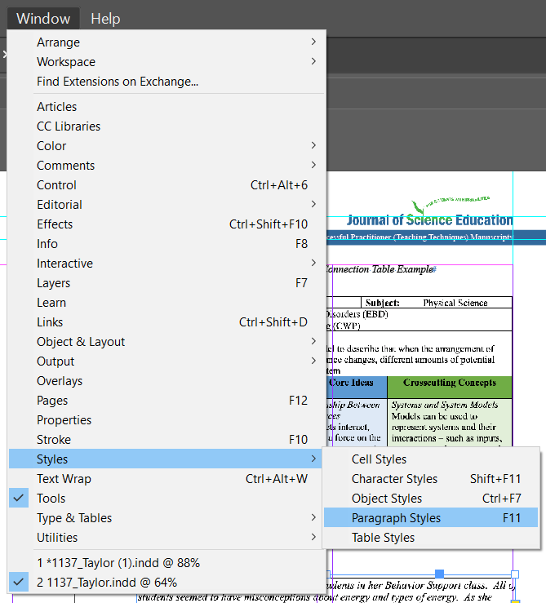
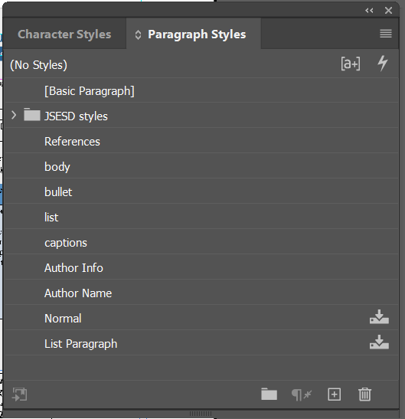
Defining typographic styles for text elements on the page.
Figure 1 : Paragraph style tab in Indesign.

Slide 12
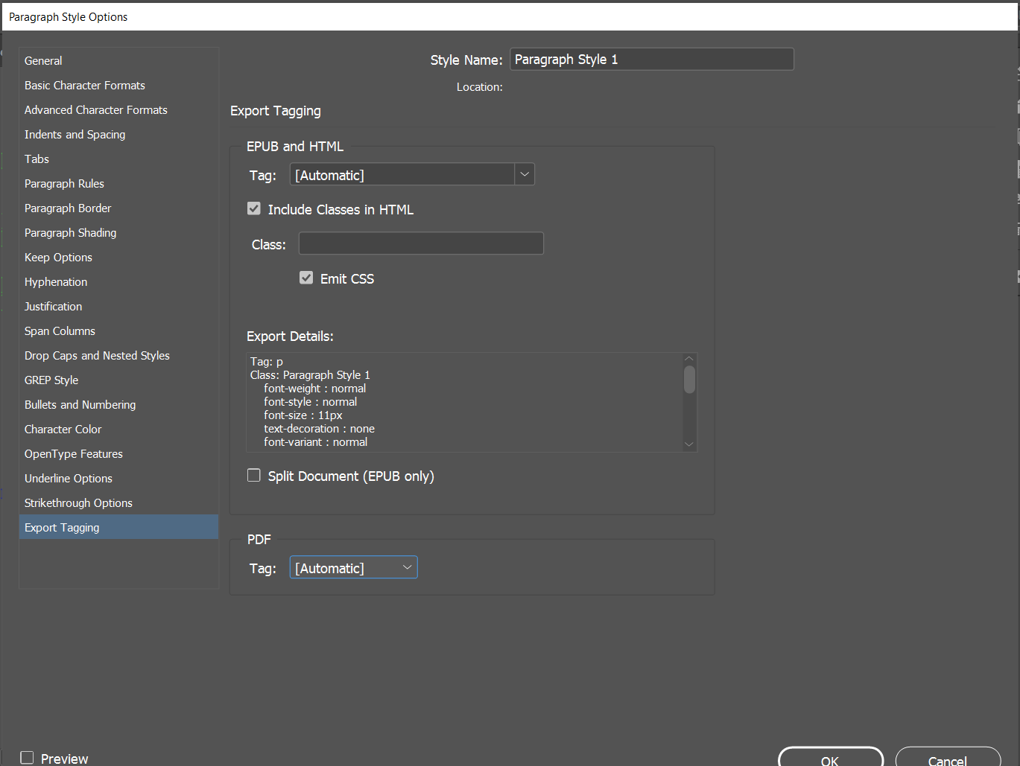
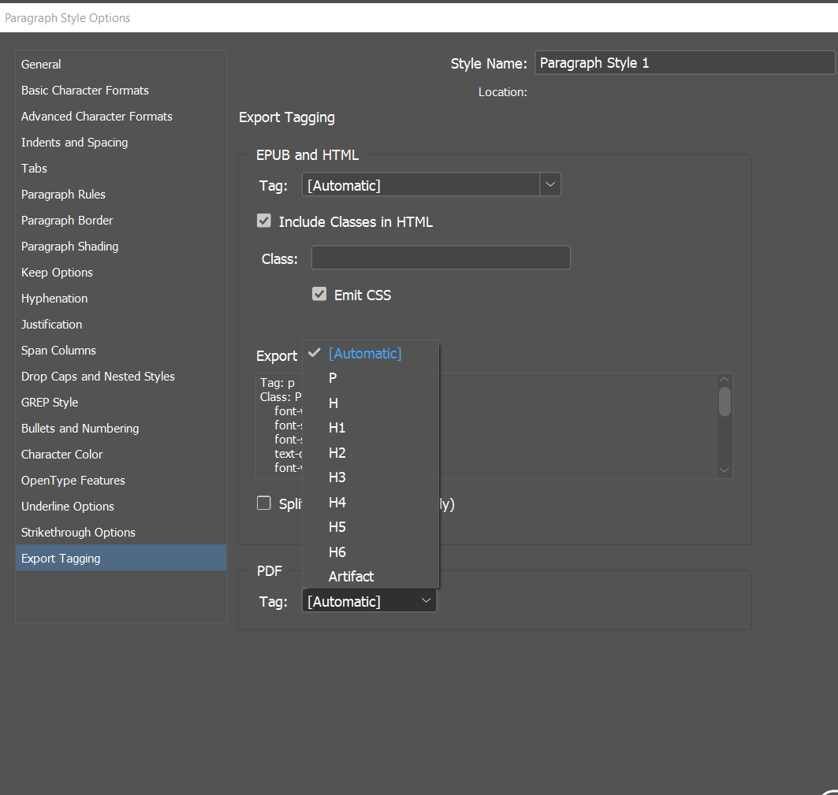
Defining typographic styles for text elements on the page.
Figure 2 : Export tagging option on edit paragraph styles.

Slide 13
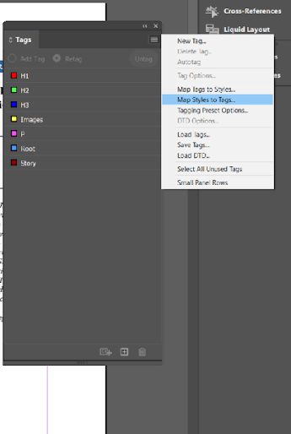
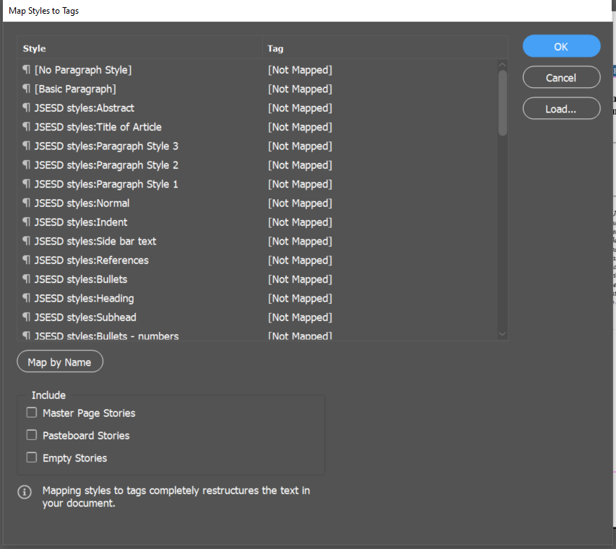
Creating tags.
Figure 3 : Mapping your style to the corresponding tags in Indesign.

Slide 14
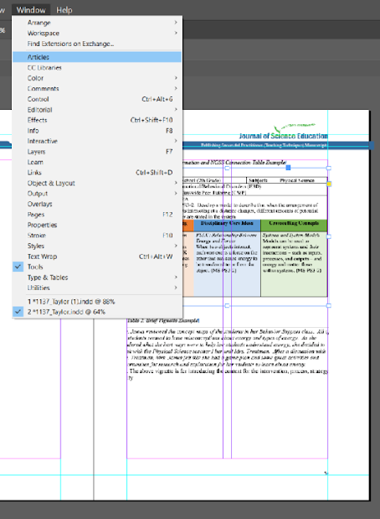
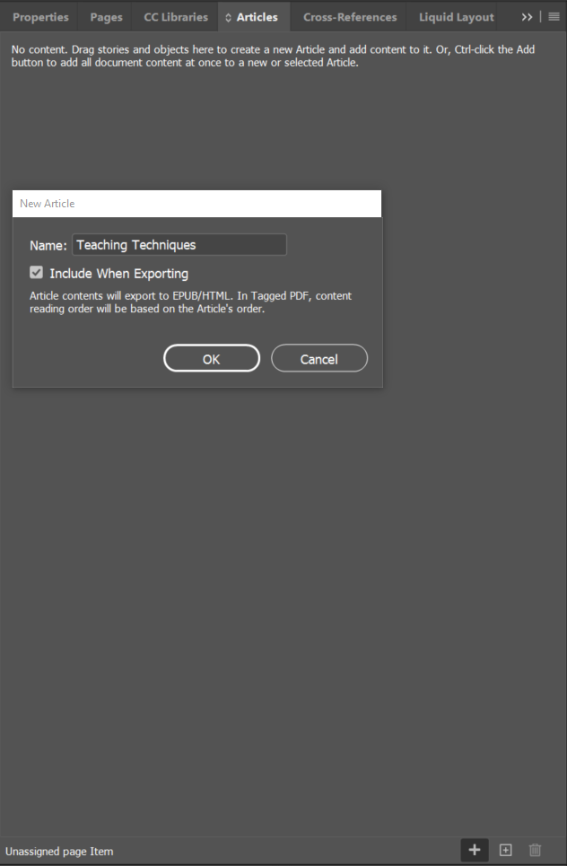
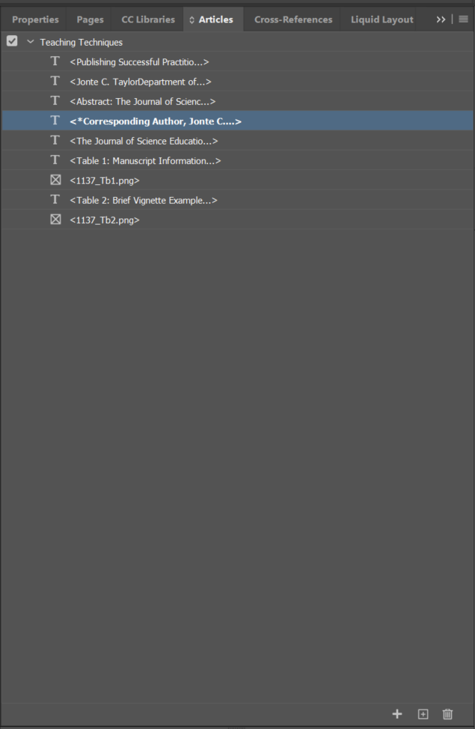
Ordering the content.
Figure 4 : Arranging the sections in the order panel

Slide 15
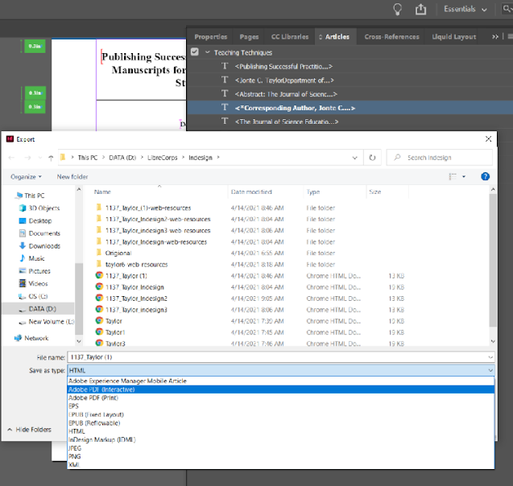
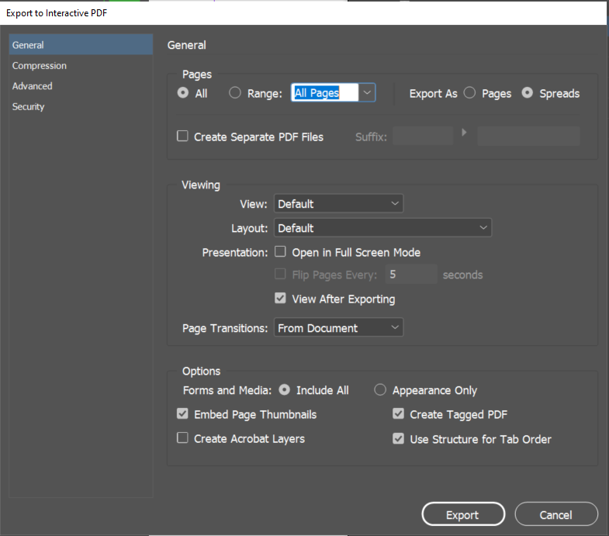
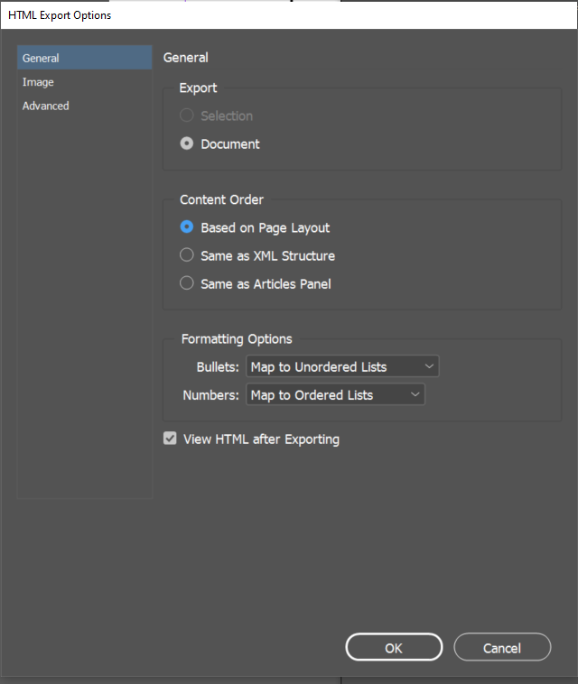
Exporting to PDF/HTML
Figure 4 : Figure 5 : Exporting the document.

Slide 16
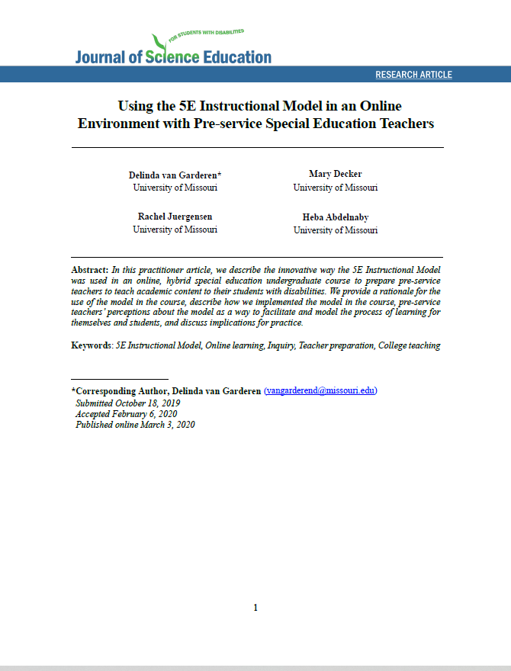
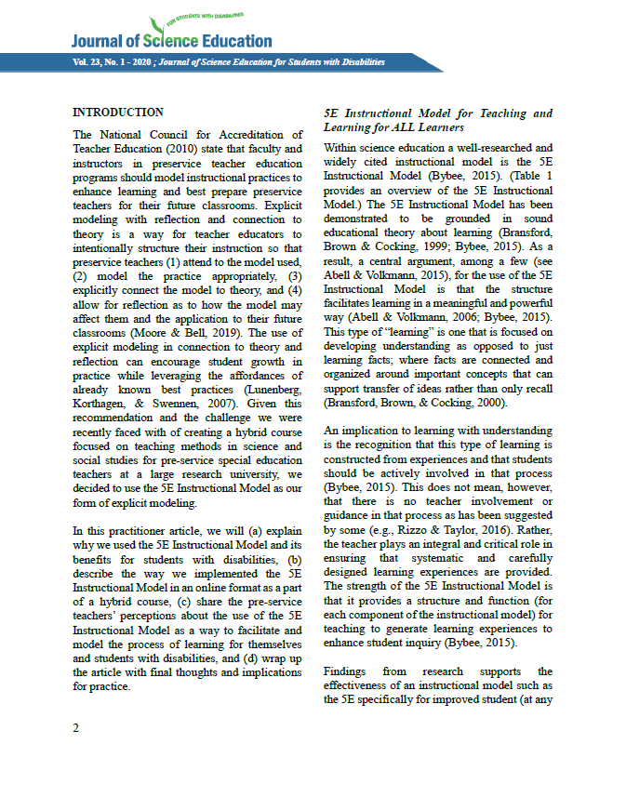
LaTeX Publishing Template

Slide 17
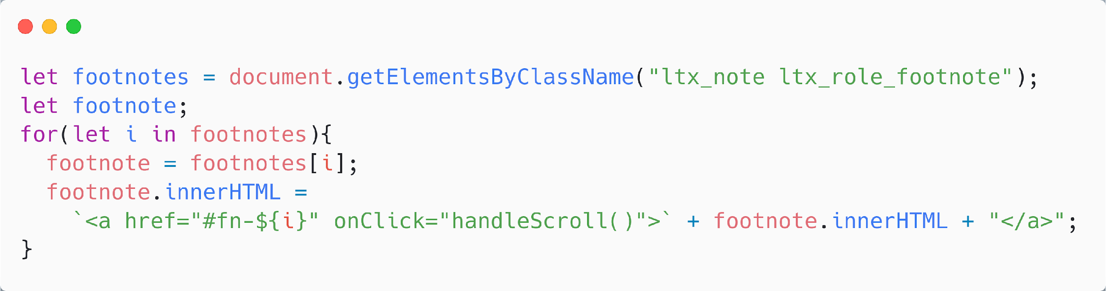
LaTeXML
LaTeXML is an open-source Latex to XML/HTML/MathML Converter.
Fixing minor errors and enhancing the accessibility of HTML file with client-side JavaScript.
Notes:
We used LaTeXML library for converting document from latex to HTML, LaTeXML as the name suggests first converts latex to an intermediate XML before converting to any other document formats.
LateXML renders a highly accessible HTML and overcomes some of the issues related to figures and equations that we previously had.
We tried to further improve the accessibility and the appearance of the rendered HTML document with the help of client side JS.
Here is the code snippet for making the footnotes accessible, which was previously visible or accessible only on the hover state.

Slide 18
Challenges
Transferring Content from “docx” to “LaTeX”.
Styling Content.
Formatting Layout.
  2 different end-product formats.
Reading Order in LaTeX.
Adding accessible images and tables.
Notes:
Now as with any project, we encountered a number of challenges. Some we are still struggling with today.
Nearly all journal submissions are given in the format of .docx which often times includes a variety of styles and elements. We are continuing work today in order to ensure that styles defined in the .docx document can be easily and automatically transferred into out LaTeX template
When we began this project, our team was fairly new to LaTeX and learning how to make a template which suited the needs and styles of the journal took a bit of a learning curve. Doing dual column layouts in pdf, but single column layouts in HTML, including banners and figures. All took a fair amount of work and luckily with some help from members here in the community, we were able to get a first version of our template complete.
Lastly, ensuring that out LaTeX template generated accessible output is a constant challenge as we encounter new types of figures, tables, and elements. We’ve put in efforts to try and utilize tools to make our PDFs more accessible to screen readers as well but have not yet accomplished that.

Slide 19

Future Hopes
Ensure all open access journals at RIT are equal access.
Provide infrastructure for an accessible publishing pipeline for others to use.
Notes:
We aspire that this work on not just exploring how LaTeX can make academic publications more accessible but how we can design better publishing pipelines that allows all publishers to be able to easily make their journals accessible. The nature of all of our software and examples being transparent and open is key to this.
We hope that The Journal of Science Education for Students with Disabilities can be an example for other open access journals to follow in order to make their journals more accessible.

Slide 20
Thank You !

Slide 21
Abstract
A screen reader is a vital tool that helps individuals who are blind or low-vision read digital text. Unfortunately, not all file formats receive the same level of support from screen readers. For example, while PDF files have accessibility features that can be used, they are often not the preferred file format for screen reader users. Between line breaks, multiple columns, symbols, and images, screen readers often struggle with academic journal articles in certain file formats. We will discuss the collaboration of the Open@RIT project with an open access journal and their combined goal of improving accessibility and readership for all. We will explore the difficulties that journals face on their journey towards accessibility, why this journey is worth making, and show how using LaTeX to publish both to our traditional PDF format as well as a more accessible HTML format allowed us to make a big leap towards becoming a more accessible journal.

