Slide 1
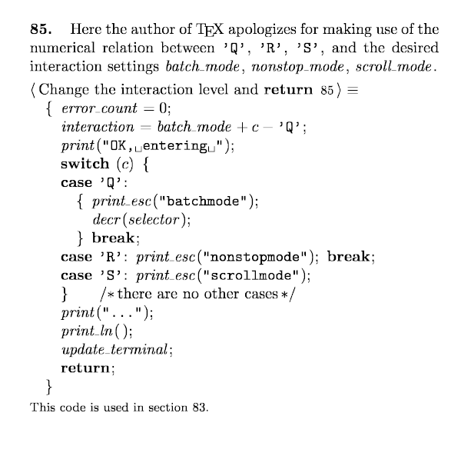
cweb Source Code for T_{E}X Why, How, and What Martin Ruckert, August 2021
Fakultät für Informatik und
Mathematk

Slide 2
Why?
Why do we want cweb Source Code of T_{E}X ?
Toolchain
Modification
Debugging
Education
Experiments
Example: ktex.w
tex.web + etex.ch + 32bit pointer type + kpathsea library = ktex.w
It is not the purest implementation of T_{E}X .
It is a useful basis.
It is still close to the original T_{E}X .
DEMO

Slide 3
Why?
ktex.w
Why do we want cweb Source Code of T_{E}X ?
Toolchain
Modification
Debugging
Education
Experiments
cweave
ctangle
ktex.tex
ktex.c
tex
gcc
ktex.dvi
ktex
bplain.tex
*latex.ltx
ktex.fmt
klatex.fmt

Slide 4
Why?
ktex.w
Why do we want cweb Source Code of T_{E}X ?
Toolchain
Modification
Debugging
Education
Experiments
cweave
ctangle
ktex.tex
ktex.c
tex
gcc
ktex.dvi
ktex
bplain.tex
*latex.ltx
ktex.fmt
klatex.fmt

Slide 5
Why?
Why do we want cweb Source Code of T_{E}X ?
Toolchain
Modification
Debugging
Education
Experiments
Example: HintView, the HINT viewer.
Backend:
literate cweb programs
User Interface:
C (Windows)
Java (Android)
Rendering:
OpenGL
Programming Environment
MS Visual Studio (Windows)
Android Studio (Android)

Slide 6

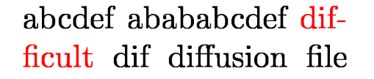
Why?
disc_node
replace_count = 1
pre_break = f-
post_break = fi
lig_node:
ffi
f f i
Why do we want cweb Source Code of T_{E}X ?
Toolchain
Modification
Debugging
Education
Experiments
ignore_node:
info = 1
list =
lig_node:
ffi
f f i
ignore_node:
info = 0
list = null

Slide 7
Why?
Why do we want cweb Source Code of T_{E}X ?
Toolchain
Modification
Debugging
Education
Experiments

Slide 8
How ?
Start with tex.web
Apply web change files, e.g. ε-T_{E}X
Apply patch files
Convert web file to cweb file
run web2w
apply patch file
Apply cweb change files, e.g. for kT_{E}X
For T_{E}X related projects
Extract code and Link

Slide 9
How ?
The basis: ctex.w
Close to Don Knuth's original T_{E}X
Passes trip test
No command line
No kpathsearch
Start with tex.web
Apply web change files, e.g. ε-T_{E}X
Apply patch files
Convert web file to cweb file
run web2w
apply patch file
Apply cweb change files, e.g. for kT_{E}X
For T_{E}X related projects
Extract code and Link
tex.web
web2w
systematic changes
tex.w
ctex.patch
individual changes
ctex.w

Slide 10
How ?
The extended basis: ectex.w
tex.web
Start with tex.web
Apply web change files, e.g. ε-T_{E}X
Apply patch files
Convert web file to cweb file
run web2w
apply patch files
Apply cweb change files, e.g. for kT_{E}X
For T_{E}X related projects
Extract code and Link
etex.ch
etex.web
web2w
systematic changes
etex.w
ectex.patch
ctex.patch
individual changes
ectex.w
Extended features of ε-T_{E}X

Slide 11
How ?
tex.web
etex.ch
etex.web
Start with tex.web
Apply web change files, e.g. ε-T_{E}X
Apply patch files
Convert web file to cweb file
run web2w
apply patch files
Apply cweb change files, e.g. for kT_{E}X
For T_{E}X related projects
Extract code and Link
tex64.patch
enlarging constants
etex64.web
web2w
systematic changes
etex64.w
ectex.patch
ctex.patch
individual changes
ectex64.w
Large constants, e.g. 64 bit memory words
Extended features of ε-T_{E}X

Slide 12
How ?
tex.web
etex.ch
etex.web
Start with tex.web
Apply web change files, e.g. ε-T_{E}X
Apply patch files
Convert web file to cweb file
run web2w
apply patch files
Apply cweb change files, e.g. for kT_{E}X
For T_{E}X related projects
Extract code and Link
tex64.patch
enlarging constants
etex64.web
web2w
systematic changes
etex64.w
ectex.patch
ctex.patch
individual changes
ectex64.w
ktex.ch
ktex.w
T_{E}X Live compatible T_{E}X engine

Slide 13
What? systematic changes: Macros
web2w translation of WEB macros to cweb macros
WEB:
@d define(#)==if global then geq_define(#)@+else eq_define(#)
...
@<Assignments@>=
set_font: define(cur_font_loc, data, cur_chr);
cweb:
@d define(A, B, C) if (global) geq_define(A, B, C);@+else eq_define(A, B, C)

Slide 14
What? systematic changes: Macros
New in web2w version 1.0
WEB:
@d char_info_end(#)==#].qqqq
@d char_info(#)==font_info[char_base[#]+char_info_end
...
cur_h:=cur_h+char_width(f)(char_info(f)(c));
cweb:
@d char_info(A, B) font_info[char_base[A]+B].qqqq
...
cur_h=cur_h+char_width(f, char_info(f, c));

Slide 15
What? individual changes: nonlocal goto
@<Error hand...@>=
static void jump_out(void)
- {@+goto end_of_TEX;
+ {@+ close_files_and_terminate(); exit(0);
}

Slide 16
What? individual changes: cwebmac.tex has no \L
@<Types...@>=
typedef int scaled; /*this type is used for scaled integers*/
- typedef int32_t nonnegative_integer; /*$0\L x<2^{31}$*/
+ typedef int32_t nonnegative_integer; /*$0\le x<2^{31}$*/
typedef int8_t small_number; /*this type is self-explanatory*/

Slide 17
What? individual changes: single character strings
@<Put each...@>=
- primitive('-', discretionary, 1);
+ primitive("-", discretionary, 1);
@!@:Single-character primitives -}{\quad\.{\\-}@>

Slide 18
What? individual changes: use / as directory separator
- @d TEX_area "TeXinputs:"
+ @d TEX_area "TeXinputs/"
@.TeXinputs@>
- @d TEX_font_area "TeXfonts:"
+ @d TEX_font_area "TeXfonts/"
@.TeXfonts@>

