Slide 1
Electronic health care records (EHR) anonymizer
Programming Lab II
Presented by
Thomas Lordick, Bryce Fransen, Alexander Hoch
WS 2020

Slide 2
Outline
Background EHR’S and the problem of data privacy
Workflow
Live Demo
Improvements & Conclusion

Slide 3
Electronic Health Care records
„Digital documention of an individuals medical history"
Including patients …
Personal
Diagnosis and past history
Medication
etc. … information.

Slide 4
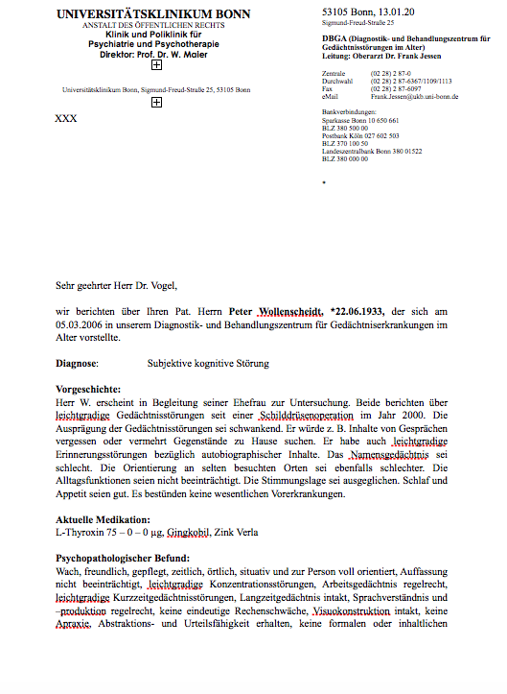
Name, Birthdate, Visiting date
Medical history
Psychopathlogical findings

Slide 5
Data privacy & and its problems for research
Electronic health care data is personal
How to protect patients privacy ?
To anonymize or not to anonymize?
What makes data anonymous ?
Define categories
How to ensure sufficient data quality ?
Data still meaningful after all ?
Oreilly.com: Anonymizing Health Data by Luk Arbuckle, Khaled El Emam

Slide 6


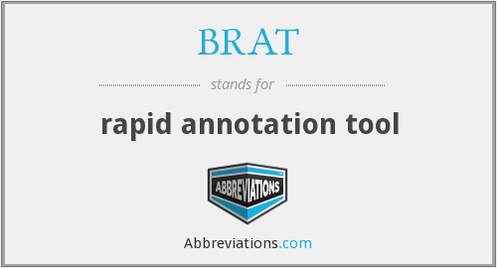
Approaches
Reading/Writing Word documents
Text mining and RegEx for automatic anonymization
Solution for non-IT Users -> Graphical User Interface
User interaction

Slide 7
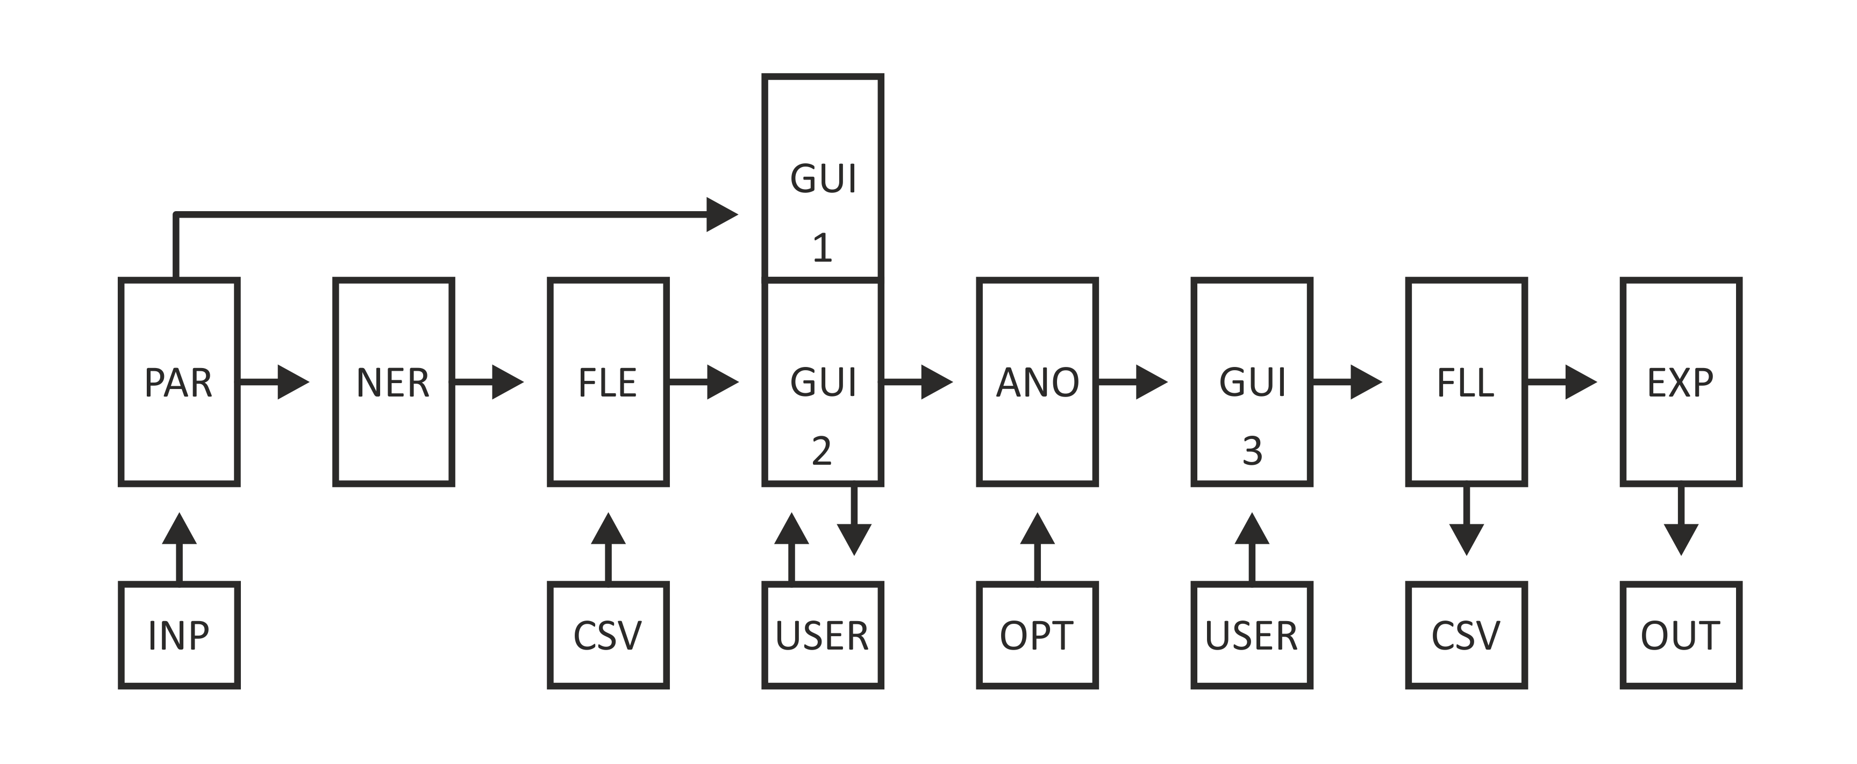
Workflow

Slide 8
Stanford NLP and further annotations
Named Entity Recognition API for German cores
RegEx
-> Entities: PERSON, ADDRESS,ORGA,DATE,GENDER
Thinz Jenny Rose Finkel, Trond Grenager, and Christopher Manning. 2005. Incorporating Non-local Information into Information Extraction Systems by Gibbs Sampling. Proceedings of the 43nd Annual Meeting of the Association for Computational Linguistics (ACL 2005), pp. 363-370.ufügen

Slide 9
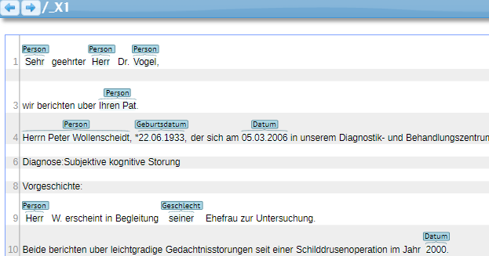
Brat rapid annotation tool
Annotation viewer
Enables to add/edit/delete annotations in a text
Text saved as .txt file and annotations in .ann file

Slide 10
Graphical user interface (GUI)
Main point of user interaction
Incorporates Brat webserver and original text

Slide 11
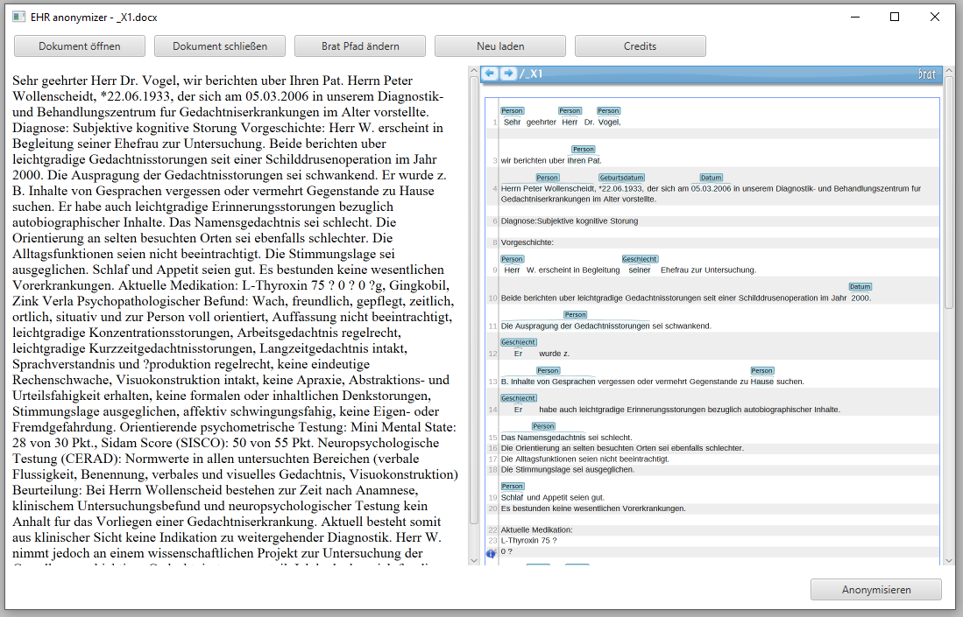
Graphical user interface (Main)
Webview to display input text
Webview to display Brat server to annotate text

Slide 12
Graphical user interface (Buttons)
Open document
Close document
Change Brat path
Refresh
Credits
Anonymize

Slide 13
Defined Classes
Storable Annotation
Names -> Person.csv
"J. Doe"
Organizations -> Organisation.csv
"Organisation"
Address information -> Adresse.csv
"Adresse"
Gender information -> Geschlecht.csv
Changes to the neutral form
NLP only Annotation
Date Information -> year or month/year/placeholder/no change

Slide 14
Anonymizer
Exchanged annotated words to placeholder/to anonymization option
Change dates according to options

Slide 15
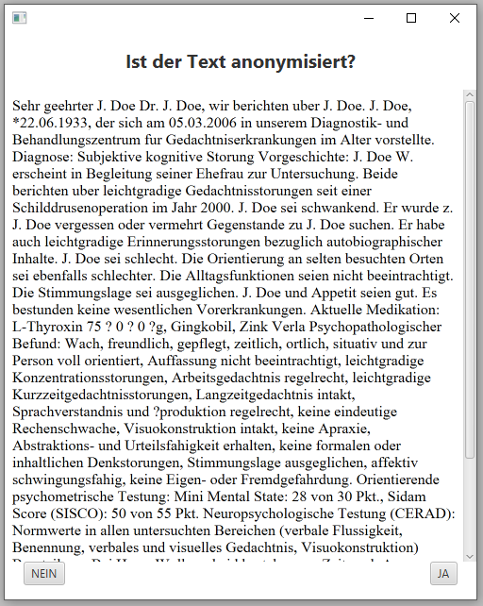
Anonymizer
Exchanged annotated words to placeholder/to anonymization option
Change dates according to options
Is the text anonymized?

Slide 16
Feedback Loop: Part I
User loads a document
Tokenization of text (token list)
Create a list for each csv file annotations
For all csv lists:
Compare csv list with token list
Creates new list of similar words
Finds all indexes of each word in the text
Append words to the .ann file with index and class label
Create list of all annotations for future reference
Ready for user to review/edit document

Slide 17
Feedback Loop: Part II
After user clicks export
Create list of all annotations from the .ann file
Compare the beginning annotation list with the final annotation list
Append all newly discovered annotations to a new list
Add the new annotations to the correct csv file
Anonymized Document is exported

Slide 18
Live Demo

Slide 19

Future Improvements
GUI:
Format the original text (the left side) better
Feedback loop:
Hard to handle multiple words (I.e. Organization Names)
Possible fix: Should have used ".contains()" function
Better handling of annotations that user does not want to be stored
Temporary annotation
Figure out how a user can personalize the built in NLP package
Delete annoying annotations that are obviously tagged incorrectly
Export:
Better formatting

