Slide 1






Project operator
Partners of the operator

Slide 2






Telemetry
and
Communication
Station entry · telemetry · radio link · Control Center
Project operator
Partners of the operator

Slide 3

Overview and layout
Three station loops
1. Telemetry
sensors → Arduino → RS-485 → collector → DBMS
2. LAN
station server & dashboard → operator workstations
Labels: local bus · network · RF link
3. Radio
station (LoRa / Yagi) ↔ RF ↔ Control Center
Note
Wired telemetry and the radio link are separate data paths.
Visual: overview block diagram
Project operator
Partners of the operator

Slide 4

Entering the base. Deployment
Deploying telemetry
• Arduino nodes with sensors on a shared RS-485 bus
• USB–RS485 adapter → PC running tlmtry-collector
Discovery
• DISCOVER — device reports its manifest (metrics, poll interval)
• Device address range 1…100
Polling
• READ — periodic polling; values stored in the database
• Each device can use its own poll interval
Result
• Status shows addresses, online state, and sample count
Visual: RS-485 bus sketch + status screenshot
Keywords:
RS-485, Arduino, sensors
Project operator
Partners of the operator

Slide 5
Managing and accessing telemetry servers. Dashboard
DBMS
• Primary store: SQLite or PostgreSQL
• Tables: devices → metrics → samples
Read path
• CLI: tlmtry-collector status
• SQL queries / JOINs
• Python: Storage API or SQLAlchemy
LAN and dashboard
• Station monitoring dashboard — browser over LAN
• From a workstation: host URL and UI port
• PostgreSQL (if used): port 5432
Same data everywhere
• Charts show the same samples as in the DB
Visual: mini ER + station dashboard
Keywords:
Database, LAN, TCP/IP
Project operator
Partners of the operator

Slide 6
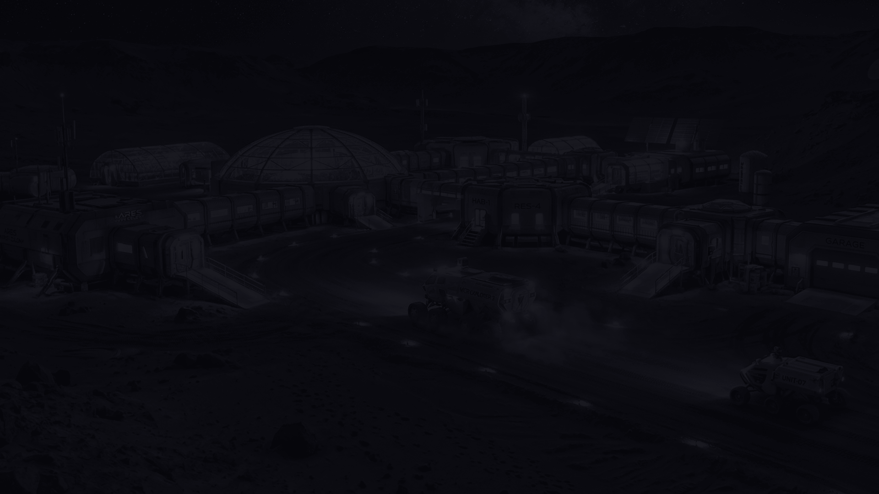
Establishing communication. Installing the antenna. T-sessions and RS-sessions
RF hardware
• LoRa modem + directional Yagi antenna
• UHF band operation
Antenna setup
• Connect the antenna securely
• Aim it using the radiation pattern (main lobe)
Propagation
• Prefer line of sight
• Watch obstacles and beam direction
Sessions
• Start a T-session / RS-session
• Confirm the session is active
Note: RF loop ≠ RS-485 telemetry bus
Visual: Yagi photo + pattern diagram
Keywords:
LoRa, Yagi, UHF, signal propagation
Project operator
Partners of the operator

Slide 7
Data exchange between the station and the Control Center
Port monitor
• Station-side raw / service traffic on the link
Exchange workflow
• Messaging during the session
• File transfer as a typical scenario
Control Center dashboard
• Operator view at the MCC
• Mission / RF picture for the center
Do not mix dashboards
• Station dashboard ≠ Control Center dashboard
• Local bench telemetry vs RF / mission link
Visual: split screen station | MCC
Keywords:
port monitor, messages, files, MCC dashboard
Project operator
Partners of the operator

Slide 8

Task No. 1: Controlling the communication satellite
Task overview
Practical task overviews — covered in separate materials.
Keywords:
SDR, STM32, Arduino IDE/CubeProgrammer
Project operator
Partners of the operator

Slide 9
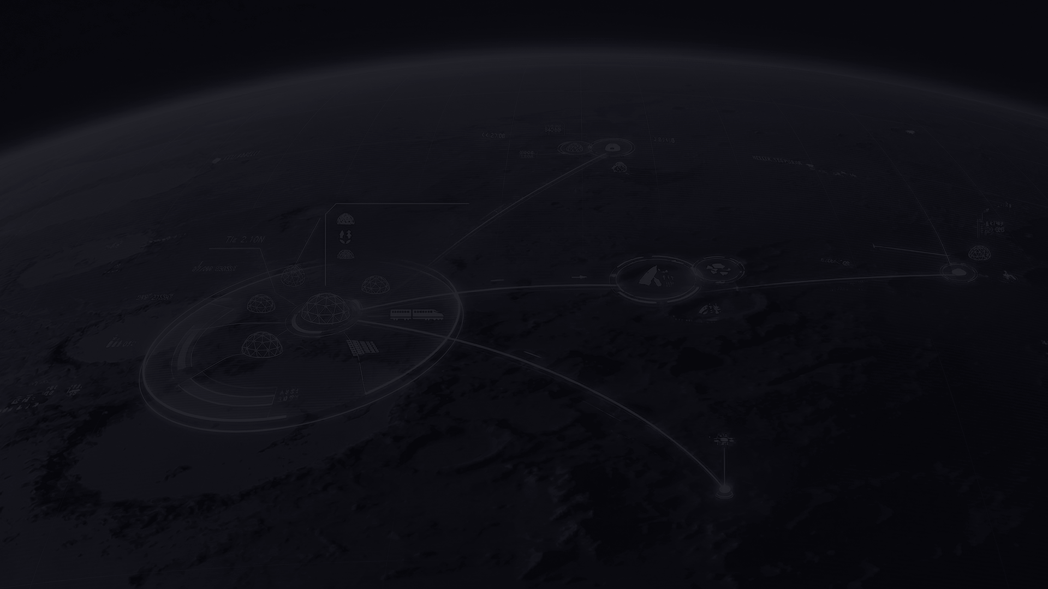
Task No. 2: Establishing communication with the second station
Task overview
Practical task overviews — covered in separate materials.
Keywords:
(see separate materials)
Project operator
Partners of the operator

Slide 10

Task No. 3: Localization of the descent capsule beacon
Task overview
Practical task overviews — covered in separate materials.
Keywords:
(see separate materials)
Project operator
Partners of the operator

Slide 11

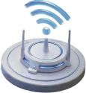
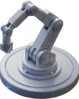
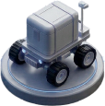
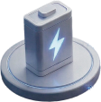
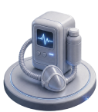
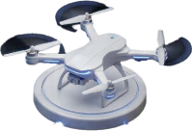
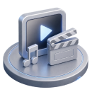
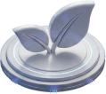
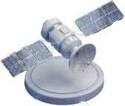
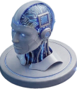
Icons
Project operator
Partners of the operator

Slide 12





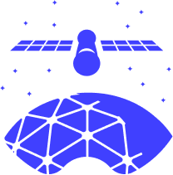
Takeaways
Three loops:
telemetry (RS-485 + DBMS) · LAN / dashboard · radio ↔ Control Center
Next: practical tasks on the bench.
Visual: reuse the overview diagram from slide 3.

