Slide 1
SMART DIGITAL ASSISTANT
Team Members
1.Akksaya Rajasri. G.P [711715104005]
2. Durga Devi. S [711715104017]
3. Gracelin. S [711715104020]
Facultyguide : Industrial guide :
Dr. PASUMPON PANDIAN A Mr. HARI BALA KUMARAN
Assistant professor Designation
Department of CSE
Department of CSE, KGiSL Institute of Technology, Coimbatore

Slide 2
Abstract
The project “Smart Digital Assistant” is about generating data from several vehicles and store them in simple storage service(S3) and the data are fetched using lambda function and through interaction model alexa tells the data to the user when required.
Department of CSE, KGiSL Institute of Technology, Coimbatore

Slide 3
Area Introduction-Existing system
In all fuel bunks having types of digital display unit in order to display the value of fuel adding to the vehicle. But the disadvantage of using load cell is that it can’t be used for measurement of highly reactive material such as petrol. So we decided to store the data in S3 and to redirect it with voice user interface.
Department of CSE, KGiSL Institute of Technology, Coimbatore

Slide 4
Proposed System
Advantages over existing methods
Minimal man power consumption.
Minimal time consumption.
Computational errors and mistakes are minimized.
Future Enhancements
Manual work has to be reduced.
Accuracy.
Result to be received very quickly.
To speed up the operation.
Department of CSE, KGiSL Institute of Technology, Coimbatore

Slide 5
Literature Review
Drawbacks of existing methods
Human needs to look into the readings of the fuel level and know the results, which is time consuming and it is also a extra task to the user in the busy routine works.
References
http://www.ierjournal.org/pupload/vol2iss9/SMART%20DIGITAL%20FUEL%20INDICATOR%20SYSTEM.pdf
Department of CSE, KGiSL Institute of Technology, Coimbatore

Slide 6
Module Splitup
Module-1
Module-2
Module-3
Connecting
Lambda function and Alexa developers console
And test them
Data Collection
Understanding data
Cleaning data
Interaction model
Data’s redirect to js code
Integrating js code into Lambda fuction
Department of CSE, KGiSL Institute of Technology, Coimbatore

Slide 7
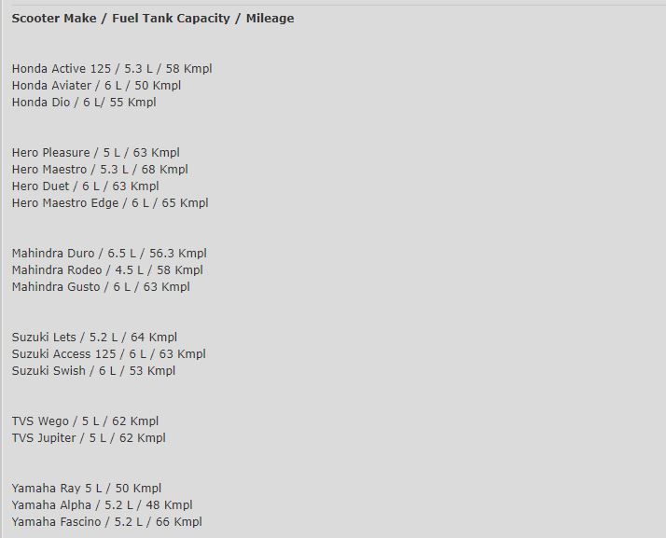
Module-1
Data collection
Department of CSE, KGiSL Institute of Technology, Coimbatore

Slide 8
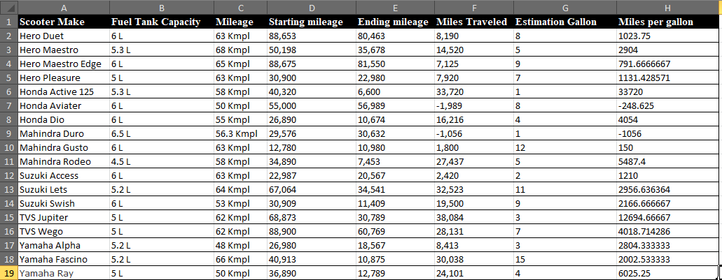
Collected data and cleaned
Department of CSE, KGiSL Institute of Technology, Coimbatore

Slide 9
Building Skill
Logged into developer.amazon.console.
Create a skill (custom)
Custom models
Interaction model
Invocation
Intent
Slot
Interfaces
Endpoint

Slide 10
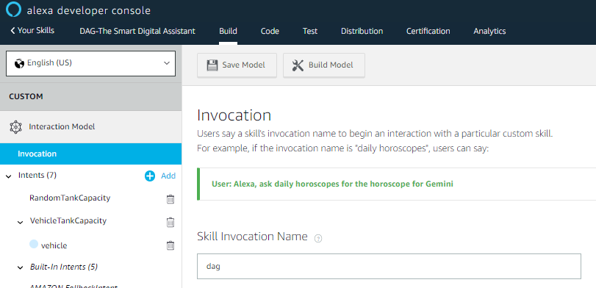
INTERACTION MODEL
Invocation

Slide 11
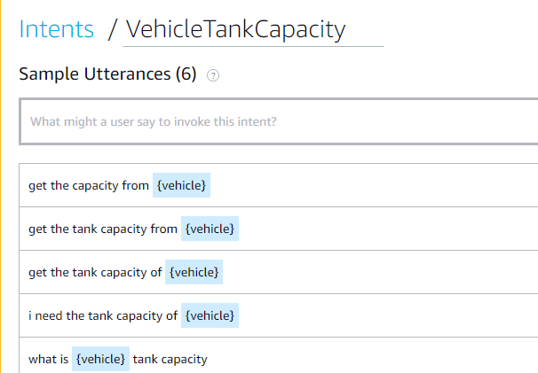
INTENT
Vehicle Tank Capacity

Slide 12
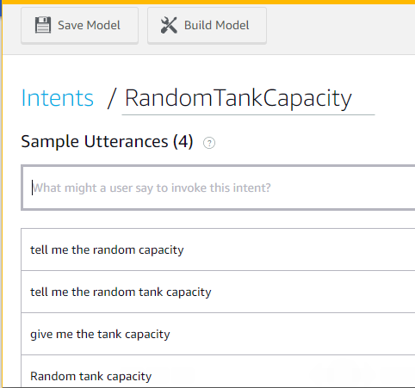
Random Capacity

Slide 13
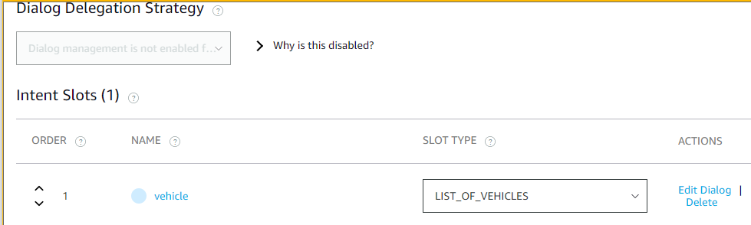
SLOTS

Slide 14
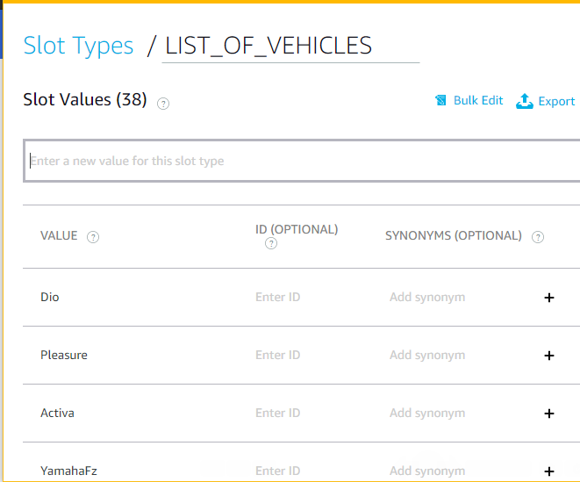

Slide 15
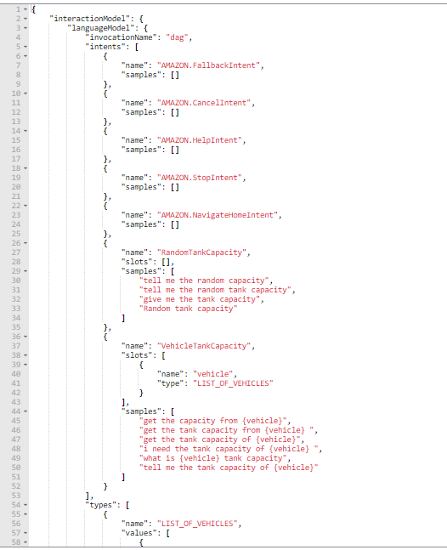
JSON Editor

Slide 16
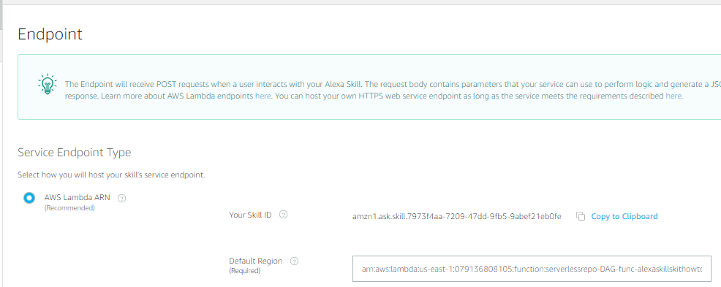
ENDPOINT

Slide 17
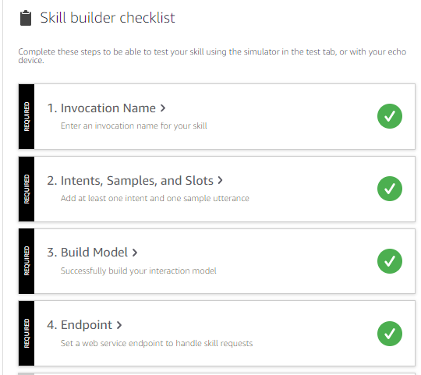
Skill builder checklist

Slide 18
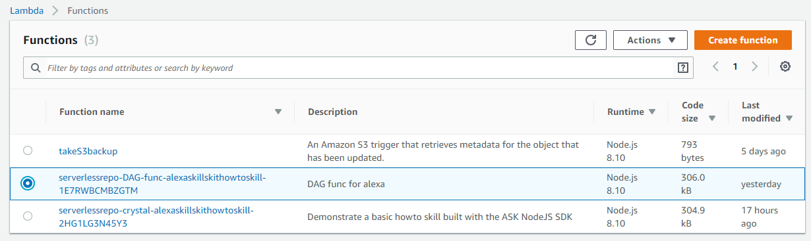
Connecting with lambda
Log into AWS account
Enable lambda service
AWS LAMBDA
Creating lambda function

Slide 19
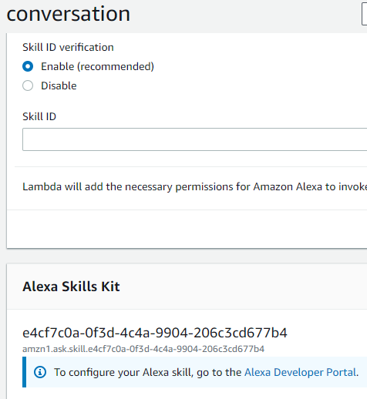
ENDPOINT CONNECTION (ARN)
aws.amazon.com

Slide 20
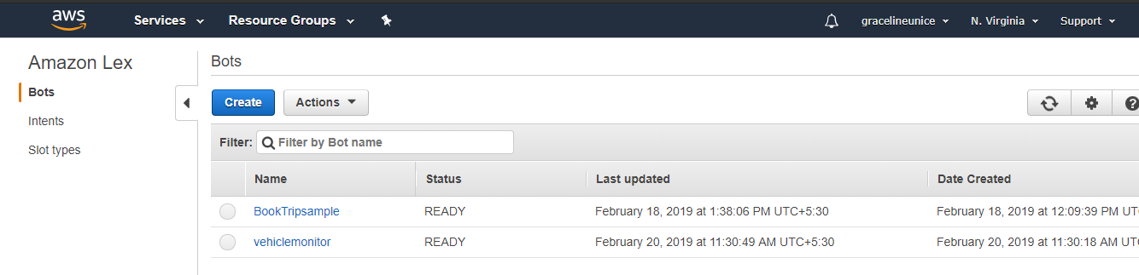
AMAZON LEX

Slide 21
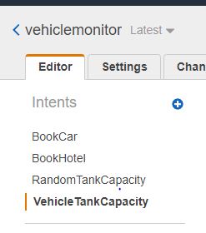
Creating intents in lex

Slide 22
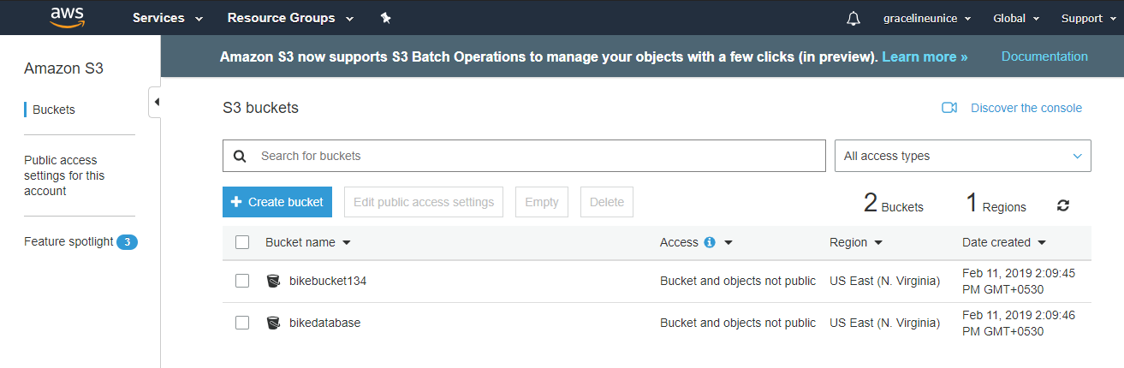
SIMPLE STORAGE SERVICE (S3)
Creating bucket

Slide 23
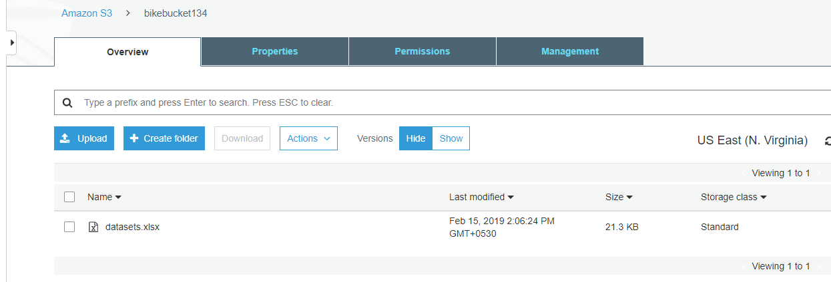
Uploading files

Slide 24
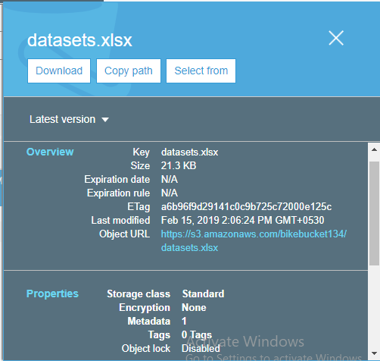
Overview of bucket

Slide 25
THANK YOU

