Slide 1
SMART DIGITAL ASSISTANT
Team Members
1.Akksaya Rajasri. G.P [711715104005]
2. Durga Devi. S [711715104017]
3. Gracelin. S [711715104020]
Facultyguide : Industrial guide :
Dr. PASUMPON PANDIAN A Mr. HARI BALA KUMARAN
Assistant professor Designation
Department of CSE
Department of CSE, KGiSL Institute of Technology, Coimbatore

Slide 2
Abstract
The project “Smart Digital Assistant” is about how to convert the analog process of fuel level indication to smart digital fuel indication, in which the correct measure of fuel is measured in litres and the readings are reported to the user using voice user interface by amazon alexa.
Department of CSE, KGiSL Institute of Technology, Coimbatore

Slide 3
Area Introduction-Existing system
In all fuel bunks having types of digital displays unit in order to display the value of fuel adding to the vehicle. But the disadvantage of using load cell is that it can’t be used for measurement of highly reactive material such as petrol. So we decided to use Guage for petrol level measurement and to redirect with voice user interface.
Department of CSE, KGiSL Institute of Technology, Coimbatore

Slide 4
Proposed System
Advantages over existing methods
Minimal man power consumption.
Minimal time consumption.
Computational errors and mistakes are minimized.
Future Enhancements
Manual work has to be reduced.
Accuracy.
Result to be received very quickly.
To speed up the operation.
Department of CSE, KGiSL Institute of Technology, Coimbatore

Slide 5
Literature Review
Drawbacks of existing methods
Human needs to look into the readings of the fuel level and know the results, which is time consuming and it is also a extra task to the user in the busy routine works.
References
http://www.ierjournal.org/pupload/vol2iss9/SMART%20DIGITAL%20FUEL%20INDICATOR%20SYSTEM.pdf
Department of CSE, KGiSL Institute of Technology, Coimbatore

Slide 6
Module Splitup
Module-1
Module-2
Module-3
Data Collection
Understanding data
Cleaning data
Interaction model
Data’s redirect to python code
Integrating python into Raspberry pi
Connecting IOT with raspberry pi
Alexa voice
recognition
Department of CSE, KGiSL Institute of Technology, Coimbatore

Slide 7
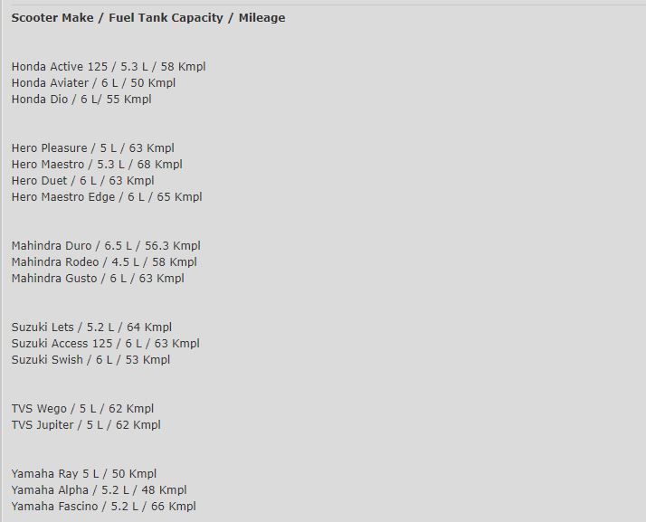
Module-1
Data collection
Department of CSE, KGiSL Institute of Technology, Coimbatore

Slide 8
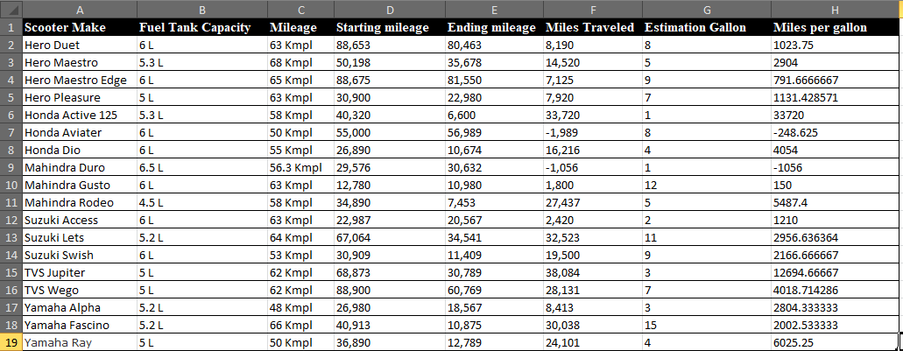
Collected data and cleaned
Department of CSE, KGiSL Institute of Technology, Coimbatore

Slide 9
Building Skill
Logged into developer.amazon.console.
Create a skill (custom)
Custom models
Interaction model
Invocation
Intent
Interfaces
Endpoint

Slide 10
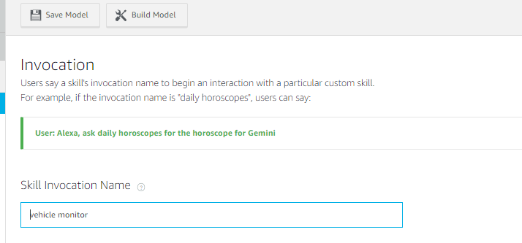
INTERACTION MODEL
Invocation

Slide 11
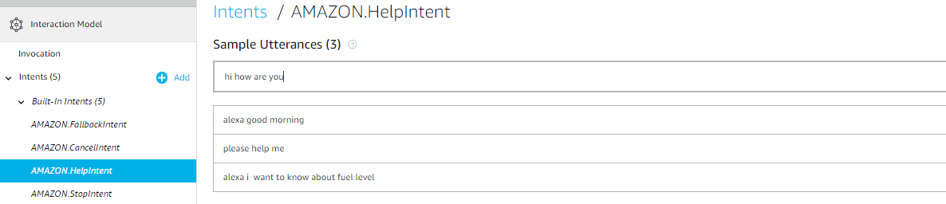
Intent

Slide 12
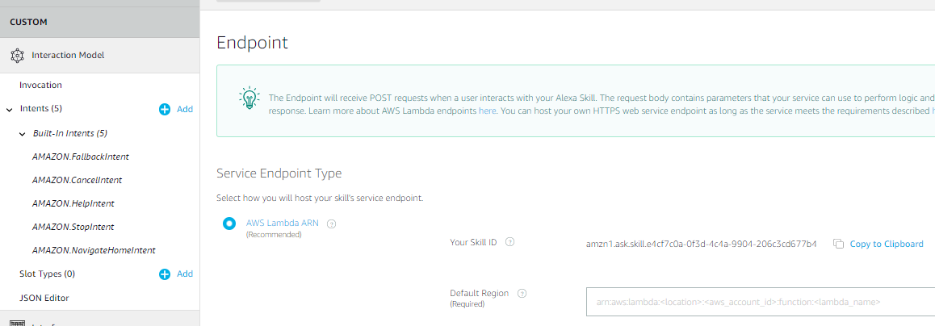
ENDPOINT

Slide 13
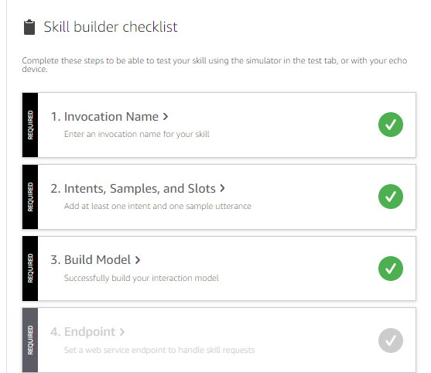
Skill builder checklist

Slide 14
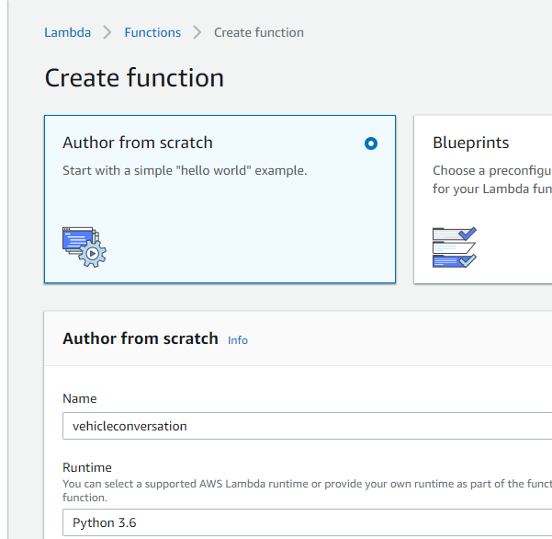
Connecting with lambda
Log into AWS account
Enable lambda service
AWS LAMBDA
Creating lambda function

Slide 15
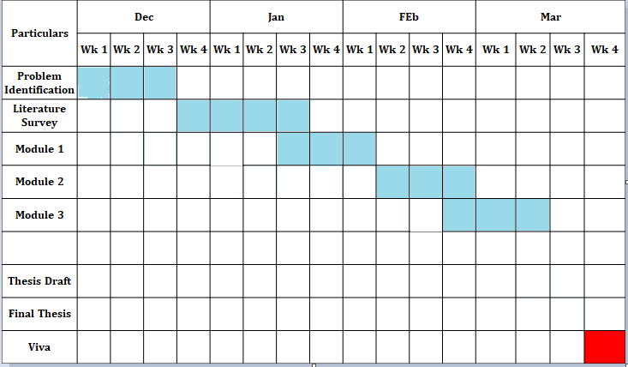
Project Planner/ Timeline chart

Slide 16
THANK YOU

