Slide 1
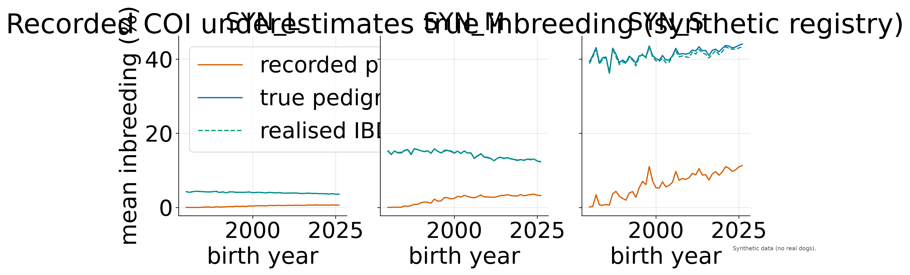
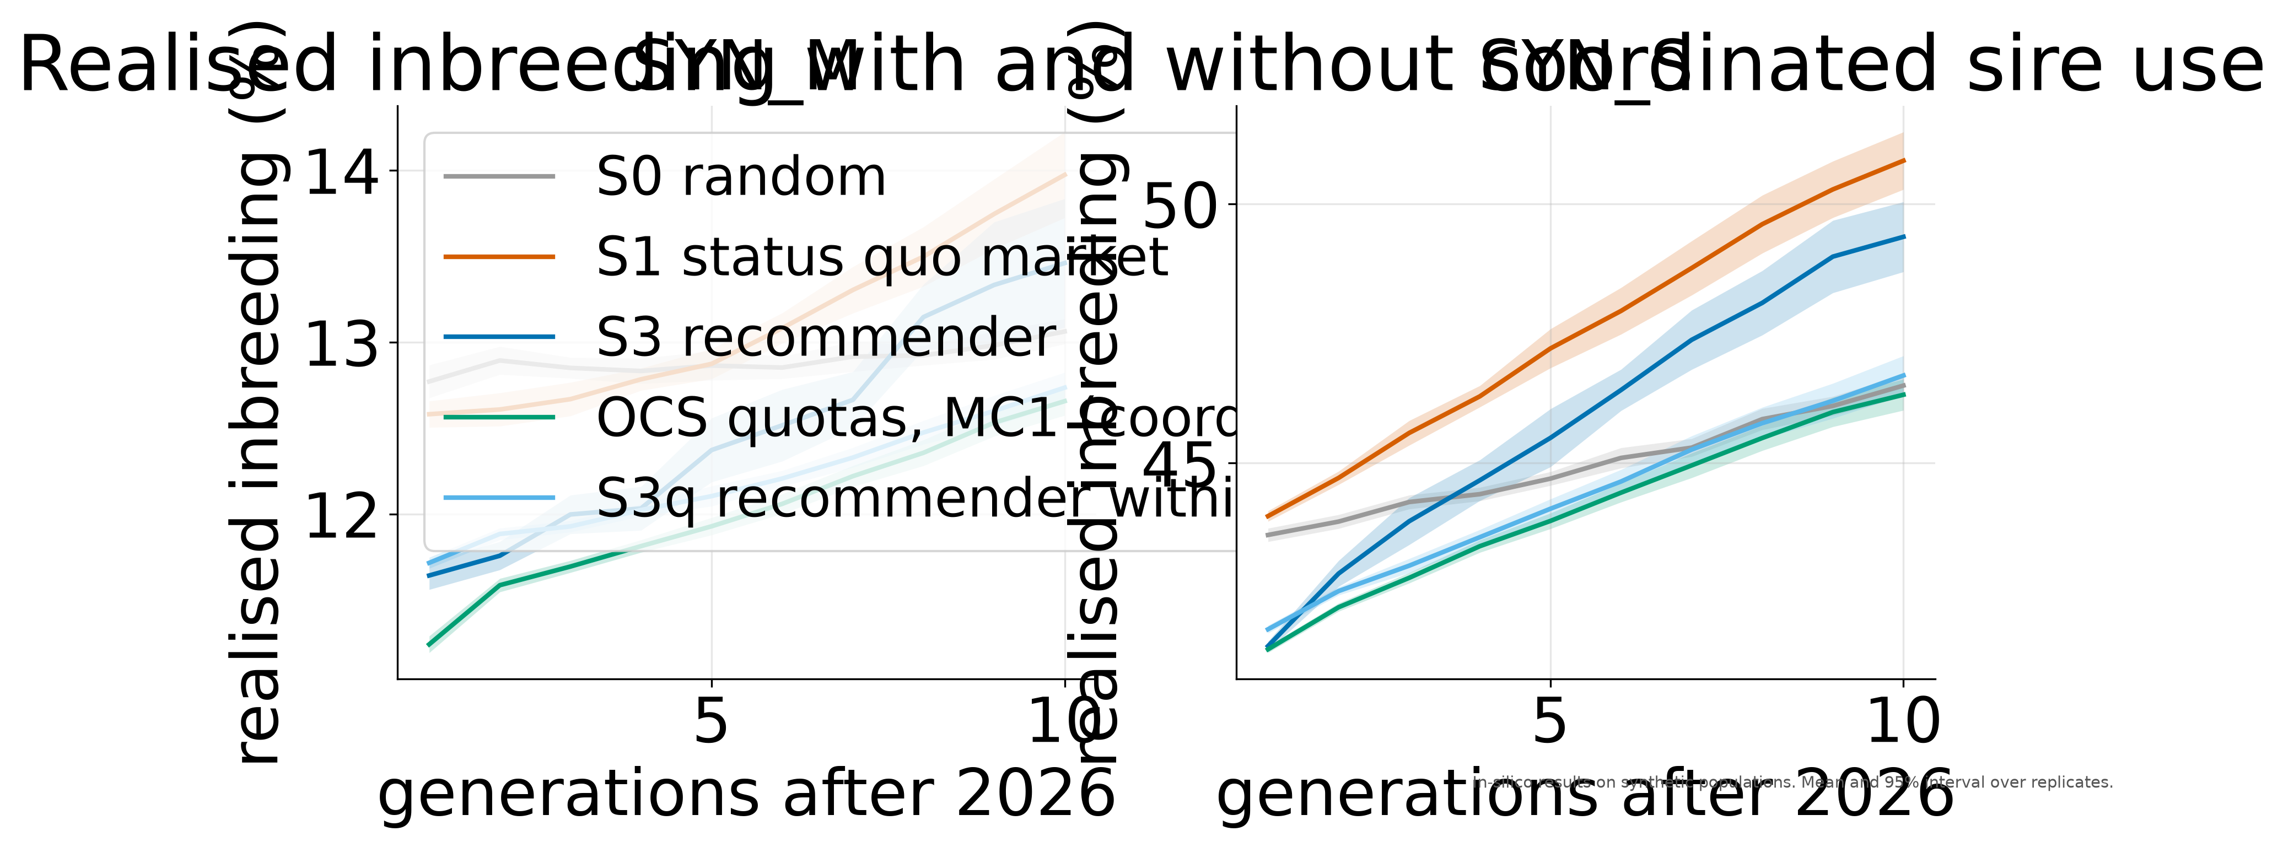
Breeding Smarter: A Data-Driven Matching System for Genetic Diversity in Dogs and Beyond
Tea Ćetojević Tisaj, TODO colleague · University of Zagreb, FER [FER logo]
The problem
• Purebred dogs: mean genomic inbreeding 0.249 across 227 breeds.
• Popular sires in all 215 Kennel Club breeds.
• 57% of 1,054,293 dogs carry a disease variant.
Why now
EU Regulation 2026/1818 bans close-relative matings across the EU.
What we built
An open engine: exact inbreeding and kinship, EU, FCI and kennel-club rules, and an explained score for every candidate sire. Tested on a calibrated synthetic registry (153,641 dogs; 39 of 47 calibration checks pass, 8 soft warnings, 0 failures).
[pipeline diagram: insert conference/poster/pipeline.svg]
Recorded COI hides inbreeding
2025 puppies of the small breed: recorded COI 10.9%, true inbreeding 43.7%.
Does it work?
Explainable matches
Ten simulated generations: the recommender cut realised inbreeding by 1.5 points in the small breed and nearly removed affected puppies at tested loci, but breeders all chose the same sires. Club quotas fix this: coordinated sire planning raised Ne from 33 (today's market) to 54 in the small breed and from 188 to 283 in the medium breed; the recommender within quotas did as well. Random mating still kept the most diversity in the medium breed.
Honesty box
Partner with us
All dogs are synthetic. Results are in silico. Some EU rules are not yet verified.
Free pilot for kennel and breed clubs; code runs on your premises.
[QR: demo, DOI, contact]
Refs: Bannasch 2021; Lewis 2015; Donner 2023; Meuwissen and Luo 1992; Colleau 2002.

