Slide 1

Hospital Management Data Analysis
By:
Toyyib Oluwadamilre, UTHMAN
Link:
Hospital Management (Toyyib Oluwadamilare, Uthman) - Jupyter Notebook

Slide 2
Introduction
This project explores hospital management data across patients, doctors, treatments, billing, and appointments.
By cleaning, transforming, and analyzing the dataset, we uncover key operational and financial insights that highlight both challenges and opportunities for improved hospital performance.
Dataset Overview:
5 related tables: Appointments, Patients, Doctors, Treatments, Billing
Project Goal:
Clean and transform raw hospital data
Analyze patterns and relationships
Uncover actionable insights for hospital management
Provide data-driven recommendations
2

Slide 3
Data Cleaning & Transformation
Data Cleaning:
Data Transformation
Patients: created a full_name column, derived age from date of birth
Checked for missing values
Identified and removed duplicates
Doctors: created a full_name column
Built new patient & doctor tables
Corrected inconsistent data types
Dropped irrelevant columns: appointment_time, bill_date, amount, etc.
Merged all tables into one hospital dataframe for analysis
3

Slide 4
Key Business Questions
Total expected revenue vs actual revenue
Payment patterns (status, method)
Branch revenue performance
Treatment revenue analysis
Most common reasons for visits
Top billing doctor
Monthly appointments and revenue trends
Insurance provider contributions
4

Slide 5
Revenue Analysis
Expected Revenue:
$551,249.85
Actualized Revenue:
$173,424.90
Revenue Gap:
$377,824.95
Significant gap between potential and realized revenue (68.5% unrealized)
Key Observations:
Only 31.5% of expected revenue was actualized
Indicates major challenges in payment collection
Potential issues with billing processes
Opportunity for significant financial improvement
5

Slide 6
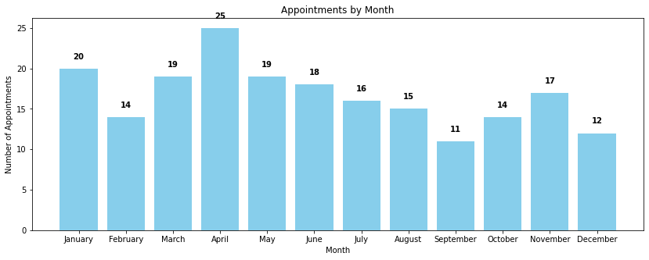
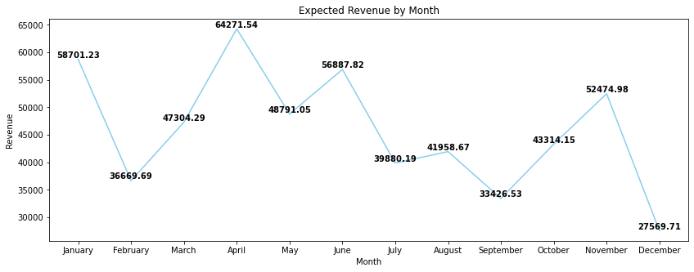
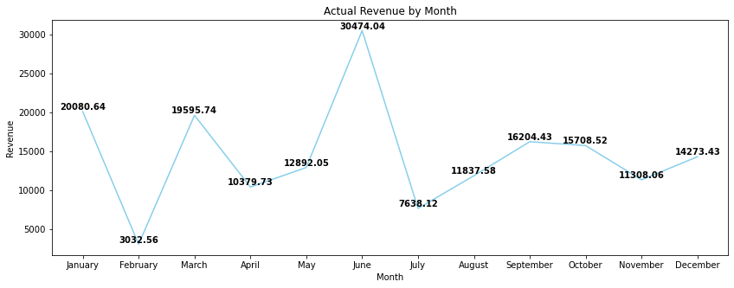
Appointments by Month
Expected Revenue by Month
Actual Revenue by Month
6

Slide 7
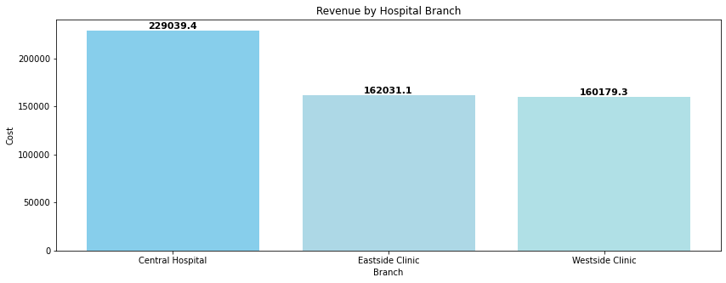
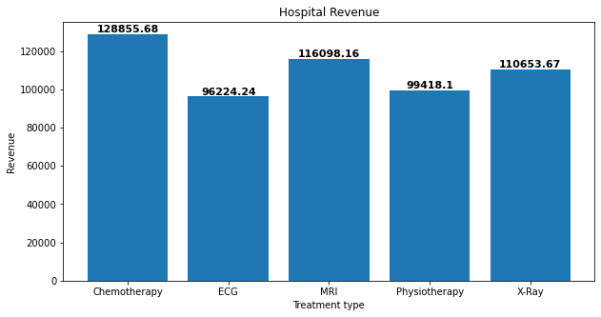
Branch Revenue Performance
Revenue By Treatment Type
Key Finding:
Key Finding:
Central Hospital branch generated the most revenue
Chemotherapy generated the most revenue
7

Slide 8
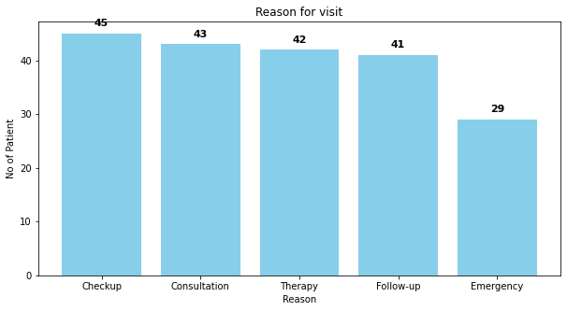
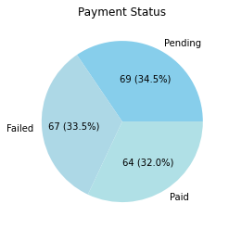
Visit Reasons & Payment Status
Patient Visit Reasons
Payment Status
Most visits were for routine checkups
Most payments are pending (34.5%)
Few emergency cases recorded
Significant number of payments failed (33.5%)
Preventive care dominates patient visits
Few successful payments (32%)
8
6

Slide 9
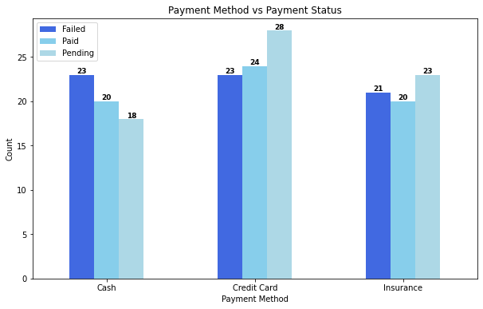
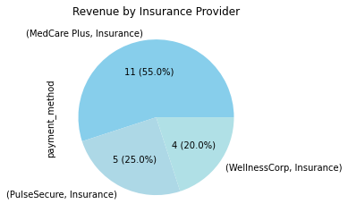
Payment Method vs Payment Status
Revenue by Insurance Provider
Key Finding:
Key Finding:
Credit card payments were the most successful
MedCare Plus Insurance contributed over 50% of successful payments
9

Slide 10
Monthly Trends & Performance
Monthly Insights
Appointments:
April recorded the highest number of appointments while September recorded the lowest
Revenue:
- Expected: April is expected to generate the highest revenue and December to generate the lowest revenue
- Actual: The highest revenue was generated in June while February recorded the lowest
10
8

Slide 11
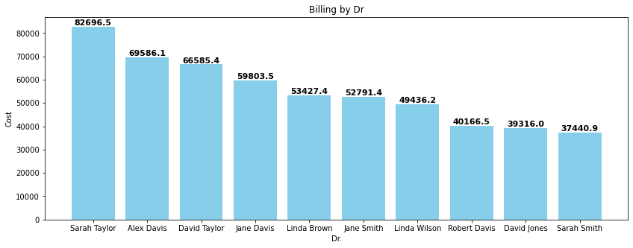
Doctor’s Performance
Top Billing Doctor:
Dr. Sarah Taylor
Billed the most for the year
11

Slide 12
Conclusion & Recommendations
Key Findings
Recommendations
Strong revenue potential vs actual realization gap
Improve payment processing systems
Payment challenges limit financial performance
Reduce failures and pending payments to close revenue gap
Certain treatments and branches drive most revenue
Strengthen insurance partnerships
Top doctors contribute disproportionately to billing
Focus on MedCare Plus and other key providers
Leverage high-performing treatments
Optimize chemotherapy and other profitable services
Support top doctors
Replicate Dr. Sarah Taylor's efficiency across staff
Balance branch performance
Apply Central Hospital best practices to other locations
12

