Slide 1
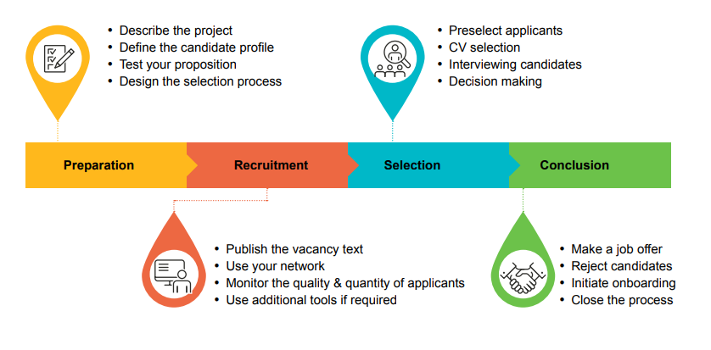








Get financial and departmental approval
Fill in vacancy format
Publish the vacancy
CV selection
Interview candidates
Make decision
Safety check
Job offer
PREPARATION
~ 8 weeks
RECRUITMENT
~ 4-6 weeks
SELECTION
up to 12 weeks*
COMPLETION
~ 6 weeks or more**
Contract and administrative tasks
Prepare for first workday
Use your network
*Depending on knowledge safety check ** Depending on visa

Slide 2
Get financial and departmental approval
Fill in vacancy format
Publish the vacancy
CV selection
Interview candidates
Make decision
Safety check
Job offer
PREPARATION
~ 8 weeks
RECRUITMENT
~ 4-6 weeks
SELECTION
up to 12 weeks*
COMPLETION
~ 6 weeks or more**
Contract and administrative tasks
Prepare for first workday
Use your network
*Depending on knowledge safety check ** Depending on visa

Slide 3
Get financial and departmental approval
Fill in vacancy format
Publish the vacancy
CV selection
Interview candidates
Make decision
Safety check
Job offer
PREPARATION
~ 8 weeks
RECRUITMENT
~ 4-6 weeks
SELECTION
up to 12 weeks*
COMPLETION
~ 6 weeks or more**
Contract and administrative tasks
Prepare for first workday
Use your network
*Depending on knowledge safety check ** Depending on visa

Slide 4
Get financial and departmental approval
Fill in vacancy format
Publish the vacancy
CV selection
Interview candidates
Make decision
Safety check
Job offer
PREPARATION
~ 8 weeks
RECRUITMENT
~ 4-6 weeks
SELECTION
up to 12 weeks*
COMPLETION
~ 6 weeks or more**
Contract and administrative tasks
Prepare for first workday
Use your network
*Depending on knowledge safety check ** Depending on visa

Slide 5
Get financial and departmental approval
Fill in vacancy format
Publish the vacancy
CV selection
Interview candidates
Make decision
Safety check
Job offer
PREPARATION
~ 8 weeks
RECRUITMENT
~ 4-6 weeks
SELECTION
up to 12 weeks*
COMPLETION
~ 6 weeks or more**
Contract and administrative tasks
Prepare for first workday
Use your network
*Depending on knowledge safety check ** Depending on visa

Slide 6

PHASE | STEP | IN CHARGE | EXECUTION | COMMENTS
PREPARATION | Get financial and departmental approval |  | Contact department secretary for financial check
 | Fill in vacancy format |  | Download vacancy format¹, sent the filled in form to secr-he-citg@tudelft.nl | Selection committee consists of at least 2 TU Delft staff members, one being from another section than your own The Talent Acquisition Specialist can give tips and advice on recruitment approach
 | Publish the vacancy |  | Department secretary checks the format after which the vacancy is published by recruitment
RECRUITMENT | Use your network |  | See tips how to get more exposure in step 2.1
SELECTION | Selection steps |  | See selection guide chapter 3² and the important notes in step 3.1 | Management assistants can help with planning of the interviews
 | Knowledge safety check |  | If candidate is in risk category³, contact department secretary
 | Job offer |  | Is made by management assistants and checked by department secretary and HR advisor before sending it.
CONCLUSION | Contract and administrative tasks |  | Management assistant arranges onboarding in MyHR
 | Prepare for first workday |  | See checklist first workday in step 4.2
Roles
TAS
Candidate(s)
Vacancy holder
Selection committee
Recruitment
Department secretary
HR advisor
Management assistants

