Slide 1
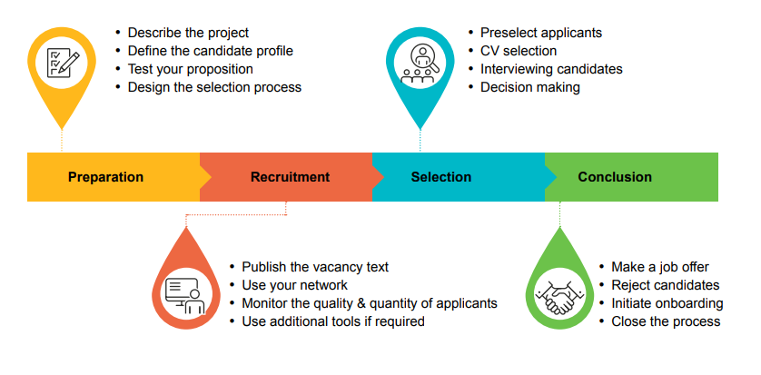








Discuss vacancy
Compose selection committee
Create and post vacancy
CV selection to longlist
Online interviews to shortlist
On campus selection
PREPARATION
~ 15 weeks
RECRUITMENT
~ 4-6 weeks
SELECTION
up to 12 weeks*
COMPLETION
~ 6 weeks or more**
Use your network
Prepare for selection
Contact with the candidate
Reject candidates
Contract and administrative tasks
Prepare for first workday

Slide 2
Discuss vacancy
Compose selection committee
Create and post vacancy
CV selection to longlist
Online interviews to shortlist
On campus selection
PREPARATION
~ 15 weeks
RECRUITMENT
~ 4-6 weeks
SELECTION
up to 12 weeks*
COMPLETION
~ 6 weeks or more**
Use your network
Prepare for selection
Contact with the candidate
Reject candidates
Contract and administrative tasks
Prepare for first workday

Slide 3
Discuss vacancy
Compose selection committee
Create and post vacancy
CV selection to longlist
Online interviews to shortlist
On campus selection
PREPARATION
~ 15 weeks
RECRUITMENT
~ 4-6 weeks
SELECTION
up to 12 weeks*
COMPLETION
~ 6 weeks or more**
Use your network
Prepare for selection
Contact with the candidate
Reject candidates
Contract and administrative tasks
Prepare for first workday

Slide 4
Discuss vacancy
Compose selection committee
Create and post vacancy
CV selection to longlist
Online interviews to shortlist
On campus selection
PREPARATION
~ 15 weeks
RECRUITMENT
~ 4-6 weeks
SELECTION
up to 12 weeks*
COMPLETION
~ 6 weeks or more**
Use your network
Prepare for selection
Contact with the candidate
Reject candidates
Contract and administrative tasks
Prepare for first workday

Slide 5
Discuss vacancy
Compose selection committee
Create and post vacancy
CV selection to longlist
Online interviews to shortlist
On campus selection
PREPARATION
~ 15 weeks
RECRUITMENT
~ 4-6 weeks
SELECTION
up to 12 weeks*
COMPLETION
~ 6 weeks or more**
Use your network
Prepare for selection
Contact with the candidate
Reject candidates
Contract and administrative tasks
Prepare for first workday

