Slide 1
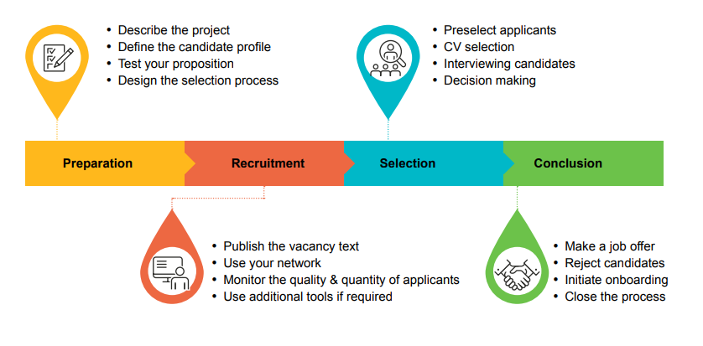








Get financial and departmental approval
Fill in vacancy format
Publish the vacancy
CV selection
Interview candidates
Make decision
Safety check
Job offer
PREPARATION
~ 8 weeks
RECRUITMENT
~ 4-6 weeks
SELECTION
up to 12 weeks*
COMPLETION
~ 6 weeks or more**
Contract and administrative tasks
Prepare for first workday
Use your network
*Depending on knowledge safety check ** Depending on visa

Slide 2
Get financial and departmental approval
Fill in vacancy format
Publish the vacancy
CV selection
Interview candidates
Make decision
Safety check
Job offer
PREPARATION
~ 8 weeks
RECRUITMENT
~ 4-6 weeks
SELECTION
up to 12 weeks*
COMPLETION
~ 6 weeks or more**
Contract and administrative tasks
Prepare for first workday
Use your network
*Depending on knowledge safety check ** Depending on visa

Slide 3
Get financial and departmental approval
Fill in vacancy format
Publish the vacancy
CV selection
Interview candidates
Make decision
Safety check
Job offer
PREPARATION
~ 8 weeks
RECRUITMENT
~ 4-6 weeks
SELECTION
up to 12 weeks*
COMPLETION
~ 6 weeks or more**
Contract and administrative tasks
Prepare for first workday
Use your network
*Depending on knowledge safety check ** Depending on visa

Slide 4
Get financial and departmental approval
Fill in vacancy format
Publish the vacancy
CV selection
Interview candidates
Make decision
Safety check
Job offer
PREPARATION
~ 8 weeks
RECRUITMENT
~ 4-6 weeks
SELECTION
up to 12 weeks*
COMPLETION
~ 6 weeks or more**
Contract and administrative tasks
Prepare for first workday
Use your network
*Depending on knowledge safety check ** Depending on visa

Slide 5
Get financial and departmental approval
Fill in vacancy format
Publish the vacancy
CV selection
Interview candidates
Make decision
Safety check
Job offer
PREPARATION
~ 8 weeks
RECRUITMENT
~ 4-6 weeks
SELECTION
up to 12 weeks*
COMPLETION
~ 6 weeks or more**
Contract and administrative tasks
Prepare for first workday
Use your network
*Depending on knowledge safety check ** Depending on visa

