Slide 1




Slide 2

WHY YOU NEED TO PITCH?

Slide 3

How to Pitch ?

Slide 4
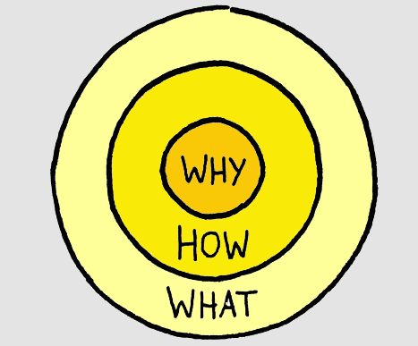

Slide 5
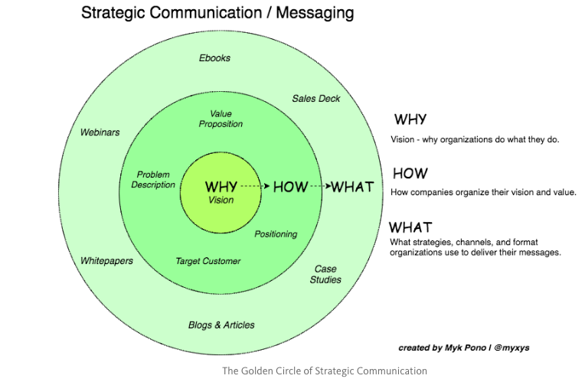

Slide 6

3 KEYS FOR A BEST PITCH

Slide 7



