Slide 1


CNSCC.202: HCI
GROUP3
TASK-1
Haotian Sang
Chenhui Mao
Xiao Xie
Yuekai Yin
Zhuohua Qi

Slide 2
 | VHT
 | Vision | Hearing | Touch
Capability | Receive information about environment visually Size and depth Brightness Color Movement Changes in luminance | Provide information about environment acoustically Distances, direction Through pitch, loudness, Timbre | Provide feedback about environment Thermoreceptors Nociceptors Mechanoreceptor
Limitation | Color blind people Sight impaired people Optical illusions | Less accurate distinguishing high frequencies than low Hearing impaired people | Hard to implement Finger impaired people
Implication | Provide a bold color that can caught one’s attention Using comfortable color | Sounding information should be at human acceptable level Using comfortable and clear sound | Touching level should be at human sensible level Different information should be transfer distinct touching feeling.

Slide 3
 | MEMORY
 | Sensory Memories | Short-Term Memory | Long-Term Memory
Capability | Buffers for stimuli received through senses Iconic memory Echoic memory Haptic memory | Scratch-pad for temporary recall Accessed rapidly(70ms) Decay rapidly(200ms) | Repository for all our knowledge Huge, unlimited capacity Slow access time ~1/10 s Slow decay
Limitation | Constantly overwritten Can only selectively attend to one of above stimuli | Limited capacity: 7±2 chunks | Need to rehearsal (repetition) Easier to remember things that represent objects Interference
Implication | Focus on one aspect rather than all above | Design in chunks within 5-9,which can be easier to remember (such as website) | Place the commonly used tool in conspicuous position Icon should relevant to the purpose

Slide 4
 | THINKING: REASONING
 | Deductive Reasoning | Inductive Reasoning | Abductive Reasoning
Capability | Derive logically necessary conclusion from given rules | Generalize from cases seen to cases unseen | Reasoning from event to cause
Limitation | Often be misapplied Sometimes truth and validity clash | Unreliable (can only be proved to be false not true) | Unreliable (can lead to false explanations)
Implication | If validity rather than truth was preferred, all premises would have to be made explicit. | Gather as much as evidence to support inductive inference Check negative evidence to test the truth of the statement | Avoid an event always following an action Provide evidence to the contrary

Slide 5
 | THINKING: PROBLEM SOLVING
Capability | Process of finding solution to unfamiliar task using knowledge Several theories (Gestalt, Problem space theory, Analogy)
Limitation | Gestalt: not provide sufficient evidence or structure to support its theories Problem space theory: operates within the constraints of the human processing system; limited by the capacity of STM, and the speed at which information can be retrieved Analogy: people often miss analogous information, unless it is semantically close to the problem domain
Implication | Gestalt: combine different components, prepare sufficient information which relevant to it Problem space theory: delete redundant components, classify the data Analogy: the analogous semantical information needs to be close to the problem domain.

Slide 6
 | EMOTION
Capability | Involves both cognitive & physical response Affect influence our respond to situation
Limitation | Negative affect can make it harder to do easy job
Implication | Design a delightful interface that can stimulate positive emotion, rather than a frustrated interface that can stimulate negative emotion.

Slide 7
CNSCC.202: HCI
GROUP3
TASK-2
Haotian Sang
Chenhui Mao
Xiao Xie
Yuekai Yin
Zhuohua Qi

Slide 8


Add “one-touch calling” button:
Provide manual service
Call the police
Multilanguage support:
Provide service for multi-lingual clients
Provide voice service for dialects

Slide 9

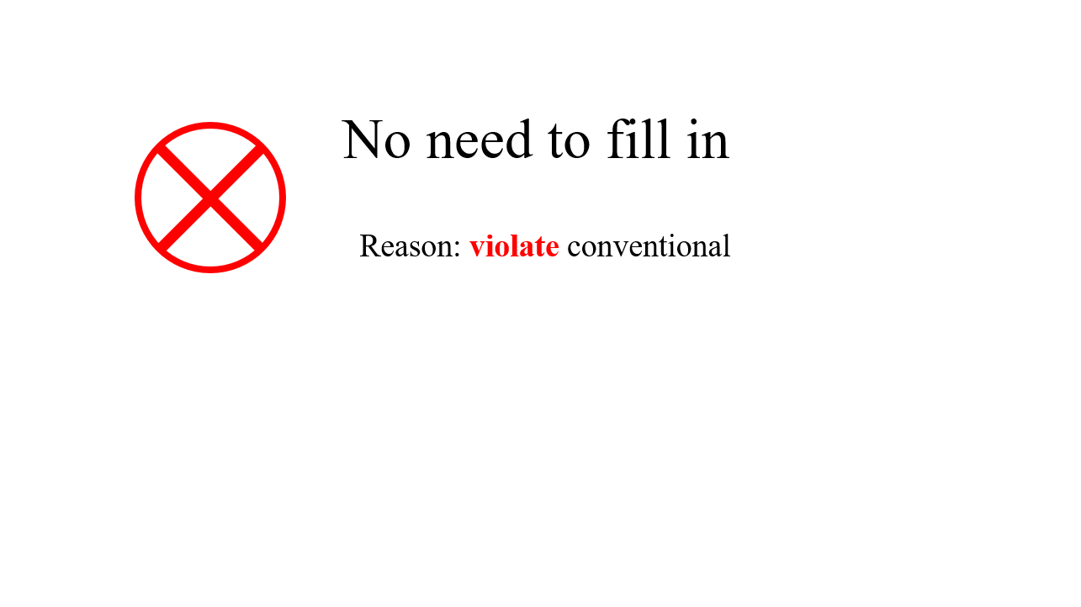




Warning on the screen:
Remind of unclear handwriting or put the form in the wrong area
Reminding by vibration
Adapt bold font to key words and Add figures:
1. Reduce reading cost
2. Conspicuous marking

Slide 10
Rational distribution:
Consider left-hander and other special crowd
Reduce moving cost
Integrated in Integration
to existing machine in the bank
Simplify the whole system

Slide 11
Work Division

Slide 12
PPT:
Qi Zhuohua, Sanghaotian
Presentation:
Task1: Mao Chenhui
Task2: Sang Haotian
Task1:
VHT: Xie xiao
Memory: Mao Chenhui,
Thinking-Reasoning: Qi Zhuohua,
Thinking-Problem Solving: Sang Haotian
Emotion: Yin Yuekai

Slide 13
Task 2:
Part1: Yin Yuekai
Part2: Xie Xiao
Part3: Mao Chenhui
Part4: Sang Haotian
Part5: Qi Zhuohua

