Slide 1


Personal Part

Slide 2




Add figures and Adapt bold font to key words :
Reduce reading cost
Causes: the output in the video and essay shows that there only the words descriptions of information which can be modified.
Reasons:
-Show Auxiliary identifier help customers understand the contents easily.
-Show Auxiliary identifier to help customers read more quickly.

Slide 3

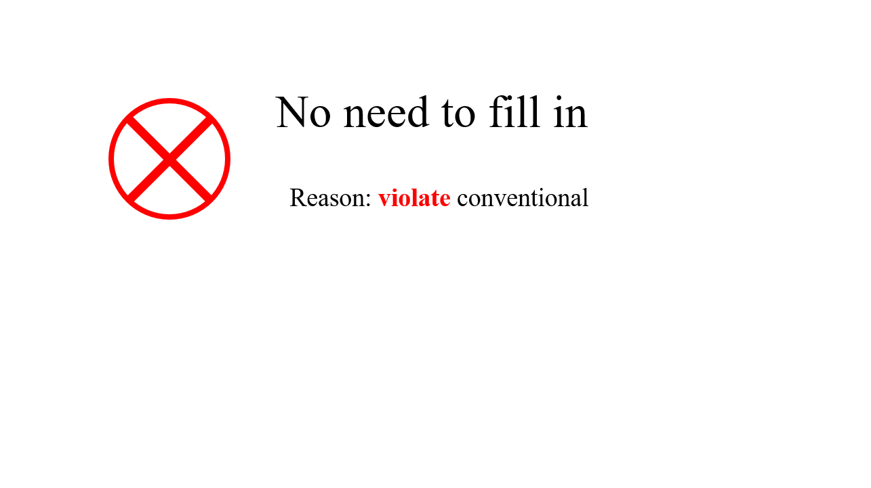
Adapt bold font to key words and Add figures:
2. Conspicuous marking
Causes: the output in the video and essay shows that there are no way to adjust the bold of font and always use the black font.
Reasons:
-Provide a button which can bold the font for elder and others.
-Show key words in red color which are more visible.
-Show warning symbols to help customers realize the wrong places more quickly.

