Slide 1


CNSCC.202: HCI
TASK-4
Haotian
Chenhui
Yuekai
Xiao
Zhuohua
Sang
Mao
Yin
Xie
Qi
Notes:
Q1: 进行对比，高亮自己与final不同的地方？→就把自己的结果整理高亮，类似尹悦凯的
Q2:不提交PPT？word转pdf会不会更好？

Slide 2
Final Result

Slide 3
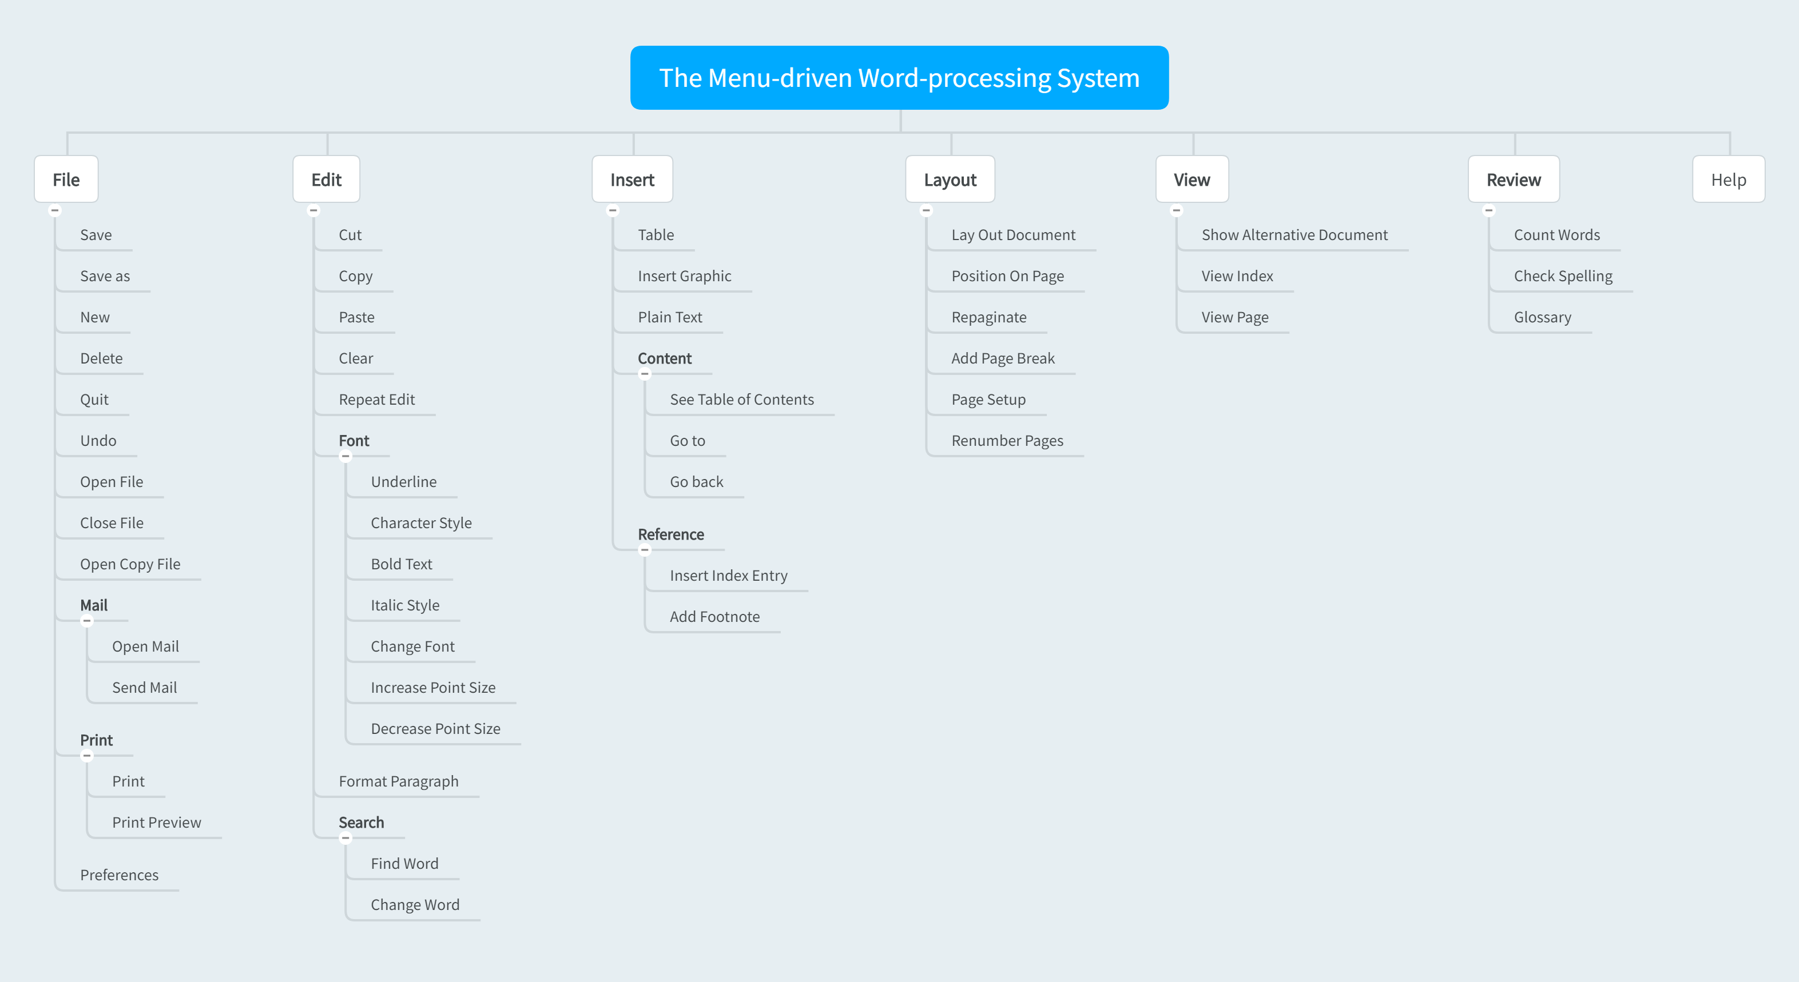

Slide 4
Individual Works
In the part, both original result and comparison of every member are displayed.
The differences between origin individual work and final result have been highlighted.
The headings have been bolded. Some may be secondary.

Slide 5
Chenhui Mao

Slide 6
Chenhui Mao
The difference between us mainly focus on preference, go to, go back, show alternative document, because they have ambiguous meaning that every member from our group have different understanding of the words literal meaning.
I think the preference related to the format preference that should be included into “Format” heading, however other group members think that preference indicate the saving preference, so the final version we place the preference into “File” part.
Go to and go back is the most controversial one, I believe the go to and go back means the go to somewhere to find the file or go back to previous direction, however other members think that it means go to a certain content like a hyperlink.
Finally the show alternative document, none of our member have a good understanding relate to that words, so I just accord to its literal meaning to put in the “File” heading.
As for other function, though, we place them under different heading, we all group the same function together, because those function do not have ambiguous meaning, and they are used frequently during our life.

Slide 7
Haotian Sang

Slide 8
Haotian Sang
The difference between us mainly focus on the “Search”, “Share”, “Help” headings put in the 1st level, because it’s easy to use. However, other group members thinks that the 1st level should be clearly, and my choice makes there are too many items in first which makes it difficult to read (Short Term Memory). Therefore, we put some of them in “Layout” or “File” headings.
What’s more, the page-relevant labels I put in “Page” heading. After discussion, I understood some misunderstand parts, and found some of them can be put in other items which is better.
Finally, show alternative document, none of our member have a good understanding related to that words, so I just put it to the “Help” heading.

Slide 9
Xiao Xie

Slide 10
Xiao Xie
The differences between the final result and mine mainly lie on the following functions: undo, character style, cut copy, paste, clear, repeat edit. Since they are all frequently-used functions, I group them as “Home” for handy uses.
Besides, I also group some functions like format paragraph and repaginate as a sub-heading of “Edit”, because they share some similarities and all are related to the operation of editing.
In addition, I put functions like insert index entry, add footnote into one independent 1st heading, “References”, as it would be easier for users to memorize, if not, there may be too many functions in one heading, which is against with the law of “People can only memorize 7± 2 chunks at most”.

Slide 11
Yuekai Yin

Slide 12
Yuekai Yin
Firstly, our result used 2-level classification in order to make the classification more clear and easier to understand.
And then, our final result put the “Mail” into the “File” category and put “Reference” into “Insert” category. But I made them as separate categories because I preferred the existing classification in Microsoft Office more. However, other group members considered that we should have our own opinion and my original result was a bit fractional. Additionally, functions under these 2 headings have similar function meanings with their father categories, so that the “Mail” could be put under the “File” , and “Reference” could be put under the “Insert”.
Similar disagreements occurred in the renumber page, and I still followed Microsoft Word's classification approach and placed it under the category of “Insert”. But other group members did not agree with that.
At last, I think the meaning of go to and go back are jump to a reference of a particular text, so they should put under the “Reference”. However, other members considered that these two functions are more like the use of hyperlink so they are the part of the “Content”.

Slide 13
Zhuohua Qi

Slide 14
Zhuohua Qi
The most significant change is that we use more secondary headings. I divided functions into too much individual headings at first, but later we tried to reset the hierarchical headings.
Combine most functions under “Text” heading which are closed related to font as “Font” into “Edit”.
Group the “Reference” as a secondary heading into “Insert”.
Separate “Review" heading into “Review” and “View” headings, which makes the classification more specific.
In my opinion, function help should be a separate heading, which might lead users to assistance faster. This idea was well received by other teammates.
Some functions are difficult for us to distinguish.
Functions like show alternative document and view pages confused all of us, and they were transferred to "View" after the discussion because of the literal meaning from verbs.
Some functions like go to and go back were really ambiguous and without rhyme, so I had no idea about them and left them alone.

Slide 15
Thinking and Discussion

Slide 16
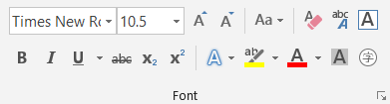
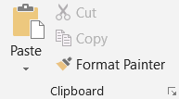
Q: | Why do some functions always seem to be grouped together?
A: | Operate on the same object Implicit (e.g., underline, bold text, italic style) Explicit (e.g., position on page, page setup, renumber pages) Related functions Semblable (e.g. view index, view page, save, save as) Opposite (e.g., increase point size, decrease point size) Similar procedure (e.g., Insert-tables, insert graphic, plain text) Sequential operations (e.g., cut, copy, paste)

Slide 17
Q: | Why do some groups of functions always get categorized correctly? | Why are some less easy to place under the ‘correct’ heading?
A: | Clear natural language Explicit naming (e.g., change font) Explicit function (e.g., print preview) High connectivity (e.g., bold text) High frequency of use (e.g., undo) Common functions for various systems (e.g., save) | Ambiguous language Vaguely naming (e.g., go to, go back) Vaguely faction (e.g., show alternative document) Poorly pertinency (e.g., preferences) Low frequency of use (e.g., glossary) Specific functions for specific systems (e.g., show alternative document)

Slide 18
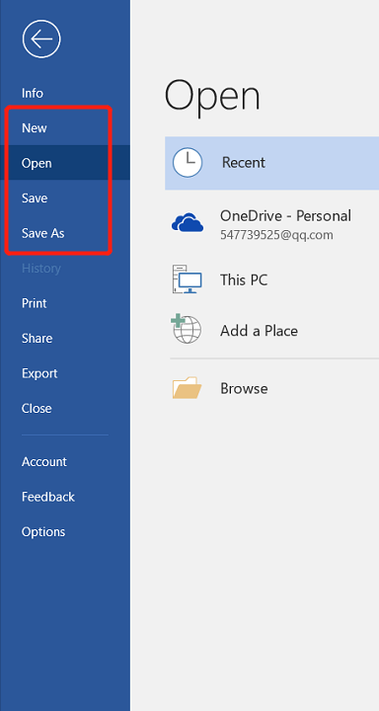
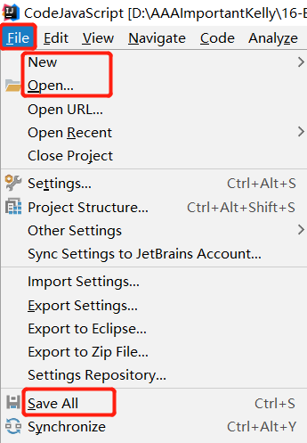
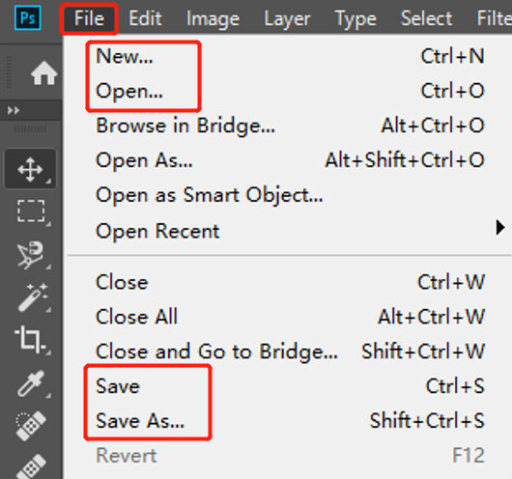
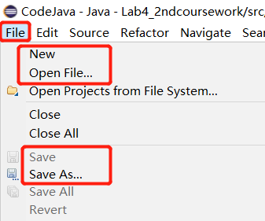
Common functions for various systems

Slide 19
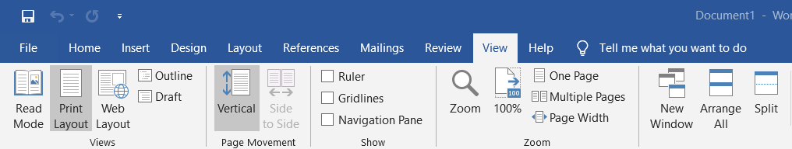
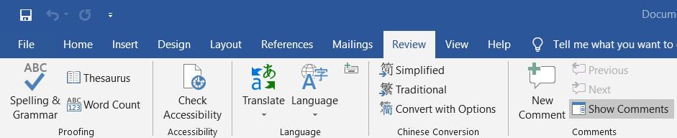
Specific functions for specific systems

Slide 20
Q: | Why is this important?
A: | Make the layout clearer Easy and fast access to common action Improve efficiency Meet the ergonomics Better user’s experience

