Slide 1
REFACTORING CASE STUDY
FROM GOOD CLASS TO
CLEAN ARCHITECTURE
Refactoring the naive Coffee Shop Order Processor for low coupling and high cohesion.
DWG NO.
CS-001
REV
A
SCALE
N.T.S.
REF: com.coffeeshop.refactored
STATUS
APPROVED

Slide 2

SHEET 02 — DEFECT ANALYSIS
The Problem With the Base Code
One class, one method, three unrelated jobs
OrderProcessor.processOrder() NODE 01 — LOW COHESION
SUB-01
SUB-02
SUB-03
Tax Calculation
Presentation
Persistence
Hardcoded 12% VAT logic
Console receipt formatting
Direct file-system writes
FRAGILE CHANGES
HARD TO TEST
HARD TO EXTEND
Changing the VAT rate risks touching file-writing code by accident.
Can't unit test tax logic without also triggering real file I/O.
Swapping storage (e.g. to a database) means editing business logic too.
COFFEE SHOP ORDER PROCESSOR — REFACTORING
CS / SHEET 2 OF 12

Slide 3


SHEET 03 — DESIGN PRINCIPLES
Principles Applied
Two design principles guided every change
A
B
HIGH COHESION
LOW COUPLING
Single Responsibility Principle
Dependency Inversion
Each class has exactly one reason to change. Tax rules, receipt formatting, and data storage were pulled apart into their own classes.
OrderProcessor depends on TaxCalculator and OrderRepository interfaces, never on their concrete implementations. Details can change without touching orchestration.
COFFEE SHOP ORDER PROCESSOR — REFACTORING
CS / SHEET 3 OF 12

Slide 4
SHEET 04 — SCHEMATIC
The New Architecture
OrderProcessor orchestrates through interfaces, never concrete classes
OrderProcessor orchestrator
TaxCalculator
ReceiptFormatter
OrderRepository
«interface»
«concrete class»
«interface»
StandardTaxCalculator
Builds the printed receipt string
FileOrderRepository
Applies 12% VAT to a base price
Writes the transaction to orders_log.txt
Main COMPOSITION ROOT — the only class that knows every concrete type; it builds implementations and hands them to OrderProcessor through its constructor.
COFFEE SHOP ORDER PROCESSOR — REFACTORING
CS / SHEET 4 OF 12

Slide 5
SHEET 05 — SPEC COMPARISON
Before vs. After
What structurally changed when the responsibilities were pulled apart
ASPECT | BASE CODE | REFACTORED CODE
Classes | 1 | 8 (7 classes + 1 interface pair)
Responsibilities per class | 3 (tax, print, save) | 1 each
Coupling to file storage | Direct — hardcoded FileWriter | Indirect — via OrderRepository interface
Coupling to tax rule | Inline constant in method body | Isolated in StandardTaxCalculator
Unit testable in isolation | No — file I/O runs every time | Yes — swap in fake collaborators
Adding a new storage type | Edit business logic | Add one new class, change one line in Main
COFFEE SHOP ORDER PROCESSOR — REFACTORING
CS / SHEET 5 OF 12

Slide 6






SHEET 06 — BILL OF BENEFITS
What We Gained
The measurable payoff of low coupling and high cohesion
01
02
03
Testability
Maintainability
Extensibility
Each class can be unit tested with fakes/mocks for its collaborators — no real file I/O needed to test tax math.
A change to one concern (e.g. VAT rate) cannot accidentally break formatting or persistence.
New tax rules or storage backends plug in by implementing an interface — OrderProcessor never changes.
04
05
06
Readability
Reusability
Safer Collaboration
Each class name states its one job; the flow of processOrder() reads like a short checklist.
ReceiptFormatter or StandardTaxCalculator could be reused in another feature without dragging file I/O along.
Different team members can work on different classes with minimal merge conflicts.
COFFEE SHOP ORDER PROCESSOR — REFACTORING
CS / SHEET 6 OF 12

Slide 7
SHEET 07 — CONCEPT SPOTLIGHT
Low Coupling, Explained
What it means in the code, and what it looks like in real life
A
B
THE CONCEPT
REAL-WORLD EXAMPLE
Depends on contracts, not concretions
A wall power outlet
OrderProcessor only knows the TaxCalculator and OrderRepository interfaces. It never creates or references StandardTaxCalculator or FileOrderRepository directly — Main injects them through the constructor, so one can be swapped without ever touching OrderProcessor.
A lamp doesn’t care whether power comes from solar panels, a generator, or the grid — it just plugs into a standard outlet. Swap the power source behind the wall and the lamp keeps working, untouched. The outlet is the interface; the power source is the concrete implementation.
COFFEE SHOP ORDER PROCESSOR — REFACTORING
CS / SHEET 7 OF 12

Slide 8
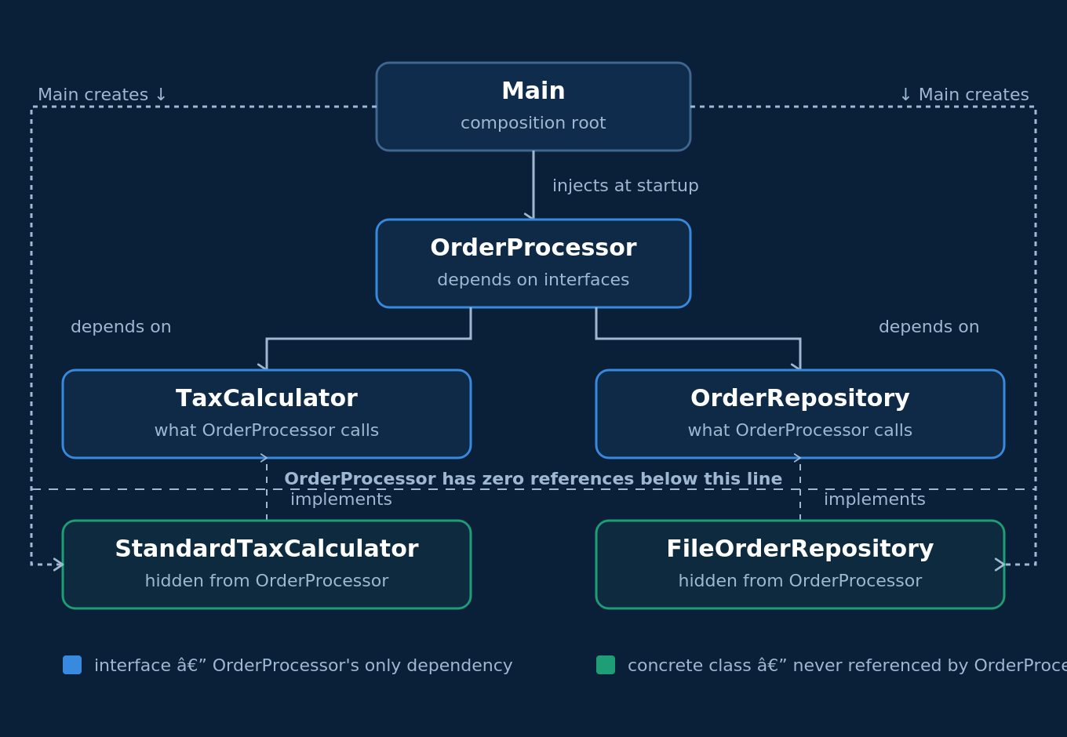
SHEET 08 — CONCEPT SPOTLIGHT
Low Coupling — The Dependency Diagram
How OrderProcessor’s dependencies actually resolve at runtime
OrderProcessor calls only the interfaces above the dashed line — Main is the only class that ever touches the concrete classes below it.
COFFEE SHOP ORDER PROCESSOR — REFACTORING
CS / SHEET 8 OF 12

Slide 9
SHEET 09 — CONCEPT SPOTLIGHT
High Cohesion, Explained
What it means in the code, and what it looks like in real life
A
B
THE CONCEPT
REAL-WORLD EXAMPLE
Every class has exactly one job
A kitchen brigade
StandardTaxCalculator only computes VAT. ReceiptFormatter only builds a string. FileOrderRepository only writes to disk. Nothing does two unrelated jobs at once — unlike the original processOrder(), which mixed tax math, printing, and file I/O together.
In a professional kitchen, the grill cook only grills and the pastry chef only bakes. Each station does one job well. If the grill breaks, pastry still runs — because no station’s work depends on also doing someone else’s job.
COFFEE SHOP ORDER PROCESSOR — REFACTORING
CS / SHEET 9 OF 12

Slide 10
SHEET 10 — CONCEPT SPOTLIGHT
The Processing Flow, Explained
What it means in the code, and what it looks like in real life
A
B
THE CONCEPT
REAL-WORLD EXAMPLE
Main wires it, OrderProcessor delegates it
A restaurant order ticket
Main builds the concrete classes once and injects them into OrderProcessor. Then processOrder() calls each collaborator in turn: TaxCalculator for the price, ReceiptFormatter to build the receipt, OrderRepository to save it. OrderProcessor never does the work itself — only coordinates who does.
A waiter doesn’t cook, plate, or wash dishes. They pass the ticket to the kitchen, hand the finished plate to the runner, and send the receipt to the register. The waiter coordinates the process without doing any single step personally.
COFFEE SHOP ORDER PROCESSOR — REFACTORING
CS / SHEET 10 OF 12

Slide 11
SHEET 11 — CONCEPT SPOTLIGHT
Class Count & Independence, Explained
What it means in the code, and what it looks like in real life
A
B
THE CONCEPT
REAL-WORLD EXAMPLE
8 classes, each with one reason to exist
A toolbox, not one multi-tool
Order (data), 2 interfaces (contracts), 2 implementations (tax + storage), ReceiptFormatter (concrete, no interface needed), OrderProcessor (orchestration), and Main (wiring). Most classes don’t depend on each other directly — only OrderProcessor depends on the rest, and only through interfaces.
A screwdriver, a wrench, and a hammer each do one job and work independently of each other. Compare that to one tool trying to do all three badly — break one function and the whole tool is useless. Separate tools mean one breaking doesn’t disable the rest.
COFFEE SHOP ORDER PROCESSOR — REFACTORING
CS / SHEET 11 OF 12

Slide 12
SHEET 12 — TITLE BLOCK
Group Members & Contributions
Equal contribution across all group members
DRAWN BY
Andem, Kurt Kurvey C.
CONTRIBUTION
25%
CHECKED BY
Mamicao, Carl B.
CONTRIBUTION
25%
ENGINEER
Dapanas, Sirverio
CONTRIBUTION
25%
APPROVED BY
Litorco, Khen S.
CONTRIBUTION
25%
COFFEE SHOP ORDER PROCESSOR — REFACTORING
CS / SHEET 12 OF 12

