Slide 1

COMPSCI GROUP PROJECT • JAVA OOP DESIGN
Coffee Shop Order System
A modern, decoupled software architecture built with robust Java Interfaces & Git Best Practices
Presented by: 5 Speakers
Submission Date: July 20, 2026

Slide 2



The Problem: Tight Coupling in Base Code
BEFORE: Messy Monolith
AFTER: Decoupled Components
One giant OrderProcessor class handling multiple, unrelated tasks in a single module:
Granular architectural components, each owning exactly ONE clearly defined responsibility:
✦
Calculating promotional discounts
✦
Isolate mathematical tax rules
✦
Hardcoding Value-Added Tax (VAT) computations
✦
Modularize receipt formatting templates
✦
Formatting print layouts and writing logs directly to local file systems
✦
Abstract filesystem logging from calculations
Fragile design: Editing tax rules breaks receipt printing.
Extensible: Swap components instantly with no regression.

Slide 3






The Solution: Interface-Driven Architecture
By creating abstract Java Interfaces, our code doesn't rely on concrete, hard-coded implementations. Instead, it interacts through reliable behavioral agreements.
Discount Policies
Tax Calculators
Output formatters
Defines how promotional discounts calculate reductions based on consumer demographics and legal codes.
Encapsulates fiscal logic so regional VAT updates happen in a isolated layer without affecting core orders.
Handles the presentation level—allowing effortless output switches between Console, SMS, App or HTML receipts.

Slide 4
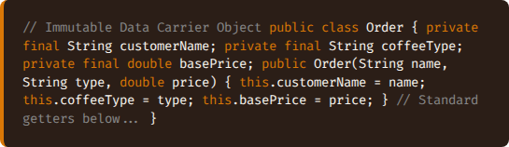
Core Domain Model: Order.java
Encapsulating Order State
Think of Order.java as a clean, standardized digital order slip. Its sole job is to hold accurate transactional properties without calculating taxes, applying codes, or printing.
✦
customerName: The consumer's identity (e.g., senior citizen status verification).
✦
coffeeType: The purchased beverage.
✦
basePrice: The raw menu price prior to applying discounts or local taxes.

Slide 5

Dynamic Discount Policies
Using the DiscountPolicy interface, we implemented clean compliance with local laws (such as Philippine RA 9994 for Senior Citizens & PWDs) without altering core code.
Policy Implementation | Target Audience | Calculated Impact | Code Architecture Impact
NoDiscountPolicy | Regular Walk-in Customers | Returns the unaltered baseline menu price. (₱150.00 → ₱150.00) | Allows standard transaction pipelines without special bypass logic.
SeniorCitizenDiscountPolicy | Senior Citizens & PWDs (RA 9994) | Subtracts a clean 20% flat discount before applying taxes. (₱90.00 → ₱72.00) | Implemented cleanly in a separate class. Swappable with zero side effects.

Slide 6

Flexible Tax Calculations
Decoupling Regional Fiscal Math
Tax legislation changes constantly. In our redesigned software system, the TaxCalculator interface isolates these numbers cleanly.
12%
✦
VatTaxCalculator: Outlines standard Philippine 12% VAT calculations.
✦
Mathematical Formula:
VALUE ADDED TAX
✦
Clean Modifiability: If regional sales taxes change from 12% to 15%, we update just one clean number in VatTaxCalculator.java. The remaining order logic continues running seamlessly.

Slide 7


Output Formatters & File Repositories
Our code clearly separates receipt layout presentation from actual data storage mechanisms using targeted Interfaces.
ReceiptFormatter
OrderRepository
Constructs formatted human-readable strings from raw transaction statistics.
Specifies standard CRUD operations to safely store records.
✦
PlainTextReceiptFormatter: Formats standard POS receipt outputs.
✦
FileOrderRepository: Directly writes clean records to orders_log.txt.
✦
Future Extensibility: Easily introduce HTML, PDF, SMS or Email receipt formatters without breaking current log streams.
✦
Enterprise Upgrades: Switch to PostgreSQL, MongoDB or cloud servers in minutes by implementing a new class.

Slide 8






The Coordinator: OrderProcessor
Instead of doing all the heavy lifting, OrderProcessor is now simply the manager. It orchestrates helper classes to run the workflow steps in perfect sequence:
1. Apply Discount
2. Calculate Tax
3. Format & Save
Calls the designated DiscountPolicy to find the correct discounted price threshold.
Asks the assigned TaxCalculator to compute the final, tax-inclusive price.
Triggers the ReceiptFormatter and outputs the results cleanly using OrderRepository.
This implementation uses "Dependency Injection" (DI) — swappable helper components are handed to the manager, ready to be used.

Slide 9
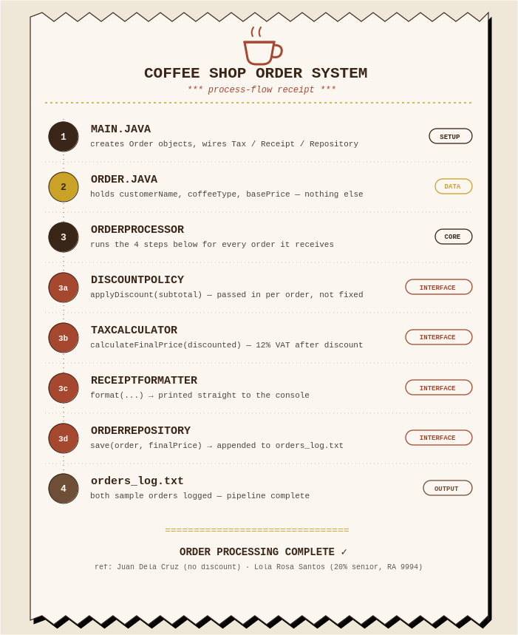
Flowchart: How an Order Is Processed
Visual Reference
Styled after the system’s own printed receipt — each stamped step below is one method call in the OrderProcessor pipeline.

Slide 10

Summary of Structural Refactoring
We divided the monolithic base code into 9 focused classes. Here is the transformation summary:
Refactored Class File | Classification | Primary Responsibility
Order.java | Domain Model | An immutable transactional model representing basic order state details.
DiscountPolicy.java / TaxCalculator.java | OOP Interfaces | Decoupled behavioral contracts governing discounts and national tax algorithms.
ReceiptFormatter.java / OrderRepository.java | OOP Interfaces | Contracts defining output rendering types and data storage targets.
PlainTextReceiptFormatter.java | Implementation | Generates beautifully structured text receipts for legacy thermal POS devices.
FileOrderRepository.java | Implementation | Safely appends complete transaction lines to local disk systems (orders_log.txt).

Slide 11
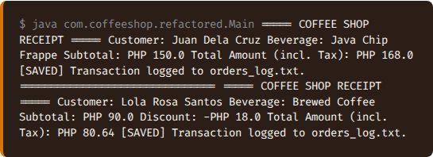
System Execution & Outputs
Bootstrapping in Main.java
Our program's entry point sets up the architectural pieces once and executes real transactions:
✦
Configures a 12% VAT module.
✦
Injects flat file storage into the Repository.
✦
Processes Juan Dela Cruz (regular customer, no discount).
✦
Processes Lola Rosa Santos (senior citizen customer, 20% discount applied cleanly).

Slide 12
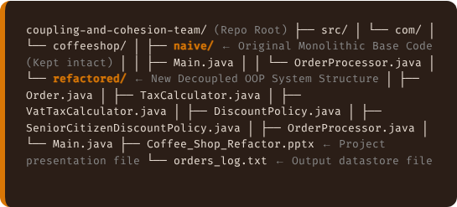
Standard Project Folder Structure
To ensure our refactored architectural enhancements are easily reviewable, we maintain a side-by-side package structure:
Strict Packaging Standards
✦
Coexistence: naive/ and refactored/ are strictly parallel sibling directories directly inside the coffeeshop namespace.
✦
Verification: Refactored classes never import naive classes, keeping imports separate.
✦
Presentation: The slide file sits directly in the root repository folder, as requested.

Slide 13




Team Git & Collaboration Guide
To safely push changes to GitHub Classroom without overriding team commits, we strictly follow this workflow:
1. Clone Repo
2. Write & Test
3. Local Commit
4. Push Remote
Execute git clone to copy the remote team codebase to your local workspace.
Write refactored classes sibling to naive. Verify code works identically.
Commit changes locally using descriptive logs in VS Code or Terminal.
Execute git push or sync changes to publish your progress to GitHub Classroom.

Slide 14

Why This Architecture Wins
High Cohesion & Loose Coupling
Breaking up monolithic codebases into smaller, isolated modules yields tangible benefits:
SOLID
✦
Single Responsibility (SRP): Each class is focused on one clear task. Making updates to VAT calculations doesn't risk breaking receipt formats or storage code.
✦
Open-Closed Principle: Adding a student discount or switching log systems involves writing a new class rather than modifying original classes.
OOP PRINCIPLES
✦
Team-Friendly Design: Developers can write, test, and debug their own modules in parallel without running into Git merge conflicts.

Slide 15
Team Contribution & Scoring
Each member’s contribution to this project is scored out of 100 points total.
Team Member | Points
Apay-Yeo, Lhester | 20
Tuclab, Rahamier | 20
Alingod, Precious | 20
Patungao, Brandon | 20
Cabar, Bea | 20
TOTAL | 100
COMPSCI Group Project · Java OOP Design · July 20, 2026

Slide 16
Thank You For Your Attention!!!!
FEEL FREE TO ASK QUESTIONS...
ORAYT!!!

