Slide 1

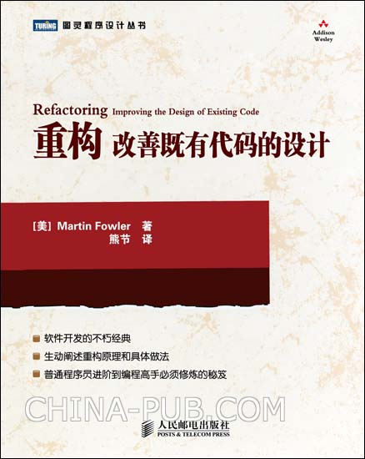
重构——改善既有代码的设计
Refactoring: Improving the Design of Existing Code

Slide 2
什么是重构
private double amountFor(Rental aRental)
{ // 计算一笔租片费用
double result = 0;
switch (aRental.getMovie().getPriceCode())
{
case Movie.REGULAR: // 普通片
result += 2;
if (aRental.getDaysRented() > 2)
result += (aRental.getDaysRented() - 2) * 1.5;
break;
case Movie.NEW_RELEASE: // 新片
result += aRental.getDaysRented() * 3;
break;
case Movie.CHILDRENS: // 儿童片
result += 1.5;
if (aRental.getDaysRented() > 3)
result += (aRental.getDaysRented() - 3) * 1.5;
break;
}
return result;
}
private double amountFor(Rental each)
{ // 计算一笔租片费用
double thisAmount = 0;
switch (each.getMovie().getPriceCode())
{
case Movie.REGULAR: // 普通片
thisAmount += 2;
if (each.getDaysRented() > 2)
thisAmount += (each.getDaysRented() - 2) * 1.5;
break;
case Movie.NEW_RELEASE: // 新片
thisAmount += each.getDaysRented() * 3;
break;
case Movie.CHILDRENS: // 儿童片
thisAmount += 1.5;
if (each.getDaysRented() > 3)
thisAmount += (each.getDaysRented() - 3) * 1.5;
break;
}
return thisAmount;
}
重构即在不改变代码外在行为的前提下，对代码做出修改，以改进程序的内部结构，提高代码的可理解性和可维护性。

Slide 3
为什么要重构
重构改进软件设计
重构使软件更易被理解
重构帮助找到BUG
重构帮助提高编程速度

Slide 4
何时进行重构
添加功能时重构
修补错误时重构
复审代码时重构

Slide 5
何时不应该重构
代码不能正常运作时
项目已近最后期限时

Slide 6
对谁进行重构(Bad Smells in Code)
Duplicated Code
Long Method
Large Class
Long Parameter List
Divergent Change
Shotgun Surgery
Feature Envy
Data Clumps
Primitive Obsession
Switch Statements
Parallel Inheritance Hierarchies
Lazy Class
Speculative Generality
Temporary Field
Message Chains
Middle Man
Inappropriate Intimacy
Alternative Classes with Different Interfaces
Incomplete Library Class
Data Class
Refused Bequest
Comments

Slide 7
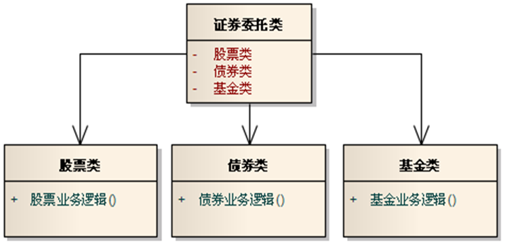

Bad Smells in Code
Divergent Change
Notes:
发散式变化(Divergent Change)
一个类由于不同的原因而被修改。
重构方法:
将类拆分成多个，每个类只因为一种变化而修改。

Slide 8
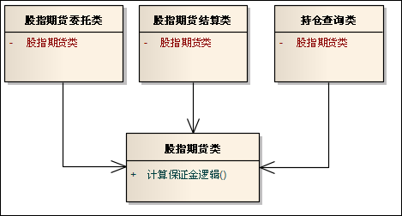
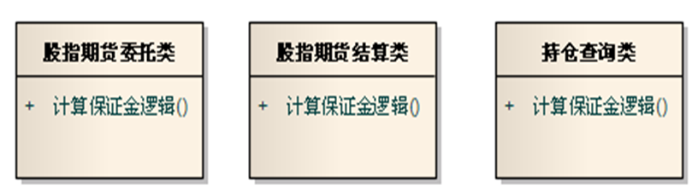
Bad Smells in Code
Shotgun Surgery
Notes:
霰弹式修改(Shotgun Surgery)
与发散式变化相反，遇到变化时需要修改许多不同的类。
重构方法:
将类似的功能放到一个类中。

Slide 9
Bad Smells in Code
Feature Envy
class MovieList
{
...
public:
void WriteTo(Writer &aWriter)
{
Iterator aIterator = m_movies.iterator();
while (aIterator.hasNext())
{
Movie &aMovie = (Movie &)aIterator.next();
aWriter.write(aMovie.getName());
aWriter.write("|");
aWriter.write(aMovie.getCategory());
aWriter.write("|");
aWriter.write(aMovie.getPersonator());
aWriter.write("\n");
}
}
};

Slide 10
Bad Smells in Code
Switch Statements
double Calc(double fData1, char cOp, double fData2)
{
double fResult;
switch (cOp)
{
case '+': fResult = fData1 + fData2; break;
case '-': fResult = fData1 - fData2; break;
case '*': fResult = fData1 * fData2; break;
case '/':
{
if (fData2==0.) throw string("除数不能为零！");
fResult = fData1 / fData2;
break;
}
default: throw string("不可识别的运算符！");
}
return fResult;
}

Slide 11
Bad Smells in Code
Temporary Field
class TemporaryFieldDemo
{
public:
void swap()
{
temp = x;
x = y;
y = temp;
}
...
protected:
int x, y;
int temp;
};

Slide 12
Bad Smells in Code
Message Chains
class MessageChainsDemo
{
public:
double getTemperature()
{
Thermoment aThermoment = m_station.getThermoment();
return aThermoment.getTemperature();
}
...
protected:
Station m_station;
};

Slide 13
Bad Smells in Code
Refused Bequest
//长方形
class Rectangle
{
public:
virtual void setHeight(int h) { m_height=h; }
virtual void setWidth(int w) { m_width=w; }
virtual int Height() const { return m_height; }
virtual int Width() const { return m_width; }
virtual int Cycle() const { return (Height() + Width()) * 2; }
virtual int Area() const { return Height() * Width(); }
private:
int m_height;
int m_width;
};
//正方形
class Square : public Rectangle
{
public:
void setEdge(int edge)
{
m_height = edge;
m_width = edge;
}
void setWidth(int w){ setSize(w); }
void setHeight(int h){ setSize(h); }
};

Slide 14
重构前的准备(Building Test)
自测试代码
单元测试
功能测试

Slide 15
如何重构
Composing Methods 重新组织函数
Moving Features Between Objects 特性迁移
Organizing Data 重新组织数据
Simplifying Conditional Expressions 简化条件表达式
Making Method Calls Simpler 简化函数调用
Dealing with Generalization 处理概括关系
Big Refactorings 大型重构

Slide 16
Composing Methods
Extract Method
Inline Method
Inline Temp
Replace Temp with Query
Introduce Explaining Variable
Split Temporary Variable
Remove Assignments to Parameters
Replace Method with Method Object
Substitute Algorithm

Slide 17
Moving Features Between Objects
Move Method
Move Field
Extract Class
Inline Class
Hide Delegate
Remove Middle Man
Introduce Foreign Method
Introduce Local Extension

Slide 18
Organizing Data
Self Encapsulate Field
Replace Data Value with Object
Change Value to Reference
Change Reference to Value
Replace Array with Object
Duplicate Observed Data
Change Unidirectional Association to Bidirectional
Change Bidirectional Association to Unidirectional
Replace Magic Number with Symbolic Constant
Encapsulate Field
Encapsulate Collection
Replace Record with Data Class
Replace Type Code with Class
Replace Type Code with Subclasses
Replace Type Code with State/Strategy
Replace Subclass with Fields

Slide 19
Simplifying Conditional Expression
Decompose Conditional
Consolidate Conditional Expression
Consolidate Duplicate Conditional Fragments
Remove Control Flag
Replace Nested Conditional with Guard Clauses
Replace Conditional with Polymorphism
Introduce Null Object
Introduce Assertion

Slide 20
Making Method Calls Simpler
Rename Method
Add Parameter
Remove Parameter
Separate Query from Modifier
Parameterize Method
Replace Parameter with Explicit Methods
Preserve Whole Object
Replace Parameter with Method
Introduce Parameter Object
Remove Setting Method
Hide Method
Replace Constructor with Factory Method
Encapsulate Downcast
Replace Error Code with Exception
Replace Exception with Test

Slide 21
Dealing with Generalization
Pull Up Field
Pull Up Method
Pull Up Constructor Body
Push Down Method
Push Down Field
Extract Subclass
Extract Superclass
Extract Interface
Collapse Hierarchy
Form Template Method
Replace Inheritance with Delegation
Replace Delegation with Inheritance

Slide 22
Big Refactorings
Tease Apart Inheritance
Convert Procedural Design to Objects
Separate Domain from Presentation
Extract Hierarchy

Slide 23
class MovieList
{
...
public:
void WriteTo(Writer &aWriter)
{
Iterator aIterator = m_movies.iterator();
while (aIterator.hasNext())
{
Movie &aMovie = (Movie &)aIterator.next();
aWriter.write(aMovie.getName());
aWriter.write("|");
aWriter.write(aMovie.getCategory());
aWriter.write("|");
aWriter.write(aMovie.getPersonator());
aWriter.write("\n");
}
}
};
Extract Method →

Slide 24
class Movie
{
...
public:
void WriteTo(Writer &aWriter)
{
aWriter.write(getName());
aWriter.write("|");
aWriter.write(getCategory());
aWriter.write("|");
aWriter.write(getPersonator());
aWriter.write("\n");
}
};
class MovieList
{
public:
void WriteTo(Writer &aWriter)
{
Iterator aIterator = m_movies.iterator();
while (aIterator.hasNext())
{
Movie &aMovie = (Movie &)aIterator.next();
aMovie.WriteTo(aWriter);
}
}
};

Slide 25
double GetPrice()
{
// price is base price - quantity discount + shipping
return Quantity * itemPrice - max(0, quantity-500) * itemPrice * 0.05 + min(quantity*itemPrice*0.1, 100);
}
Introduce Explaining Variable →
double GetPrice()
{
double basePrice = quantity * itemPrice;
double quantityDiscount =
max(0, quantity - 500) * itemPrice*0.05;
double shipping = min(basePrice * 0.1, 100);
return basePrice - quantityDiscount + shipping;
}

Slide 26
double temp = 2 * (_height + _width);
do something with temp...
temp = _height * _width;
do something with temp...
Split Temporary Variable →
double perimeter = 2 * (_height + _width);
do something with perimeter...
double area = _height * _width;
do something with area...

Slide 27
int getRating()
{
return (moreThanFiveLateDeliveries()) ? 2 : 1;
}
int moreThanFiveLateDeliveries()
{
return _numberOfLateDeliveries > 5;
}
Inline Method →
int getRating()
{
return (_numberOfLatedDeliveries > 5) ? 2 : 1;
}

Slide 28
double basePrice = anOrder.basePrice();
return (basePrice > 1000);
Inline Temp →
return (anOrder.basePrice() > 1000);

Slide 29
double basePrice = _quantity * _itemPrice;
if (basePrice > 1000)
return basePrice * 0.95;
else
return basePrice * 0.98;
Replace Temp with Query →
if (basePrice() > 1000)
return basePrice() * 0.95;
else
return basePrice() * 0.98;
...
double basePrice()
{
return _quantity * _itemPrice;
}

Slide 30
double getPrice()
{
int basePrice = _quantity * _itemPrice;
double discountFactor;
if (basePrice > 1000)
discountFactor = 0.95;
else
discountFactor = 0.98;
return basePrice * discountFactor;
}
Replace Temp with Query →
int basePrice()
{
return _quantity * _itemPrice;
}
double getPrice()
{
double discountFactor;
if (basePrice() > 1000)
discountFactor = 0.95;
else
discountFactor = 0.98;
return basePrice() * discountFactor;
}

Slide 31
double getPrice()
{
double discountFactor;
if (basePrice() > 1000)
discountFactor = 0.95;
else
discountFactor = 0.98;
return basePrice() * discountFactor;
}
Replace Temp with Query →
double discountFactor()
{
if (basePrice() > 1000) return 0.95;
else return 0.98;
}
double getPrice()
{
return basePrice() * discountFactor();
}

Slide 32
int discount(int inputVal, int quantity, int yearToDate)
{
if (inputVal > 50) inputVal -= 2;
if (quantity > 100) inputVal -= 1;
if (yearToDate > 10000) inputVal -= 4;
return inputVal;
}
Remove Assignments to Parameters →
int discount(int inputVal, int quantity, int yearToDate)
{
int result = inputVal;
if (inputVal> 50) result -= 2;
if (quantity > 100) result -= 1;
if (yearToDate > 10000) result -= 4;
return result;
}

Slide 33
class Account
{
int gamma(int inputVal, int quantity, int yearToDate)
{
int importantValue1 = (inputVal * quantity) + delta();
int importantValue2 = (inputVal * yearToDate) + 100;
if ((yearToDate - importantValue1) > 100)
importantValue2 -= 20;
int importantValue3 = importantValue2 * 7;
...
return importantValue3 - 2 * importantValue1;
}
...
};
Replace Method with Method Object →

Slide 34
class Gamma
{
public:
Gamma(Account &_account, int _inputVal, int _quantity, int _yearToDate)
: account(_account), inputVal(_inputVal),
quantity(_quantity), yearToDate(_yearToDate)
{
}
int compute()
{
importantValue1 = (inputVal * quantity) + _account.delta();
importantValue2 = (inputVal * yearToDate) + 100;
if ((yearToDate - importantValue1) > 100)
importantValue2 -= 20;
int importantValue3 = importantValue2 * 7;
...
return importantValue3 - 2 * importantValue1;
}
private:
Account &account;
int inputVal;
int quantity;
int yearToDate;
int importantValue1;
int importantValue2;
int importantValue3;
};

Slide 35
class Account
{
...
int gamma(int inputVal, int quantity, int yearToDate()
{
return Gamma(*this, inputVal, quantity,
yearToDate).compute(); }
...
};

Slide 36
int fib(int n)
{
int result;
if (n == 0)
result = 0;
else if (n <= 2)
result = 1;
else
result = fib(n - 1) + fib(n - 2);
return result;
}
Replace Nested Conditional with Guard Clauses →
int fib(int n)
{
if (n == 0) return 0;
if (n <= 2) return 1;
return fib(n - 1) + fib(n - 2);
}

Slide 37
class Employee
{
...
private:
// 0:engineer, 1:salesman, 2:manager
int m_EmployeeType;
};
Replace Type with Subclasses →

Slide 38
class Employee
{
...
};
class Engineer : public Employee
{
...
};
class Salesman : public Employee
{
...
};
class Manager : public Employee
{
...
};

Slide 39
class Employee
{
...
public:
string GetDepartmentName() const
{
switch (m_EmployeeType)
{
case 0: return "Engineering";
case 1: return "Sales";
case 2: return "Management";
default: return "Unknown";
}
}
private:
// 0:engineer, 1:salesman, 2:manager
int m_EmployeeType;
};
Replace Conditional with Polymorphism →

Slide 40
class Employee
{
...
public:
virtual string GetDepartmentName() const
{
return "Unknown";
};
};
class Engineer : public Employee
{
...
public:
string GetDepartmentName() const { return "Engineering"; }
};
class Salesman : public Employee
{
...
public:
string GetDepartmentName() const { return "Sales"; }
};
class Manager : public Employee
{
...
public:
string GetDepartmentName() const { return "Management"; }
};

