Slide 1
单元测试
彭四伟 pengsw@mail.buct.edu.cn

Slide 2
创建测试目标
public class Complex
{
public Complex()
{
x = 0;
y = 0;
}
public Complex(double ax, double ay)
{
x = ax;
y = ay;
}
public double x { get; set; }
public double y { get; set; }
public static Complex operator+(Complex c1, Complex c2)
{
return new Complex(c1.x + c2.x, c1.y + c2.y);
}
public static Complex operator-(Complex c1, Complex c2)
{
return new Complex(c1.x - c2.x, c1.y - c2.y);
}
}

Slide 3
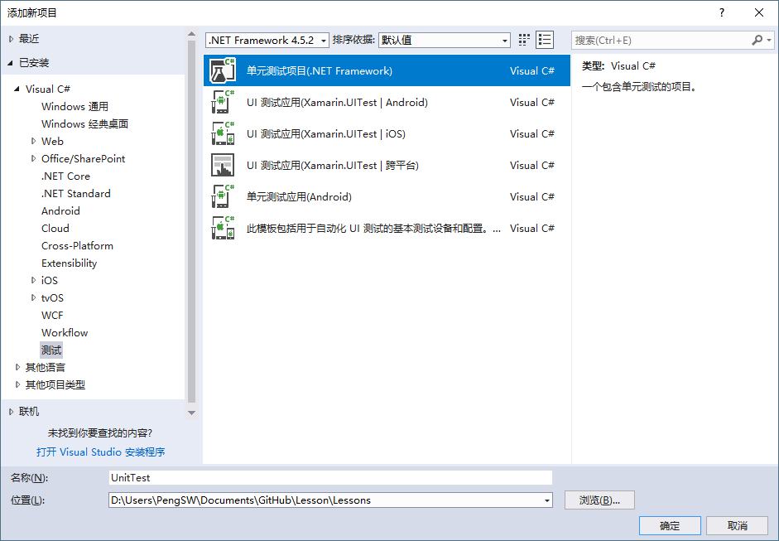
创建单元测试项目

Slide 4
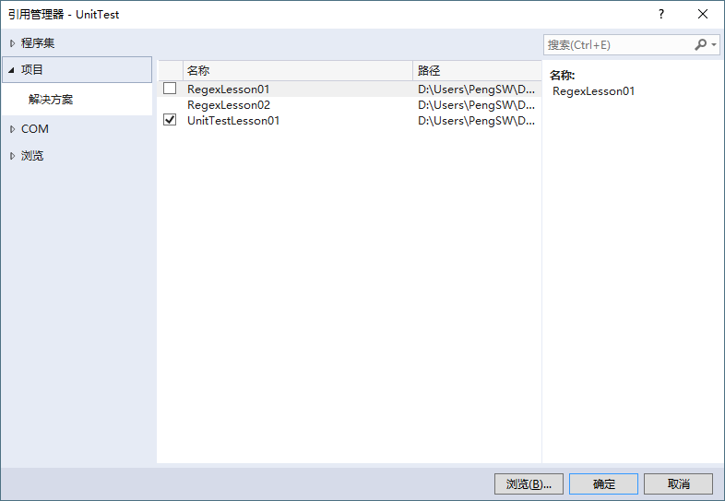
创建单元测试
在UnitTest项目中添加对测试目标项目的引用

Slide 5
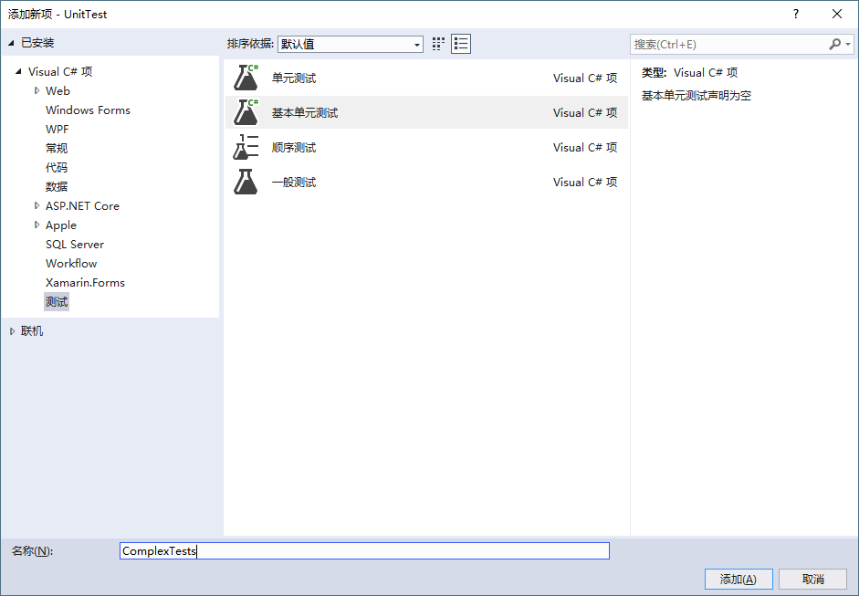
创建单元测试
在UnitTest项目中添加测试类

Slide 6
创建单元测试
using Microsoft.VisualStudio.TestTools.UnitTesting;
namespace UnitTestLesson01.Tests
{
[TestClass()]
public class ComplexTests
{
[TestMethod()]
public void ComplexAddTest()
{
Complex c1 = new Complex(1, 2);
Complex c2 = new Complex(3, 4);
Complex c3 = c1 + c2;
Assert.AreEqual(c3.x, 4);
Assert.AreEqual(c3.y, 6);
}
}
}

Slide 7
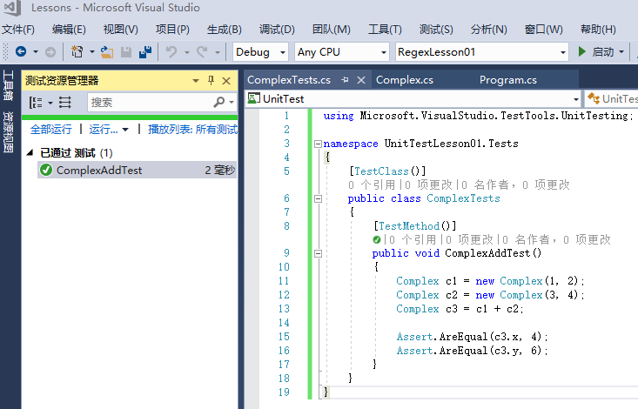
执行单元测试
打开测试资源管理器

Slide 8
namespace UnitTestLesson01
{
public class Complex
{
public Complex(double ax, double ay)
{
x = ax;
y = ay;
}
public double x { get; set; }
public double y { get; set; }
public static Complex operator+(Complex c1, Complex c2)
{
return new Complex(c1.x + c2.x, c1.y + c2.y);
}
public static Complex operator-(Complex c1, Complex c2)
{
return new Complex(c1.x - c2.x, c1.x - c2.y);
}
}
}
using System;
using Microsoft.VisualStudio.TestTools.UnitTesting;
using UnitTestLesson01;
namespace UnitTests
{
[TestClass]
public class ComplexTests
{
[TestMethod]
public void ComplexAddTest()
{
Complex c1 = new Complex(1, 2);
Complex c2 = new Complex(3, 4);
Complex c3 = c1 + c2;
Console.WriteLine($"{c1.x}+{c1.y}i + {c2.x}+{c2.y}i = {c3.x}+{c3.y}i");
Assert.AreEqual(c3.x, 4);
Assert.AreEqual(c3.y, 6);
}
[TestMethod]
public void ComplexSubTest()
{
Complex c1 = new Complex(4, 7);
Complex c2 = new Complex(1, 2);
Complex c3 = c1 - c2;
Assert.AreEqual(c3.x, 3);
Assert.AreEqual(c3.y, 5);
}
}
}

Slide 9
using System;
using Microsoft.VisualStudio.TestTools.UnitTesting;
namespace UnitTestLesson01.Tests
{
[TestClass()]
public class MyHelperTests
{
const int TestLength = 16;
// 随机序列的排序测试
[TestMethod]
public void MySortTest3()
{
MyHelper aTarget = new MyHelper();
int[] L = new int[TestLength];
Random aRandom = new Random();
for (int i = 0; i < L.Length; i++)
L[i] = i + 1;
for (int i = 0; i < 100; i++)
{
int a = aRandom.Next() % TestLength;
int b = aRandom.Next() % TestLength;
if (a != b)
{
int temp = L[a];
L[a] = L[b];
L[b] = temp;
}
}
aTarget.MySort(L);
for (int i = 0; i < L.Length; i++)
Assert.AreEqual(L[i], i + 1);
}
}
}
namespace UnitTestLesson01
{
public class MyHelper
{
public void MySort(int[] L)
{
for (int i = 0; i < L.Length; i++)
{
for (int j = 0; j < L.Length - i - 1; j++)
{
if (L[j] > L[j+1])
{
int temp = L[j];
L[j] = L[j + 1];
L[j + 1] = temp;
}
}
}
}
}
}
using System;
using Microsoft.VisualStudio.TestTools.UnitTesting;
namespace UnitTestLesson01.Tests
{
[TestClass()]
public class MyHelperTests
{
const int TestLength = 16;
// 有序序列的排序测试
[TestMethod()]
public void MySortTest1()
{
MyHelper aTarget = new MyHelper();
int[] L = new int[TestLength];
for (int i = 0; i < L.Length; i++) L[i] = i + 1;
aTarget.MySort(L);
for (int i = 0; i < L.Length; i++)
Assert.AreEqual(L[i], i + 1);
}
}
}
using System;
using Microsoft.VisualStudio.TestTools.UnitTesting;
namespace UnitTestLesson01.Tests
{
[TestClass()]
public class MyHelperTests
{
const int TestLength = 16;
// 逆序序列的排序测试
[TestMethod]
public void MySortTest2()
{
MyHelper aTarget = new MyHelper();
int[] L = new int[TestLength];
for (int i = 0; i < L.Length; i++) L[i] = TestLength - i;
aTarget.MySort(L);
for (int i = 0; i < L.Length; i++)
Assert.AreEqual(L[i], i + 1);
}
}
}

Slide 10
单元测试练习
请编写一个排序算法作为测试目标。
请编写对排序算法的单元测试，分别测试有序、随机和逆序情况下的排序结果是否正确。
请编写一个有序表合并算法作为测试目标。
请编写对有序表合并算法的单元测试，分别测试无交叉、有交叉、无重复、有重复情况下的排序结果是否正确。

