Slide 1
Good Morning! Tap your snowman.
Snowmen still on the board are the friends we miss today.
Ava
Liam
Mia
Noah
Zoe
Ethan
Lily
Owen
Ruby
Jack
Ella
Caleb
Nora
Milo
Sadie
Theo
Ivy
Finn
Hazel
Leo

Slide 2

Happy Halloween! Tap your pumpkin.
Pumpkins still on the board are the friends we miss today.
Ava
Liam
Mia
Noah
Zoe
Ethan
Lily
Owen
Ruby
Jack
Ella
Caleb
Nora
Milo
Sadie
Theo
Ivy
Finn
Hazel
Leo

Slide 3
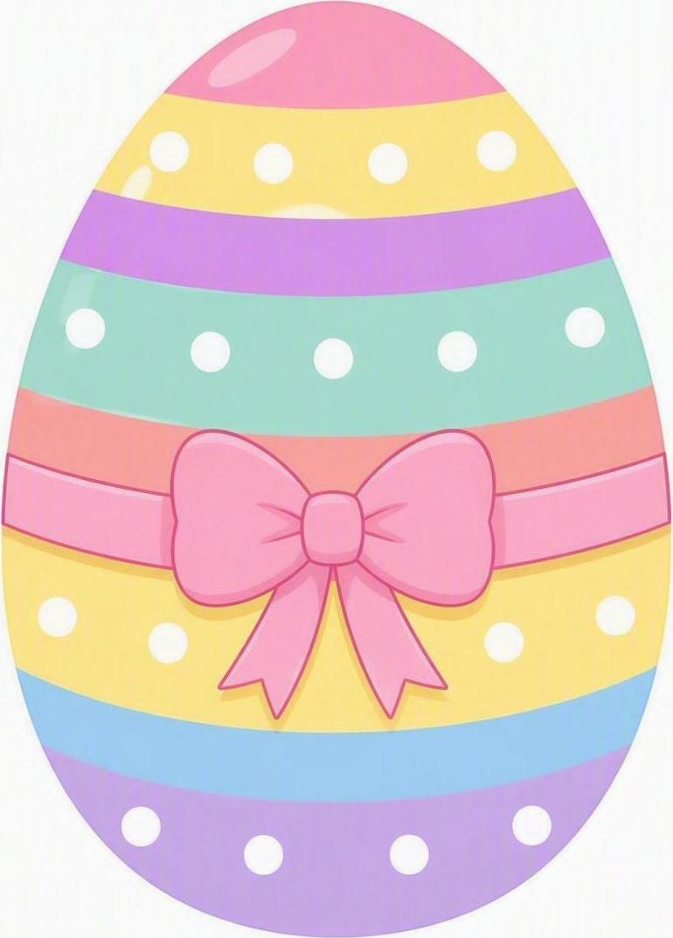
Happy Easter! Tap your egg.
Eggs still on the board are the friends we miss today.
Ava
Liam
Mia
Noah
Zoe
Ethan
Lily
Owen
Ruby
Jack
Ella
Caleb
Nora
Milo
Sadie
Theo
Ivy
Finn
Hazel
Leo

Slide 4
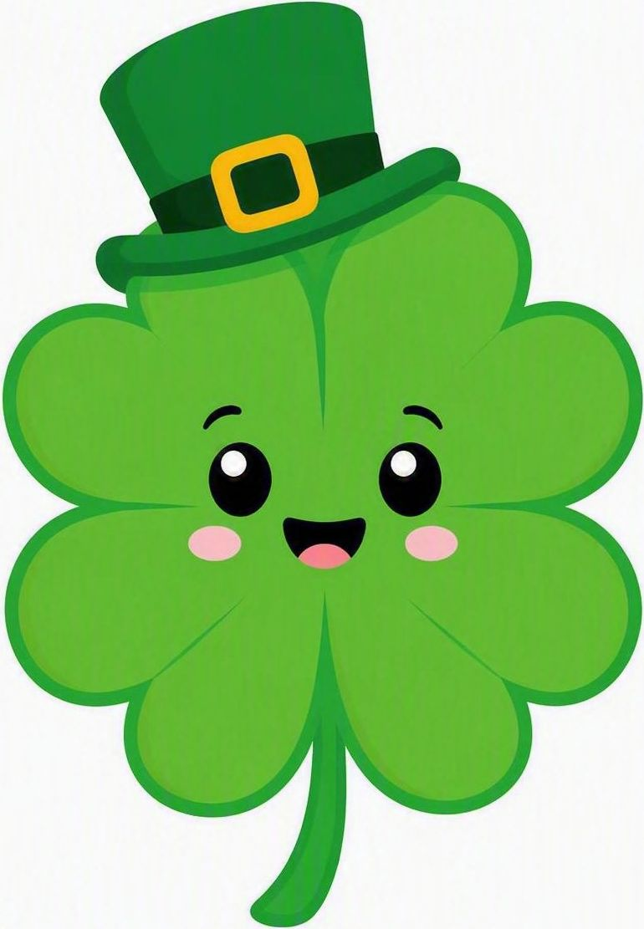
Happy St. Patrick's Day! Tap your shamrock.
Shamrocks still on the board are the friends we miss today.
Ava
Liam
Mia
Noah
Zoe
Ethan
Lily
Owen
Ruby
Jack
Ella
Caleb
Nora
Milo
Sadie
Theo
Ivy
Finn
Hazel
Leo

Slide 5

Good Morning! Tap your star.
Stars still on the board are the friends we miss today.
Ava
Liam
Mia
Noah
Zoe
Ethan
Lily
Owen
Ruby
Jack
Ella
Caleb
Nora
Milo
Sadie
Theo
Ivy
Finn
Hazel
Leo

