Slide 1
Accessibility and AI

Slide 2



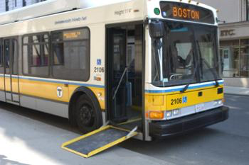
What is Accessibility?

Slide 3
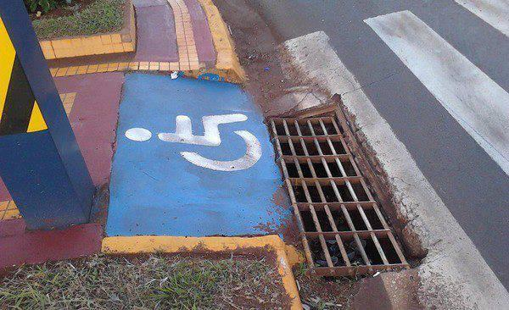

Slide 4
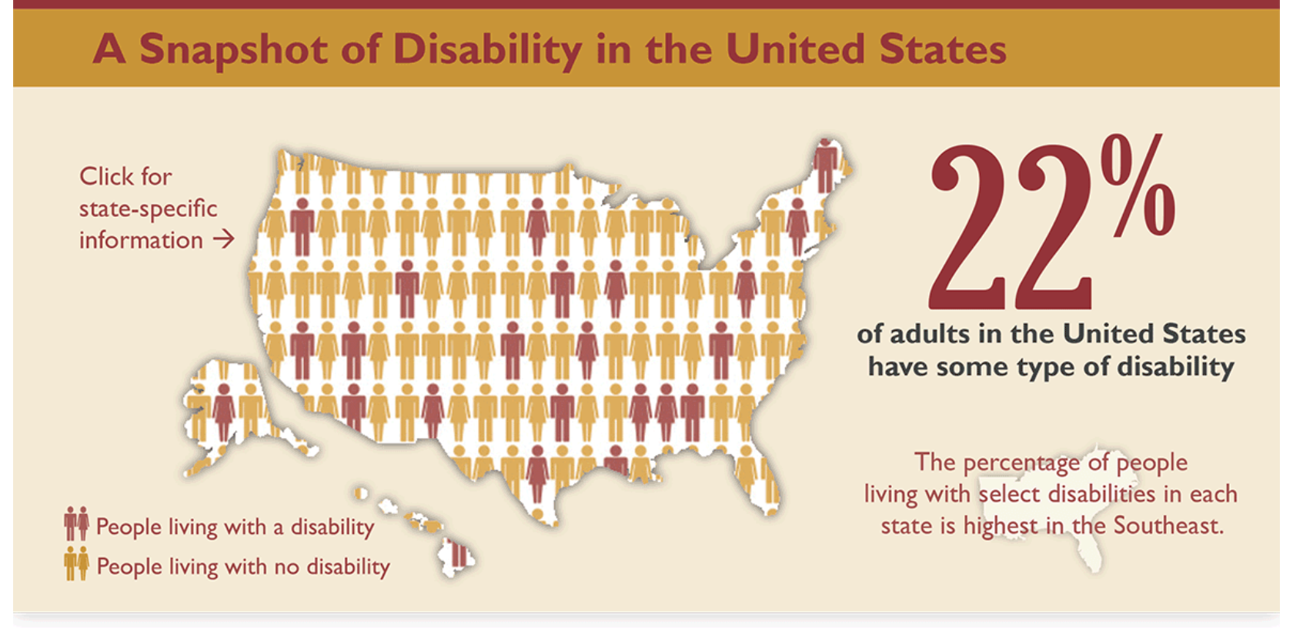
Why is Accessibility Important?
More than one billion people around the world live with disabilities.
In the United States, approximately 20% of individuals above the age of 18 have some disability.
http://www.cdc.gov/ncbddd/disabilityandhealth/infographic-disability-impacts-all.html

Slide 5


The reasons for making software accessible to people with disabilities are multifold:
Ethical Reasons
Technical Reasons

Slide 6

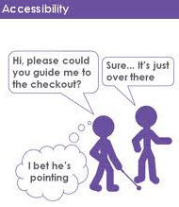
How to Engineer Accessible Software?
Planning & Requirements
Design & Implementation
Testing & Maintenance
The disability is not the problem.
The accessibility is the problem.
Mohamed Jemni
#TED2013

Slide 7

Not all Disabilities are Visible

Slide 8




A cognitive impairment is something that inhibits a user's ability to perform one or more cerebral tasks.
Cognitive impairments can be physical, mental, or behavioral
Examples of some cerebral tasks are:
Memory Problem Solving
Comprehension Processing

Slide 9
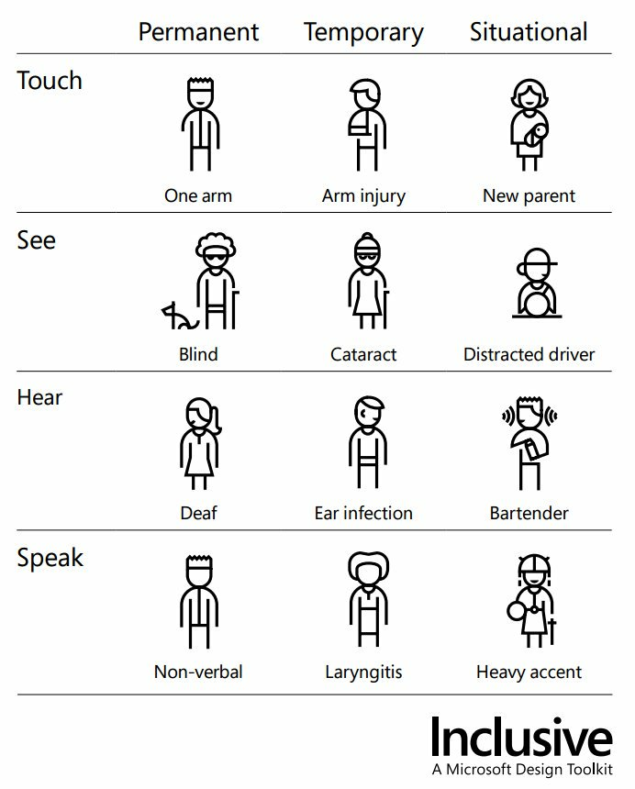
Accessibility Benefits Everyone!

Slide 10
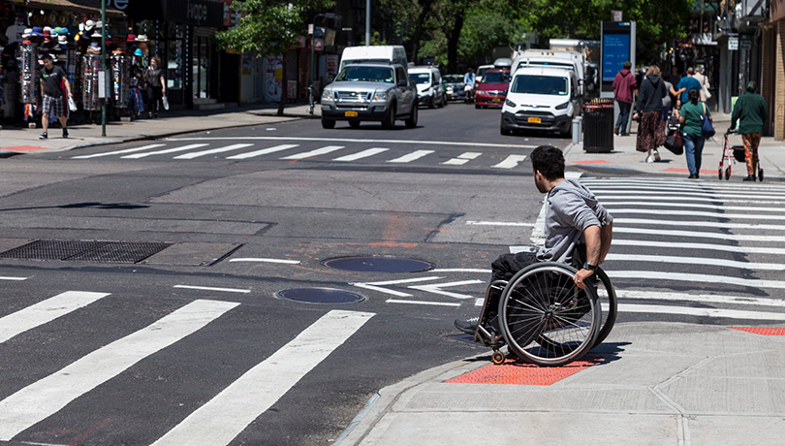
Non-Inclusive AI
Body recognition systems (e.g., in AR/VR)
Speech recognition
Scholar Jutta Treviranus tested an AI model that guides autonomous vehicles
Treviaranus recounts, “When I presented a capture of my friend who uses a wheelchair to the learning models, they all chose to run her over.
I was told that the learning models were immature models and not yet smart enough to recognize people in wheelchairs.
When I came back to test out the smarter models they ran her over with greater confidence.
https://ainowinstitute.org/disabilitybiasai-2019.pdf

Slide 11
AI as a Solution
Automated alt-text
Contrast analysis of an image
Content simplification

Slide 12
References
Engineering software for accessibility, Microsoft Press, 2009.
A Web For Everyone, Rosenfeld Media, 2014
http://www.sigaccess.org/newsletter/2019-10/guo.html
https://ainowinstitute.org/disabilitybiasai-2019.pdf

Slide 13
Further Reading, Sources and Opportunities
Accessibility Fundamentals
Microsoft AI for accessibility projects
Web Content Accessibility Guidelines (WCAG)
Section 508: Accessibility Laws and Policies

