Slide 1
SQL Recursion

Slide 2
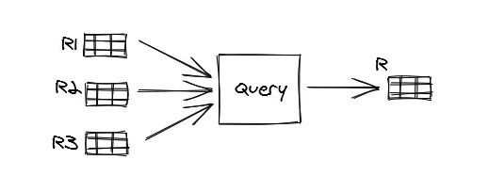
Query returning a table
SELECT <something> FROM R1, R2, R3 WHERE <condition>
https://medium.com/swlh/recursion-in-sql-explained-graphically-679f6a0f143b

Slide 3
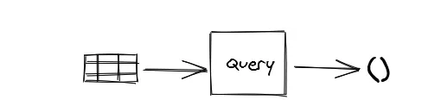
Query returning empty results
SELECT <something> FROM R1 WHERE 1 = 2

Slide 4
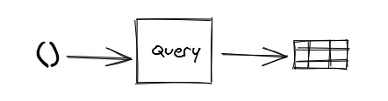
Query return something from nothing
SELECT 1

Slide 5
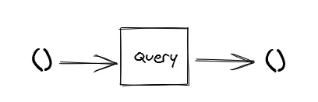
Query taking nothing and return nothing
SELECT 1 WHERE 1 = 2

Slide 6

CTE Queries
n
2
WITH R AS (SELECT 1 AS n)
SELECT n + 1 FROM R

Slide 7

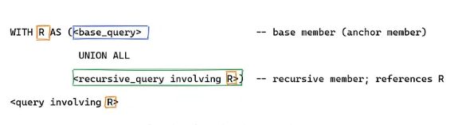
Recursive CTE Query
Recursive
Recursive

Slide 8
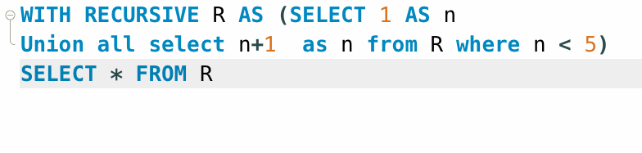
Example
n
1
2
3
4
5

Slide 9
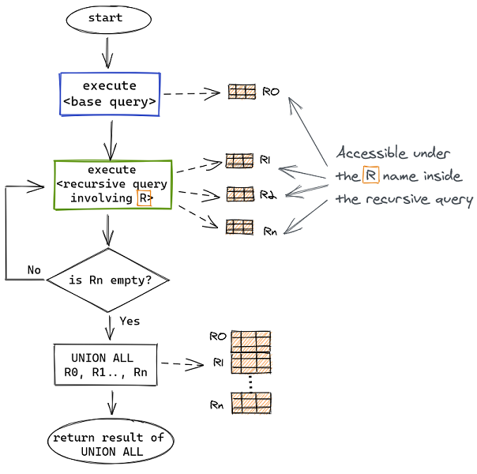
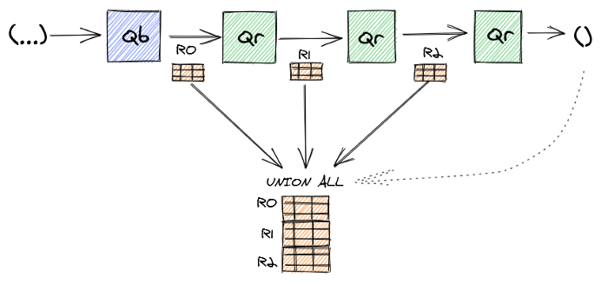
How it works

Slide 10
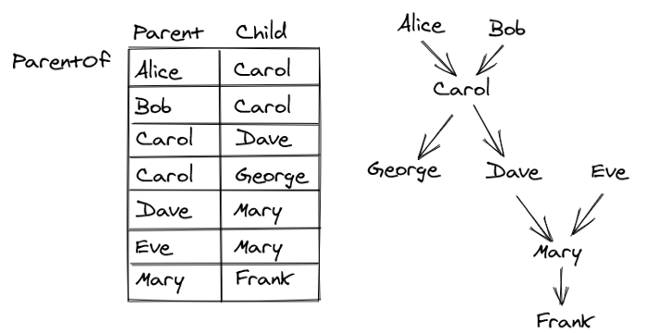
Example 2

Slide 11
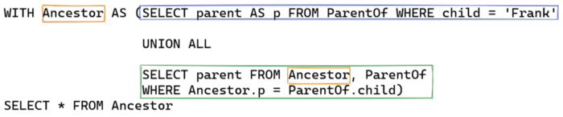
Recursive Query Example

Slide 12
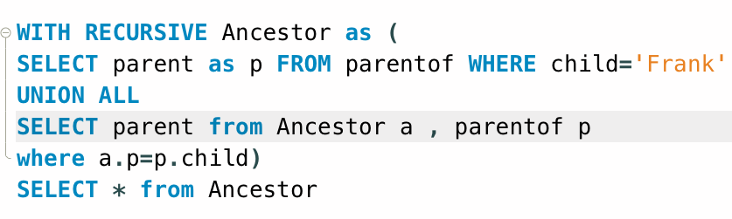
MySQL Query
p
Mary
Dave
Eve
Carol
Alice
Bob
https://teachingow.github.io/DBMS-SQL-Labs/inclass/Lab4

Slide 13
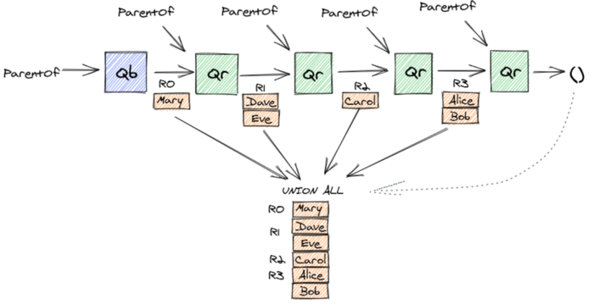
Query Execution
p
Mary
Dave
Eve
Carol
Alice
Bob

Slide 14
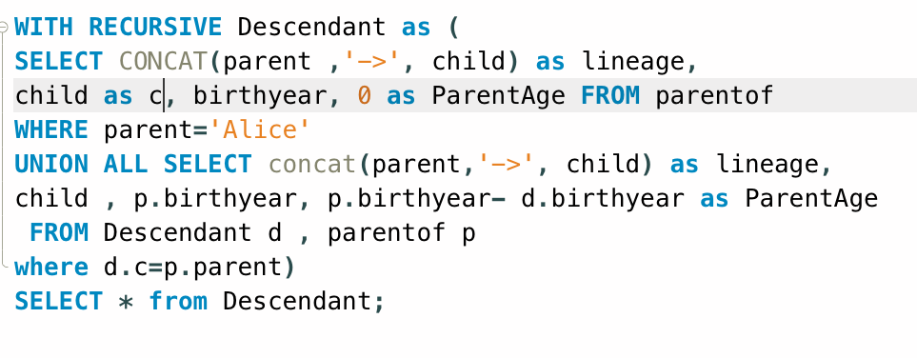
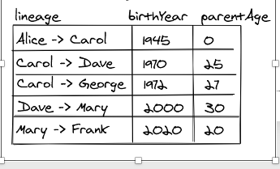
Example 3

Slide 15
Practice and hosted labs
Recursive common table expressions
Recursive CTE and window-function lab
Nested-query foundations
Your task: Write an anchor and recursive step for a hierarchy. State a stopping rule, track depth, and explain what happens if the data contains a cycle.
Hosted on GitHub Pages. Internet access required.
Notes:
Course-aligned practice links. Write an anchor and recursive step for a hierarchy. State a stopping rule, track depth, and explain what happens if the data contains a cycle.
https://teachingow.github.io/DBMS-SQL-Labs/labs/window-recursive/window-recursive.html
https://teachingow.github.io/DBMS-SQL-Labs/labs/set-nested/set-nested-queries.html

